Slide 1
بسم الله الرحمن الرحيم
Database Programming
برمجة قواعد البيانات
أستاذات/المادة: م. لندا عمر البدري
م. نجلاء حسن

Slide 2
Introduction to PL/SQL

Slide 3
Programming in Oracle with PL/SQL
Procedural
Language
Structured Query Language

Slide 4
What is PL/SQL?
Oracle’s procedural extension to SQL.
Supplements SQL with several high-level programming features such as block structure, variables, constants and types, the assignment statement, conditional statements, loops,
customized error handling, and structured data.

Slide 5
Using SQL Queries in PL/SQL
Programs
• Action queries can be used as in SQL*Plus
• May use variables in action queries
• DDL commands may not be used in PL/SQL

Slide 6
Fundamentals of PL/SQL
Full-featured programming language
An interpreted language
Type , execute in SQL*Plus editor

Slide 7
Variables and Data Types
Variables
– Used to store numbers, character strings, dates,
and other data values
– Avoid using keywords, table names and column
names as variable names
– Must be declared with data type before use:
variable_name data_type_declaration;

Slide 8
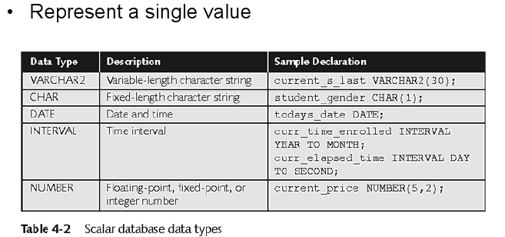
Scalar Data Types

Slide 9
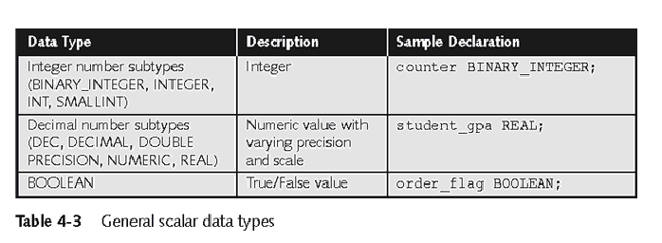
Scalar Data Types

Slide 10
Scalar Data Types
Variables are declared in PL/SQL using the syntax
<variable-name> <datatype> [not null] [:=<initial-value>]
Constants are declared as follows:
<constant-name> constant <datatype> := <value>;

Slide 11
Examples
a binary_integer;
cno number(5) not null :=1111;
cname varchar2(30);
commission real(5,2) :=12.5;
maxcolumn constant integer(2) :=30;
Hired_date date;
Done boolean;
Only one variable can be declared at a time!

Slide 12
Anchored Data Types
Anchored data types are determined by looking up another object’s data type, which could be a column in the database.
The anchored declarations have the syntax:
<variable-name> <object>%type [not null] [:=<initial-value>]
where <object> is another previously declared PL/SQL variable or a database column.

Slide 13
Anchored Data Types (cont.)
Examples
Cnum customers.cno%type;
Cname customers.cname%type;
commission real(5,2) :=12.5;
X commission%type;

Slide 14
Composite Data Types
PL/SQL provides two composite data types: PL/SQL tables and records.
PL/SQL records can be table based, cursor based, or
programmer defined.
Their declaration syntaxes are:
<record-var-name> <table-name>%rowtype;
<record-var-name> <cursor-name>%rowtype;
type <type-name> is record
(<field1> <datatype1>,
<field2> <datatype2>, … ,
<fieldN> <datatypeN>);

Slide 15
Composite Data Types (cont.)
PL/SQL tables are similar to database tables, except
that they always consists of just one column indexed by
binary integers. These tables have no bound and grow
dynamically much like database tables.
The syntax for declaring a PL/SQL table type is:
type <table-type-name> is table of <datatype>
index by binary_integer;

Slide 16
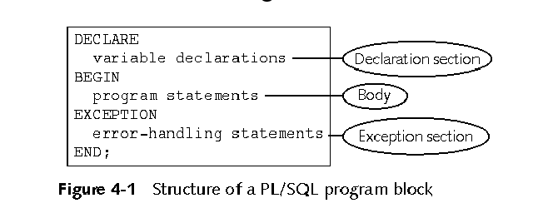
PL/SQL Program Blocks

Slide 17
PL/SQL Program Blocks
Declaration part :is where objects are defined . The declaration part is optional .
Executable Part : consists of executable statement ( SQL statement , PL/SQL statement , or both ).
Exception Handling Part :In PL/SQL , a warning or error condition is called an exception .The exception handling part consists of code for handling errors .this part is optional .

Slide 18
Comments:
– Not executed by interpreter
– Enclosed between /* and */
– On one line beginning with --

Slide 19
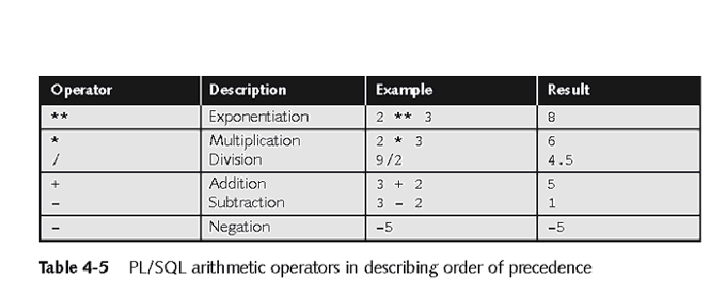
Arithmetic Operators

Slide 20
Assignment Statements
Assigns a value to a variable
variable_name := value;
X:=5;
Value can be a literal:
first_name := 'John';
Value can be another variable:
current_first_name := first_name;

Slide 21
Executing a PL/SQL
Program in SQL*Plus
• Create program in SQL*Plus window
• Press Enter, type / then execute•

Slide 22
The first PL/SQL program – Anonymous blocks
You can execute this from the SQL*PLUS command prompt:
BEGIN
  DBMS_OUTPUT.PUT_LINE('Hello World!');
END;
/
This is called an anonymous block – that is a block without a name.
  A block is surrounded by BEGIN, END keywords.
  The built-in procedure PUT_LINE, part of the DBMS_OUTPUT package. This procedure takes a string as input and displays that string on screen.
  The / indicates that we are finished.
However, in order to really see the “Hello world” message on the screen, you should set the SQL*PLUS environment variable:
  SQL> SET SERVEROUTPUT ON

Slide 23
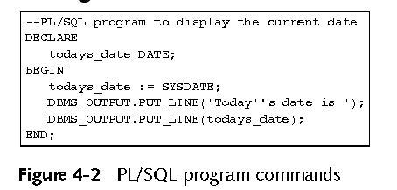
Executing a PL/SQL
Program in SQL*Plus

Slide 24
Input and output example
set serveroutput on
ACCEPT high PROMPT 'Enter a number: '
DECLARE
i number_table.num%TYPE:=1;
BEGIN
dbms_output.put_line('Look , I can print from PL/SQL!!!');
i := i + &high ;
INSERT INTO number_table
VALUES(i);
END;

Slide 25
SELECT Statements
DECLARE
v_sname VARCHAR2(10);
v_rating NUMBER(3);
BEGIN
SELECT sname, rating
FROM Salary
INTO v_sname, v_rating
WHERE sid = 112;
dbms_output.put_line(‘v_sname=‘||v_sname);
dbms_output.put_line(‘v_rating=‘||v_rating);
END;
/
rating | sname | Sid
500 | Hala | 112
600 | Mona | 113
INTO clause is required.
Query must return exactly one row.
Otherwise, a NO_DATA_FOUND or TOO_MANY_ROWS exception is thrown

Slide 26
Conditional statements
Conditional statements in PL/SQL have 3 variables:
if-then
if-then-else
if-then-elsei
elsif

Slide 27
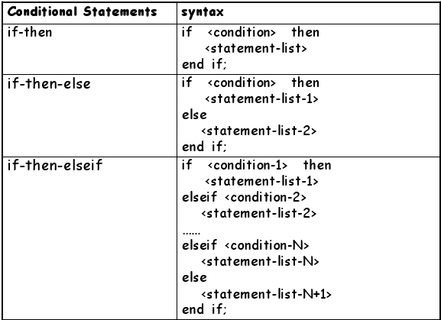
Conditional statements
elsif
elsif
elsif

Slide 28
PL/SQL Decision Control Structures
Use IF/ELSIF to evaluate many conditions:
– IF condition1 THEN
commands that execute if condition1 is TRUE;
ELSIF condition2 THEN
commands that execute if condition2 is TRUE;
ELSIF condition3 THEN
commands that execute if condition3 is TRUE;
...
ELSE
commands that execute if none of the
conditions are TRUE;
END IF;

Slide 29
Conditional logic –IF statement
Examples
IF hourly_wage > 10 THEN
  hourly_wage := hourly_wage * 1.5;
ELSE
  hourly_wage := hourly_wage * 1.1;
END IF;
IF salary BETWEEN 1000AND 4000 THEN
  bonus := 1500;
ELSIF salary > 4000 AND salary <= 10000 THEN bonus := 1000;
ELSE bonus := 0;
END IF;
Comments
You can put parenthesis around boolean expression after the IF and ELSIF .
You don’t need to put {, } or BEGIN, END to surround several statements between IF and ELSIF/ELSE, or between ELSIF/ELSE and END IF;

Slide 30
Example
1)
if (cnum > 1000) and (cnum < 9000) then
dbms_output.put_line(‘Customer no ‘ || cnum);
end if;
2)
if (cnum > 1000) and (cnum < 9000) then
i := i+1;
dbms_output.put_line(‘ Valid Customer ‘ || cnum);
else
j := j+1;
dbms_output.put_line(‘Invalid Customer ‘ || cnum);
end if;

Slide 31
Example (cont.)
3)
if (score > 90) then
na := na+1;
elsif (score > 80) then
nb := nb+1;
elsif (score > 70) then
nc := nc+1;
elsif (score > 60) then
nd := nd+1;
else
nf := nf+1;
end if;

Slide 32
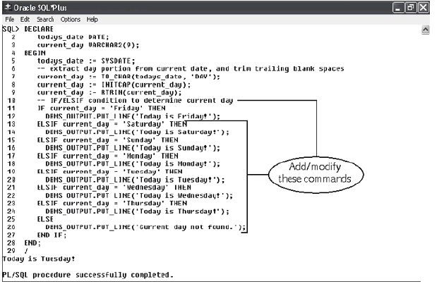
IF/ELSIF Example

Slide 33
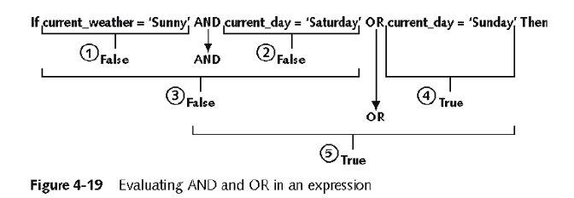
Complex Conditions
Created with logical operators AND, OR and NOT
AND is evaluated before OR
Use () to set precedence

Slide 34
Conditional logic
Condition:
Nested conditions:
If <cond>
then <command>
elsif <cond2>
then <command2>
else
<command3>
end if;
If <cond>
then
if <cond2>
then
<command1>
end if;
else <command2>
end if;

Slide 35
IF-THEN-ELSIF Statements
. . .
IF rating > 7 THEN
v_message := 'You are great';
ELSIF rating >= 5 THEN
v_message := 'Not bad';
ELSE
v_message := 'Pretty bad';
END IF;
. . .
Notes:
IF-THEN-ELSIF Statements
When possible, use the ELSIF clause instead of nesting IF statements. The code is easier to read and understand, and the logic is clearly identified. If the action in the ELSE clause consists purely of another IF statement, it is more convenient to use the ELSIF clause. This makes the code clearer by removing the need for nested END IFs at the end of each further set of conditions and actions.
Example
IF condition1 THEN
statement1;
ELSIF condition2 THEN
statement2;
ELSIF condition3 THEN
statement3;
END IF;
The example IF-THEN-ELSIF statement above is further defined as follows:
For a given value entered, return a calculated value. If the entered value is over 100, then the calculated value is two times the entered value. If the entered value is between 50 and 100, then the calculated value is 50% of the starting value. If the entered value is less than 50, then the calculated value is 10% of the starting value.
Note: Any arithmetic expression containing null values evaluates to null.

Slide 36
Suppose we have the following table:
create table mylog(
who varchar2(30),
logon_num number
);
mylog
logon_num | who
3 | Hala
4 | Amal
2 | Mona
Want to keep track of how many times someone logged on to the DB
When running, if user is already in table, increment logon_num. Otherwise, insert user into table

Slide 37
Solution
DECLARE
cnt NUMBER;
BEGIN
select count(*)
into cnt
from mylog
where who = user;
if cnt > 0 then
update mylog
set logon_num = logon_num + 1
where who = user;
else
insert into mylog values(user, 1);
end if;
commit;
end;
/

Slide 38
Conditional logic –Simple CASE statement
CASE selector
WHEN expression_1 THEN statements
[WHEN expression_2 THEN statements]
[ELSE statements]
END CASE;
selector can be an expression of any datatype, and it provides the value we are comparing.
Expression_n is the expression to test for equality with the selector.
If no WHEN matches the selector value, then the ELSE clause is executed.
If there is no ELSE clause PL/SQL will implicitly supply:
ELSE RAISE CASE_NOT_FOUND; which will terminate the program with an error (if the program ends up in the ELSE clause).

Slide 39
CASE grade
WHEN 'A' THEN
dbms_output.put_line('Excellent');
WHEN 'B' THEN
dbms_output.put_line('Very Good');
WHEN 'C' THEN
dbms_output.put_line('Good');
WHEN 'D' THEN dbms_output.put_line('Fair');
WHEN 'F' THEN dbms_output.put_line('Poor');
ELSE dbms_output.put_line('No such grade');
END CASE;

Slide 40

THE END

