Slide 1
مثلي الجمل التالية مستخدمة المنطق الرياضي
Gold is valuable
valuable (gold).
Jane is female
female (jane).
John owns gold
owns (johns, gold).
Johns is the father of Mary
father (john, marry).

Slide 2
مثلي الجمل التالية مستخدمة المنطق الرياضي
Birmingham is smaller than London
smaller(Birmingham, London)
Birmingham is not a country
¬country(Birmingham)
Charlton Heston is a man
man(Charlton Heston)

Slide 3
مثلي الجمل التالية مستخدمة المنطق الرياضي
There is a person who wrote computer-chess.
∃X (Write(x, Computer-Chess))
All elephants are of color gray.
∀X (Elephant (X) → Color(X,Gray))
3. Everybody loves somebody
∀x ∃y Loves(x, y)

Slide 4
مثلي الجمل التالية مستخدمة المنطق الرياضي
Any one passing their history exam and winning the lottery is happy.
X (pass(x, history exam) Λ win (x, the lottery)→happy(x))
Any one who studies or is lucky can pass all the exam
X y (study(x) V lucky(x) → pass(x, y)).
John did not study but he is lucky
¬ study (John) Λ lucky(John).
Any one is lucky wins the lottery
X (lucky(x) → win(x, the lottery)).

Slide 5
All people that are not poor and smart are happy. Those people that read are not stupid. John can read and wealthy. Happy people have exciting lives. Can any one be found with an exciting life?
All people that are not poor and smart are happy.
X ( ¬ poor(x) Λ smart(x)→ happy(x).
Those people that read are not stupid.
X (read (x) → ¬ stupid(x)).
John can read and wealthy.
Read (John) → wealthy (John).
Happy people have exciting lives.
W (happy (w) → exciting (w)).
The negation of the conclusion is:
W (¬ exciting (w)).

Slide 6
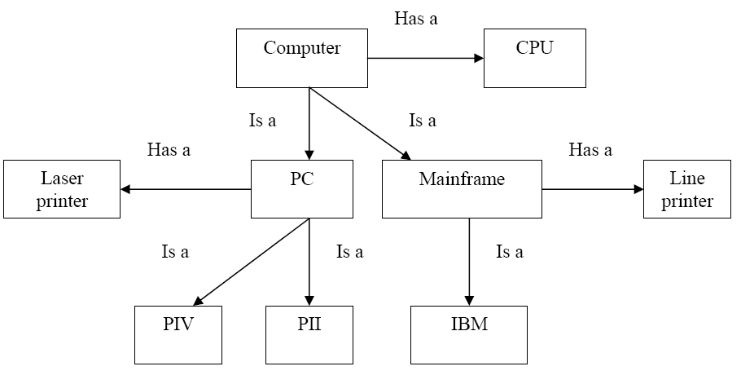
Computer has many part like a CPU and the computer divided into two type, the first one is the mainframe and the second is the personal computer ,Mainframe has line printer with large sheet but the personal computer has laser printer , IBM as example to the mainframe and PIII and PIV as example to the personal computer.

Slide 7
الشكل التالي يعبر عن شبكة لفظية لعلاقة المانجو مع الطعام. ويمكننا أيضا أن نعبر عن هذه العلاقات في صورتين:
1. جمل وفق المنطق الرياضي
2. أطر جدولية
Food
Is a
Sweet
Has Taste
Has Shape
Fruit
Lovely
Instance
Color
Price
Yellow
Mango
Expensive

Slide 8
.1 التعبير عن العلاقات بالمنطق الرياضي
Isa(Fruit, Food)
Instance(Mango, Fruit)
Color(Mango, Yellow)
…….
وهكذا نستطيع التعبير عن جميع العلاقات

Slide 9
2. الأطر الجدولية
Fruit الإطار الخاص ب : Fruit Is a : Food Has Taste: Sweet Has Shape: Lovely
Person الإطار الخاص ب Mango: Instance: Fruit Price: Expensive Color: Yellow Has Taste: Sweet Has Shape: Lovely
وهكذا يمكن أن نحدد الأطر الخاصة ببقية الكائنات.

Slide 10
الشكل التالي يعبر عن شبكة دلالية لعلاقة أسرية. يمكننا من خلال هذا الشكل أن نعبر عن هذه العلاقات قي صورتين:
1.جمل وفق المنطق الرياضي
2. أطر جدوليه
Mammals
Subset-of
legs
2
Person
HasMother
Subset of
Female
Person
Male
Person
Subset-of
Member of
Member of
Mariam
Sister of
Ahmad
legs
1

Slide 11
الشكل التالي يعبر عن شبكة دلالية لعلاقة أسرية. يمكننا من خلال هذا الشكل أن نعبر عن هذه العلاقات قي صورتين:
1.جمل وفق المنطق الرياضي
2. أطر جدولية
حالة استثنائية:
أحمد له رجلا واحدة بينما لكل البشر رجلان
Sister_of(Mariam,Ahmed)
Legs(Ahmed)=1
Member_of(Mariam,Female_Person)
Ahmed الإطار الخاص ب : Ahmed Member of : Male Person Legs: 1 Has Sister : Mariam
Person الإطار الخاص ب Person: Subset of : Mammal Legs: 2 Has Mother : Female Person

Slide 12
The Truth Table
P | Q | NOT ¬(P) | AND P ^ Q | OR P v Q | Implies P → Q | Biconditional P ←→ Q
T | T | F | T | T | T | T
T | F | F | F | T | F | F
F | T | T | F | T | T | F
F | F | T | F | F | T | T

Slide 13
The Example of Logical Operation
جدول حقيقة يوضح تكافؤ ¬P∨Q و P→Q
¬P∨Q≡ P→Q | P→Q | ¬P∨Q | ¬P | Q | P
T | T | T | F | T | T
T | F | F | F | F | T
T | T | T | T | T | F
T | T | T | T | F | F

Slide 14
The Example of Logical Operation
Consider P and Q as a propositional statement. Show the result when (P ^ (P → Q)) → Q
P | Q | P → Q | P ^ (P → Q) | (P ^ (P → Q)) → Q
T | T | T | T | T
T | F | F | F | T
F | T | T | F | T
F | F | T | F | T

