Slide 1
بسم الله الرحمن الرحيم
Database Programming
برمجة قواعد البيانات
أستاذات/المادة: م. لندا عمر البدري
م. نجلاء حسن

Slide 2
Control Statements

Slide 3
Conditional statements
Conditional statements in PL/SQL have 3 types:
if-then
if-then-else
if-then-elsei
elsif

Slide 4
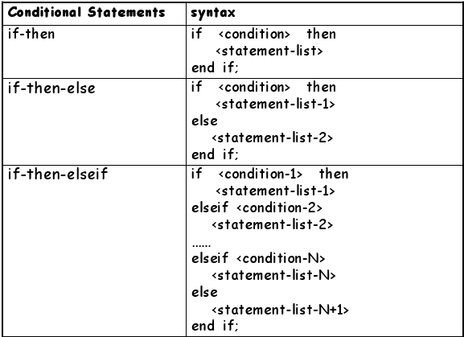
Conditional statements
elsif
elsif
elsif

Slide 5
PL/SQL Decision Control Structures
Use IF/ELSIF to evaluate many conditions:
– IF condition1 THEN
commands that execute if condition1 is TRUE;
ELSIF condition2 THEN
commands that execute if condition2 is TRUE;
ELSIF condition3 THEN
commands that execute if condition3 is TRUE;
...
ELSE
commands that execute if none of the
conditions are TRUE;
END IF;

Slide 6
Conditional logic –IF statement
Examples
IF hourly_wage > 10 THEN
  hourly_wage := hourly_wage * 1.5;
ELSE
  hourly_wage := hourly_wage * 1.1;
END IF;
IF salary BETWEEN 1000AND 4000 THEN
  bonus := 1500;
ELSIF salary > 4000 AND salary <= 10000 THEN bonus := 1000;
ELSE bonus := 0;
END IF;
Comments
You can put parenthesis around boolean expression after the IF and ELSIF .
You don’t need to put {, } or BEGIN, END to surround several statements between IF and ELSIF/ELSE, or between ELSIF/ELSE and END IF;

Slide 7
Example
1)
if (cnum > 1000) and (cnum < 9000) then
dbms_output.put_line(‘Customer no ‘ || cnum);
end if;
2)
if (cnum > 1000) and (cnum < 9000) then
i := i+1;
dbms_output.put_line(‘ Valid Customer ‘ || cnum);
else
j := j+1;
dbms_output.put_line(‘Invalid Customer ‘ || cnum);
end if;

Slide 8
Example (cont.)
3)
if (score > 90) then
na := na+1;
elsif (score > 80) then
nb := nb+1;
elsif (score > 70) then
nc := nc+1;
elsif (score > 60) then
nd := nd+1;
else
nf := nf+1;
end if;

Slide 9
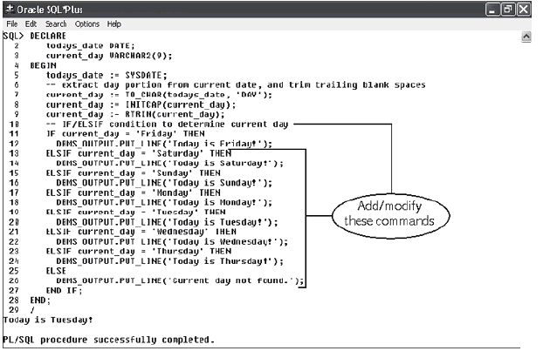
IF/ELSIF Example

Slide 10
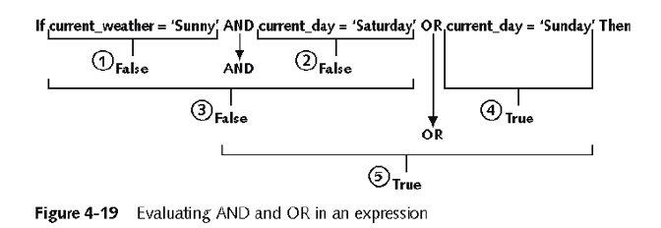
Complex Conditions
Created with logical operators AND, OR and NOT
AND is evaluated before OR
Use () to set precedence

Slide 11
Conditional logic
Condition:
Nested conditions:
If <cond>
then <command>
elsif <cond2>
then <command2>
else
<command3>
end if;
If <cond>
then
if <cond2>
then
<command1>
end if;
else <command2>
end if;

Slide 12
IF-THEN-ELSIF Statements
. . .
IF rating > 7 THEN
v_message := 'You are great';
ELSIF rating >= 5 THEN
v_message := 'Not bad';
ELSE
v_message := 'Pretty bad';
END IF;
. . .
Notes:
IF-THEN-ELSIF Statements
When possible, use the ELSIF clause instead of nesting IF statements. The code is easier to read and understand, and the logic is clearly identified. If the action in the ELSE clause consists purely of another IF statement, it is more convenient to use the ELSIF clause. This makes the code clearer by removing the need for nested END IFs at the end of each further set of conditions and actions.
Example
IF condition1 THEN
statement1;
ELSIF condition2 THEN
statement2;
ELSIF condition3 THEN
statement3;
END IF;
The example IF-THEN-ELSIF statement above is further defined as follows:
For a given value entered, return a calculated value. If the entered value is over 100, then the calculated value is two times the entered value. If the entered value is between 50 and 100, then the calculated value is 50% of the starting value. If the entered value is less than 50, then the calculated value is 10% of the starting value.
Note: Any arithmetic expression containing null values evaluates to null.

Slide 13
Suppose we have the following table:
create table mylog(
who varchar2(30),
logon_num number
);
mylog
logon_num | who
3 | Hala
4 | Amal
2 | Mona
Want to keep track of how many times someone logged on to the DB
When running, if user is already in table, increment logon_num. Otherwise, insert user into table

Slide 14
Solution
DECLARE
cnt NUMBER;
BEGIN
select count(*)
into cnt
from mylog
where who = user;
if cnt > 0 then
update mylog
set logon_num = logon_num + 1
where who = user;
else
insert into mylog values(user, 1);
end if;
commit;
end;
/

Slide 15
Conditional logic –Simple CASE statement
CASE selector
WHEN expression_1 THEN statements
[WHEN expression_2 THEN statements]
[ELSE statements]
END CASE;
selector can be an expression of any datatype, and it provides the value we are comparing.
Expression_n is the expression to test for equality with the selector.
If no WHEN matches the selector value, then the ELSE clause is executed.
If there is no ELSE clause PL/SQL will implicitly supply:
ELSE RAISE CASE_NOT_FOUND; which will terminate the program with an error (if the program ends up in the ELSE clause).

Slide 16
CASE grade
WHEN 'A' THEN
dbms_output.put_line('Excellent');
WHEN 'B' THEN
dbms_output.put_line('Very Good');
WHEN 'C' THEN
dbms_output.put_line('Good');
WHEN 'D' THEN dbms_output.put_line('Fair');
WHEN 'F' THEN dbms_output.put_line('Poor');
ELSE dbms_output.put_line('No such grade');
END CASE;

Slide 17
Loops
Program structure that executes a series of program statements, and periodically evaluates an exit condition to determine if the loop should repeat or exit
Pretest loop: evaluates the exit condition before any program commands execute
Posttest loop: executes one or more program commands before the loop evaluates the exit condition for the first time
PL/SQL has 5 loop structures

Slide 18
The LOOP...EXIT Loop
  LOOP
  [program statements]
  IF condition THEN
  EXIT;
  END IF;
  [additional program statements]
  END LOOP

Slide 19
The LOOP...EXIT Loop
create table number_table(
num NUMBER(10)
);
DECLARE
i number_table.num%TYPE:=1;
BEGIN
LOOP
IF i > 10 THEN EXIT ;
END IF;
INSERT INTO number_table
VALUES(i);
i := i + 1;
END LOOP;
END;
Notes:
WHILE Loop
In the example in the slide, the quantity increases with each iteration of the loop until the quantity is no longer less than the maximum price allowed for spending on the item.

Slide 20
The LOOP...EXIT WHEN Loop
  LOOP
  program statements
  EXIT WHEN condition;
  END LOOP;

Slide 21
The LOOP...EXIT WHEN Loop
DECLARE
i number_table.num%TYPE:=1;
BEGIN
LOOP
INSERT INTO number_table
VALUES(i);
i := i + 1;
EXIT WHEN I >10 ;
END LOOP;
END;
Notes:
WHILE Loop
In the example in the slide, the quantity increases with each iteration of the loop until the quantity is no longer less than the maximum price allowed for spending on the item.

Slide 22
The WHILE...LOOP
  WHILE condition LOOP
  program statements
  END LOOP;

Slide 23
The WHILE...LOOP
DECLARE
i number_table.num%TYPE:=1;
BEGIN
WHILE i<=10 LOOP
INSERT INTO number_table
VALUES(i);
i := i + 1;
END LOOP;
END;
Notes:
WHILE Loop
In the example in the slide, the quantity increases with each iteration of the loop until the quantity is no longer less than the maximum price allowed for spending on the item.

Slide 24
The Numeric FOR Loop
  FOR counter_variable IN start_value .. end_value
  LOOP
  program statements
  END LOOP;

Slide 25
Loops: FOR Loop
DECLARE
i number_table.num%TYPE;
BEGIN
FOR i IN 1..10 LOOP
INSERT INTO number_table VALUES(i);
END LOOP;
END;
Notice that i is incremented automatically

Slide 26
Lastly the Cursor FOR Loop , which we will discuss later

Slide 27
GOTO statement
When executed , the GOTO statement changes the flow of control in a PL/SQL block .
The two parts needed to code a GOTO statement are :
Defining the label name : a label name is optionally used to name the PL/SQL block .(defined by using angular brckets <<label name >>).
Using the GOTO statement to pass the control to the label .

Slide 28
DECLARE
……………………..
BEGIN
…………………………
<<label_name>>
……………..
……………..
GOTO label_name;
……………….
END;

Slide 29
Transfer of control with the GOTO statement is allowed in the following places :
From a block or to an executable statement .
Branch from an exception handler into an enclosing block .

Slide 30
DECLARE
OLD fare.fisrt%TYPE;
NEW OLD%TYPE;
Mroute_code fare.route_code%TYPE;
BEGIN
Mroute_code:=‘&mroute_code’;
Select first INTO OLD
FROM fare WHERE route_code= mroute_code;
For I in 1..3 LOOP
NEW := OLD-(OLD*0.20);
IF NEW<200 THEN
GOTO less200;
ELSE
INSERT INTO NEW_TABLE VALUES (mroute_code, OLD, NEW);
OLD:=NEW;
END IF;
END LOOP;
GO TO successful;
<<less200>>
DBMS_OUTPUT.PUT_LINE(‘Terminateed – fare less than 200’);
<<successful>>
DBMS_OUTPUT.PUT_LINE(‘PROCESSING OVER’);
END;
/
………. | ……. | Route_code | First
 |  | Ms_as | 300
 |  | Ms_ds | 200
fare
T_new | T_old | Mroute_code_t
240 | 300 | Ms_as
New_table

Slide 31
NULL Statement
The NULL statement is used to explicitly specify inaction. i.e it does nothing other than pass control to the next statement .
For example :
IF newfare>90 THEN
Statements;
ELSE
NULL;
END IF ;

Slide 32

THE END

