Slide 1
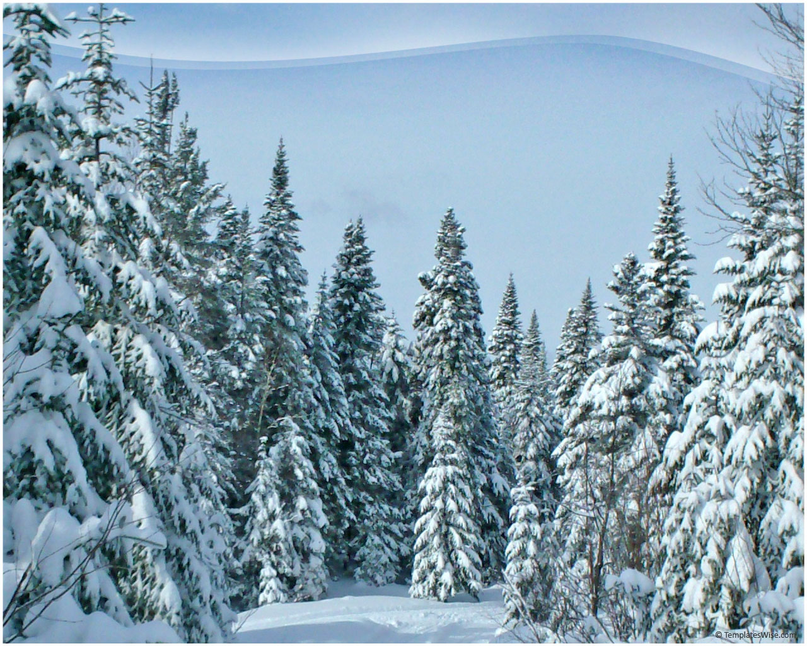
Introduction to exceptions

Slide 2
Introduction to exceptions
In PL/SQL , an error condition is called an exception .
Exceptions can be either internally defined or user defined .
Internal exceptions are implicitly raised , where as user-defined exceptions are explicitly raised; by using the RAISE statement.
For example , If you try to divide a number by zero , the predefined exception zero-divide is raised automatically .
User defined exceptions must be raised explicitly by using RAISE statement .

Slide 3
You can define exceptions of your own in the declarative part .In the executable part , you check for the condition that needs special attention . If you fined that the condition exists, you execute a RAISE statement .
can declare an exception as follows :
declare
past-due exception;
acct-num number(5);
Begin

Slide 4
Some of the scope rules for exceptions are as the follows:
You cannot declare an exception twice in the same block , but you can declare the same exception in two different block.
Exceptions declared in a block are considered local to that block and global to all its sub-blocks.
Because a block can reference only local or global exceptions , enclosing blocks cannot reference exceptions declared in a sub-block.

Slide 5
Internal exceptions
An internal exception is raised implicitly whenever the PL/SQL block violates an Oracle rule .
Every Oracle error has a number , but exceptions must be handled by name . So ,PL/SQL predefine some error common Oracle errors as exceptions .
For example , the predefined exception storage-error is raised when PL/SQL runs out of memory , no-data-found is raised when a select statement returns no rows , and zero-divide is raised if a number is divided by zero .
To handle all the other errors that have not been defiend in the block ‘OTHERS’ exception can be used.

Slide 6
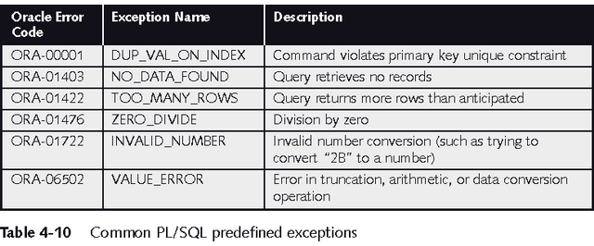
Predefined Exceptions

Slide 7
Example
Exception
when NO_DATA_FOUND then
DBMS_OUTPUT.PUT_LINE
When OTHERS then
Statements;
END;

Slide 8
The optional OTHERS exception handler is always the last handler in the block; it acts as the handler for all exceptions the block does .
The block can have only one OTHERS handler.
If two or more exceptions are to be executed in the same sequence of statements , list the exception names in the WHEN clause, separating them by the keyword OR , as in the following example:

Slide 9
Example
Exception
when NO_DATA_FOUND or TOO_MANY_ROWS
Then
Statements to handle these errors
When OTHERS then statements
END;

Slide 10
There can be any number of exception handlers and each handler can associate a sequence of statements with a list of exceptions . But an exception name can appear only once in the exception handling part of a block.
Only one exception at a time can be active in the exception handling part of a block .
An exception handler can reference only those variables that the current block can reference .
If the nested block does not have an exception handler , then the exception handler of the next outer block is executed .

Slide 11
example
Declare
<<Outer-block>>
Begin
Select into…. --inner block select
<<inner-block>>
Declare
Begin
Select into …… --inner block select
Exception
When NO-DATA-FOUND then …
END inner-block;
Statement; --outer block statements
Exception --outer block exception
When NO_DATA_FOUND then …….
When TOO_MANY_ROWS then …..
END outer_block;

Slide 12
User defined exceptions
An exception is a specific kind of runtime error
When that particular error occurs , the exception is said to be raised.
An exception is declared in the declarative part of a PL/SQL block by naming the exception and defining it as data type EXCEPTION .
Unlike internal exceptions must be given names .

Slide 13
User-defined exceptions need to be raised explicitly using the RAISE statement .
To handle raised exceptions , separate routines called exceptions handlers are written .

Slide 14
Declarative
section
Executable section
Exception handling
section
Declare
Raise
Reference
Name the exception
Explicitly raise the
exception by
using the
raise statement
Handle the raised
Exception

Slide 15
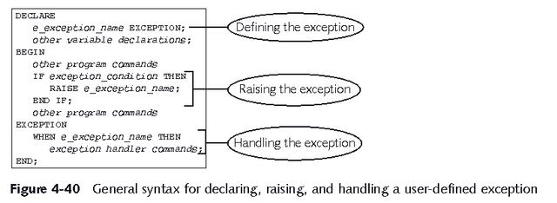
User-Defined Exceptions

Slide 16
Example
Declare
e_invalid_product exception ;
Begin
Update product
Set descrip = ‘&product_description’
Where prodid= &product_number ;
If SQL%NOTFOUND then
Raise e-invalid-product;
Endif ;
Commit;
Exception
When e-invalid-product then
DBMS_OUTPUT.PUT_LINE(‘ invalid product number’);
END;

Slide 17
Example
Declare
Erec emp%rowtype;
Begin
Select * into erec from emp where ename =‘&name’;
DBMS_OUTPUT.PUT_LINE(erec.job||’ ‘||erec.sal);
Exception
When no_data_found then
DBMS_OUT_LINE(‘No such employee exists in the table’);
End;
/

Slide 18
THE END

