Slide 1
Computer Data Security & Privacy

Slide 2
Lecture # 4
Public – key cryptography & massage authentication

Slide 3
OUTLINES
Public-Key Cryptography and Message Authentication
Approaches to Message Authentication
Secure Hash Functions and HMAC
Digital signature
Public-Key Cryptography Principles
Public-Key Cryptography Algorithms

Slide 4
Authentication
Authentication means user name and password, to find that the asserted identity is a valid for the particular person or not. So with such type of authentication it becomes difficult for the unauthorized person to enter.

Slide 5
Approaches to Message Authentication
Authentication Using Conventional Encryption
  Only the sender and receiver should share a key
Message Authentication Code
  Calculate the MAC as a function of the message and the key. MAC = F(K, M)

Slide 6
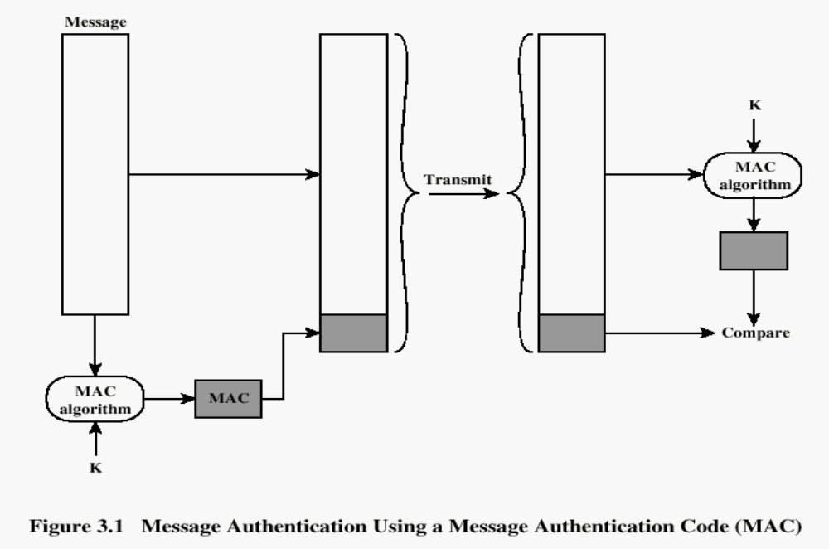

Slide 7
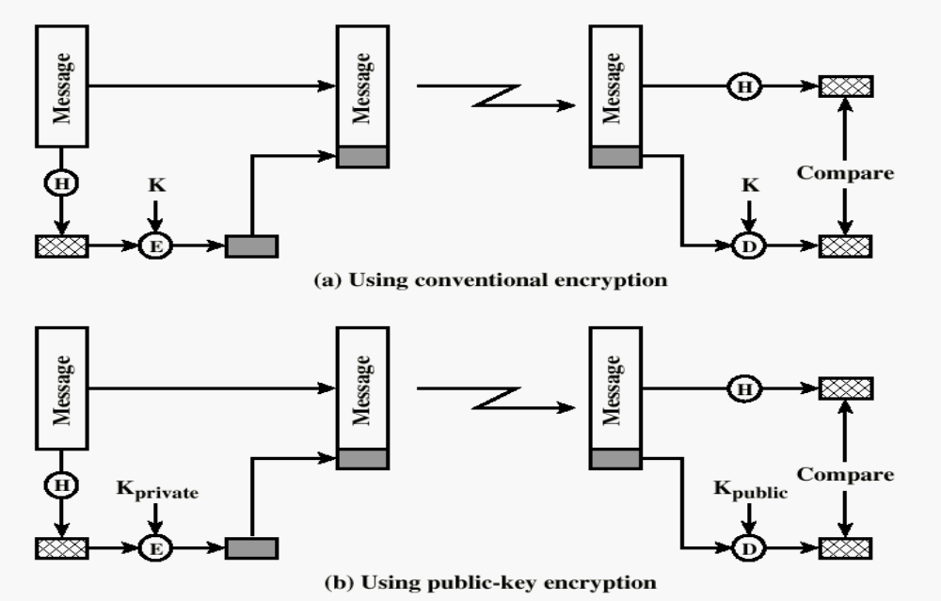
One-way HASH function

Slide 8
Digital signature
Is a mechanism by which a message is authenticated i.e. proving that a message is effectively coming from a given sender, much like a signature on a paper.

Slide 9
Typical Digital Signature Approach

Slide 10
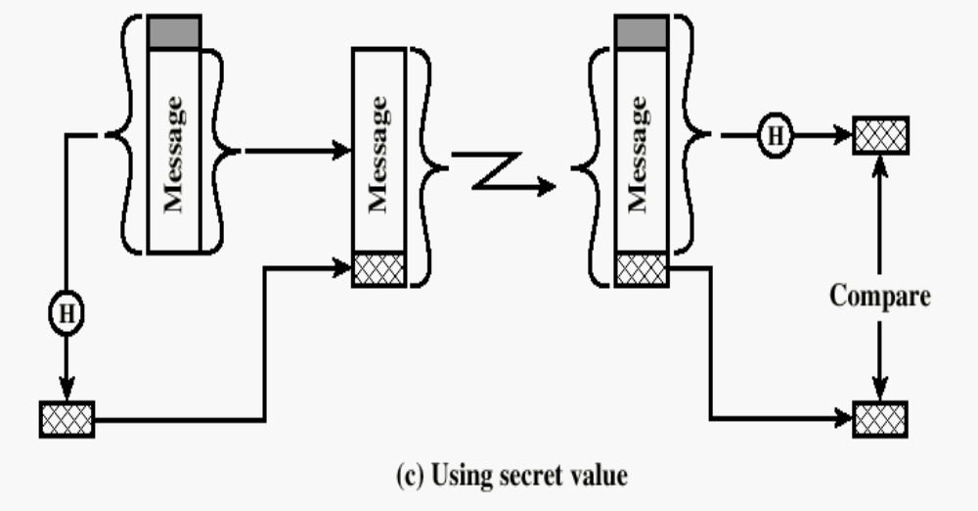
One-way HASH function
Secret value is added before the hash and removed before transmission.

Slide 11
Motivations:
  Cryptographic hash functions executes faster in software than encryptoin algorithms such as DES
  Library code for cryptographic hash functions is widely available.

Slide 12
Public-Key Cryptography Principles
The use of two keys has consequences in: key distribution, confidentiality and authentication.
The scheme has six ingredients
  Plaintext
  Encryption algorithm
  Public and private key
  Ciphertext
  Decryption algorithm

Slide 13
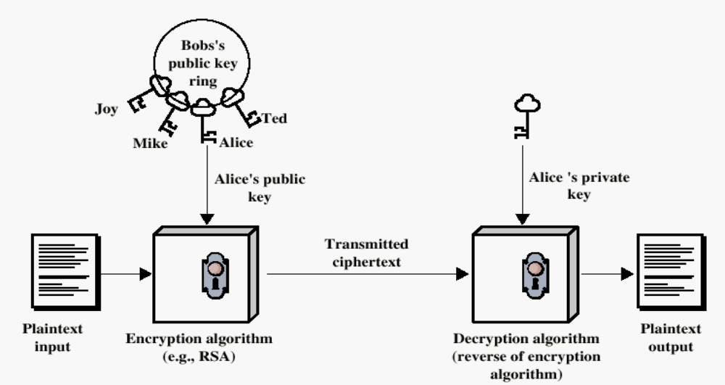
Encryption using Public-Key system

Slide 14
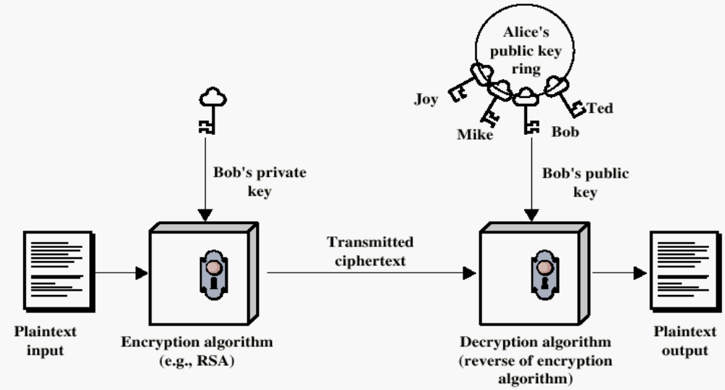
Authentication using Public-Key System

Slide 15
Applications for Public-Key Cryptosystems
  Encryption/decryption: The sender encrypts a message with the recipient’s public key.
  Digital signature: The sender ”signs” a message with its private key.

Slide 16
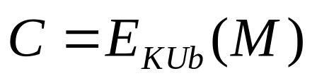
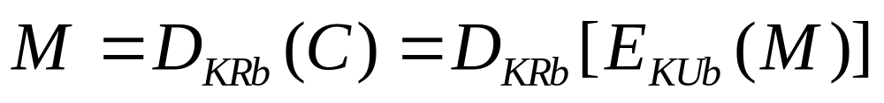
Requirements for Public-Key Cryptography
Computationally easy for a party B to generate a pair (public key KUb, private key KR_{b})
Easy for sender to generate ciphertext:
Easy for the receiver to decrypt ciphertect using private key:

Slide 17
Requirements for Public-Key Cryptography
Computationally infeasible to determine private key (KR_{b}) knowing public key (KU_{b})
Computationally infeasible to recover message M, knowing KU_{b} and ciphertext C
Either of the two keys can be used for encryption, with the other used for decryption:

Slide 18
Public-Key Cryptographic Algorithms
RSA
RSA - Ron Rives, Adi Shamir and Len Adleman at MIT, in 1977.
  RSA is a block cipher
  The most widely implemented

Slide 19
Home work (groups)
The Next Lecture

Slide 20
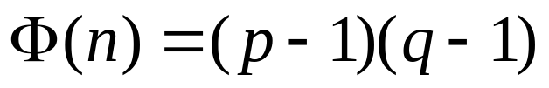
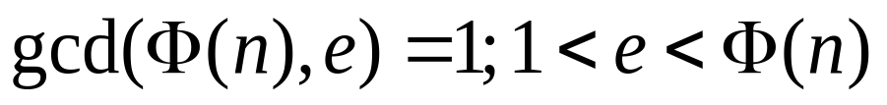
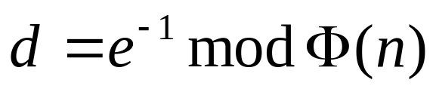
The RSA Algorithm – Key Generation
Select p,q p and q both prime
Calculate n = p x q
Calculate
Select integer e
Calculate d
Public Key KU = {e,n}
Private key KR = {d,n}

Slide 21
The RSA Algorithm - Encryption
Plaintext: M<n
Ciphertext: C = Me (mod n)

Slide 22
The RSA Algorithm - Decryption
Ciphertext: C
Plaintext: M = C^{d} (mod n)

Slide 23
Class Work!!!
(Plaintext = 19)
Public Key KU = {5,119}
Private key KR = {77,119}

Slide 24
END SLIDE SHOW # 4

