Slide 1
Computer Data Security & Privacy

Slide 2
Lecture # 5
Firewalls

Slide 3
Outline
Firewall Design Principles
  Firewall Characteristics
  Types of Firewalls
  Firewall Configurations.

Slide 4
Firewalls
Are computer security systems that protect your office / home pcs or network from hacker.
Are software programs or hardware devices that filter the traffic that flow into pc or network through internet connection.

Slide 5
firewalls
Hardware Firewall:
Are usually Router , Ethernet card and hub computer connect to this router & access the web.
Software Firewall:
New generation Operating Systems Come with built in firewalls or buy a firewall software for the computer that accesses the internet.

Slide 6
Firewall Design Principles
The firewall is inserted between the network and the Internet
Aims:
  Establish a controlled link
  Protect the network from Internet-based attacks

Slide 7
Firewall Characteristics
Design goals:
  All traffic from inside to outside must pass through the firewall Only authorized traffic will be allowed to pass.

Slide 8
Firewall Characteristics
Four general techniques:
Service control
  Determines the types of Internet services that can be accessed, inbound or outbound
Direction control
  Determines the direction in which particular service requests are allowed to flow

Slide 9
Firewall Characteristics
User control
  Controls access to a service according to which user is attempting to access it
Behavior control
  Controls how particular services are used (e.g. filter e-mail)

Slide 10
Types of Firewalls
Three common types of Firewalls:
  Packet-filtering routers
  Application-level gateways
  Circuit-level gateways

Slide 11
Types of Firewalls
Packet-filtering Router
  Applies a set of rules to each incoming IP packet and then forwards or discards the packet
  Filter packets going in both directions
  The packet filter is typically set up as a list of rules based on matches to fields in the IP or TCP header
  Two default policies (discard or forward)

Slide 12
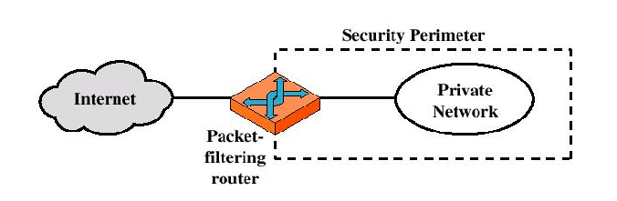
Types of Firewalls
Packet-filtering Router

Slide 13
Types of Firewalls
Advantages:
  Simplicity
  High speed
Disadvantages:
  Difficulty of setting up packet filter rules
  Need Authentication

Slide 14
Types of Firewalls
Possible attacks
IP address spoofing
  Source routing attacks

Slide 15
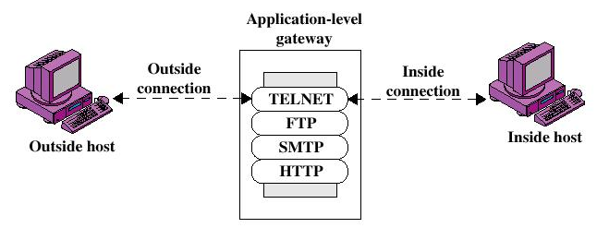
Types of Firewalls
Application-level Gateway

Slide 16
Types of Firewalls
Application-level Gateway
  Also called proxy server
  Acts as a relay of application-level traffic

Slide 17
Types of Firewalls
Advantages:
  Higher security than packet filters
  Easy to log and audit all incoming traffic
Disadvantages:
  Additional processing overhead on each connection (gateway)

Slide 18
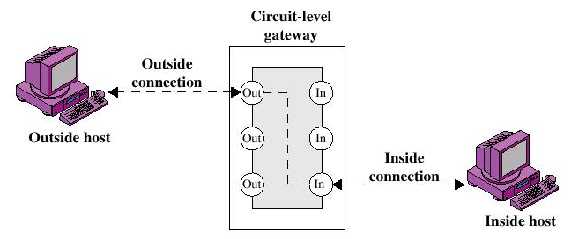
Types of Firewalls
Circuit-level Gateway

Slide 19
Types of Firewalls
Circuit-level Gateway
  Stand-alone system or
  Specialized function performed by an Application-level Gateway
  Sets up two TCP connections
  The gateway typically relays TCP segments from one connection to the other without examining the contents

Slide 20
Types of Firewalls
Circuit-level Gateway
  The security function consists of determining which connections will be allowed
  Typically use is a situation in which the system administrator trusts the internal users

Slide 21
END SLIDE SHOW

