Slide 1


Slide 2
3C
Call that a holiday

Slide 3
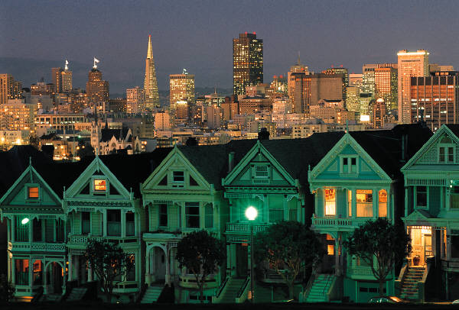
Which holidays can you remember from your childhood?
Have you or anyone you know ever had an unusual holiday ? If so , why was it unusual?

Slide 4
Reading and vocabulary

Slide 5
Alan’s holiday

Slide 6
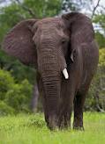
How long did he stay?
What was the accommodation like?
What did he do during the holiday?
What was the best thing about the holiday?
What was the most difficult part about the holiday?
Would he go on the same holiday again?
3 weeks
Comfortable guest house in the jungle.
He had a facelift operation
In the third week he went on Safari .
He had to spend 5 days inside the hospital
Yes,he would come back again

Slide 7
Emily’s holiday

Slide 8
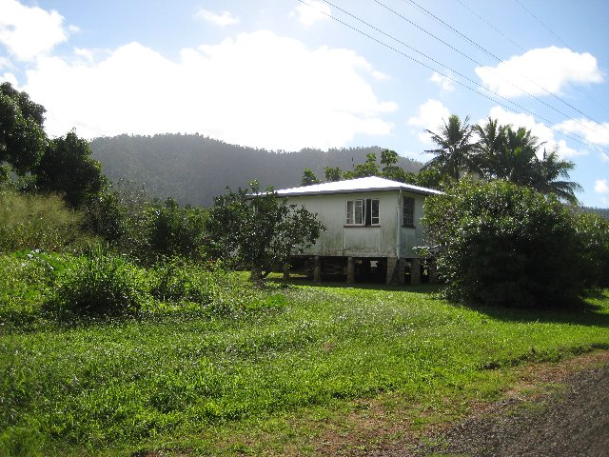
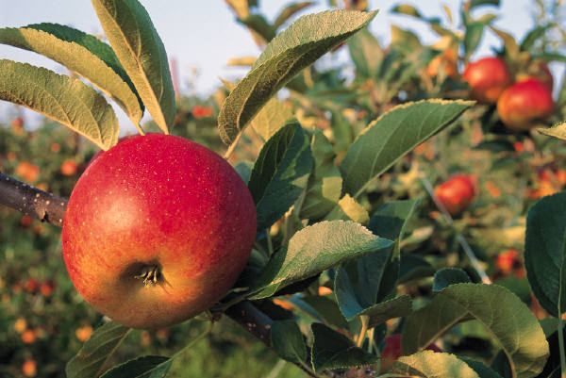
How long did she stay?
What was the accommodation like?
What did she do during the holiday?
What was the best thing about the holiday?
What was the most difficult part about the holiday?
Would she go on the same holiday again?
2 weeks
Farmhouse but she missed the comfort of her own bed
She worked 5 hours a day six days a week.
The people she met there who were from all the world and it felt great to eat natural organic food everyday.
Doing what the couple asked because she was not very strong.
Yes, she would

Slide 9
Vocabulary

Slide 10
Word Formation
Suffixes for adjectives and nouns

Slide 11
We sometimes makes adjectives from nouns ,or nouns from adjectives, by adding an ending ( a suffix), for example
Happy happiness

Slide 12
A) work in pairs

Slide 13
B)

Slide 14
adjective | noun | suffix
Difficult | Difficulty | _y
Honest | Honesty
Modest | Modesty
Patient | Patience | _ce
Confident | Confidence
Important | Importance
Kind | Kindness | _ness
Sad | Sadness
Lazy | Laziness
Popular | Popularity | _ity
Active | Activity
Tourist | touristy

Slide 15
noun | adjective | suffix
Danger | Dangerous | _ous
Adventure | Adventurous
Fame | Famous
Comfort | Comfortable | _able
Knowledge | Knowledgeable
Fashion | Fashionable
Nature | Natural | _al
Tradition | Traditional
Music | Musical
Health | Healthy | _y
Noise | Noisy
Possible | Possibility

Slide 16
C)
Popularity
Difficulty
Kindness
Dangerous
Comfortable
healthy

Slide 17
Tip
When the adjective or noun ends in –t,-y,or –e,we sometimes have to change the spelling:
Patient patience
Lazy laziness
Nature natural

Slide 18
D)+E)

Slide 19
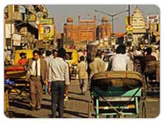
3D/A trip to India

Slide 20
What are the top 3 cities in the world that you would like to visit ?

Slide 21
Look at the photo of Delhi,in India. Would you like to go there?Why?Why not?

Slide 22
(1)-a)
The best time to visit.
Changing money.

Slide 23
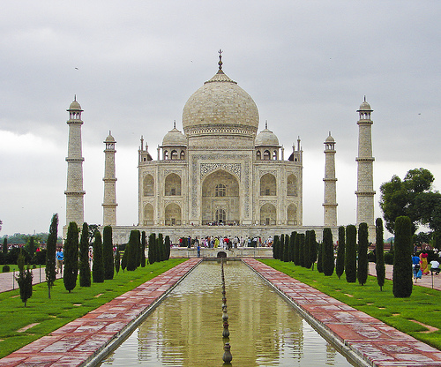

Slide 24
Ellen thinks
ricks shows are the best way to get around the city.
It’s better to travel to other cities by bus.
Michael should visit the museums in Delhi.
He should go to the Red Fort in Old Delhi.
He can visit the Taj Mahal and come back the same day.
There’s only one good restaurant in Connaught Place.

Slide 25
3) Review

Slide 26
Match
A | B
Set off | Problems
Pick up | Your parents
Get around | Early
Deal with | A hotel
Check into/out of | A country
Bring back | A lot of noise
Get back | At the airport
Put up with | From Spain
Look forward to | A holiday
See someone off | Souvenirs

Slide 27
5
Divide these words into nouns (N) and adjectives(A).
Health | Tourist | Difficult
Patience | Kind | Comfortable
Popular | Nature | danger

Slide 28
Nouns | Adjectives
Health | Difficult
Tourist | Kind
Patience | Popular
Nature | Comfortable
danger

Slide 29
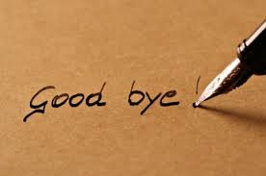
Prepared by,
Mrs.Azzah

