Slide 1
Computer Data Security & Privacy

Slide 2
Lecture # 7
Access Control

Slide 3
Trusted Systems
One way to enhance the ability of a system to defend against intruders and malicious programs is to implement trusted system technology.

Slide 4
Data Access Control
Through the user access control procedure (log on), a user can be identified to the system.
Associated with each user, there can be a profile that specifies permissible operations and file accesses
The operation system can enforce rules based on the user profile

Slide 5
Data Access Control
General models of access control:
  Access matrix
  Access control list
  Capability list

Slide 6
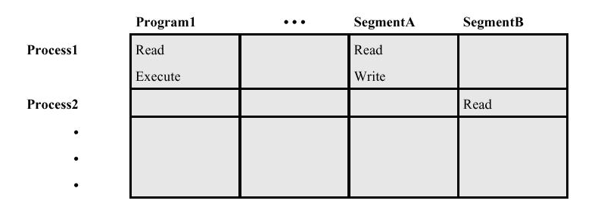
Data Access Control
Access Matrix

Slide 7
Data Access Control
Access Matrix: Basic elements of the model
  Subject: An entity capable of accessing objects, the concept of subject equates with that of process
  Object: Anything to which access is controlled (e.g. files, programs)
  Access right: The way in which an object is accessed by a subject (e.g. read, write, execute)

Slide 8
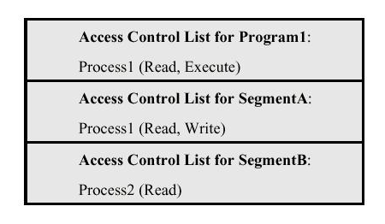
Data Access Control
Access Control List: Decomposition of the matrix by columns

Slide 9
Data Access Control
Access Control List
  An access control list, lists users and their permitted access right.
  The list may contain a default or public entry.

Slide 10
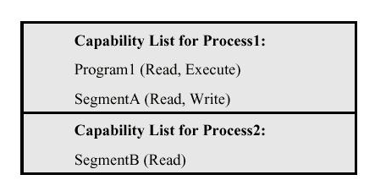
Data Access Control
Capability list: Decomposition of the matrix by rows.

Slide 11
Data Access Control
Capability list
  A capability ticket specifies authorized objects and operations for a user
  Each user have a number of tickets

Slide 12
The Concept of Trusted Systems
Trusted Systems
  Protection of data and resources on the basis of levels of security (e.g. military)
  Users can be granted clearances to access certain categories of data

Slide 13
The Concept of Trusted Systems
Multilevel security
  Definition of multiple categories or levels of data
A multilevel secure system must enforce:
  No read up: A subject can only read an object of less or equal security level (Simple Security Property)
  No write down: A subject can only write into an object of greater or equal security level.

Slide 14
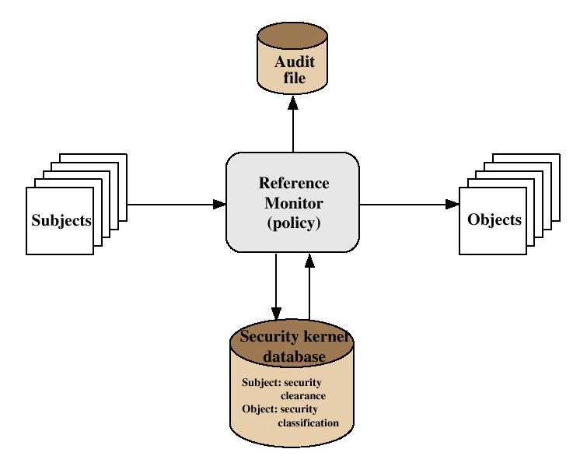
The Concept of Trusted Systems
Reference Monitor Concept: Multilevel security for a data processing system

Slide 15
The Concept of Trusted Systems
Reference Monitor
  Controlling element in the hardware and operating system of a computer that regulates the access of subjects to objects on basis of security parameters
  The monitor has access to a file (security kernel database)
  The monitor enforces the security rules (no read up, no write down)

Slide 16
The Concept of Trusted Systems
Properties of the Reference Monitor
  Complete mediation: Security rules are enforced on every access
  Isolation: The reference monitor and database are protected from unauthorized modification
  Verifiability: The reference monitor’s correctness must be provable (mathematically)

Slide 17
The Concept of Trusted Systems
A system that can provide such verifications (properties) is referred to as a trusted system

Slide 18
Trojan Horse Defense
Secure, trusted operating systems are one way to secure against Trojan Horse attacks

Slide 19
END SLIDE SHOW

