Slide 1
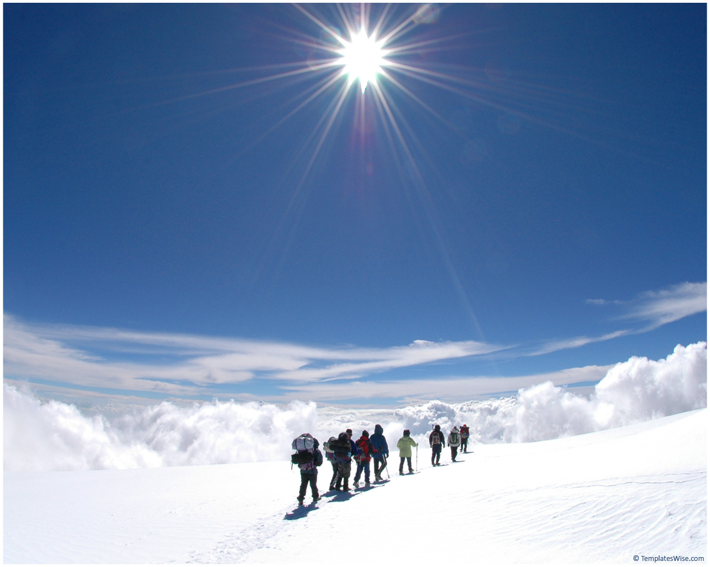
Cursors
تابع محاضرة 9

Slide 2
cursors
A cursor is a work area used by Oracle for processing multiple rows returned by the query .
It keeps track of witch row is currently being processed .
The set of rows returned by the query can consist of zero , one or many rows depending on the number of rows that meet the query’s search condition .

Slide 3
cursors
When a query returns multiple rows , a cursor can be explicitly defined to :
process beyond the first row returned by the query .
Keep track of which row is currently being processed .
The set of rows , returned by a multi-row query , is called the active set .

Slide 4
CURSORS
A cursor is a private set of records
Implicit cursors are created for every query made in Oracle
Explicit cursors can be declared by a programmer within PL/SQL.

Slide 5
Type of cursors
To process a SQL statement , PL/SQL opens a work area called a context area .
PL/SQL construct called ‘cursor’ allows you to name a context area, access its information and in some cases , control it’s processing .
PL/SQL uses two types of cursors , implicit and explicit cursors .

Slide 6
Implicit cursors
Oracle automatically opens a context area to process each SQL statement .
Even when the SQL statement is not a query , there is useful information stored in Oracle context area . To access this information , PL/SQL refers to the most recently opened context area as “SQL%” cursor .

Slide 7
Explicit cursor
If a query returns multiple rows a cursor can be defined to keep track of which row is being processed . This is known as explicit cursor .

Slide 8
Explicit Cursor Control
Declare the cursor
Open the cursor
Fetch a row
Test for end of cursor
Close the cursor
Note: there is a FOR LOOP available with an implicit fetch

Slide 9
Defining a cursor
A cursor is defined in the declarative part of the PL/SQL block by naming it and associating it with a query .
To define a cursor you use the following statement :
CURSOR<cursor-name> IS
<select statement>;
Example :
CURSOR cur_first IS
Select pnr_no, flightno, flight_date,reserv_date,pass_name,class
From reservation
Where class=‘F’;

Slide 10
Manipulating explicit cursor
The following three statements are used to manipulating cursor :
Open.
Fetch.
Close.
A cursor must be necessarily declared before referencing it in an OPEN,CLOSE ,or FETCH statement .

Slide 11
Manipulating explicit cursor
Any variable must be declared before referencing it in a cursor declaration.
Values cannot be assigned to a cursor name nor can a cursor name be used as a value in a PL/SQL expression.
The cursor name is not a PL/SQL variable it is only a name used to reference a query.

Slide 12
The OPEN statement
The cursor must be initialized or opened with the OPEN statement , before any rows are returned by the query .
OPENing the cursor executes the query and identifies the active set, the OPEN statement is used as follows :
OPEN<cursor-name>;
Example :
OPEN cur_first;

Slide 13
The FETCH statement
A FETCH statement is used to retrieve the rows in the active set one at a time .
FETCH can be executed repeatedly until all rows have been retrieved .
The format of the FETCH statement is as follows :
FETCH<cursorname> INTO variable1,variable2,….,variableN;
Or
FETCH <cursorname> INTO record_variable;

Slide 14
Creating a Cursor
We create a Cursor when we want to go over a result of a query
Syntax Example:
DECLARE
cursor c is select * from sailors;
sailorData sailors%ROWTYPE;
BEGIN
open c;
fetch c into sailorData;
sailorData is a variable that can hold a ROW from the sailors table
Here the first row of sailors is inserted into sailorData

Slide 15
Example
To fetch row into a record variable ‘mrec’, declared by using %ROWTYPE based on the cursor, you would use the following code:
FETCH cur_first INTO mrec;
--mrec is declared using %rowtype based on –cursor .

Slide 16
The CLOSE statement
When the last row has been processed , the cursor must be closed with a CLOSE statement and this makes the active set undefined .
The format of CLOSE statement is as the follows :
CLOSE<cursorname>;
Example:
CLOSE cur_first;

Slide 17
Once a cursor is closed , it can be reopened by either issuing the OPEN command to re-evaluate parameters and re-initialize the active set, or by using a cursor FOR loop to implicitly open the cursor .

Slide 18
Attributes of an EXPLICIT cursor
Every explicit cursor has four attributes that can be used to access the cursor’s context area .
To use these attributes you simply append it to the name of the cursor .
The four attributes are :
%NOTFOUND.
%FOUND.
%ROWCOUNT.
%ISOPEN.

Slide 19
Cursor Attributes
cursorname%ROWCOUNT Rows returned so far
cursorname%FOUND One or more rows retrieved
cursorname%NOTFOUND No rows found
Cursorname%ISOPEN Is the cursor open

Slide 20
The %NOTFOUND attribute
This attribute evaluate to TRUE if the last FETCH failed because no more rows were available , or to FALSE if the last FETCH returned a row .
Example:
OPEN cur_first;
LOOP
FETCH cur_first INTO mrec;
EXIT WHEN cur_first %NOTFOUNT;
………
………
END LOOP;

Slide 21
The %FOUND attribute
This attribute evaluates to TRUE if the last FETCH succeeded because a row was a available , or to FALSE if the last FETCH failed because no more rows were available .
The following example uses %FOUND to take either of two alternative actions:
LOOP
FETCH cur_first INTO mrec;
IF cur_first %FOUND THEN
………
………
ELSE
EXIT;
END IF;
……….
END LOOP;
This attribute is the logical opposite of %NOTFOUND.

Slide 22
The %ROWCOUNT attribute
The %ROWCOUNT attribute returns the number of rows FETCHed from the active set so far.
Example:
LOOP
FETCH cur_first INTO mrec;
……..
…….
IF cur_first%ROWCOUNT = 5 then
EXIT
END IF;
………
END LOOP;

Slide 23
The %ISOPEN attribute
This attribute evaluated to TRUE if an explicit cursor is open and FALSE if it is closed .
Example :
IF cur_first%ISOPEN THEN
FETCH cur_frist INTO mrec;
ELSE
OPEN cur_frist;
END IF;

Slide 24
Example
DECLARE
CURSOR cur_first IS - -declaring the cursor
SELECT pnr_no, flightno, flight_date , reserve_date, pass_name , class
FROM reservation
WHERE class=‘F’;
mrec cur_first%ROWTYPE;
msrno passengers.srno%TYPE;
BEGIN
OPEN cur_first --intializing the cursor
LOOP
FETCH cur_first INTO mrec; --fetch a row from the cuursor
EXIT WHEN cur_fisrt%NOTFOUND; --Exit when there are no more rows
msrno := cur_first%ROWCOUNT;
INSERT INTO passengers VALUES (msrno, mrec.pnr_no, mrec.flightno,
Mrec.flight_date, merc.reserv_date, mrec.pass_name, mrec.class);
END LOOP;
CLOSE cur_first; -- closing the cursor
END;
/

Slide 25
Sample Cursor Program
DECLARE
CURSOR students_cursor IS
SELECT * from students;
v_student students_cursor%rowtype;
/* instead we could do v_student students%rowtype */
BEGIN
DBMS_OUTPUT.PUT_LINE ('******************');
OPEN students_cursor;
FETCH students_cursor into v_student;
WHILE students_cursor%found LOOP
DBMS_OUTPUT.PUT_LINE (v_student.last);
DBMS_OUTPUT.PUT_LINE (v_student.major);
DBMS_OUTPUT.PUT_LINE ('******************');
FETCH students_cursor into v_student;
END LOOP;
CLOSE students_cursor;
END;
/

Slide 26
Sample Cursor Program
(same program without composite variable)
DECLARE
CURSOR students_cursor IS
SELECT last, major from students;
v_Last students.last%type;
v_major students.major%type;
BEGIN
DBMS_OUTPUT.PUT_LINE ('******************');
OPEN students_cursor;
FETCH students_cursor into v_last, v_major;
WHILE students_cursor%found LOOP
DBMS_OUTPUT.PUT_LINE (v_last);
DBMS_OUTPUT.PUT_LINE (v_major);
DBMS_OUTPUT.PUT_LINE ('******************');
FETCH students_cursor into v_last, v_major;
END LOOP;
CLOSE students_cursor;
END;
/

Slide 27
  1) DECLARE
  /* Output variables to hold the result of the query: */
  2) a T1.e%TYPE;
  3) b T1.f%TYPE;
  /* Cursor declaration: line 4-8*/
  4) BEGIN
  9) OPEN T1Cursor;
  10) LOOP
  /* Retrieve each row of the result of the above query
  into PL/SQL variables: */
  11) FETCH T1Cursor INTO a, b;
  /* If there are no more rows to fetch, exit the loop: */
  12) EXIT WHEN T1Cursor%NOTFOUND;
  /* Insert the reverse tuple: */
  13) INSERT INTO T1 VALUES(b, a);
  14) END LOOP;
  /* Free cursor used by the query. */
  15) CLOSE T1Cursor;
  16) END;
  /

Slide 28
DECLARE
CURSOR my_cursor IS
SELECT sal + NVL(comm, 0) wages, ename
FROM emp;
my_rec my_cursor%ROWTYPE;
BEGIN
OPEN my_cursor;
LOOP
FETCH my_cursor INTO my_rec;
EXIT WHEN my_cursor% NOTFOUND;
IF my_rec.wages > 2000 THEN
INSERT INTO temp VALUES (NULL, my_rec.wages,
my_rec.ename);
END IF;
END LOOP;
CLOSE my_cursor;
END;

Slide 29
DECLARE
num1 data_table.n1%TYPE; -- Declare variables
num2 data_table.n2%TYPE; -- to be of same type as
num3 data_table.n3%TYPE; -- database columns
result temp.num_col1%TYPE;
CURSOR c1 IS
SELECT n1, n2, n3 FROM data_table
WHERE exper_num = 1;
BEGIN
OPEN c1;
LOOP
FETCH c1 INTO :num1, :num2, :num3;
EXIT WHEN c1%NOTFOUND;
-- the c1%NOTFOUND condition evaluates
-- to TRUE when FETCH finds no more rows
/* calculate and store the results */
result := num2/(num1 + num3);
INSERT INTO temp VALUES (result, NULL, NULL);
END LOOP;
CLOSE c1;
COMMIT;
END;

Slide 30
Example
The example given below stores all the employee name in a PL/SQL table , using a cursor , and then displays the names from the PL/SQL table .

Slide 31
DECLARE
TYPE nametabtyp IS TABLE OF CHAR(10) INDEX BY BINARY_INTEGER;
Name_tab nametabtyp;
CURSOR cur_emp IS SELECT ename FROM emp;
Num INTEGER;
n_rows INTEGER;
BEGIN
OPEN cur_emp;
Num:=1;
LOOP
FETCH cur_emp INTO name_tab(num);
EXIT WHEN cur_emp%NOTFOUND;
n_rows:=cur_emp%ROWCOUNT;
num:= num+1;
END LOOP;
CLOSE cur_emp;
FOR i IN 1..n_rows LOOP
DBMS_OUTPUT.PUT_LINE(‘Name’|| I ||’:’|| name_tab(i));
END LOOP;
END;
/

