Slide 1

Overview of PL/SQL
Stored Program Units

Slide 2
Self-contained group of program statements that can be used within a larger program.
Easier to conceptualize, design, and debug
Save valuable programming time because you can reuse them in multiple database applications
Other PL/SQL programs can reference them .

Slide 3
Creating Stored Program Units
Procedure: a subprogram that performs a specific action .
Procedure: a program unit that can receive multiple input parameters and return multiple output values or return no output values.
Function: a function is subprogram that returns a value .
Function: a program unit that can receive multiple input parameters, and always returns a single output value.
Functions and procedures are stored a like , except that functions has a RETURN clause.

Slide 4
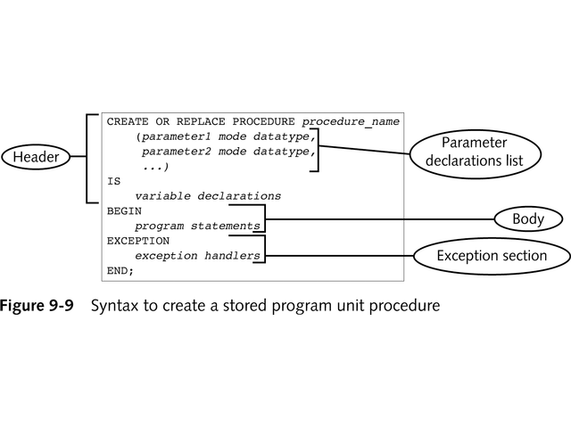
Syntax to create a stored program unit procedure

Slide 5
Parameter Declarations List
Defines the parameters and declares their associated data types
Enclosed in parentheses
Separated by commas
The data type specified in a parameter declaration must be unconstrained. In the other words, you cannot declare a parameter as follows.
CREATE PROCEDURE add_name(name CHAR(20)) IS
BEGIN
……..
……..
END;

Slide 6
The OR REPLACE option will automatically drop the procedure, if it already exits , and recreate the procedure without a warning .
Procedures are stored in the database and can be invoked or called by any anonymous block.

Slide 7
CREATE PROCEDURE branch_sum(p_branch branch.branch_code%TYPE) IS
Rcount number(3);
Ccount number(3);
Rtotal number(8);
Ctotal number(8);
Mcity varchar2(15);
BEGIN
SELECT city INTO mcity
FROM branch
WHERE branch_code=p_branch;
SELECT COUNT(*), SUM(total_fare) INTO Rcount, Rtotal
FROM reservation
WHERE branch_code = p_branch;
SELECT COUNT(*), SUM(total_fare) INTO Ccount, Ctotal
FROM cancellation
WHERE branch_code = p_branch;
IF Rtotal IS NULL THEN Rtotal:=0
END IF;
IF Ctotal IS NULL THEN Ctotal:=0
END IF;
INSERT INTO branch_summary VALUES (Mcity, Rcount, Rtotal, Ccount, Ctotal);
EXCEPTION
WHEN NO_DATA_FOUND THEN
DBMS_OUTPUT.PUT_LINE (‘no such branch ’) ;
END;
/

Slide 8
Calling a Stored Procedure
From SQL*Plus command line:
  EXECUTE procedure_name (parameter1_value, parameter2_value, ...);
  EX: EXECUTE branch_sum(‘NYK’);
Call a procedure as a PL/SQL statement :
Ex: To call the procedure branch_sum as a PL/SQL statement in a program you would use
DECLEARE
…….
BEGIN
…….
branch_sum(‘NYK’);
……
END;

Slide 9
Maintaining a procedure
You can drop a procedure using the DROP PROCEDURE command as follows :
DROP PROCEDURE <procedure_name>;

Slide 10
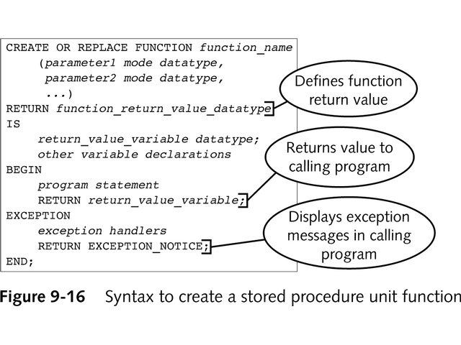
Creating a Stored Program Unit Function

Slide 11
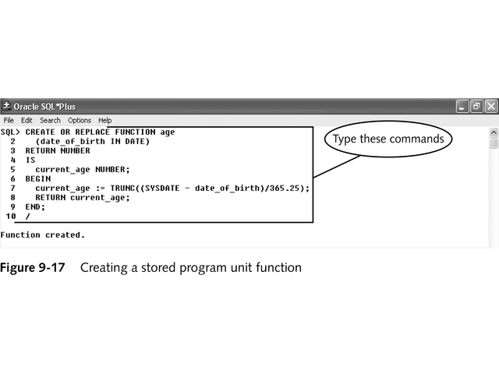
Creating a Stored
Program Unit Function
Last command in function must be RETURN

Slide 12
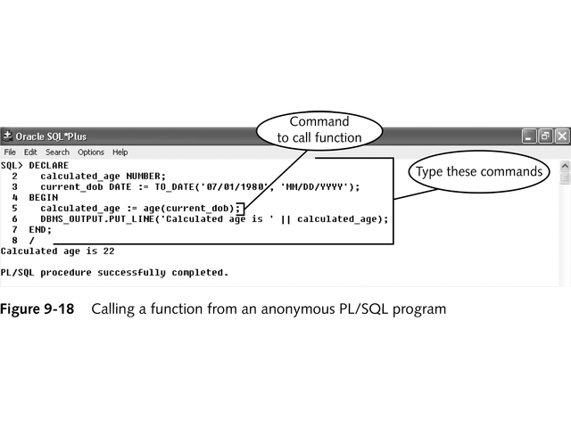
Calling a Function
variable_name := function_name(parameter1, parameter2, ...);

Slide 13
CREATE FUNCTION day_fun(mday number) RETURN CHAR IS
Disp_day CHAR(15);
BEGIN
IF mday=1 THEN
Disp_day:=‘sunday’;
ELSIF mday=2 THEN
Disp_day:=‘monday’;
ELSIF mday=3 THEN
Disp_day:=‘tuesday’;
ELSIF mday=4 THEN
Disp_day:=‘wensday’;
ELSIF mday=5 THEN
Disp_day:=‘thursday’;
ELSIF mday=6 THEN
Disp_day:=‘friday’;
ELSIF mday=7 THEN
Disp_day:=‘saturday’;
END IF;
RETURN Disp_day;
END;
/

Slide 14
Calling a function
Call a function as a PL/SQL statement to call the function day_fun as a PL/SQL statement in a program you would use :
DECLEARE
charadays CHAR(15);
BEGIN
………
Chardays:=day_fun(3);
……..
END;
The result returned by the function ‘day_fun’ will be assigned / stored in the variable ‘chardays’.
Call a function as a part of an expression .
To call the function day_fun as part of an expression , you would use :
IF ‘day_fun(3) = ‘Tuesday’ then
……….
END IF;
……….

Slide 15
Maintaining a function
You can drop a function using the DROP FUNCTION command as follows :
DROP FUNCTION <function_name>;

Slide 16
THE END

