Slide 1
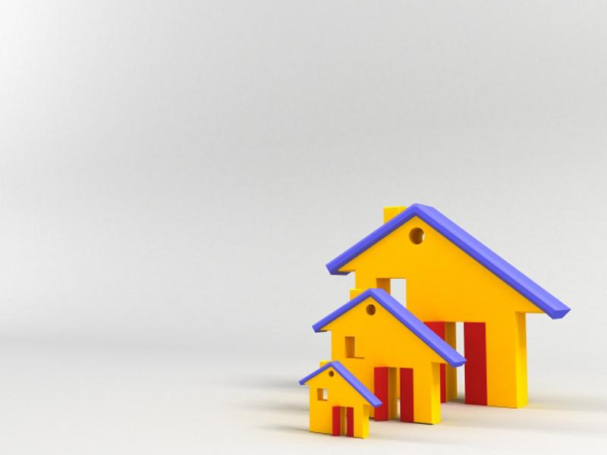

Unit 5
Home truths
Ms. Nehad A. Asiri
Powerpoint Templates

Slide 2

Objectives
By the end of this class, students
should be able to :
Use new vocabulary items and adjectives to describe houses, character and behavior.
Make caparisons using comparatives, superlatives , much , as……as , a bit, etc.
Listen to different descriptions of houses.
Give information about various
places to live in.

Slide 3
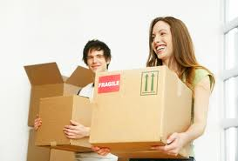
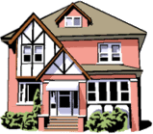
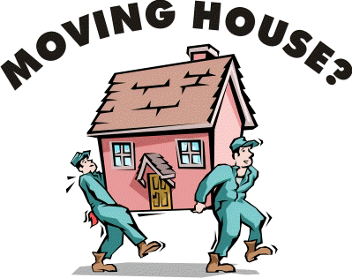
Moving house
5A

Slide 4
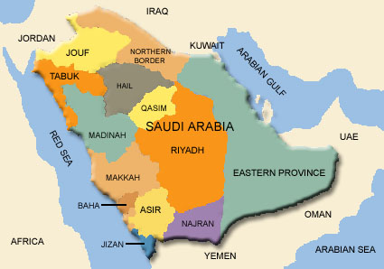


Moving house
5A
Introduction
Where do you live ?
What does your house look like? Describe it.
Do you want to move to another house? Why ? Why not?

Slide 5

1. Vocabulary - Homes
Let’s learn new words Pg. 37

Slide 6
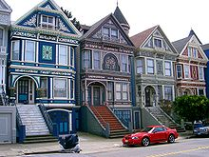
A terraced house: a row of identical houses share side walls.

Slide 7
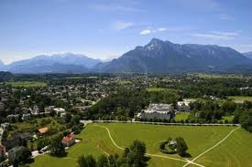
With a nice view
I live in a house with a nice view

Slide 8
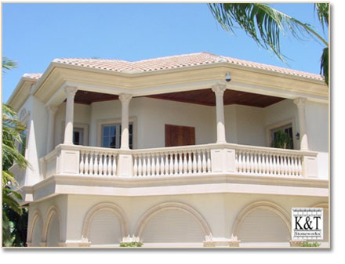
A balcony

Slide 9
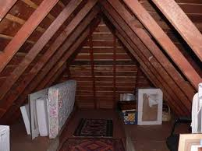
A detached house: a house that stands alone.
A loft A room or space directly under the roof of a house used for accommodations or storage.

Slide 10
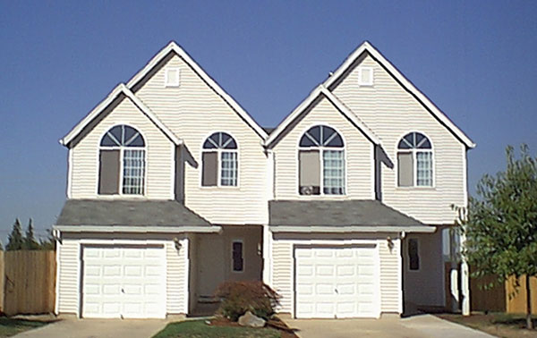
A semi detached house:
a house which joins to another house on one side but not on the other.

Slide 11
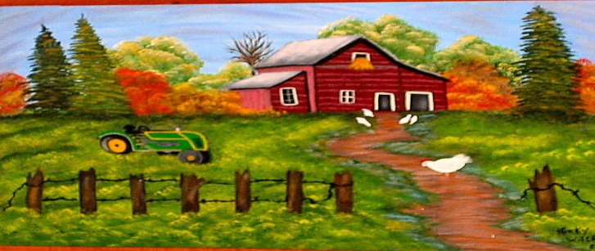
In the country
My father likes spending the summer in the country.

Slide 12
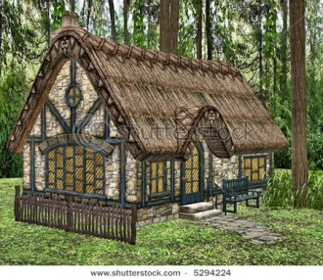
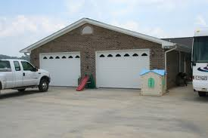
A cottage
A small, single-storied house, especially in the country.
A garage

Slide 13
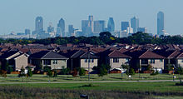
In the suburbs: an area where people live outside the center of a city .
A study: a room intended or equipped for studying or writing.
A basement: the lowest floor of a building, usually below ground level

Slide 14
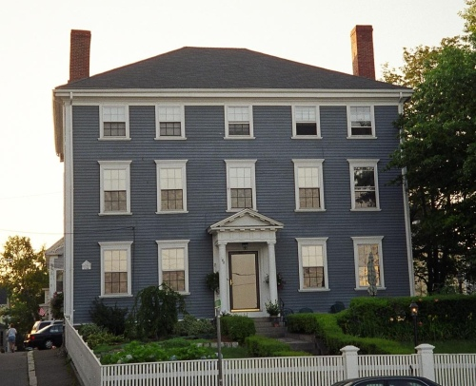
A cellar: a room or enclosed space under a house used for storage.
A three-storey house/building
Neighborhood: a district where people live.

Slide 15
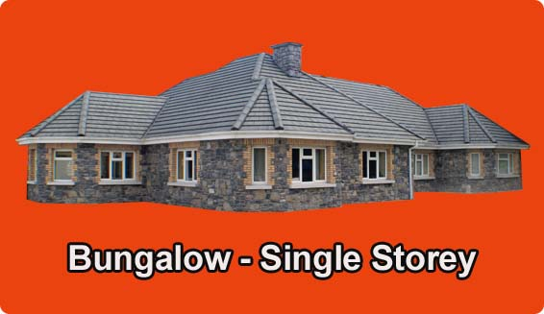
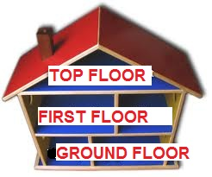
En-suite bathroom: connected directly to the bedroom.
A bungalow

Slide 16
Within walking distance of the shops: close enough to walk to.
My house is within walking distance from Rashid Mall.
Fitted kitchen : all the units are 'fitted' into the walls.
Carol has spent a lot of money on her new fitted kitchen.

Slide 17

After learning the meanings of these new words, let’s work in pairs to put them into groups 1, 2, and 3
Ex.1 – pg.36

Slide 18
3. PARTS OF A HOME | 2. LOCATION | 1.TYPES OF HOME
A balcony | With a nice view | A terraced house
A loft | In the country | A detached house
A garage | In the suburbs | A semi-detached house
A study | In a good/bad/rough neighborhood | A cottage
A basement | On the ground/first/top floor | A three-storey house
A cellar | Within walking distance of the shops | A bungalow
An en-suite bathroom | - | -
A fitted kitchen | - | -

Slide 19
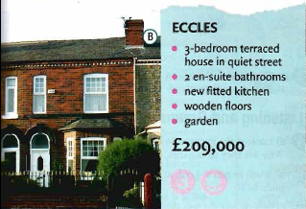
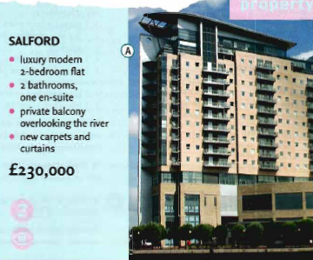
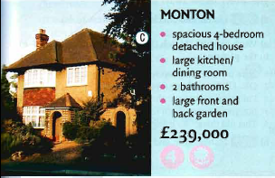
3. Reading , Listening and Grammar
a) Read this advertisement for places to live in Manchester, England. Pg.36-37
Which one do you like best? Why ?

Slide 20
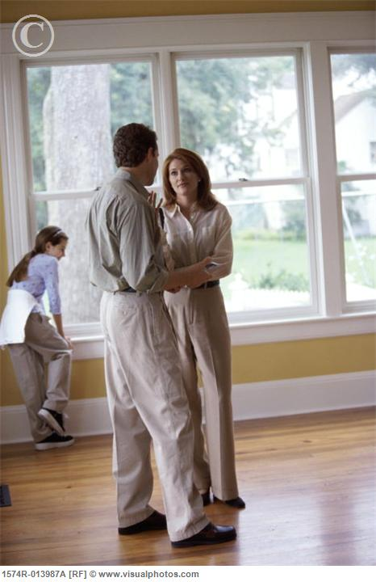

b) Ian and Liz are looking for a new place to live in. Listen to their conversation.
Which place do they both like?

Slide 21
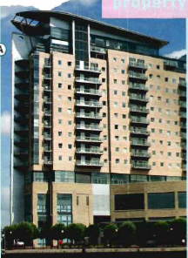
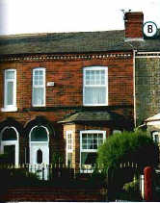
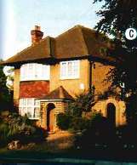
4. Look at these sentences. Are they about places A, B or C ?
It’s the least expensive place we’ve seen.
It seemed slightly bigger than our house.
It’s one of the oldest houses we’ve seen so far.
It was much noisier than the other two.
The garden was far smaller than I expected.
It felt a lot more spacious.
It had the most amazing view.
It’s a little further away from the city centre.
It’s got the worst bathroom I’ve ever seen.
It’s a bit less expensive than the Monton house.
B
B
C
C
C
A
A
C
B
A

Slide 22

5. Making Comparisons Comparative & Superlative Adjectives
First you must ask yourself,
‘How many things am I comparing?‘
If you are comparing only two things then you must use a comparative, if it’s three or more, then it must be a superlative.

Slide 23
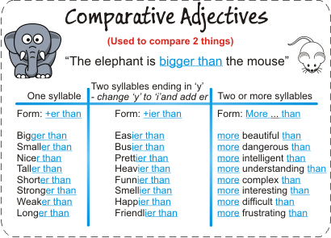
My sister is taller than me.
She's looking happier today.
Reema is more careful with her writing than I am with mine.

Slide 24
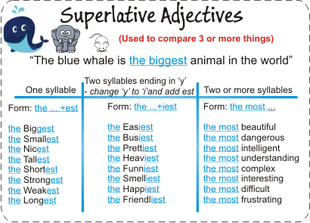
My brother is the tallest in our family.
The richest people are not always the happiest.
Albert Einstein was the most intelligent person at his time.

Slide 25
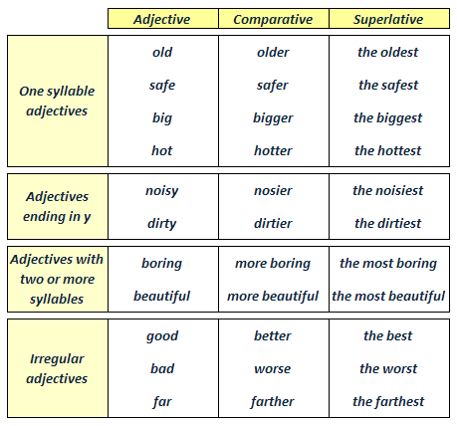
Comparatives and Superlatives

Slide 26
Before the superlative
We use;
the----( it had the most amazing view)
or
Possessive ‘s ( Nora’s) – *He is Peter’s best friend.
or
Possessive adjective ( her,her,his,my,your,their,our )

Slide 27
(the + superlative)
is the most common form

Slide 28
The opposite of more is less;
It’s a bit less expensive than the Monton house.
The opposite of most is least;
It’s the least expensive place we’ve seen.

Slide 29
We use much, far, or a lot before a comparative to say there’s a big difference.
It was (much/far/a lot)noisier than the other two.

Slide 30
We use slightly ,a little or a bit before a comparative to say there’s a small difference.
It seems( slightly/a little/ a bit )bigger than our house.

Slide 31
We can also use more and most with nouns:
It’s got more rooms than the last house.
This house has got the most space.

Slide 32
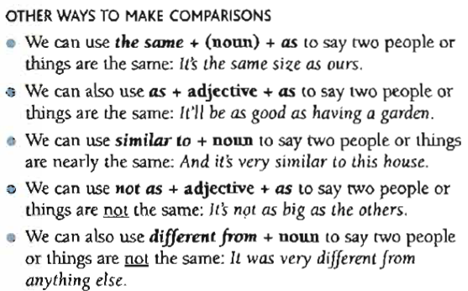
It’s the same size as ours.
It’ll be as good as having a garden.
It’s very similar to this house.
It’s not as big as the others.
It was very different from anything else.

Slide 33
Tip !
We can say( different from or different to )
This flat is different from the one in Salford.
This falt is different to the one in Salford.

Slide 34

Now let’s try doing exercise 7 pg. 37

Slide 35

Do not forget to do your assignment
5A Exercise 8 – pg. 37
That’s it for today..
See you next time ..
Prepared by:
Ms. Nehad A. Asiri

Slide 36
detached house - a house that stands alone
terrace(d) house, terrace, row house, linked house
s a style of medium-density housing that originated in Europe in the 16th century, where a row of identical or mirror-image houses share side walls
\
Semi-detached
consists of pairs of houses built side by side as units sharing a party wall
this is sometimes colloquially called a duplex
bungalow
A bungalow is a type of house, with varying meanings across the world. Common features to many (but not all) of these definitions include being detached, low-rise

