Slide 1
Good Afternoon

Slide 2
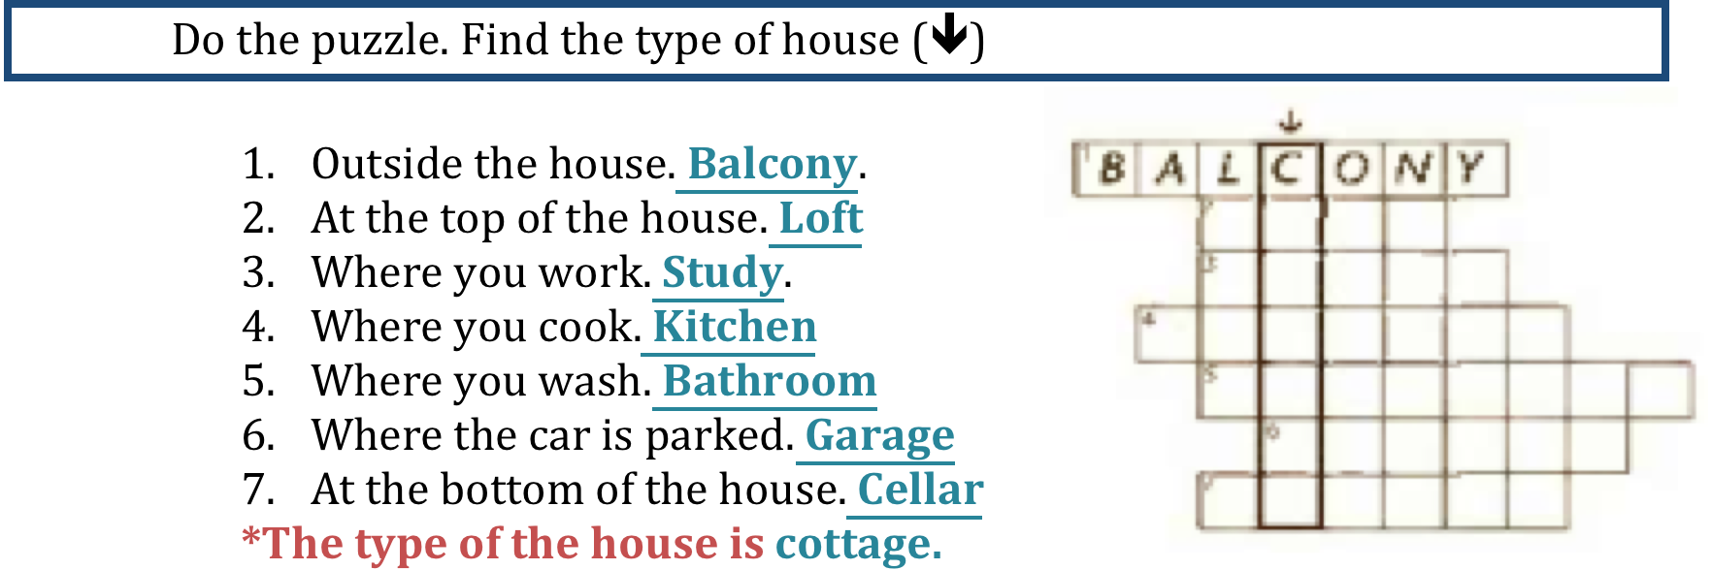
loft
study
kitchen
bathroom
garage
cellar

Slide 3
choose
This room is gorgeous. It’s more attractive than the other one.
(more/much/as)
I think he is the same age as me.
(-/as/so)
This house is far nicer than the one we saw yesterday.
(far/near/more)
He is more sensitive than me.
(more/much/far)
Your handwriting is better than mine.
(better/good/best)
Al-Masmak is the most beautiful Palace in Riyadh.
(more/so/most)
It’s a bit heavier ,but not much.
(bit/more/much)
It’s the least spacious flat we’ve seen .all the others were a lot bigger
(bit/least/less)

Slide 4
Ch.5 Home truths
5B A load of old junk
Ms. Nehad A. Asiri

Slide 5
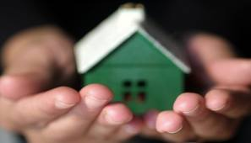
“ A house divided against itself cannot stand.”
Abraham Lincoln

Slide 6
OBJECTIVES
Upon completion of this class, students must be able to:
Use and define different phrasal verbs.
Use the future tense correctly. (will – be going to )
Use the present continuous tense correctly.
Construct clear sentences using appropriate grammar rules.
Read for specific information.

Slide 7
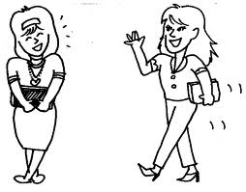
VOCABULARY – Phrasal verbs
A phrasal verb is a verb plus a preposition or adverb which creates a meaning different from the original verb.
Example:
I ran into my teacher at the movies last night. run + into = meet

Slide 8
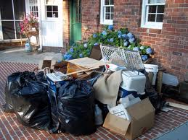

a) Check these words in the dictionary.
1
Get rid of : to discard or throw away.
I need to get rid of old junk in the house.

Slide 9
Check these words in the dictionary.
keep :to save .
Keep X get rid of
I will keep this old book. It’s very useful.

Slide 10

Check these words in the dictionary.
Stuff Different objects and things.
I need to buy some stuff for the party.

Slide 11
Check these words in the dictionary.
Junk: anything that is regarded as
worthless, meaningless; trash.

Slide 12
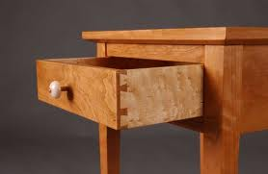
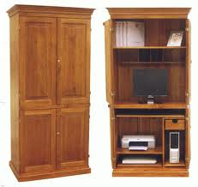
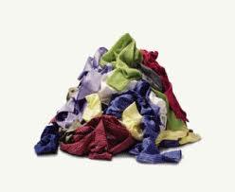
Check these words in the dictionary.
A drawer
A cupboard
A pile

Slide 13

READING TIME pg. 38
Now let’s read the article and learn some new phrasal verbs.
Guess the meaning of the phrasal verbs in bold .
2

Slide 14

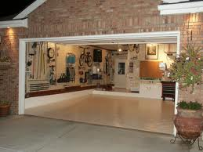
Clear (sth) out
To tidy or clean a room or a house and remove the things you don’t want any more.
I’m going to clear out the garage this weekend.

Slide 15
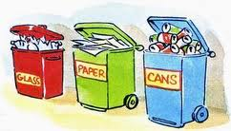
Sort (sth) out
To organize or arrange things.
I need to sort out the garbage according to it’s material.

Slide 16
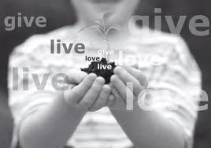
Give (sth) away
To give something to someone for free.
I didn’t need my old TV so I gave it away.

Slide 17
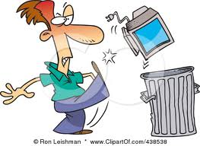
Throw (sth) away / throw (sth) out
To put something in the rubbish bin because you don’t want it anymore.
This chair is broken. I will throw it out.

Slide 18
Take (sth) out
Remove something from a place.
Can you take the garbage out for me , please?

Slide 19
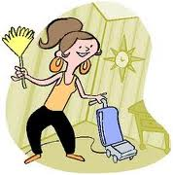
Tidy (sth) up
To make a place neat and organized by putting things back in their places.
Tidy up the house. Some friends are coming.

Slide 20
Put (sth) away
To put something in the place where you usually keep it.
Sarah, don’t leave your clothes on the floor. Put them away.

Slide 21
Come back
To return to a place.
We will have an exam when we come back after the holiday.

Slide 22
Go through (sth)
To look at things carefully in order to decide what to do with them.
I went through everything in these boxes and threw away a lot of junk.

Slide 23
What have we just learned ?
In one minute write down all the words you can remember ?

Slide 24
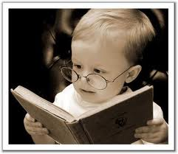

READING TIME pg. 38
b) Tick the true sentences. Correct the false ones.
The article tells you how to get rid of rubbish.
You need an hour for each room.
You should put things in three piles.
Put things you don’t want in a junk drawer.
Don’t buy things if you’ve got something similar.
c) What do you think of the advice in the article? Do you need to do this in your home?
2 hours
Things you can’t decide about

Slide 25
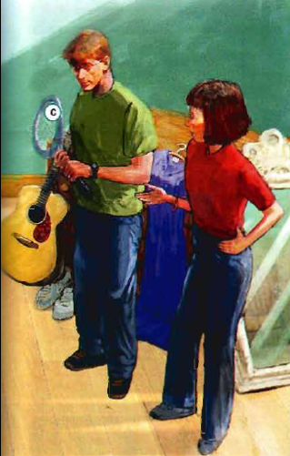
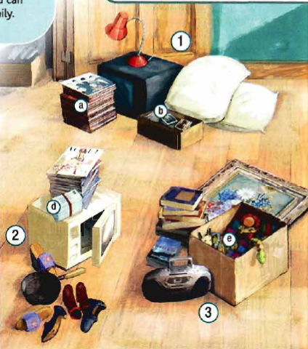

LISTENING & GRAMMAR pg. 38
4
Look at the picture. What are Ian an Liz doing ? Why are they doing this ?
continue answering b, c and d .

Slide 26

5
Work in pairs. Match these sentences to things a-e in the picture.
She’s picking them up tomorrow evening after work.
Ok, I’ll throw those away.
I’m going to sort out the rest of them at the weekend.
But you’ll never listen to them again.
That old thing? It’s going to break the first time he uses it!
e
d
b
a
c

Slide 27

The future: will, be going to , present continuous

Slide 28
Future
will
Be going to
Present continuous
1)When we decide to do something at the moment of speaking.
Ok , I’ll throw those away
For prediction that is not based on present evidence
But you will never listen to them again
We use Do you think….? To make questions with will
Do you think you will use this again?
When we already have a plan or intention to do something.
I’m going to sort out the rest of them at the weekend.
A prediction that is based on present evidence( we predict the future because of something we can see in the present)
It’s going to break the first time he uses it.
When we have an arrangement with another person
She’s picking them up tomorrow evening after work.
The arrangement doesn't have to be in the near future the important thing is how certain we are about them:
We are flying to Rio in May.(we’ve decided on the date and booked the flights)

Slide 29
WILL
When we decide to do something at the time of speaking.
I’ll throw those away.
2. A prediction or promise not based on present evidence.
Who do you think will get the job?
3. Future facts.
I’ll be 20 next birthday.
4. Offers or a Voluntary Action.
I’ll open the door for you.

Slide 30
WILL
Subject + ‘ll / will + infinitive
( positive)
She’ll be 20 next birthday.
Subject + won’t /will not + Infinitive (negative)
He won’t throw that away.
Her kids will probably / definitely like them.
I might finish it this weekend. = will possibly

Slide 31
WILL
Questions
Question word + will + subject + infinitive
When will it be here ?
Will it rain at the weekend ?

Slide 32
Be going to
Subject + am / are / is + going to + infinitive ( positive)
1. A plan or intention to do something.
I’m going to travel to Spain next summer.
2. A prediction based on present evidence.
It’s going to break the first time he uses it.
Subject + am / are / is + not + going to + infinitive ( negative)
They’re not going to use it again.

Slide 33
Be going to
Questions
Q.word + am/are/is + (not) +subject + going to+ infinitive
When am I going to see you again?
Aren’t they going to visit him ?

Slide 34
Present continuous
We us e it when we have an arrangement with another person and we know exactly when.
She’s picking them up tomorrow evening .

Slide 35
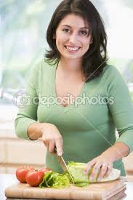
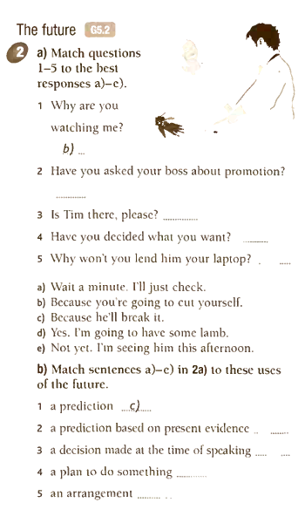
Match

Slide 36

Grammar
Now let’s try to answer the questions in exercise 6 pg.39
☺

Slide 37

That’s it for today ..
Have a good day !
Ms. Nehad A. Asiri

