Slide 1
Computer Data Security & Privacy

Slide 2
Lecture # 7
Security in Operating Systems

Slide 3
Operating System
A program that controls the execution of application programs
An interface between applications and hardware

Slide 4
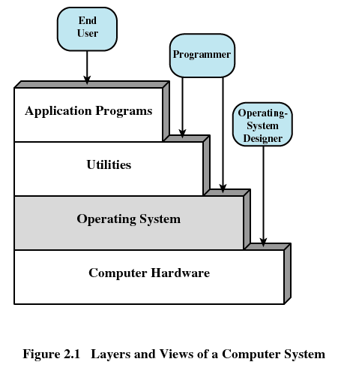

Slide 5
Security in Operating System
Security breaches
Security goals
Protection of objects

Slide 6
Breaches
Exposure
  A form of possible loss or harm in a computing system
Vulnerability
  Weakness that might be exploited to cause loss or harm
Threats
  circumstances that have the potential to cause loss or harm
Notes:
In security, an exposure is a form of possible loss or harm in a computing system, for example, unauthorized disclosure of data, modification of data or denial of legitimate access to computing.
A vulnerability is a weakness in the security system that might be exploited to cause loss or harm.
Threats to computing systems are circumstances that have the potential to cause loss or harm. Human attacks are examples of threats.

Slide 7
Threats
Interruption
Modification
Fabrication
Notes:
There are four kinds of threats:
1. Interruption is an asset of the system becomes lost, unavailable, or unusable. An example is malicious destruction of a hardware device, erasure of a program or data file, etc.
2. An interception means that some unauthorized party has gained access to an asset. The outside party can be a person, a program, or a computing system. Examples of this type of failure are illicit copying of program or data file, or wiretapping to obtain data in a network.
3. If an unauthorized party not only accesses but tampers with an asset, the threat is a modification. For example, someone might change the values in a data base, alter a program so that it performs an additional computation, or modify data being transmitted electronically.
4. An unauthorized party might fabricate counterfeit objects on a computing system. The intruder may insert spurious transactions to a network communication system, or add records to an existing data base.

Slide 8
Security Goals
Confidentiality
  the assets of a computing system are accessible only by authorized parties.
Integrity
  assets can be modified only by authorized parties or only in authorized ways.
Availability
  assets are accessible to authorized parties.
Notes:
The security goals are:

Slide 9
What Are We Protecting
Hardware
Software
Data
Communications lines and networks

Slide 10
Security and Protection
Security is a policy
  E.g., “no unauthorized user may access this file”
Protection is a mechanism
  E.g., “the system checks user identity against access permissions”
Protection mechanisms implement security policies

Slide 11
Mechanism vs. Policy
Mechanisms determine how to do something
  Provided by the operating system
  E.g., ability to set the priority of a user process
Policies determine what will be done
  E.g., determining which processes get highest priority

Slide 12
Important Security Mechanisms
Authentication
Encryption
Passwords
Access control mechanisms

Slide 13
Authentication
If a system supports more than one user, it must be able to tell who’s doing what
I.e.: all requests to the system must be tagged with user identity
Authentication is required to assure system that the target are valid

Slide 14
2. Encryption
Various algorithms can be used to make data unreadable to intruders
This process is called encryption
Typically, encryption uses a secret key known only to legitimate users of the data
Without the key, decrypting the data is computationally infeasible

Slide 15
3. Passwords
A fundamental authentication mechanism
A user proves his identity by supplying a secret.
The secret is the password

Slide 16
Passwords
Use of Passwords
Attacks on Passwords
Password Selection Criteria
Notes:
An operating system bases much of its protection on knowing who a user of the system is. The ways of an operating system identify and authenticate a user are:
1. Use of Passwords
2. Attacks on Passwords
3. Password Selection Criteria
4. The Authentication Process
5. Flaws in the Authentication Process
6. Authentication Other Than Passwords

Slide 17
Use of Passwords
Passwords are code, known only to the user and the system.
The use of passwords is fairly straightforward. A user enters some piece of identification, such as a name or an assigned user ID, if the identification matches that on file for the user, the user is authenticated to the system. If the identification match fails, the user is rejected by the system.
Notes:
Passwords are mutually agreed-upon code words, assumed to be known only to the user and the system.
The use of of passwords is fairly straightforward. A user enters some piece of identification, such as a name or an assigned user ID, if the identification matches that on file for the user, the user is authenticated to the system. If the identification match fails, the user is rejected by the system.

Slide 18
Securely Storing Passwords
Store only in encrypted form
  To check a password, encrypt it and compare to the encrypted version
  Encrypted version can be stored in a file

Slide 19
4. Data Access Control Mechanisms
Methods of specifying who can access .
Based on assumption that the system has authenticated the user

Slide 20
Data Access Control
Basic elements of the model
  Subject: An entity capable of accessing objects.
  Object: Anything to which access is controlled (e.g. files, programs)
  Access right: The way in which an object is accessed by a subject (e.g. read, write, execute)

Slide 21
Access Matrix
General models of access control.
Describes permissible accesses for the system
Associated with each user, there can be a profile that specifies permissible operations and file accesses.

Slide 22
Access Matrix Example
 | File 1 | File 2 | Server X | Segment 57
User A | Read, Write | None | Query | Read
User B | Read | Write | Update | None
User C | None | Read | Start, Stop | None
User D | None | None | Query | None

Slide 23
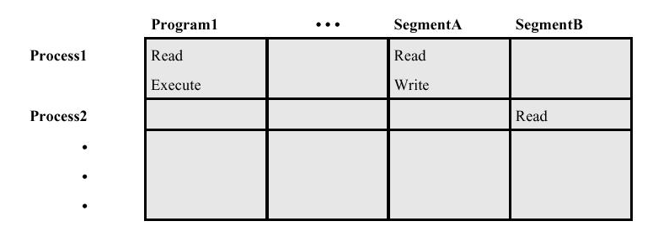
Access Matrix

Slide 24
Methods for Implementing Access Matrix
4.1 Access control lists
  Decomposition by columns
4.2 Capabilities
  Decomposition by rows

Slide 25
4.1 Access Control Lists
Each object controls who can access it
  Using an access control list
Add subjects by adding entries
Remove subjects by removing entries
+ Easy to determine who can access object
+ Easy to change who can access object
- Hard to tell what someone can access

Slide 26
Access Control List Example
File 1’s ACL
  User A: Read, Write
  User B: Read
Segment 57’s ACL
  User A: Read
 | File 1 | File 2 | Server X | Segment 57
User A | Read, Write | None | Query | Read
User B | Read | Write | Update | None
User C | None | Read | Start, Stop | None
User D | None | None | Query | None

Slide 27
4.2 Capabilities
Each subject keeps track of what it can access
Typically by keeping a capability for each object
Capabilities are like admission tickets
+ Easy to tell what a subject can access
- Hard to tell who can access an object
- Hard to control access

Slide 28
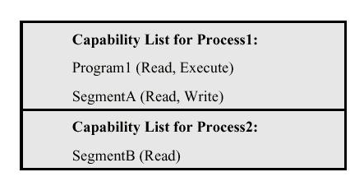
Capability Example
User A’s Capabilities
  File 1: Read, Write
  Server X: Query
User B’s Capabilities
  File 1: Read
  File 2: Write
  Server A: Update

Slide 29
Other Models of Access Control
Military model
Information flow models
Lattice model of information flow

Slide 30
END SLIDE SHOW

Slide 31
Computer Data Security & Privacy

Slide 32
Cont.
Lecture # 8
Security in Operating Systems

Slide 33
Protection In General-Purpose OS
Protected Objects and Methods
Protecting Memory and Addressing
Protecting Access to General Objects
File Protection Mechanisms
User Authentication
Notes:
Next I will talk about the security issues in general purpose operating systems. They include:

Slide 34
a. Protected Objects and Methods
Protected Objects
Security Methods of Operating Systems
Notes:
As an introduction, I will say something about the protected objects and operating system’s protecting methodology.

Slide 35
Protected Objects
    Memory
    Sharable I/O devices, such as disks
    serially reusable I/O devices, such as printers.
    sharable programs and sub-procedures
    sharable data
Notes:
With the rise of multiprogramming and multi-user, several objects of a computing system required protection are listed here.

Slide 36
Security Methods of Operating Systems
Separation: keeping one user’s objects separate from other users’
    Physical Separation
    Logical Separation
    Cryptographic Separation
Notes:
The basis of the protection is separation, keeping one user’s objects separate from other users’.
Physical separation, in which processes use different physical objects, such as separate printers for output requiring different levels of security.
Temporal separation, in which processes having different security requirements are executed at different times.
Logical separation, in which users operate under the illusion that no other processes exists, as when an operating system constrains a program’s accesses so that it cannot access objects outside its permitted domain.
Cryptographic separation, in which processes conceal their data and computations in such a way that they are unintelligible to outside processes.
Granularity of control is also a concern. For data, access can be controlled at the level of the bit, the byte, the element or word, the field, the record, the file, or the volume. The larger the level of object controlled the easier it is to implement access control.

Slide 37
b. Protecting Memory and Addressing
Fence
Relocation
Base/Bounds Registers
Tagged Architecture
Segmentation
Paging
Notes:
The most obvious problem of multiprogramming is preventing one program from affecting the memory of other programs. The techniques available so far are listed here.

Slide 38
Fence
A fence is a method to confine users to one side of a boundary.
Usually, fence is implemented via a hardware register.
Notes:
The simplest form of memory protection was introduced in single-user systems, in order to prevent a faulty user program from destroying part of the resident portion of the operating system. As its name implies, a fence is a method to confine users to one side of a boundary.

Slide 39
II. Relocation
Relocation is the process of taking a program written as if it began at address 0 and changing all addresses to reflect the actual address at which the program is located in memory.
Fence register can be used within relocation process. To each program address, the contents of the fence register are added. This both relocates the address and guarantees that no one can access a location lower than a fence address.

Slide 40
III. Base/Bounds Registers
In a multiuser, multiprogramming environment, fence register is variable. In this case fence register is called base register.
Fence registers only provide a lower bound (a starting address), but not an upper one. A second register, called a bounds register can be used to provide a upper bound. In this way, a program’s addresses are neatly confined to the space between the base and the bounds registers.
This technique protects a program’s addresses from modification by another user.

Slide 41
IV. Tagged Architecture
Tagged Architecture
  Every word of machine memory has one or more extra bits to identify the access rights to that word.
  This technique is not wide spread because of the market consideration.
Notes:
Base/bounds registers create an all-or-nothing situation for sharing, that is, either a program makes all its data available to be accessed and modified, or it prohibits access to all. But in some cases, one may want to protect some data values but not all. One of the solutions of such cases is tagged architecture.

Slide 42
V. Segmentation
Segmentation divides a program into separate pieces. Each piece has a logical unity, a relationship among all of its code or data value.
Segmentation was developed as a feasible means to have the effect of an unbounded number of base/bounds registers: a program could be divided into many pieces having different access rights.
The operating system must maintain a table of segment names and their true addresses in memory. The program address is in the form <name, offset>. OS can retrieve the real address via looking for the table then making a simple calculation:
address of the name + offset

Slide 43
VI. Paging
An alternative to segmentation is paging. The program is divided into equal-sized pieces called pages, and memory is divided into the same sized units, called page frames. Each address is represented in a form <page, offset>.
Operating system maintains a table of user page numbers and their true addresses in memory. The page portion of every <page, offset> reference is converted to a page frame address by a table lookup; the offset portion is added to the page frame address to produce the real memory address of the object referred to as <page, offset>.

Slide 44
c. Protecting Access to General Objects
Directory
Access Control List
Components of General Objects
    Memory
    a file or data set on an auxiliary storage device
    an executing program in memory
    a directory of files
    a hardware device
    a data structure, such as a stack.
    A table of the operating system
    instructions, especially privileged instructions
    passwords
    the protection mechanism itself
Notes:
Protection of memory is a specific case of the more general problem of protection of objects. Next I will discuss the general techniques for protecting access to general objects.

Slide 45
Directory
This technique works like a file directory. Imagine the set of objects to be files and the set of subjects to be users of a computing system. Every file has a unique owner who possesses “control” access rights, including the right to declare who has what access and to revoke access to any person at any time. Each user has a file directory, which lists all the files to which that user has access.
OS maintains all directories. Each user has a list (directory) that contains all the objects that user is allowed to access.

Slide 46
Access Control List
Access Control Lists (ACL)
  Common method of implementing access matrices
  Each object (resource) has a list of authorized subjects (users) who may obtain specified access rights to that object
  Subjects must be authenticated
  Each object has an access control list. This list shows all subjects who should have access to the object and what the access is.
This technique is widely used in Distributed File Systems.

Slide 47
d. File Protection Mechanisms
Basic Forms of Protection
Single Permissions
Notes:
Next I will go through the file protection mechanisms.

Slide 48
Basic Forms of Protection
All-None Protection
The principal protection was trust, combined with ignorance.
Group Protection
Users in the same group have the same right for objects.
Notes:
As described earlier, all multiuser operating systems must provide some minimal protection to keep one user from maliciously or inadvertently accessing or modifying the files of another.
Here gives two original, obsolete protection forms.
All none protection is based on trust and ignorance. Trust means that users could be trusted not to read or modify other’s files. Ignorance is based on the users only know the names of the files to which they have legitimate access.
Users in the same group have the same right for objects.

Slide 49
Single Permissions
Password or other token
  assign a password to a file
Notes:
A simplified form of password protection is applicable for file protection. A user can assign a password to a file. User accesses are limited to those who can supply the correct password at the time the file is opened.
Temporary acquired permission is provided by the Unix operating system. If this protection is set for a file to be executed, the protection level is that of the file’s owner, not the executor.

Slide 50
e. The Authentication Process
Intentionally slow
  This makes attack infeasible
Identify intruder from the normal user
  some who continuously fails to login may not be an authorized user.
  System disconnect a user after three to five failed logins
Notes:
Some authentication procedures are intentionally slow. A legitimate user will not complain if the login process takes 5 or 10 seconds. To a penetrator who is trying an exhaustive search or a dictionary search, this delay makes this class of attack infeasible.
Even a terrible typist should be able to login successfully in three to five tries. So someone who continuously fails to login may not be an authorized user. System disconnect a user after three to five failed logins

Slide 51
END SLIDE SHOW

Slide 52
Computer Data Security & Privacy

Slide 53
Lecture # 9
Operating Systems Services

Slide 54
Operating System
An Operating System (OS) is the software that manages the sharing of the resources of a computer.
An operating system processes system data and user input, and responds by allocating and managing tasks and internal system resources as a service to users and programs of the system.

Slide 55
Services
User interface
Program execution: Processes
Resource allocation
I/O operations
Notes:
Should note that not all of these are necessarily be present in any specific O/S

Slide 56
Services cont.
File-system manipulation
Communications
Protection & security
Error detection
Accounting

Slide 57
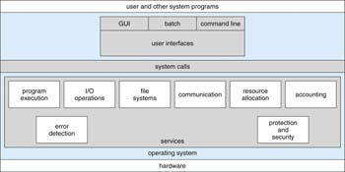

Slide 58
Services
1. User Interface
  GUI(Graphical User Interface) and command line are the most common for general purpose operating systems
Notes:
Text also talks about a batch interface as a different kind of user interface

Slide 59
2. Program execution
  System must be able to load a machine language program into RAM memory and run that program.

Slide 60
3. Resource allocation
  Multiple processes or users: Need to share, allocate, and manage resources
  Examples of types of resources: CPU cycles (time), main memory, disk files, I/O devices (printers, USB flash drives etc).

Slide 61
4. I/O operations
  All I/O that a program does is typically carried out by the OS
  This is for efficiency and protection

Slide 62
5. File-system manipulation
  creating, reading, writing files & directories

Slide 63
6. Communications
  Between processes on the same computer and processes across different computers
  e.g., Shared memory & message passing

Slide 64
7.Protection & security
  In multiuser systems, some people want to control access to their information
  Generally, “when several separate processes execute concurrently, it should not be possible for one process to interfere with others or with the operating system itself”.

Slide 65
8.Error detection
  “The operating system needs be constantly aware of possible errors” .
  Hardware errors include: power, memory, device errors
  Software errors include: divide by 0, access of an illegal memory location

Slide 66
9.Accounting
  Which processes/users use which resources and for how long?

Slide 67
Unix Security
Ashort history of Unix:
Originated in 1969 and early 70’s as a
prototype in Bell Labs.
In 1973 Unix was rewritten in C and
successfully ported.
1993 first release of Unix-like OS, called
Linux.

Slide 68
What is Unix
Multi-user, multi-process operating system.
Hierarchical file system.

Slide 69
Login and User Account
Login:
identification + authentication: =(username, password)
password length: 8 characters
password protection: encrypted and stored in /etc/passwd file.

Slide 70
Format of the Password File
Format: Username, encrypted password, user ID, Group ID, ID string, login shell
ID string = user’s full name
User ID and group ID = explained later.
Login shell= the Unix shell available to the
user after successful login.

Slide 71
User Name
Users by user name, up to 8 characters
Users by user ID (UID) internally, a 16-bit number
UIDs are linked to user names in: /etc/passwd.

Slide 72
Groups:
Fact: Users belong to one or more groups.
Why? Collecting users in groups is a convenient basis for access control decisions.
Example: put all users allowed to access email
in a group called mail.
Primary group: contains every user. The
group ID (GID) of the primary group is stored
in /etc/passwd.

Slide 73
Windows NT:
Both Linux and Windows are based on foundations developed in the mid-1970s

Slide 74
Windows NT/2000
In terms of security, Windows NT offers two types of security models:
        Workgroups (Peer to Peer)
        2. Domains (Client/Server)

Slide 75
Windows Security:
Very flexible security model based on Access Control Lists
Users are defined with:
  Privileges
  Member groups
Security can be applied to any Object
  Files, processes, synchronization objects, …
Supports auditing

Slide 76
File Systems:
FAT (File Allocation Table) format was developed in 1976 by Bill Gates, and is now supported by all Microsoft OSes.
No security parameters in FAT
NTFS (New Technology File System) is supported by Windows NT, 2000, XP

Slide 77
NTFS Details:
NTFS has many advantages
  Faster for large file systems
  Supports bigger files
  Supports access control given by permissions to files and directories
  Supports file ownership and compression
  Supports encryption.
    For Windows NT safety, it is recommended to
  install Windows on a NTFS partition, to avoid
  unwanted users to play with the registry files

Slide 78
END SLIDE SHOW

Slide 79
Computer Data Security & Privacy

Slide 80
Lecture # 10 # 11
ISO Security Standard

Slide 81
Overview :
Communication Models
Protocol Design Principles
IPSec
SSL/TLS

Slide 82
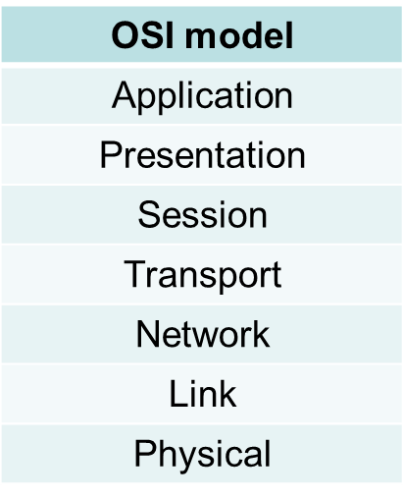
Protocol Design Principles:
  Open Systems Interconnection model (OSI).
  Framework for layering network protocols 7 layers.

Slide 83
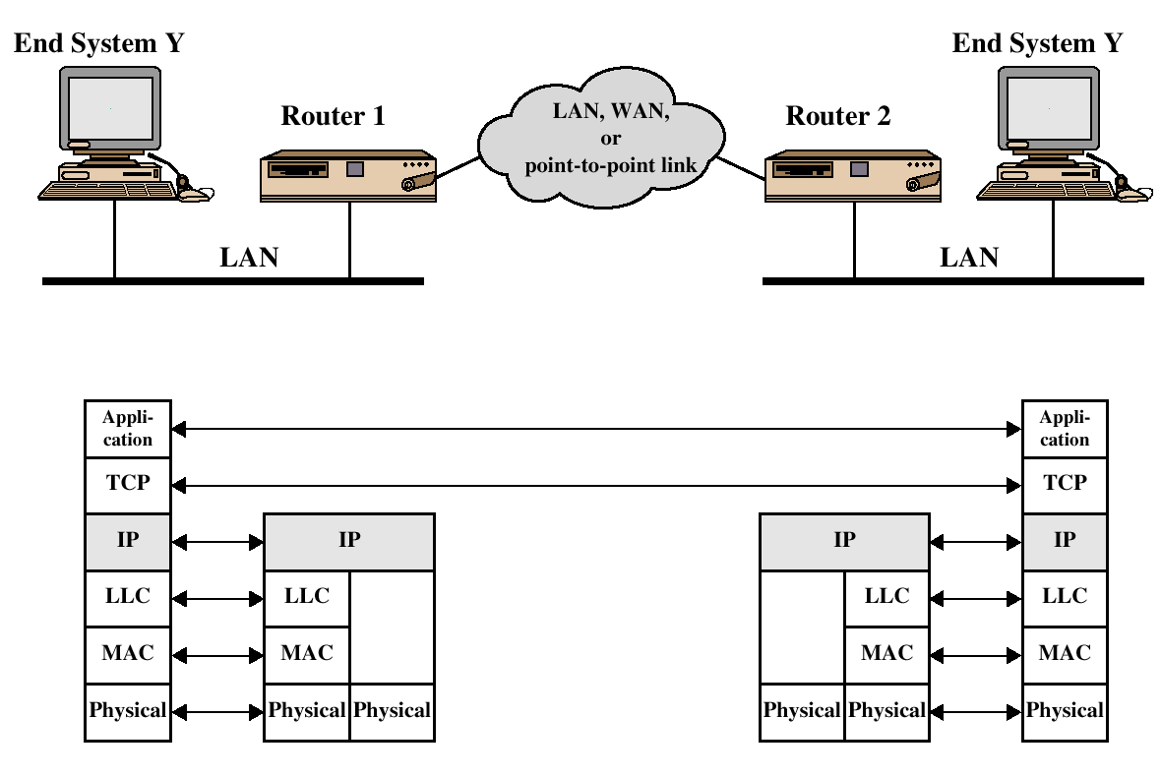
TCP/IP Example:

Slide 84
The desire for security and privacy has led to several security protocols and standards.
Among these are: Secure Socket Layer (SSL) and Transport Layer Security (TLS) Protocols; secure IP (IPSec); Secure HTTP (S-HTTP), secure E-mail ( PGP and S/MIME), SSH, and others.
We discuss some of these protocols and standards within the framework of the network protocol stack as follows:

Slide 85
TCP/IP:
Application Layer:
  PGP
  S/MIME
  S-HTTP
  HTTPS
  SET
Transport Layer:
  SSL
  TLS
Network Layer:
  IPSec
  VPN
Data Link Layer:
  PPP
  RADIUS

Slide 86
Background on IP Security:
  IP connectionless .
  provides a best-effort service
  no guaranteed delivery of packets
  no mechanism for maintaining order
  NO security protection (IPv4)
  In IPv6 – security architecture - IPsec

Slide 87
IP Security Overview
IPSec is not a single protocol. Instead, IPSec provides a set of security algorithms plus a general framework that allows a pair of communicating entities to use whichever algorithms provide security appropriate for the communication.

Slide 88
IP Security Overview
Applications of IPSec
  Secure branch office connectivity over the Internet
  Secure remote access over the Internet
  Enhancing electronic commerce security

Slide 89
IP Security Overview
Benefits of IPSec
  Provide security for individual users
IPSec can assure that:
  A router or neighbor advertisement comes from an authorized router
  A redirect message comes from the router to which the initial packet was sent
  A routing update is not forged

Slide 90
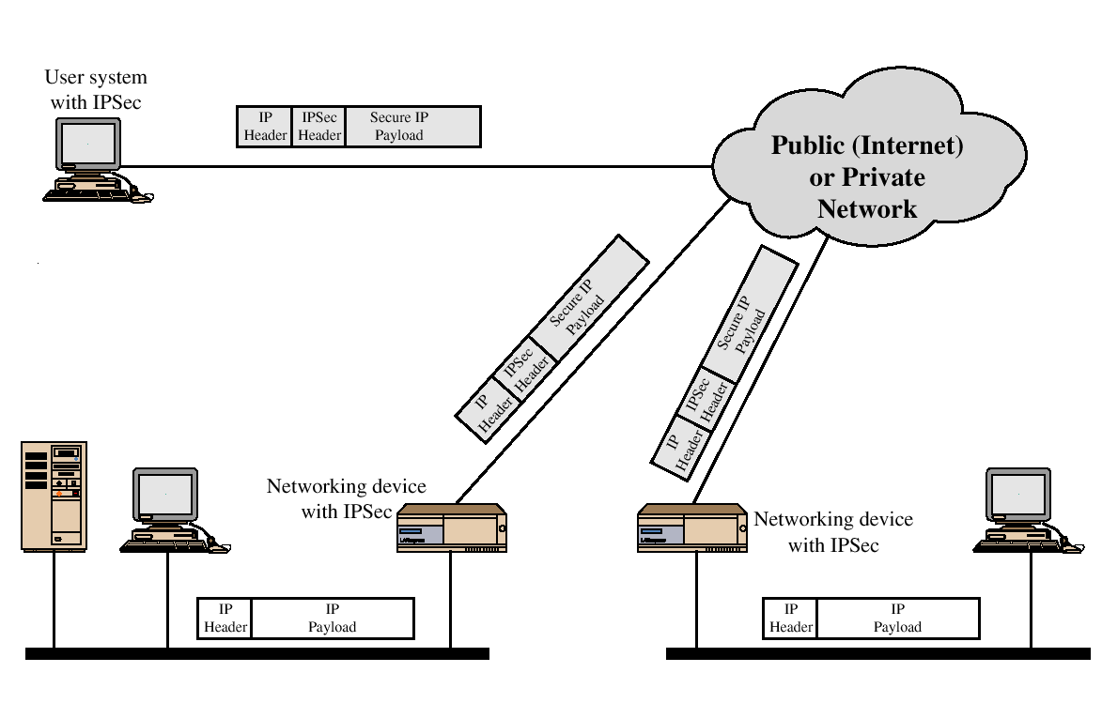
IP Security Scenario

Slide 91
IP Security:
  Optional in IPv4 and mandatory for IPv6
  2 major security mechanisms:
    IP Authentication Header
    IP Encapsulation Security Payload
  Does not contain mechanism to prevent traffic analysis attack.

Slide 92
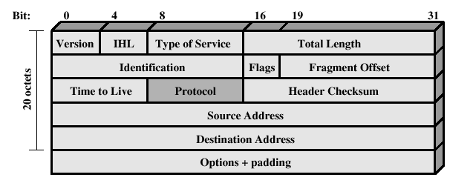
IPv4 Header

Slide 93
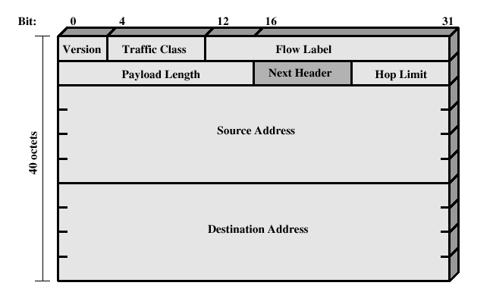
IPv6 Header:

Slide 94
Two major security mechanisms:
IP Security – Authentication Header:
  Protects the integrity and authentication of IP packets.
  Does not protect confidentiality.
IP Security – Encapsulating Security Payloads:
  Provides:
    confidentiality
    limited traffic flow confidentiality
Achieved by encryption of payload

Slide 95
Modes of IP Security – Encapsulating Security Payloads:
IP Security – Encapsulating Security Payloads:
Transport mode
  a protocol frame is encapsulated and encrypted
  provides end-to-end protection of packets

Slide 96
Modes of IP Security – Encapsulating Security Payloads:
IP Security – Encapsulating Security Payloads:
tunnel mode
  entire datagram treated as new payload
  can be thought of as IP within IP
  can be performed at security gateways
  host need not be IPsec aware
  provides traffic flow confidentiality

Slide 97
IP Security:
  IPsec services use encryption
  But are not tied to one particular key management protocol
  Considers possibility of future flaws
Summary
  IPsec provides transparent security for everyone using IP, without changing interface of IP
  Provides host-to-host security but with an overhead

Slide 98
Secure Socket Layer (Ssl)/ Transport Layer Security(tls):
SSL
Sits between application layer and TCP
Relies on properties guaranteed by TCP
Stateful and connection oriented
Contains handshake protocol where client and server agree on cipher suite
This is then used for secure transmission
Most widely used Internet security protocol

Slide 99
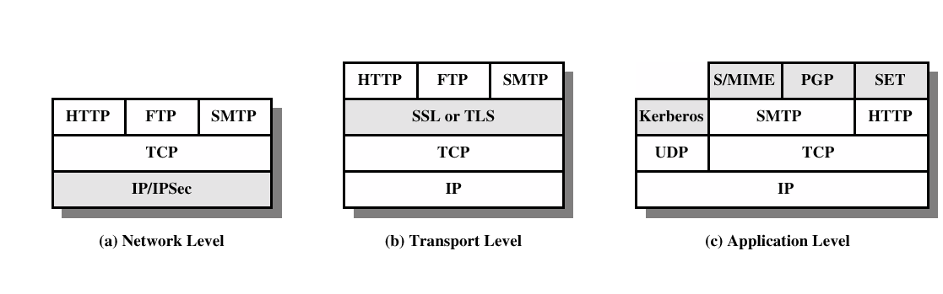
Security facilities in the TCP/IP protocol stack

Slide 100
SSL and TLS
SSL was originated by Netscape
TLS working group was formed within IETF
First version of TLS can be viewed as an SSLv3.1

Slide 101
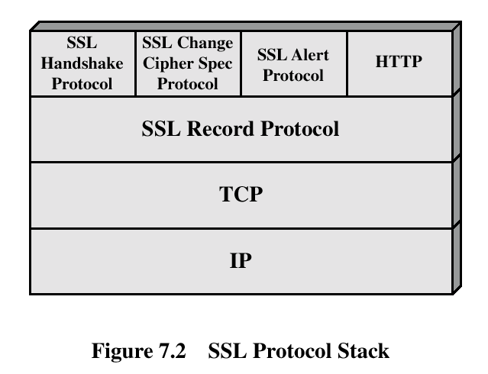
SSL Architecture

Slide 102
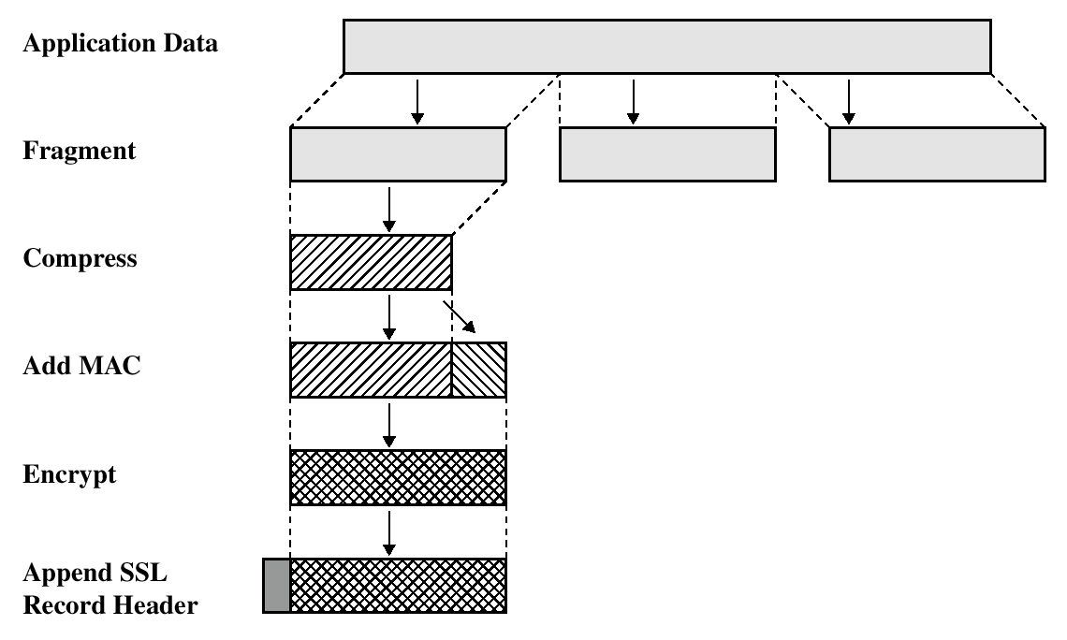
SSL Record Protocol Operation:

Slide 103
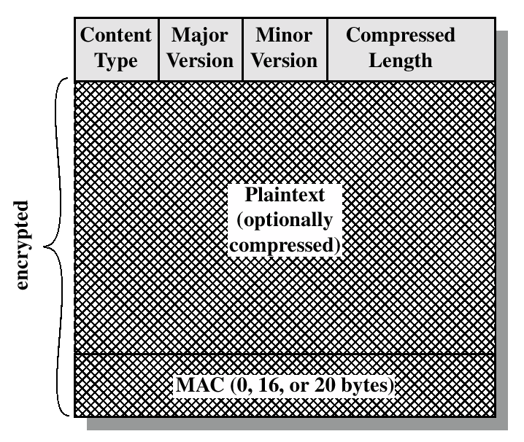
SSL Record Format:

Slide 104
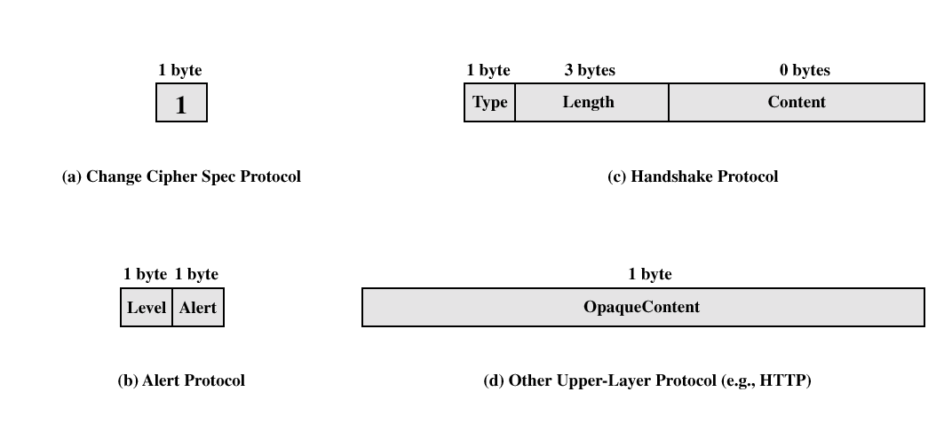
SSL Record Protocol Payload:
≥1
≥1

Slide 105
Handshake Protocol:
The most complex part of SSL.
Allows the server and client to authenticate each other.
Negotiate encryption, MAC algorithm and cryptographic keys.
Used before any application data are transmitted.

Slide 106
Transport Layer Security
The same record format as the SSL record format.
Defined in RFC 2246.
Similar to SSLv3.
Differences in the:
  version number
  message authentication code
  pseudorandom function
  alert codes
  cipher suites
  client certificate types
  certificate_verify and finished message
  cryptographic computations
  padding

Slide 107
Secure Electronic Transactions
An open encryption and security specification.
Protect credit card transaction on the Internet.
Companies involved:
  MasterCard, Visa, IBM, Microsoft, Netscape, RSA, Terisa and Verisign
Not a payment system.
Set of security protocols and formats.

Slide 108
SET Services
Provides a secure communication channel in a transaction.
Provides trust by the use of X.509v3 digital certificates.
Ensures privacy.

Slide 109
SET Overview
Key Features of SET:
  Confidentiality of information
  Integrity of data
  Cardholder account authentication
  Merchant authentication

Slide 110
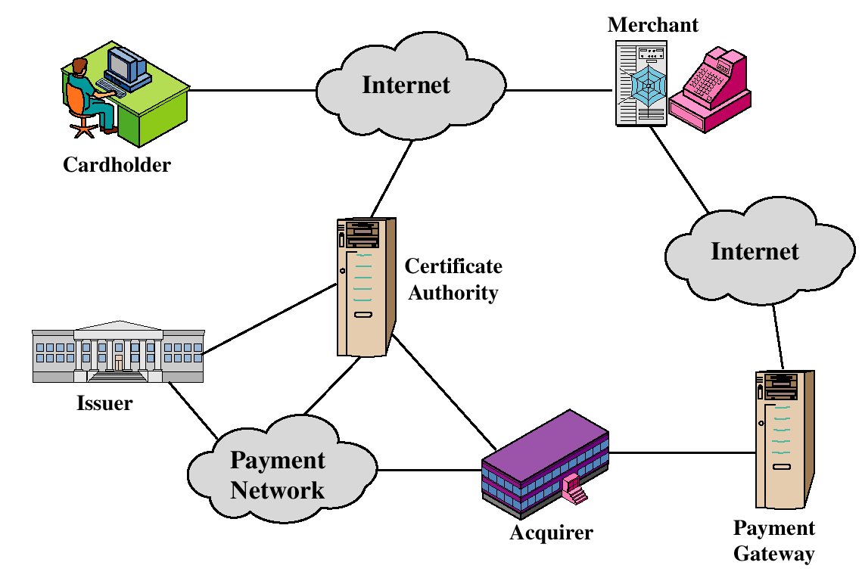
SET Participants

Slide 111
Security Associations (SA)
A one way relationsship between a sender and a receiver (affords security services)
Identified by three parameters:
  Security Parameter Index (SPI) (to select SA at the receiver)
  IP Destination address (endpoint of SA)
  Security Protocol Identifier (AH or ESP)

Slide 112
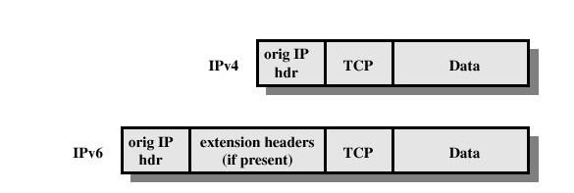
Before applying AH

Slide 113
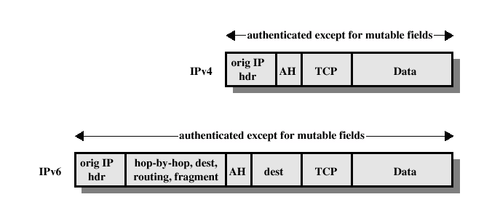
Transport Mode (AH Authentication)

Slide 114
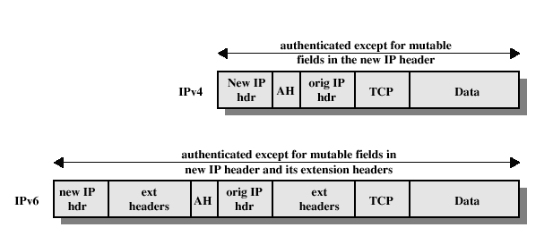
Tunnel Mode (AH Authentication)

Slide 115
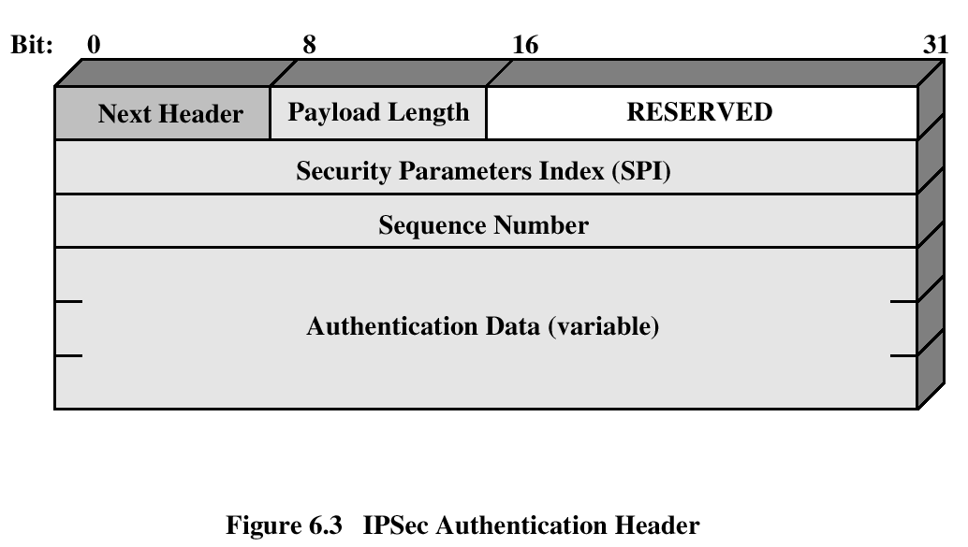
Authentication Header
Provides support for data integrity and authentication (MAC code) of IP packets.
Guards against replay attacks.

Slide 116
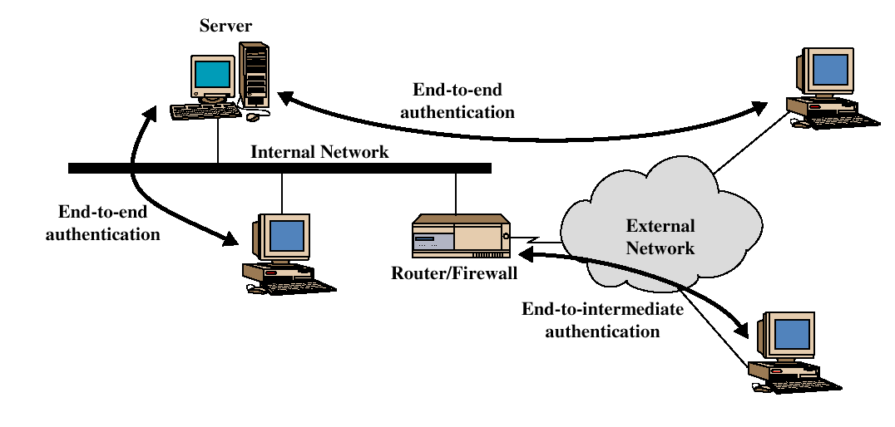
End-to-end versus End-to-Intermediate Authentication

Slide 117
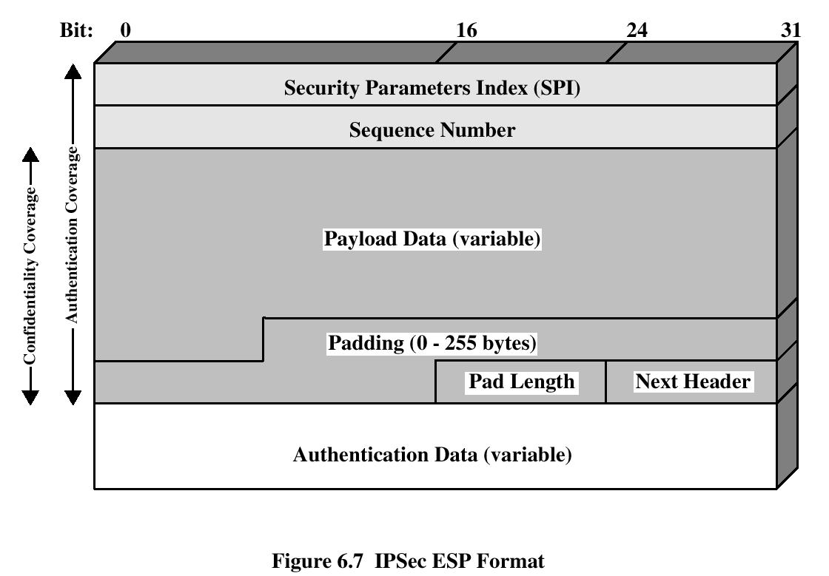
Encapsulating Security Payload
ESP provides confidentiality services

Slide 118
Encryption and Authentication Algorithms
Encryption:
  Three-key triple DES
  RC5
  IDEA
  Three-key triple IDEA
  CAST
  Blowfish
Authentication:
  HMAC-MD5-96
  HMAC-SHA-1-96

Slide 119
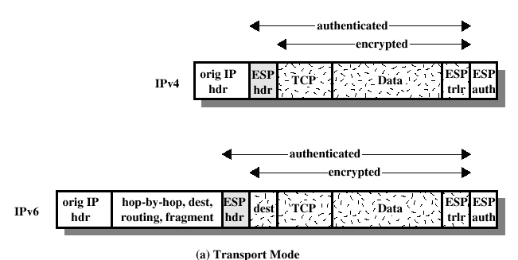
ESP Encryption and Authentication

Slide 120
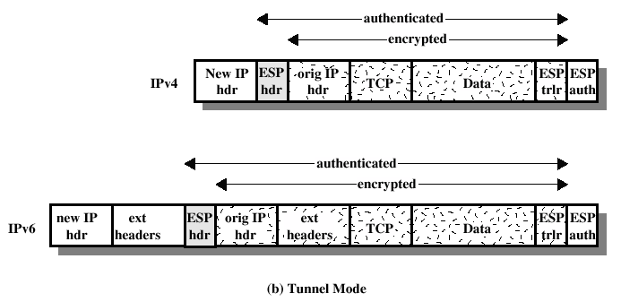
ESP Encryption and Authentication

Slide 121
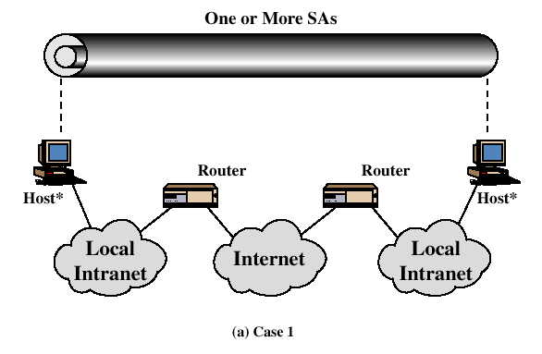
Combinations of Security Associations

Slide 122
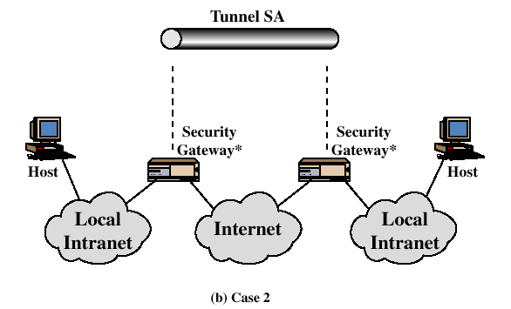
Combinations of Security Associations

Slide 123
END SLIDE SHOW

Slide 124
Computer Data Security & Privacy

Slide 125
Lecture # 12
Computer security policy & procedure
(PGp)

Slide 126
Outline
Pretty good privacy

Slide 127
Pretty Good Privacy
Philip R. Zimmerman is the creator of PGP.
PGP provides a confidentiality and authentication service that can be used for electronic mail and file storage applications.

Slide 128
Pretty Good Privacy (PGP)
  The importance of sensitive communication cannot be underestimated. The best way, so far, to protect such information is to encrypt it.
  Encryption of e-mails and any other forms of communication is vital for the security, confidentiality, and privacy of everyone. This is where PGP comes in and this is why PGP is so popular today.

Slide 129
Pretty Good Privacy (PGP)
  Pretty Good Privacy (PGP), developed by Phil Zimmermann. is a public-key cryptosystem.
  PGP works by creating a circle of trust among its users. In the circle of trust, users, starting with two, form a key ring of public key/name pairs kept by each user. Joining this “trust club” means trusting and using the keys on somebody’s key ring.

Slide 130
Pretty Good Privacy (PGP)
  Unlike the standard PKI infrastructure, this circle of trust has a built-in weakness that can be penetrated by an intruder. However, since PGP can be used to sign messages, the presence of its digital signature is used to verify the authenticity of a document or file. This goes a long way in ensuring that an e-mail message or file just downloaded from the Internet is both secure and un-tampered with.

Slide 131
Why Is PGP Popular?
It is availiable free on a variety of platforms.
Based on well known algorithms.
Wide range of applicability
Not developed or controlled by governmental or standards organizations

Slide 132
Operational Description
Consist of five services:
  Authentication
  Confidentiality
  Compression
  E-mail compatibility
  Segmentation

Slide 133
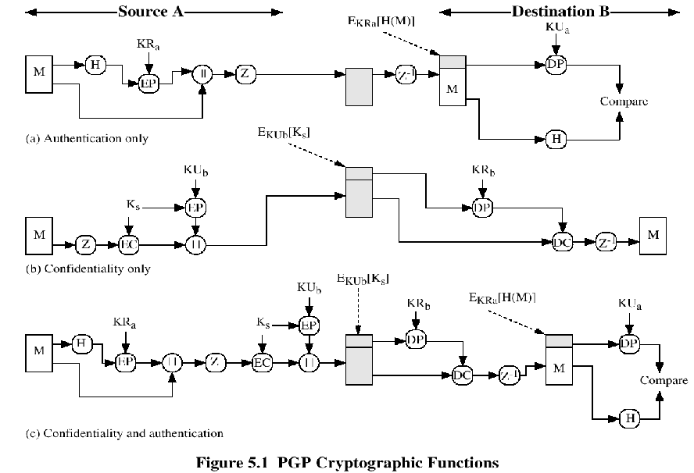

Slide 134
Compression
PGP compresses the message after applying the signature but before encryption
The placement of the compression algorithm is critical.
The compression algorithm used is ZIP (described in appendix 15A)

Slide 135
E-mail Compatibility
The scheme used is radix-64 conversion (see appendix 15B).
The use of radix-64 expands the message by 33%.

Slide 136
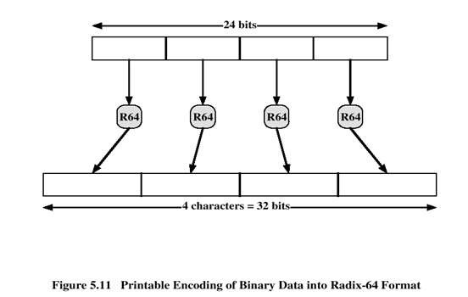

Slide 137
Segmentation and Reassembly
Often restricted to a maximum message length of 50,000 octets.
Longer messages must be broken up into segments.
PGP automatically subdivides a message that is too large.
The receiver strip off all e-mail headers and reassemble the block.

Slide 138
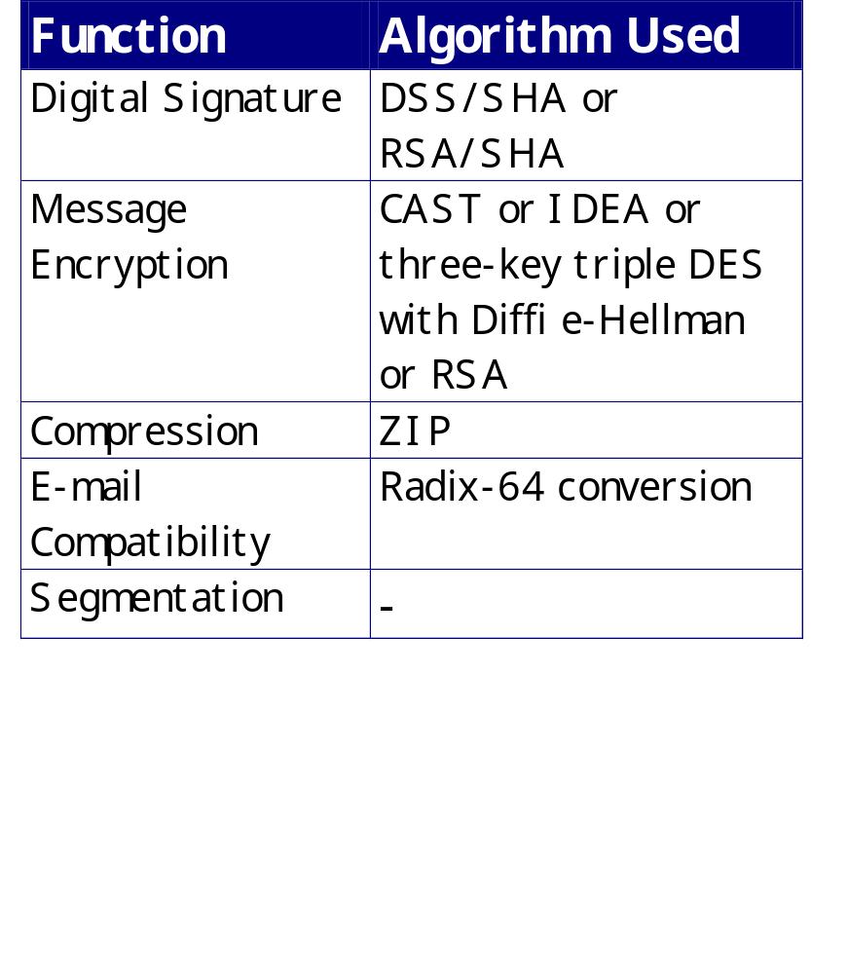
Sumary of PGP Services

Slide 139
END SLIDE SHOW

