Slide 1

Grammar 1

Slide 2
Objectives
Giving students an overview of Prepositions.
Enabling students to understand the use of Prepositions.

Slide 3
Prepositions
A preposition is a word governing, and usually
coming in front of, a noun or pronoun and
expressing a relation to another word or element, as
in:
She left before breakfast.
What did you come for?
(For what did you come?)

Slide 4
Prepositions List
Aboard, about, above, across, after, against,
Along, amid, among, anti, around, as, at, before,
behind ,below, beneath, beside, besides, between,
Beyond, but, by, despite, down, during, except,
For, from, in, inside, into, like, near, of, off, on,
opposite, outside, over, round, save, since, than
Through, to, toward, towards, under, underneath
Unlike, until, up, upon, via, with, within, without

Slide 5
English Preposition Rule
A preposition is followed by a "noun". It is never followed by a verb.
By "noun" we include:
noun (dog, money, love)
proper noun (name) (Bangkok, Mary)
pronoun (you, him, us)
noun group (my first job)
gerund (swimming)
A preposition cannot be followed by a verb. If we want to follow a
preposition by a verb, we must use the "-ing" form which is really a
gerund or verb in noun form.

Slide 6
Quick Quiz
In the following sentences, why is "to" followed by a verb? That
should be impossible, according to the above rule:
I would like to go now.
She used to smoke.
Answer to Quick Quiz: In these sentences, "to" is not a
preposition. It is part of the infinitive ("to go", "to smoke").

Slide 7




Some Prepositions of Place

Slide 8
Prepositions of Place: at, in, on
at for a POINT, In for an ENCLOSED SPACE, on for a SURFACE
on | in | at
SURFACE | ENCLOSED SPACE | POINT
on the wall | in the garden | at the corner
on the ceiling | in London | at the bus stop
on the door | in France | at the door
on the cover | in a box | at the top of the page
on the floor | in my pocket | at the end of the road
on the carpet | in my wallet | at the entrance
on the menu | in a building | at the crossroads
on a page | in a car | at the front desk

Slide 9
Notice the use of the prepositions of place at, in and on in these standard expressions:
on | in | at
on a bus | in a car | at home
on a train | in a taxi | at work
on a plane | in a helicopter | at school
on a ship | in a boat | at university
on a bicycle, on a motorbike | in a lift (elevator) | at college
on a horse, on an elephant | in the newspaper | at the top
on the radio, on television | in the sky | at the bottom
on the left, on the right | in a row | at the side
on the way | in Oxford Street | at reception

Slide 10
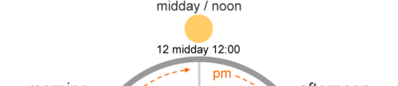
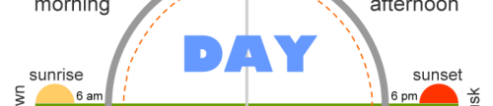
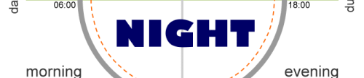

Some Prepositions of Time

Slide 11
on | in | at
DAYS and DATES | MONTHS, YEARS, CENTURIES and LONG PERIODS | PRECISE TIME
on Sunday | in May | at 3 o'clock
on Tuesdays | in summer | at 10.30am
on 6 March | in the summer | at noon
on 25 Dec. 2010 | in 1990 | at dinnertime
on Christmas Day | in the 1990s | at bedtime
on Independence Day | in the next century | at sunrise
on my birthday | in the Ice Age | at sunset
on New Year's Eve | in the past/future | at the moment

Slide 12
Notice the use of the preposition of time at in the following standard expressions:
Example | Expression
The stars shine at night. | at night
I don't usually work at the weekend. | at the weekend
I stay with my family at Christmas. | at Christmas/Easter
We finished the test at the same time. | at the same time
He's not home at present. Try later. | at present

Slide 13
Notice the use of the prepositions of time in and on in these common expressions:
on | in
on Tuesday morning | in the morning
on Saturday mornings | in the mornings
on Sunday afternoons | in the afternoon(s)
on Monday evening | in the evening(s)

Slide 14
When we say last, next, every, this we do not use at, in,
on.
I went to London last June. (not in last June)
He's coming back next Tuesday. (not on next Tuesday)
I go home every Easter. (not at every Easter)
We'll call you this evening. (not in this evening

Slide 15
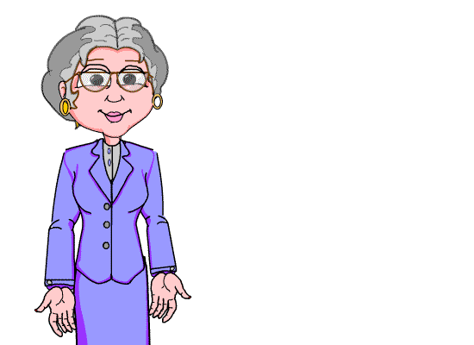
Thank you for your interest
in studies.

