Slide 1

Grammar 1

Slide 2
Objectives
Giving students an overview of interjections.
Enabling students to understand and use
interjections appropriately.

Slide 3
Interjections
Interjections are used to express feelings or emotions.
They are the least used part of speech.
Interjections function independently from the rest of the sentence
Huh ! What does that mean?
It is therefore set off from the rest of the sentence by a comma or exclamation mark.

Slide 4
Interjections
Common interjections
  Wow
  Oh
  Ouch
  Uh
  Alas
  Oops

Slide 5
Interjections
Wow! Did you see that play?
Ouch! That hurts!
I, uh, think we should leave now.
Wow! How did he catch that?
My God! that is certainly a huge cat.

Slide 6
Hi is the interjection and is used as a greeting.
Wow is the interjection and shows surprise.
Bravo is the interjection and is also used as a way to congratulate the participants.
Bah is the interjection and shows disappointment.
Hmm is the interjection and a verbalization of a mental process.
Shoo is the interjection and is being used to verbally startle the cat.
Darn is the interjection and shows disappointment.
Stop is the interjection and ceases the forthcoming action.
Yippee is the interjection and shows excitement.

Slide 7
Hi, I'm glad that you could make it to my party.
Wow! You look great tonight.
That was the best performance that I have ever seen, bravo!
I can’t believe you broke my favorite toy, bah.
Hmm, I wonder where I put my keys and wallet?
“Shoo!” shouted the woman when she saw the cat licking milk from her cereal bowl.
I guess that’s the end of the movie, darn.
Stop! You should always wear a helmet when riding a bike.
Yippee , I made this picture all by myself.

Slide 8
Worksheet

Slide 9
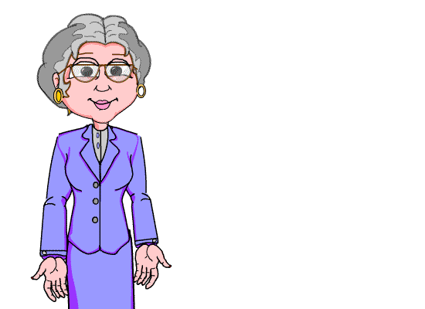
Thank you for your interest
in studying.

