Slide 1

Grammar 1

Slide 2
Objectives
Enabling students to understand gerunds, infinitives and participles .

Slide 3
Verbals
A verb form may sometimes function in sentence as another part of speech. Verb forms that are used as other part of speech are called “verbals”.
The infinitive , gerund and participle form of a verb are examples of verbals.

Slide 4
Gerunds

Slide 5
Complete the sentences with the words in the list.
Baseball tennis basketball
Playing …………….is fun.
My friend and I enjoy playing…………
I don’t know much about playing ………….
In which sentence is playing
The object of the verb?
The subject?
The object of a preposition?

Slide 6
A gerund is the –ing form of a verb used as
a noun. A gerund is used in the same ways as
a noun is used:
  Subject
  Direct Object
  Object of the Preposition

Slide 7
Gerunds as Subjects
The subject usually comes at the beginning of
the sentence.
  Swimming is the best sport ever!
  Looking for work can be a difficult task.

Slide 8
Gerunds as direct objects
Direct Objects follow action verbs and tell
who or what.
  Janie loves playing video games.
  All of the students like taking notes on gerunds.

Slide 9
Gerunds as
objects of prepositions
Objects of prepositions follow preps and are in
phrases.
  I will study for exams by taking good notes.
  You will need a new pen set for drawing pictures.

Slide 10
Infinitives

Slide 11
An infinitive is the word “to” plus the
base form of a verb.
It often functions as a noun, as either a
subject or a direct object.
It can also function as an adjective or
adverb.
It is not a preposition.

Slide 12
To + Verb
To ring the bell was her job.
I wanted to run out the door when the teacher announced a quiz.
I tried to think of an excuse, but my mind drew a blank.

Slide 13
Non-Example
I went to the store with my two year old brother, Jake.
The above example is not infinitives. “To the store” is a prepositional phrase.

Slide 14
The word “to” is a preposition when it is followed by a noun or pronoun that is its object.
I need a ride to the game. We went to Jeff’s party.
prepositions

Slide 15
Worksheet

Slide 16
Participles

Slide 17
A participle is a verb form that is used
as an adjective.
We had a drink of the sparkling water.
The creaking door awakened the dog.

Slide 18
Present Participles
Present participles are formed by
adding –ing to the base form of the
verb.
Example: The laughing student are my favorite students.

Slide 19
Past Participles
Past participles are formed by adding either –ed, -d-, -t, -en, or –n to the base form of the verb. Others may be formed as irregular verbs.

Slide 20
Worksheet

Slide 21
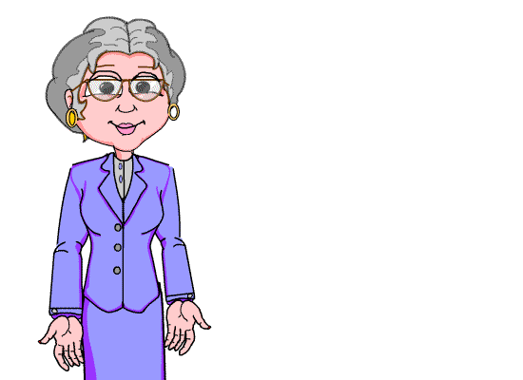
Thank you for your interest
in studies.

