Slide 1

Grammar 1

Slide 2
Objectives
Giving students an overview of Conjunctions.
Enabling students to understand the use, form, function and position of Conjunctions.

Slide 3
Conjunctions
A conjunction is a word that joins or connects
words, phrases and clauses.
I called her but she refused to recognize me.
Since you are still physically weak, you should not work so hard.

Slide 4
Function
Conjunctions have two basic functions or "jobs":
Coordinating conjunctions are used to join two parts of a
sentence that are grammatically equal. The two parts may
be single words or clauses, for example:
- Jack and Jill went up the hill.
- The water was warm, but I didn't go swimming.
Subordinating conjunctions are used to join a subordinate
dependent clause to a main clause, for example:
- I went swimming although it was cold.

Slide 5
Position
Coordinating conjunctions always come between the words or clauses that they join.
Subordinating conjunctions usually come at the beginning of the subordinate clause.

Slide 6
Coordinating Conjunctions
A coordinating conjunction joins parts of a sentence (for
example words or independent clauses) that are grammatically
equal or similar. A coordinating conjunction shows that the
elements it joins are similar in importance and structure:
Look at these examples - the two elements that the coordinating
conjunction joins are shown in square brackets [ ]:
I like [tea] and [coffee].
[Ram likes tea], but [Anthony likes coffee].
Coordinating conjunctions always come between the words or clauses that they join.

Slide 7
Coordinating Conjunctions
The 7 coordinating conjunctions are short, simple
words. They have only two or three letters. There's an
easy way to remember them - their initials spell:
F A N B O Y S
For And Nor But Or Yet So

Slide 8
Subordinating Conjunctions
A subordinating conjunction joins a subordinate (dependent)
clause to a main (independent) clause.
A subordinating conjunction always comes at the beginning of a
subordinate clause. It "introduces" a subordinate clause.
However, a subordinate clause can sometimes come after and
sometimes before a main clause. Thus, two structures are
possible:
Ram went swimming although it was raining.
Although it was raining, Ram went swimming.

Slide 9
Subordinating Conjunctions
after, although, as, because,
before, how, if, once, since,
than, that, though, till, until,
when, where, whether, while

Slide 10
The Use of different Conjunctions

Slide 11

We use AND to join two sentences

Slide 12
We use BUT to show contrast

Slide 13
We use BECAUSE to express a reason for something happening

Slide 14
We use SO to express
a result and is proceeded by comma.

Slide 15
The word OR introduces an alternative.

Slide 16
WHEN means at the
time that something happened or happens.

Slide 17
Worksheet

Slide 18
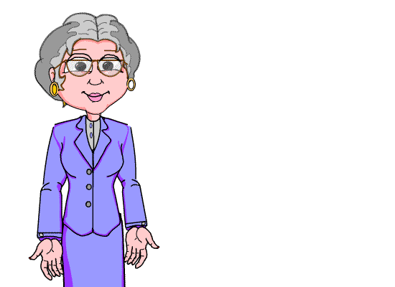
Thank you for your interest
in studies.

