Slide 1

Grammar 1

Slide 2
Objectives
Giving students an overview of adverbs.
Enabling students to understand and use
adverbs appropriately.

Slide 3
Adverb
An adverb is a word that tells us more about a verb.
It "qualifies" or "modifies" a verb (The man ran
quickly). In the following examples, the adverb is in
bold and the verb that it modifies is in italics.
John speaks loudly. (How does John speak?)
Afterwards she smoked a cigarette. (When did she smoke?)
Mary lives locally. (Where does Mary live?)

Slide 4
Adverb
Adverbs can also modify adjectives (Tara is
really beautiful), or even other adverbs (It works
very well). Look at these examples:
Modify an adjective:
- He is really handsome. (How handsome is he?)
- That was extremely kind of you.
Modify another adverb:
- He drives extremely fast.

Slide 5
Kinds of Adverbs
Adverbs of Manner
Adverbs of Place
Adverbs of Time
4. Adverbs of Degree

Slide 6
1. Adverbs of Manner
Adverbs of Manner tell us the manner or way in
which something happens. They answer the
question "how?". Adverbs of Manner mainly
modify verbs.
He speaks slowly. (How does he speak?)
They helped us cheerfully. (How did they help us?)
James Bond drives his cars fast. (How does
James Bond drive his cars?)

Slide 7
2. Adverbs of Place
Adverbs of Place tell us the place where
something happens. They answer the question
"where?". Adverbs of Place mainly modify
verbs.
Please sit here. (Where should I sit?)
They looked everywhere. (Where did they look?)
Two cars were parked outside. (Where were two cars parked?)

Slide 8
3. Adverbs of Time
Adverbs of Time tell us something about the time that
something happens. Adverbs of Time mainly modify verbs.
They can answer the question "when?":
He came yesterday. (When did he come?)
I want it now. (When do I want it?)
Or they can answer the question "how often?":
They deliver the newspaper daily. (How often do they deliver
the newspaper?)
We sometimes watch a movie. (How often do we watch a
movie?)

Slide 9
4. Adverbs of Degree
Adverbs of Degree tell us the degree or extent to which
something happens. They answer the question "how much?"
or "to what degree?". Adverbs of Degree can modify verbs,
adjectives and other adverbs.
She entirely agrees with him. (How much does she agree with him?)
Mary is very beautiful. (To what degree is Mary beautiful?
How beautiful is Mary?)
He drove quite dangerously. (To what degree did he drive
dangerously? How dangerously did he drive?)

Slide 10
Adverb Quiz

Slide 11
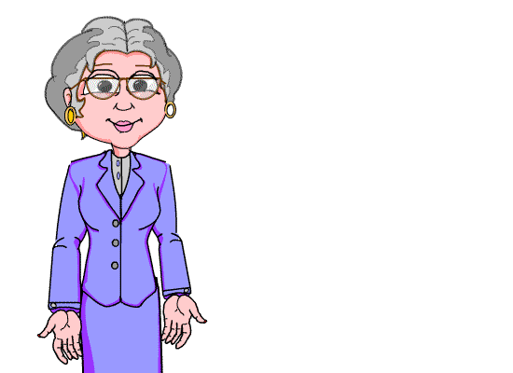
Thank you for your interest
in studying.

