Slide 1



John donne
Death be not proud
Ebtehal Al-shammri – Fatmah Basudan – Dalal Al-badran – Wafa Al-hamdan – Omaima Suliman –
Ghalia Al-qarni - Doaa Al-rowili D.Halah

Slide 2
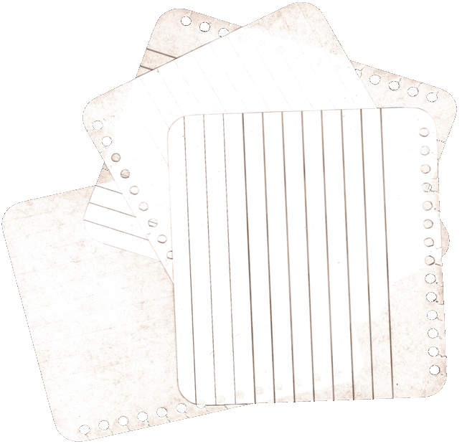

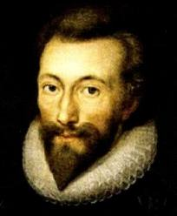
John Donne (between 24 January and 19 June 1572[– 31 March 1631) was an English poet satirist, lawyer and a cleric in the Church of England Donne lived in poverty for several years, relying heavily on wealthy friends He spent much of the money he inherited during and after his education on literature, pastimes, and travel. In 1601, Donne secretly married Anne Moore, with whom he had twelve children . Donne was born in London, into a Roman Catholic family when practice of that religion was illegal in England. Donne was the third of six children. His father, also named John Donne, Donne's father was a respected Roman Catholic who avoided unwelcome government attention out of fear of persecution. It is thought that Donne's final illness was stomach cancer, although this has not been proven. He died on 31 March 1631 having written many poems, most of which were circulated in manuscript during his lifetime.
Ebtehal Al-shammri – Fatmah Basudan – Dalal Al-badran – Wafa Al-hamdan – Omaima Suliman –
Ghalia Al-qarni - Doaa Al-rowili D.Halah

Slide 3

Themes :
- Courage and Willpower in the Face of Death
- The Uniqueness of Loving Life
- Childhood versus Adulthood
Ebtehal Al-shammri – Fatmah Basudan – Dalal Al-badran – Wafa Al-hamdan – Omaima Suliman –
Ghalia Al-qarni - Doaa Al-rowili D.Halah

Slide 4
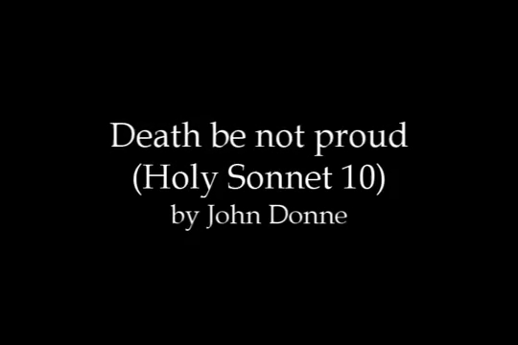
Ebtehal Al-shammri – Fatmah Basudan – Dalal Al-badran – Wafa Al-hamdan – Omaima Suliman –
Ghalia Al-qarni - Doaa Al-rowili D.Halah

Slide 5

Ebtehal Al-shammri
Ebtehal Al-shammri – Fatmah Basudan – Dalal Al-badran – Wafa Al-hamdan – Omaima Suliman –
Ghalia Al-qarni - Doaa Al-rowili D.Halah

Slide 6


Death be not proud, though some have called thee
Mighty and dreadfull, for, thou art not soe,
The Poem Begins by addressing death dramatically and directly
It does this by personifying death
The poem first attacks death for its pride calling it mighty and dreadful
Ebtehal Al-shammri – Fatmah Basudan – Dalal Al-badran – Wafa Al-hamdan – Omaima Suliman –
Ghalia Al-qarni - Doaa Al-rowili D.Halah
Notes:
انا

Slide 7
Fatmah basudan
Ebtehal Al-shammri – Fatmah Basudan – Dalal Al-badran – Wafa Al-hamdan – Omaima Suliman –
Ghalia Al-qarni - Doaa Al-rowili D.Halah

Slide 8
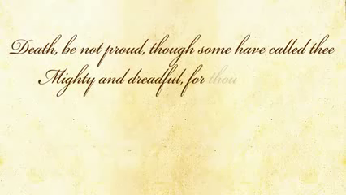
For, those, whom thou think'st, thou dost overthrow,
Die not, poore death, nor yet canst thou kill mee.
Ebtehal Al-shammri – Fatmah Basudan – Dalal Al-badran – Wafa Al-hamdan – Omaima Suliman –
Ghalia Al-qarni - Doaa Al-rowili D.Halah
Notes:
فاطمه

Slide 9
Dalal Al-badran
Ebtehal Al-shammri – Fatmah Basudan – Dalal Al-badran – Wafa Al-hamdan – Omaima Suliman –
Ghalia Al-qarni - Doaa Al-rowili D.Halah

Slide 10
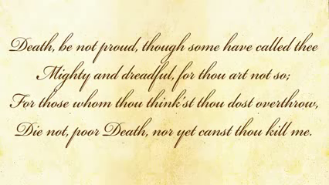
From rest and sleepe, which but thy pictures bee,
Much pleasure, then from thee, much more must flow,
The narrator is claiming that rest and sleep are nothing but pictures of death , an image of what death is , and that they provide much pleasure. So , when death actually does happen , The pleasure will be much greater.
Ebtehal Al-shammri – Fatmah Basudan – Dalal Al-badran – Wafa Al-hamdan – Omaima Suliman –
Ghalia Al-qarni - Doaa Al-rowili D.Halah
Notes:
دلال

Slide 11
Omaima Suliman
Ebtehal Al-shammri – Fatmah Basudan – Dalal Al-badran – Wafa Al-hamdan – Omaima Suliman –
Ghalia Al-qarni - Doaa Al-rowili D.Halah

Slide 12
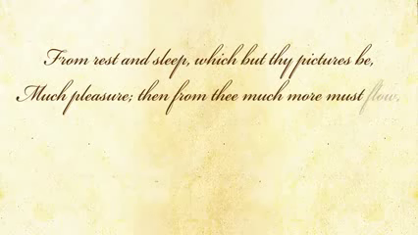
And soonest our best men with thee doe goe,
Rest of their bones, and soules deliverie.
Done uses realistic language.
The poet says virtuous and the best man are killed and surrender to you physically but not spiritually.
Poem argues that it is not a tragedy when the good die young.
The another mean of the word “Deliver” it can also refer to childbirth, which adds to the whole “new life” idea.
The comparison of death to rebirth is such a common metaphor that we rarely even think of it as a being metaphor.
Ebtehal Al-shammri – Fatmah Basudan – Dalal Al-badran – Wafa Al-hamdan – Omaima Suliman –
Ghalia Al-qarni - Doaa Al-rowili D.Halah
Notes:
اميمه

Slide 13
Wafa Al-hamdan
Ebtehal Al-shammri – Fatmah Basudan – Dalal Al-badran – Wafa Al-hamdan – Omaima Suliman –
Ghalia Al-qarni - Doaa Al-rowili D.Halah

Slide 14
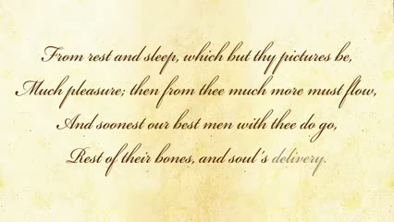
Thou art slave to Fate, Chance, kings, and desperate men,
And dost with poyson, warre, and sicknesse dwell,
Death is not a master , it is a slave
Death is dealt to others by fate and chance-personified
Death is a slave to “desperate men”- those who try to commit suicide
Death’s allies are not loyal companions but are actually hostile: poison, war, sickness-personified
Ebtehal Al-shammri – Dalal Al-badran – Wafa Al-hamdan – Omaima Suliman – Ghalia Al-qarni
D.Halah
Notes:
وفاء

Slide 15
Ghalia Al-qarni
Ebtehal Al-shammri – Fatmah Basudan – Dalal Al-badran – Wafa Al-hamdan – Omaima Suliman –
Ghalia Al-qarni - Doaa Al-rowili D.Halah

Slide 16
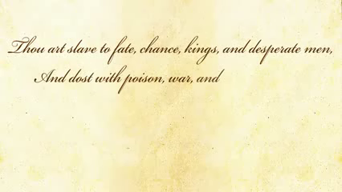
And poppie, or charmes can make us sleepe as well,
And better then thy stroake; why swell'st thou then?
Donne even pokes fun at Death saying that “poppy or charms can make us sleep as well”, meaning that death is just a weakling. He compares death to sleep “thy pictures.” Sleep is pleasan
therefore death must be, so why fear it? in other words Poppy and charms can also make us go int sleep. Then, why do you think you are better than these
The "poppy" is a flower used to make opium, an old-fashioned drug that makes people really happy,
The poppy or magic charms would work even better to make us sleep than Death would
Ebtehal Al-shammri – Fatmah Basudan – Dalal Al-badran – Wafa Al-hamdan – Omaima Suliman –
Ghalia Al-qarni - Doaa Al-rowili D.Halah
Notes:
غاليه

Slide 17
Doaa Al-rowili
Ebtehal Al-shammri – Fatmah Basudan – Dalal Al-badran – Wafa Al-hamdan – Omaima Suliman –
Ghalia Al-qarni - Doaa Al-rowili D.Halah

Slide 18
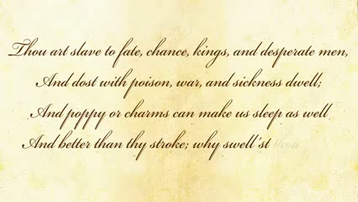
One short sleepe past, wee wake eternally,
And death shall be no more; death, thou shalt die
Finally, in the last two lines of 13 and 14 through the author’s further use of irony,
Death is told, he “...shall be no more
here is that it is only due to Christian philosophy
the belief that there is no death
Ebtehal Al-shammri – Fatmah Basudan – Dalal Al-badran – Wafa Al-hamdan – Omaima Suliman –
Ghalia Al-qarni - Doaa Al-rowili D.Halah
Notes:
دعاء

Slide 19

Do not forget to smile.
Ebtehal Al-shammri – Fatmah Basudan – Dalal Al-badran – Wafa Al-hamdan – Omaima Suliman –
Ghalia Al-qarni - Doaa Al-rowili D.Halah

Slide 20
Ebtehal Al-shammri – Fatmah Basudan – Dalal Al-badran – Wafa Al-hamdan – Omaima Suliman –
Ghalia Al-qarni - Doaa Al-rowili D.Halah

Slide 21
Ebtehal Al-shammri – Fatmah Basudan – Dalal Al-badran – Wafa Al-hamdan – Omaima Suliman –
Ghalia Al-qarni - Doaa Al-rowili D.Halah

Slide 22
Ebtehal Al-shammri – Fatmah Basudan – Dalal Al-badran – Wafa Al-hamdan – Omaima Suliman –
Ghalia Al-qarni - Doaa Al-rowili D.Halah

Slide 23
Ebtehal Al-shammri – Fatmah Basudan – Dalal Al-badran – Wafa Al-hamdan – Omaima Suliman –
Ghalia Al-qarni - Doaa Al-rowili D.Halah

