Slide 1









3.7

Slide 2

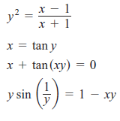

Slide 3


3.8

Slide 4
3.8
Find the derivative of:

Slide 5


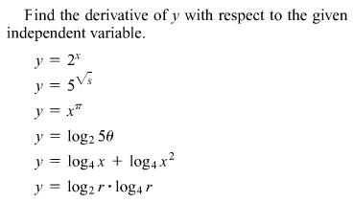
3.8

Slide 6


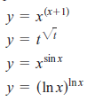


3.8

Slide 7


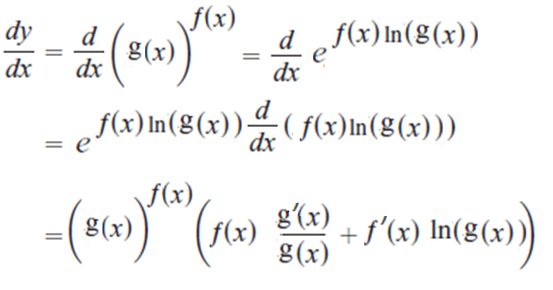
3.8
1-
2-

Slide 8

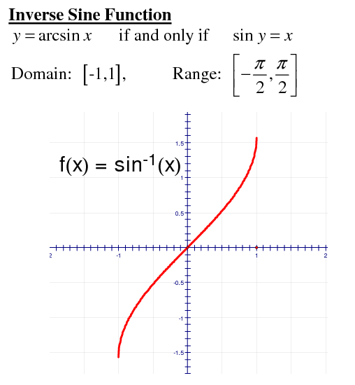
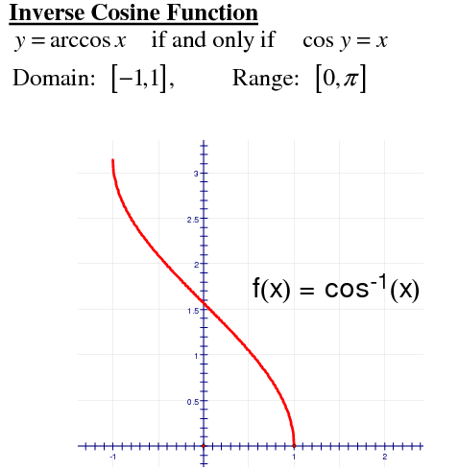
3.9

Slide 9


Slide 10
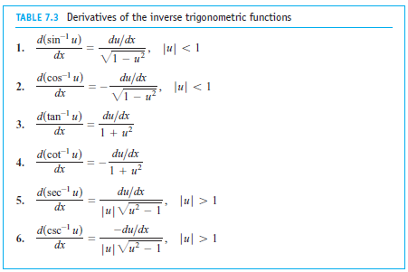

Slide 11
