Slide 1
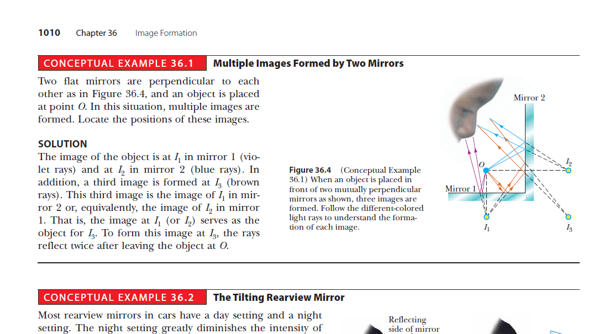

Slide 2
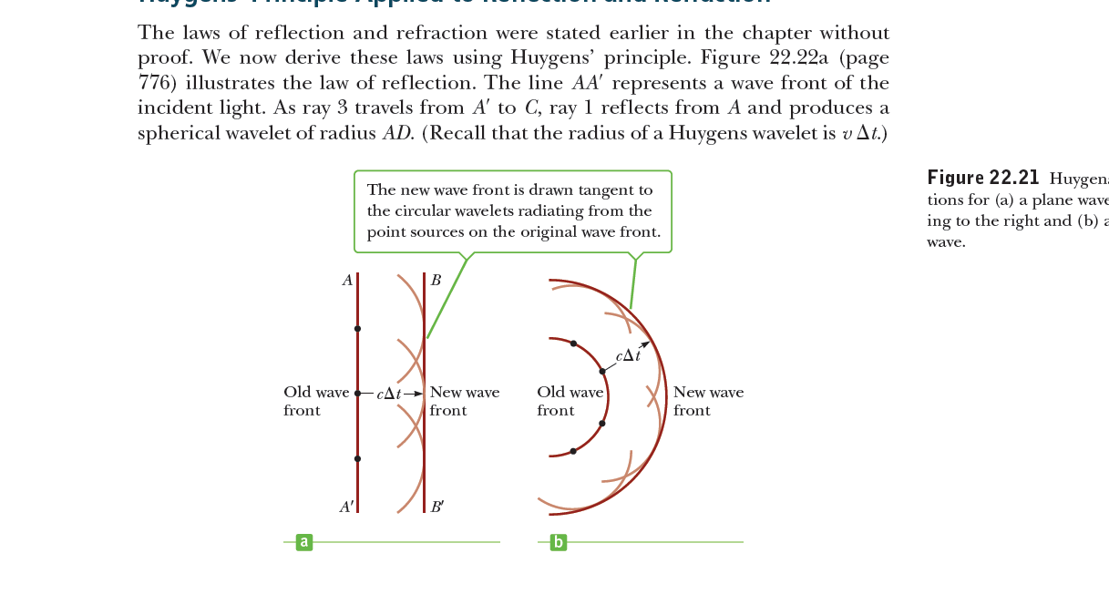
Huygens’s principle
all points on a given wave front are taken as point sources for the production of spherical secondary waves, called wavelets, that propagate outward through a medium with speeds characteristic of waves in that medium. After some time interval has passed, the new position of the wave front is the surface tangent to the wavelets.
1/R+cΔt=1/R+vΔt
1/R

Slide 3
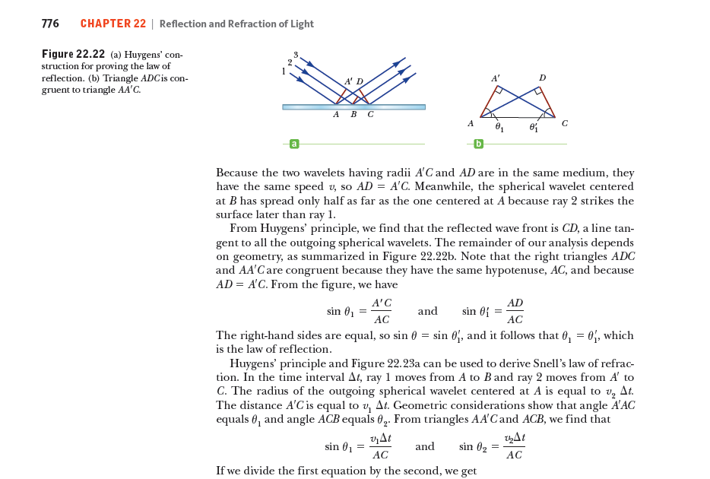
Huygens’ Principle Applied to Reflection and Refraction
The right-hand sides are equal, so sin θ = sin θ′1, and it follows that θ1 = θ′1, which is the law of reflection.

Slide 4
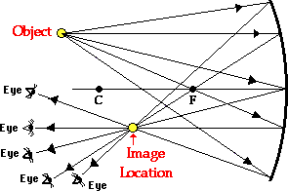
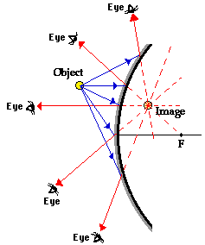
mirrors
an eye.
object.
The concave mirror
The convex mirror

Slide 5
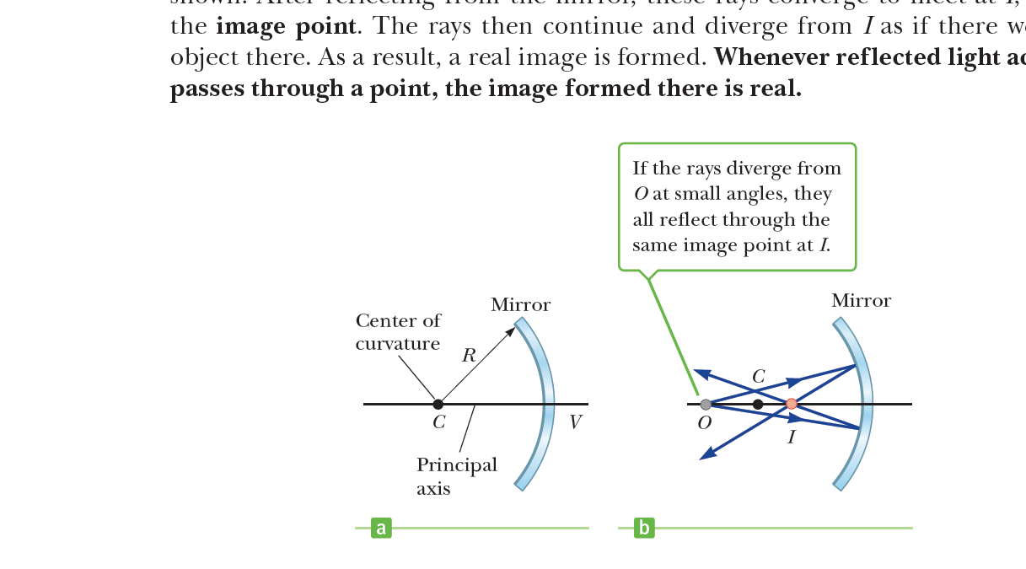
Images formed by concave mirrors
radius of curvature
Focal point
F
Mirror
polar
Focal length

Slide 6
General function for mirrors
1 = 1 + 1
f u v
X
θ
θ
h
α
β
γ
P
O
C
I
N
u
V
r
We can use the mirrors equation for both type of mirrors by considering the singe rules.

Slide 7
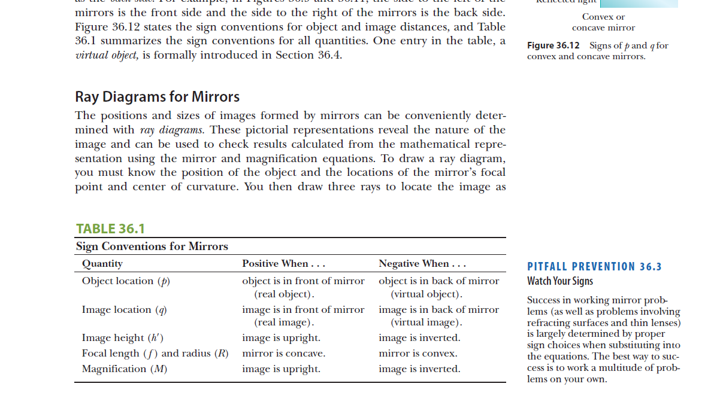
u
v

Slide 8
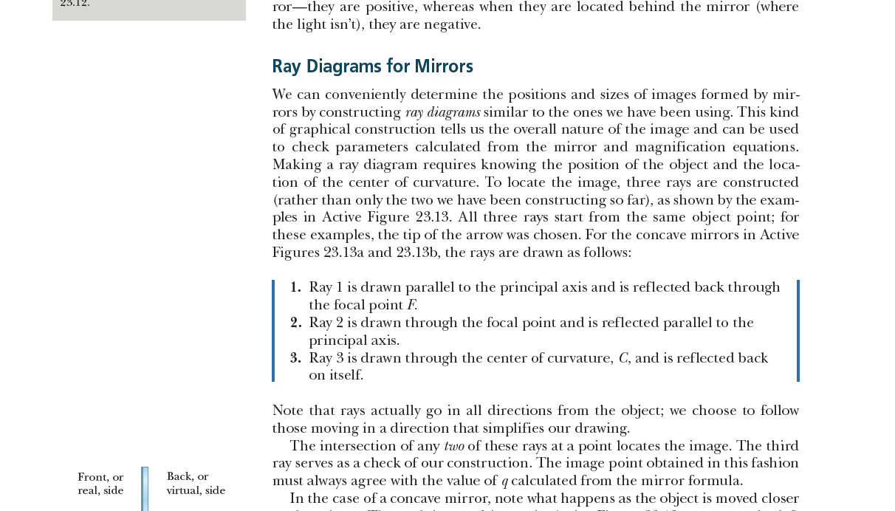
Ray diagram for concave mirrors

Slide 9
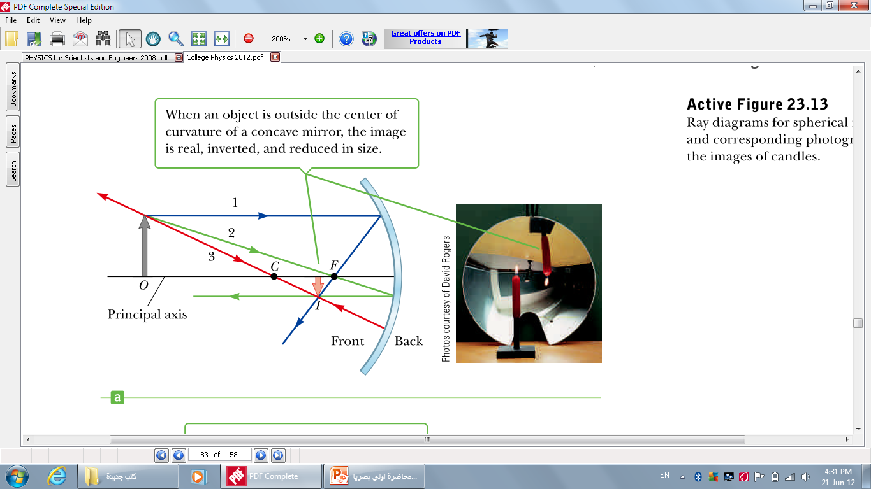

Slide 10
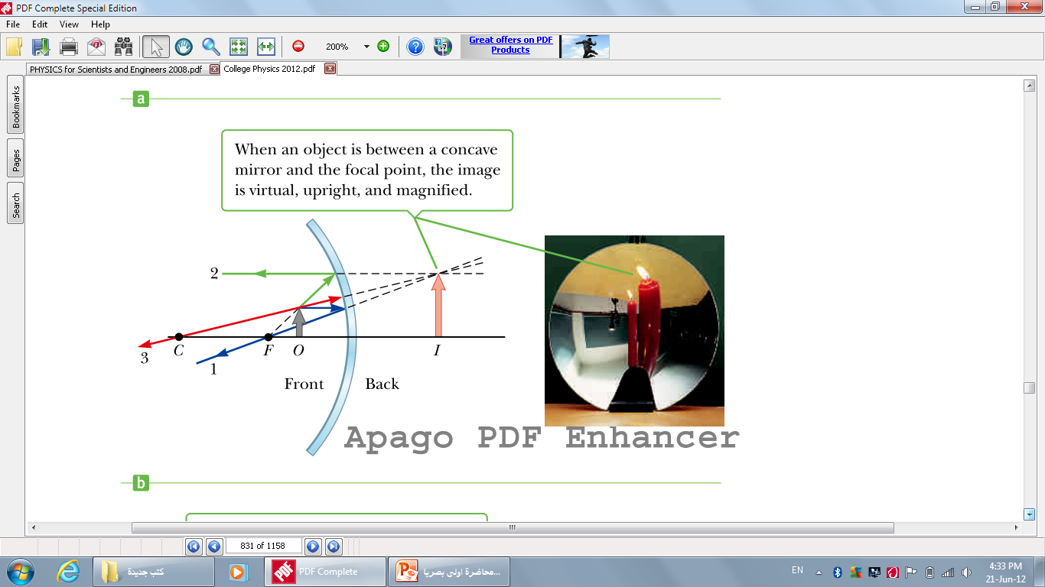

Slide 11
Ray diagram for convex mirrors
■ Ray 1 is drawn from the top of the object parallel to the principal axis and is reflected away from the focal point F.
■ Ray 2 is drawn from the top of the object toward the focal point on the back side of the mirror and is reflected parallel to the principal axis.
■ Ray 3 is drawn from the top of the object toward the center of curvature C on the back side of the mirror and is reflected back on itself.

Slide 12
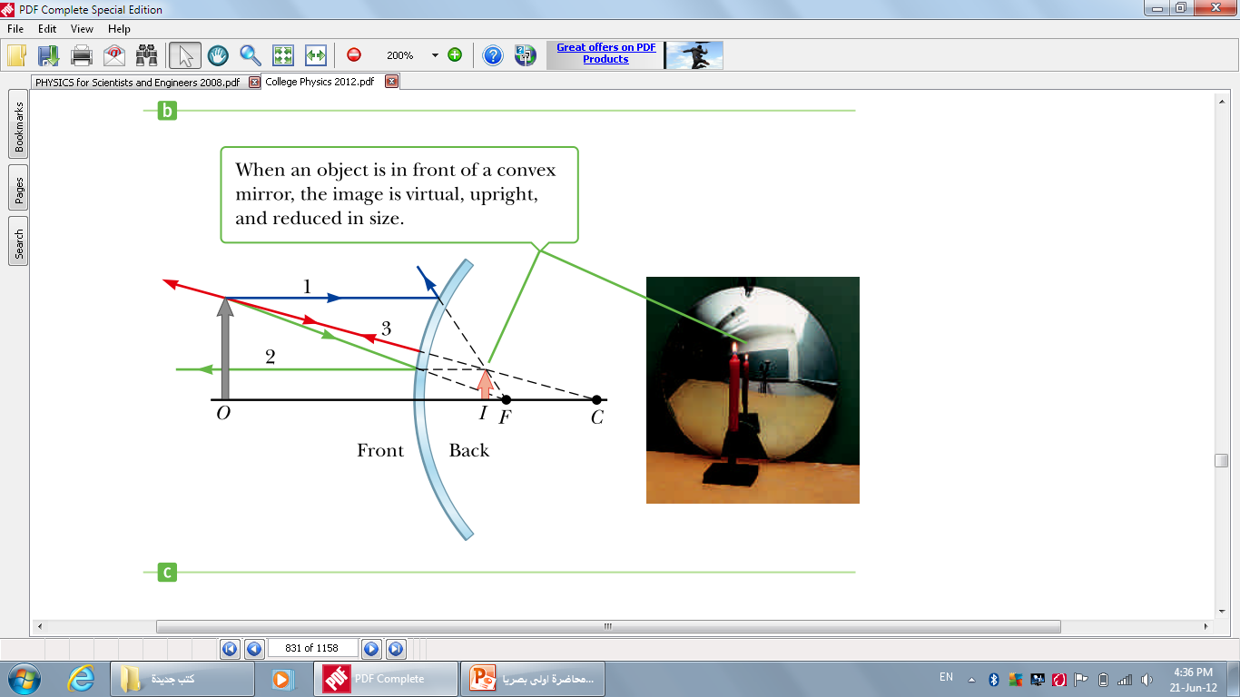

Slide 13
The magnification of mirror
M= image length = image distance = - v
Object length object distance u
The mirror power
We can measure the surface curvature by diopter where :
1 diopter =1/100 radian
So, the curvature for any surface is P=100/R
While R is a half radius of curvature

Slide 14
The cases of the general function for mirrors
1- if the object is in an infinitely distant from the mirror so:
if u=∞
1 = 1 - 1
v f u
so, v= f
2- if the object on the center of curvature of the mirror :
if u=r=2f
so , v=2f
3- if the image on the same distant of focal point :
If u=f
so, v=∞

Slide 15
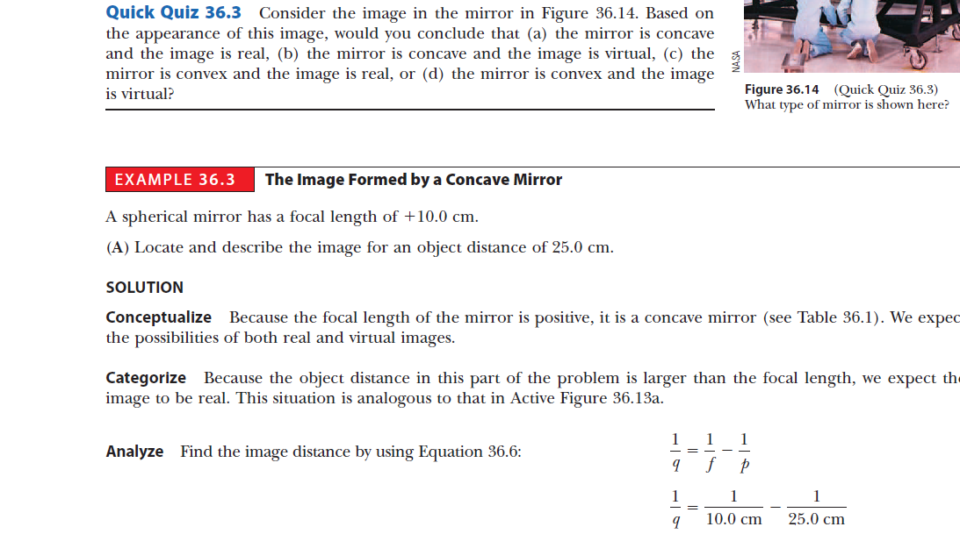
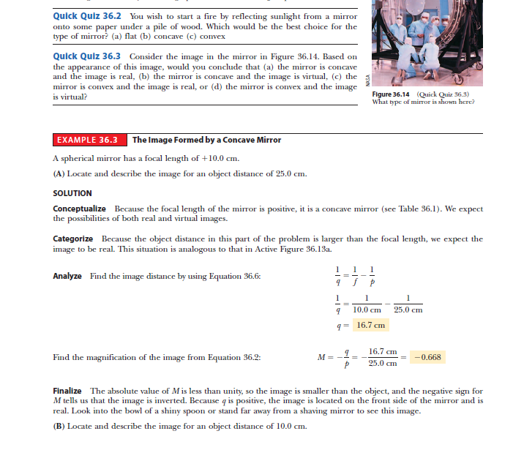
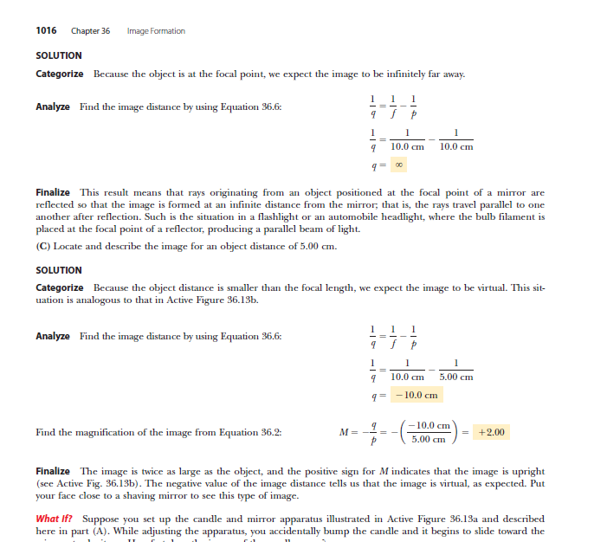

Slide 16
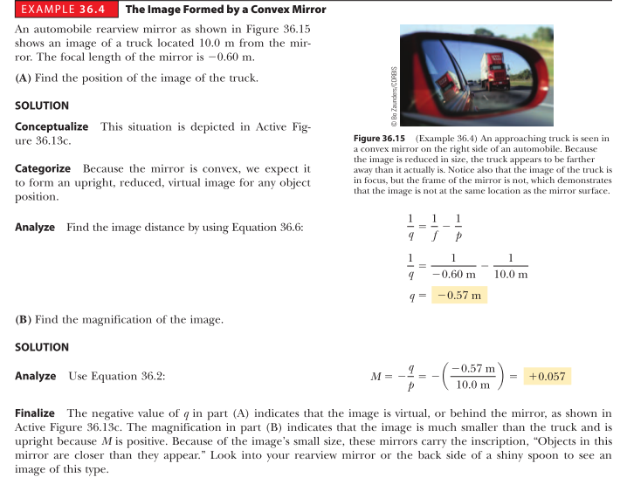

Slide 17
