Slide 1
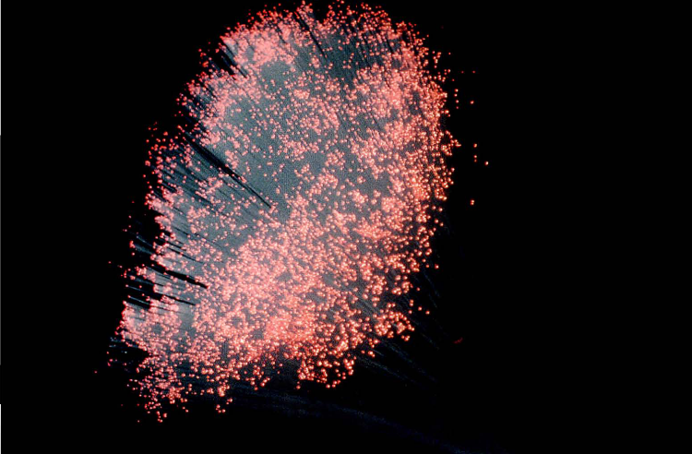
Light

Slide 2
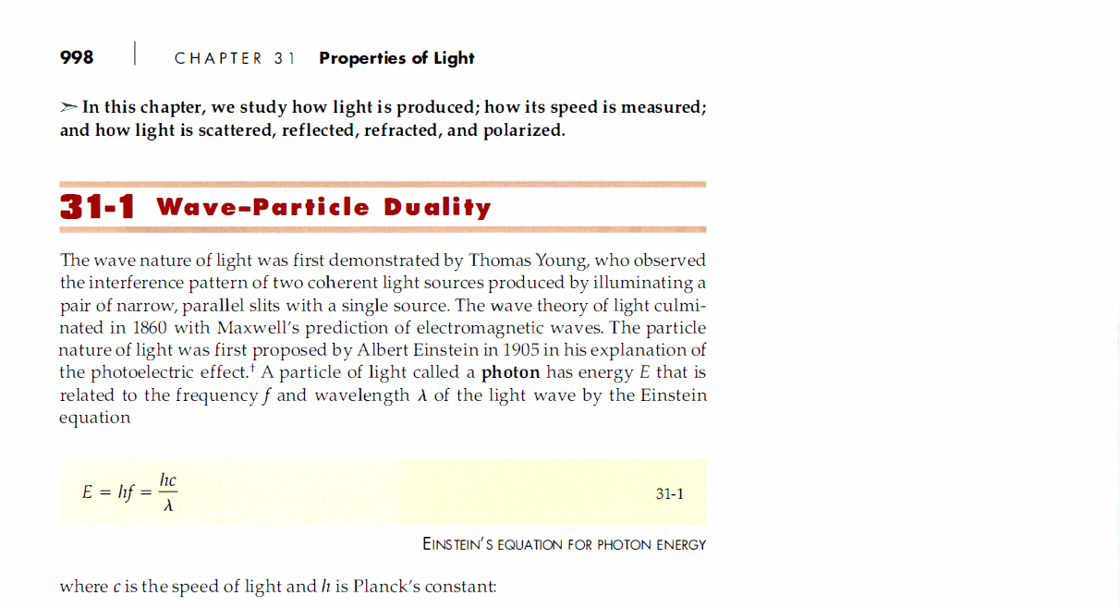
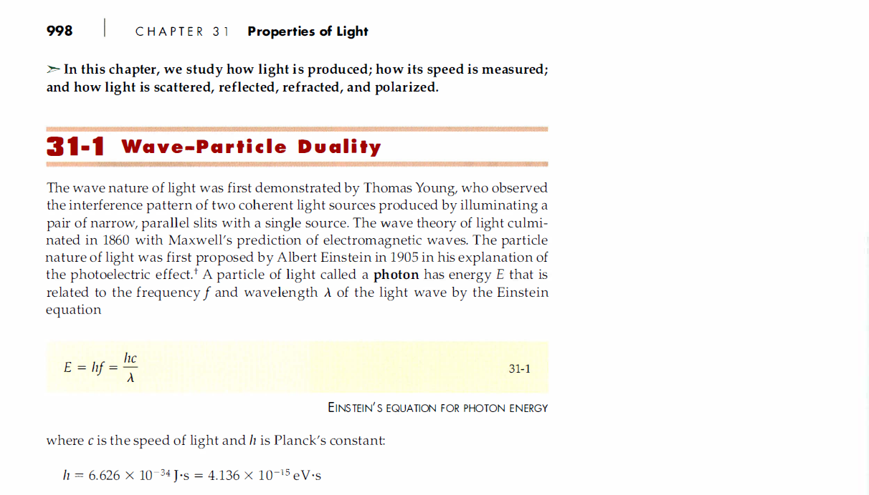
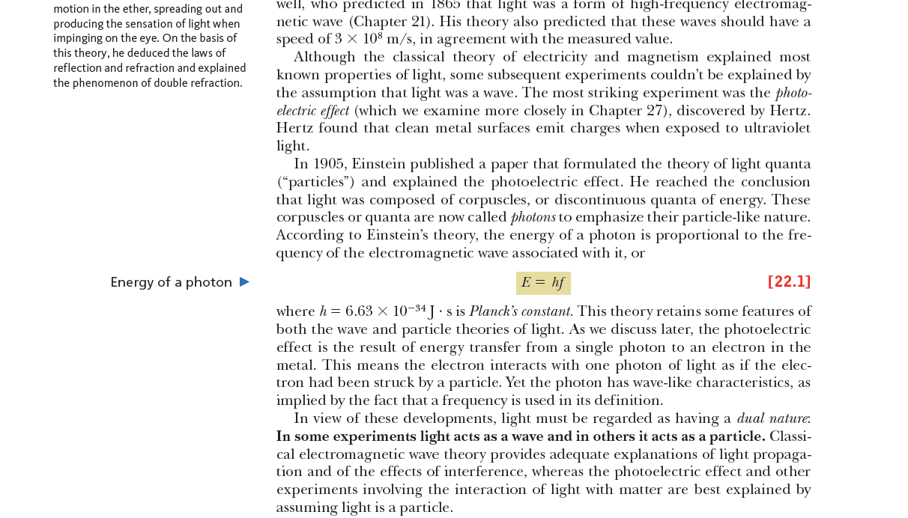
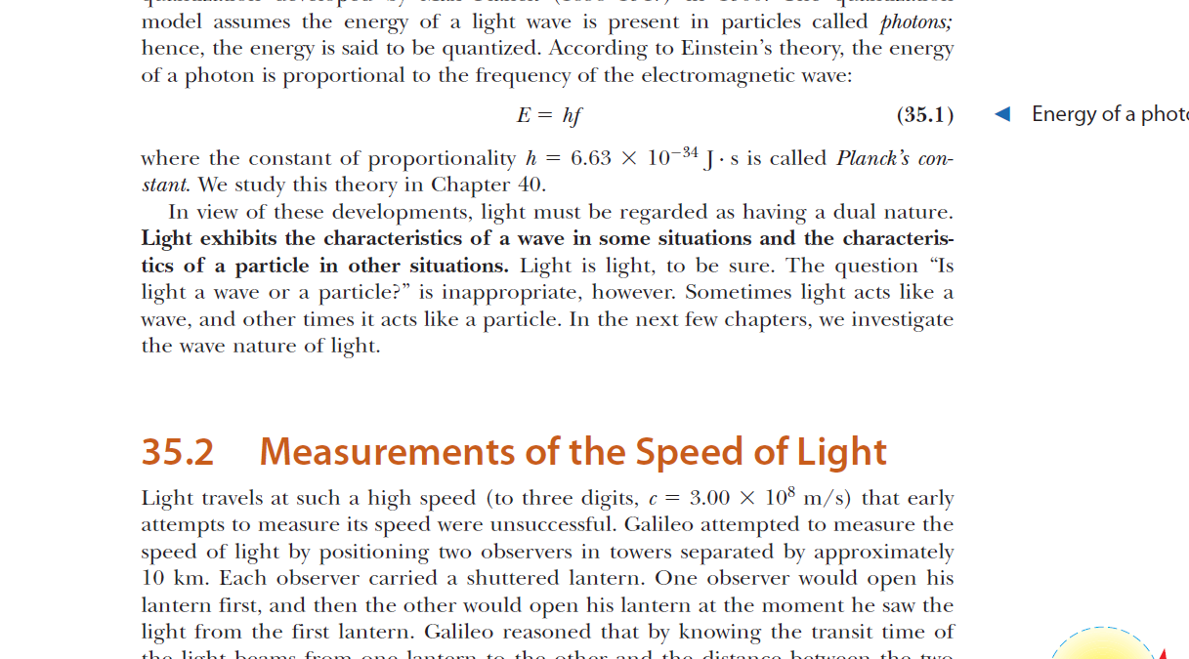
The nature of Light

Slide 3
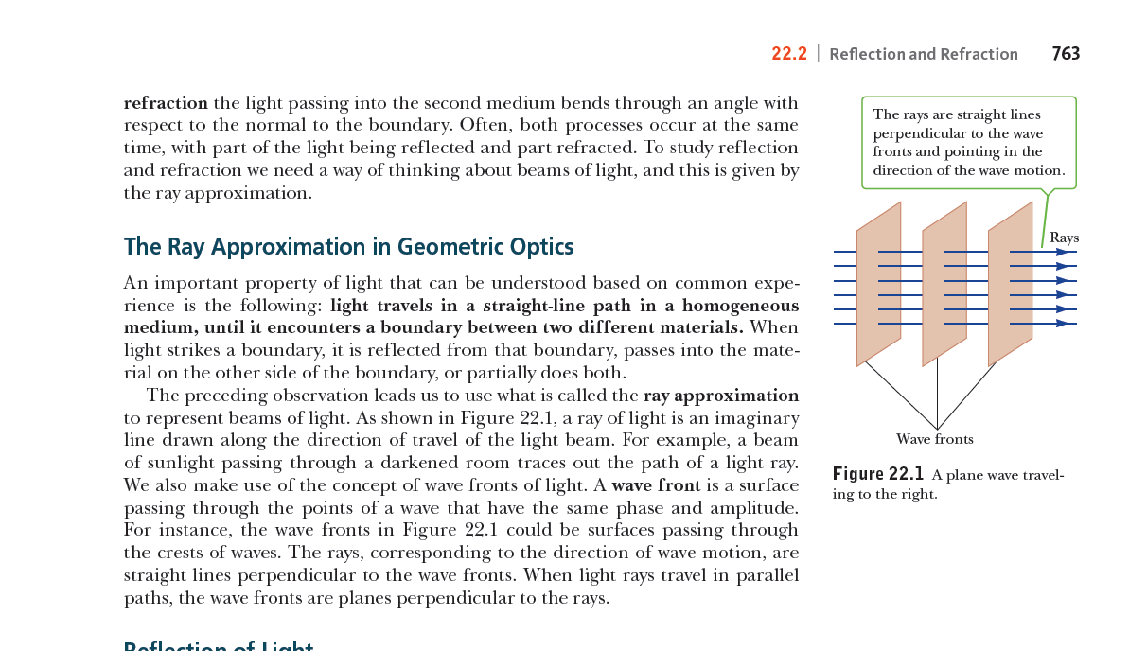

Slide 4
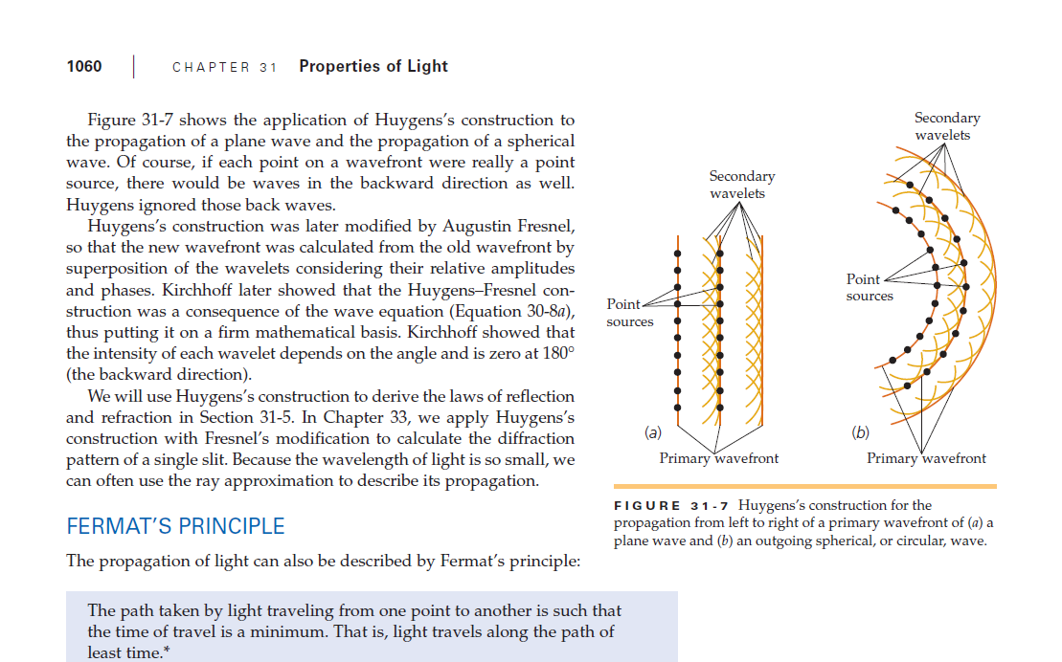
Spherical and plane waves

Slide 5
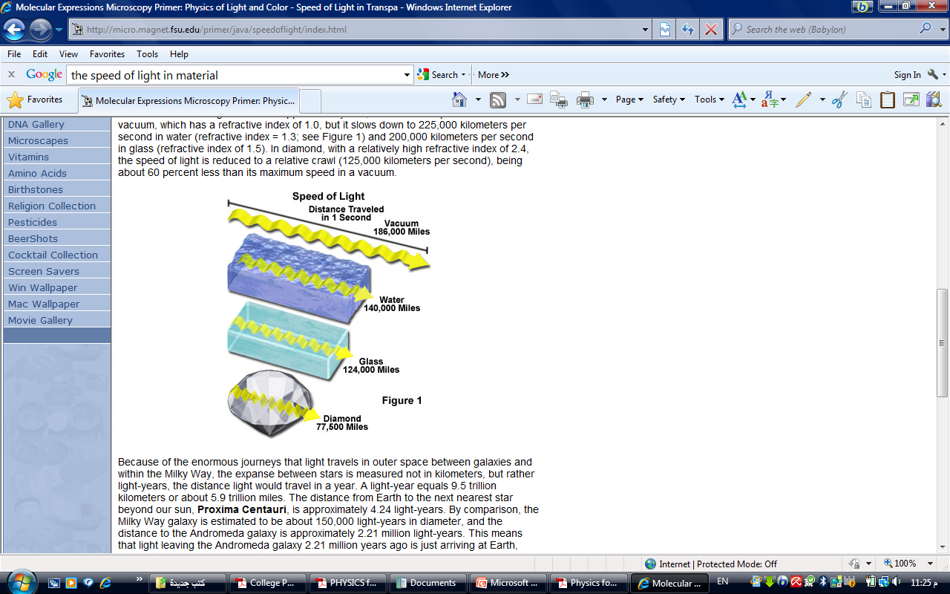
The speed of light through matters
When light traveling through the air enters a different medium, such as glass or water, the speed and wavelength of light are reduced (see Figure 1), although the frequency remains unaltered. Light travels at approximately 300,000 kilometers per second in a vacuum, which has a refractive index of 1.0, but it slows down to 225,000 kilometers per second in water (refractive index = 1.3; see Figure 1) and 200,000 kilometers per second in glass (refractive index of 1.5). In diamond, with a relatively high refractive index of 2.4, the speed of light is reduced to a relative crawl (125,000 kilometers per second), being about 60 percent less than its maximum speed in a vacuum.

Slide 6
luminous Measurement
Luminous flux
The Luminous Flux is energy. The energy is the total amount of light energy radiated from a light source per second in all directions. The luminous flux is measured in lumen. One lumen is the Luminous Flux or expressed more simply, the total amount of light energy emitted into one solid angle 4π or steradian by a point source having a luminous intensity of I candela it’s φ= 4πI
Luminous intensity
The luminous intensity of a light source (I) is the power of light. It is defined in a given direction and is measured in candela, cd .It specifies the luminous intensity in one specific angle from a light source. But it doesn’t indicate anything about the total amount of light being radiated from the light source.
Notes:
=

Slide 7
luminous Measurement
Intensity of illumination
Light and other electromagnetic waves spread out in all directions when radiated from a source. The energy transmitted by a wave can be measured by light flux per second passing through an area of 1 square meter, it’s intensity of illumination, which measured by (Lx) . If we have a light source placed in a center of spherical surface it’s diameter (r), so it’s Intensity of illumination in any point on the surface (E) is:
E=ɸ/A ( lm/m² ) = 4πI/4πr² =I/r² (cd/cm²)
= I/r² (Lx)
Intensity of illumination= Luminous intensity/ square distance

Slide 8
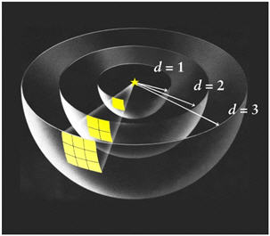
Inverse Square Law
The intensity of the influence (source) at any given radius r is the source strength divided by the area of the sphere.

Slide 9
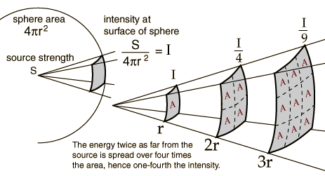
Inverse Square Law
square law?
E2=I/r₂²
E2=I/r₃²
00
E1=I/r₁²
rrr1
rrr2
Rrr3
If the light irradiated in an angle θ from the normal, the intensity of illumination is:
E=I cosθ/r²

Slide 10
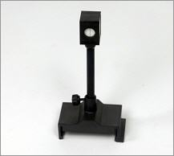
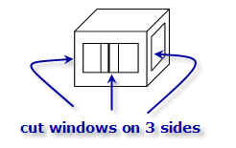
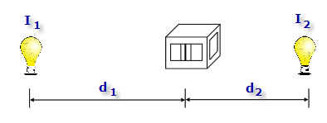

Photometer joly
.
:
paraffin wax
paraffin wax
aluminum foil

Slide 11
1- street light hung on height 7m from the ground ,the source luminous is 10lm/m2 .Find the luminous intensity.
2- Small screen placed on 50cm distance from the light source to get perpendicular rays on the screen .when change the screen position to 150cm and rotated to become the angle of incident rays is 60 ͦ .compare between the intensity of illumination on the screen in two ways.

