Slide 1
1- street light hung on height 7m from the ground ,the source luminous is 10lm/m2 .Find the luminous intensity.
2- Small screen placed on 50cm distance from the light source to get a perpendicular rays on screen .when change the screen position to 150cm and rotated to become the angle of incident rays is 60ͦ .compare between the intensity of illumination on the screen in two ways.

Slide 2
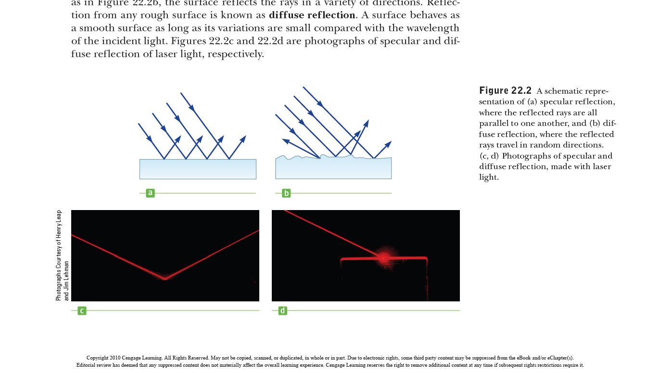
Reflection light
When a light ray traveling in a transparent medium encounters a boundary leading into a second medium, part of the incident ray is reflected back into the first medium..
specular reflection
diffuse reflection

Slide 3
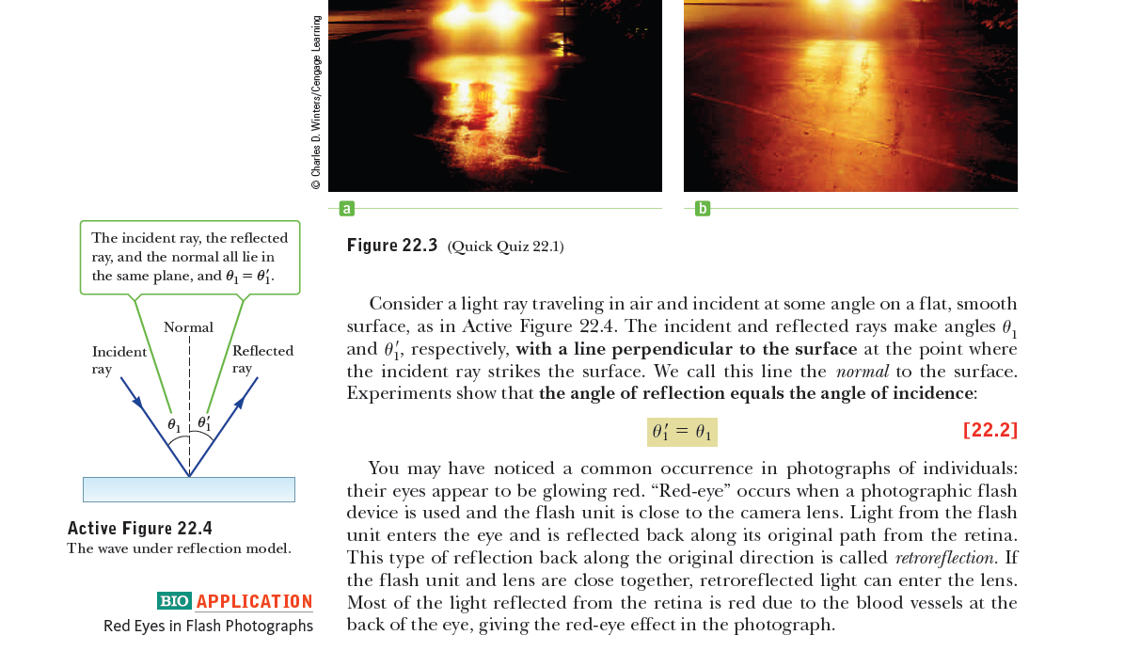
Consider a light ray traveling in air and incident at some angle on a flat, smooth surface, as in. The incident and reflected rays make angles θ1 and θ2, respectively, with a line perpendicular to the surface at the point where the incident ray strikes the surface. We call this line the normal to the surface.
Experiments show that the angle of reflection equals the angle of incidence:

Slide 4
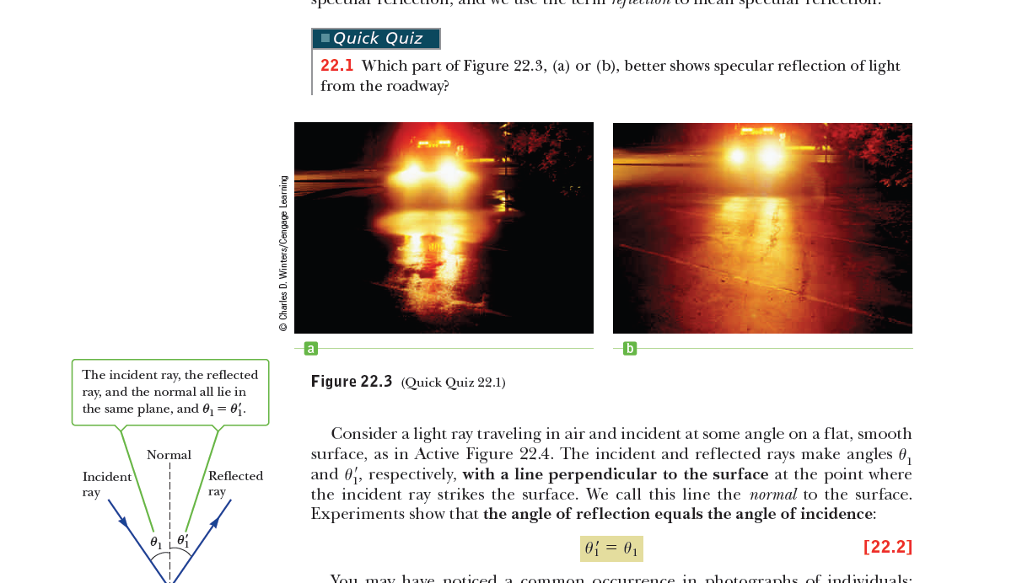

Slide 5
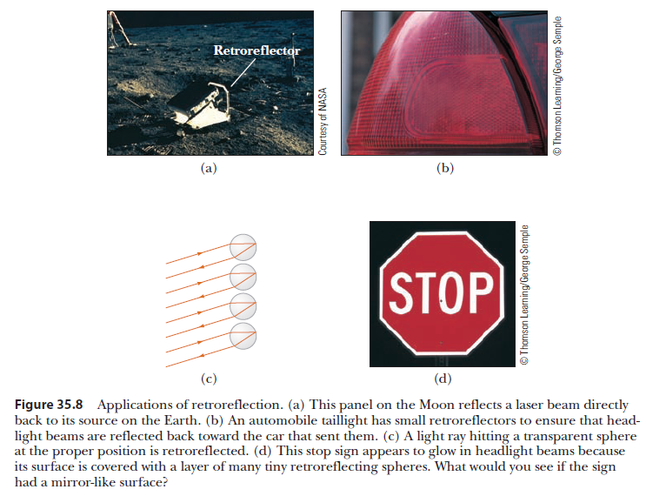

Slide 6
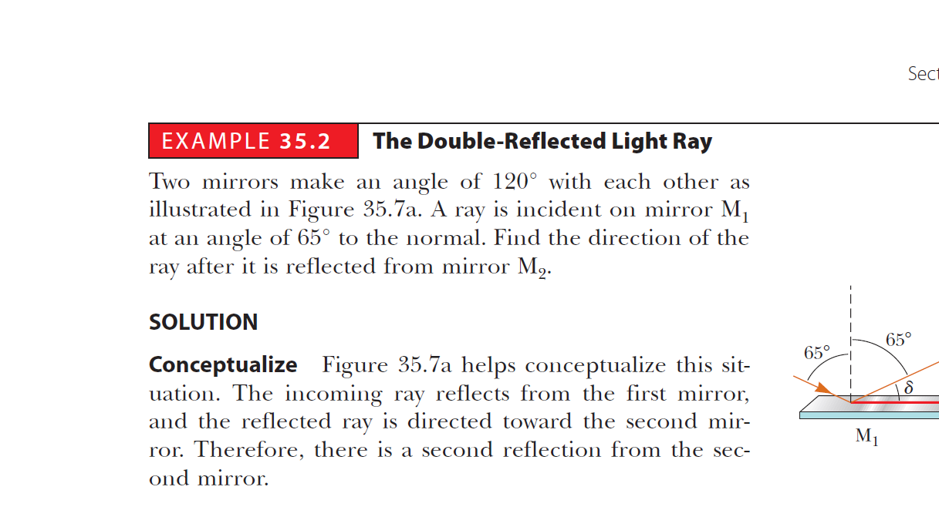
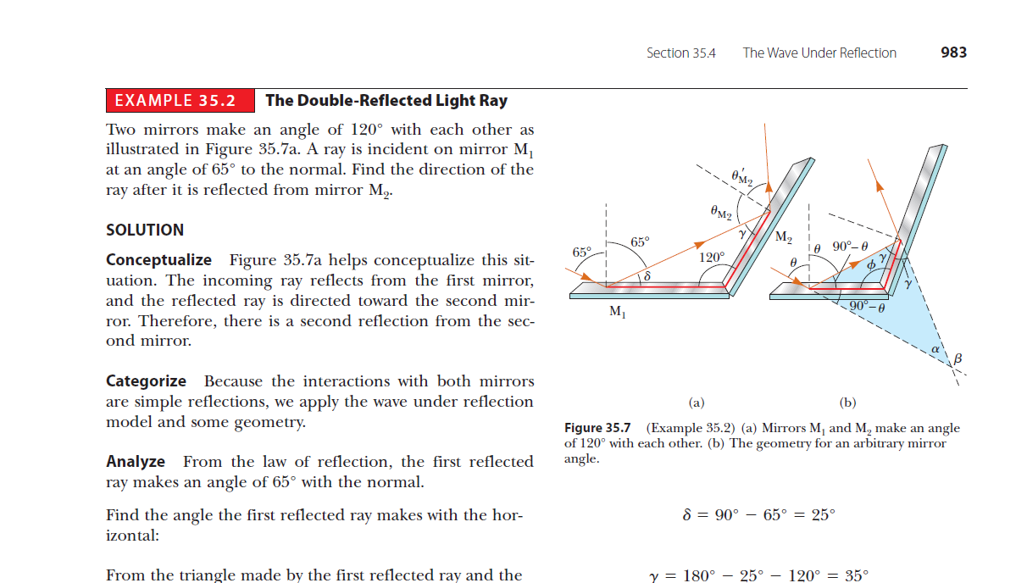

Slide 7
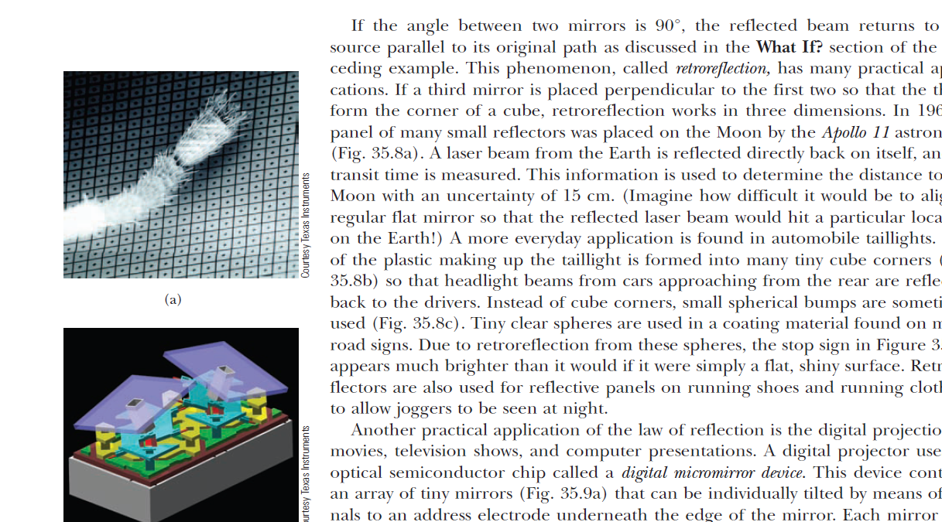
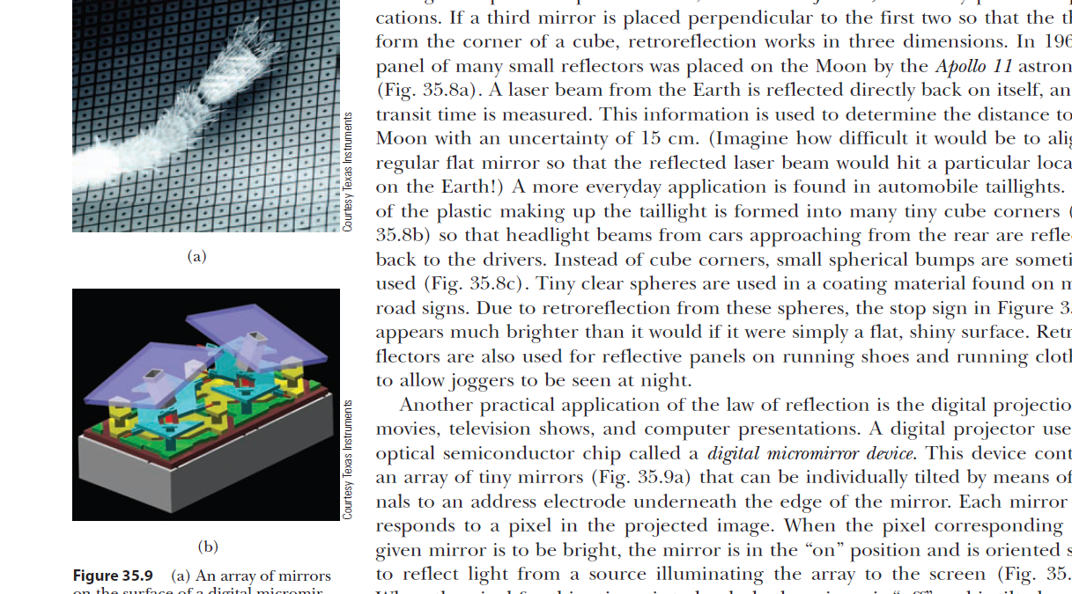
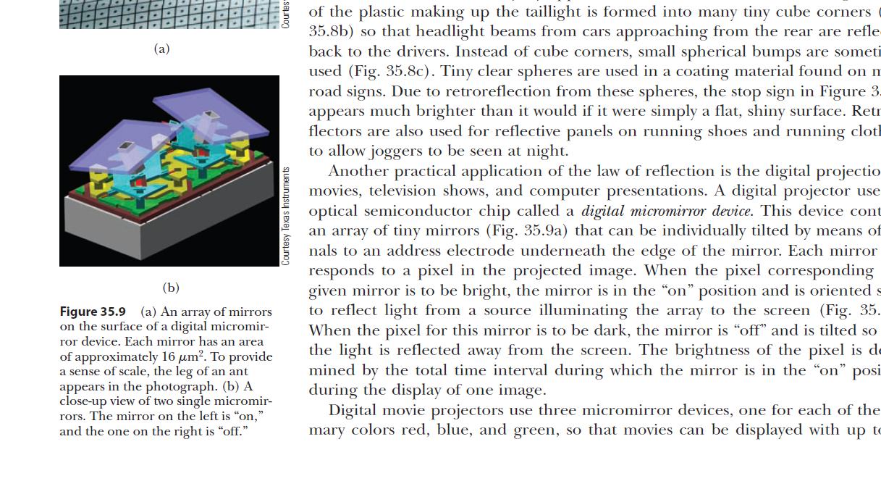

Slide 8
Reflection light
We can summarize the reflection law in:
1- the reflection angle = the incident angle
2-all the incident beam ,reflection beam and normal on the reflection surface lie in the same plane.
There are some facts about reflection we should knew:
1- if the reflection surface is rotate in θ ,the reflection ray will tilted in 2θ.
2-if we put a point source between two mirrors have θ ,the number of production images by numerous reflections at the surfaces of mirrors is :
n= 360 -1
θ

Slide 9
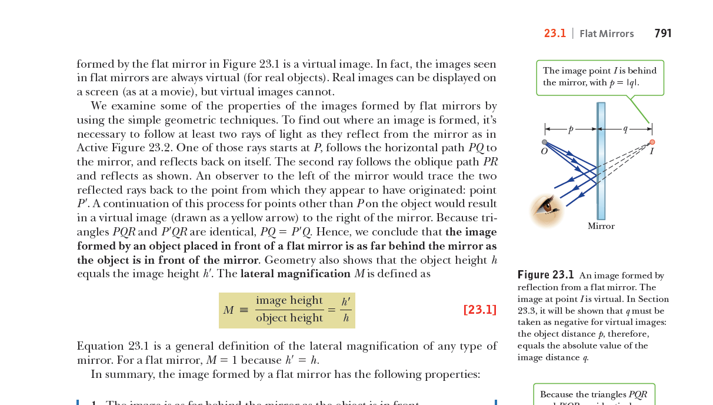
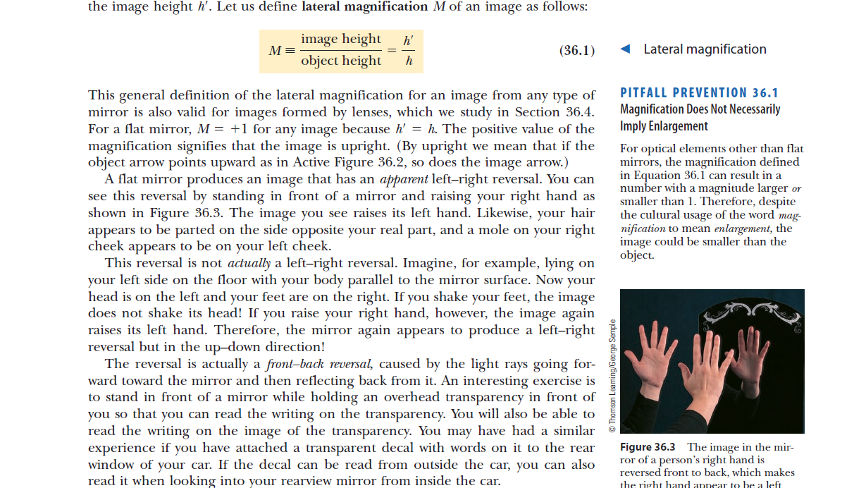
Images formed by Flat mirrors
object distance
image distance
object
image
the image formed by an object placed in front of a flat mirror is as far behind the mirror as the object is in front of the mirror.

Slide 10
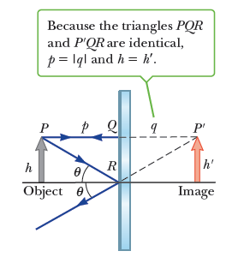
Images formed by Flat mirrors
In summary, the image formed by a flat mirror has the following properties:
1. The image is as far behind the mirror as the object is in front.
2. The image is unmagnified, virtual, and upright.

Slide 11
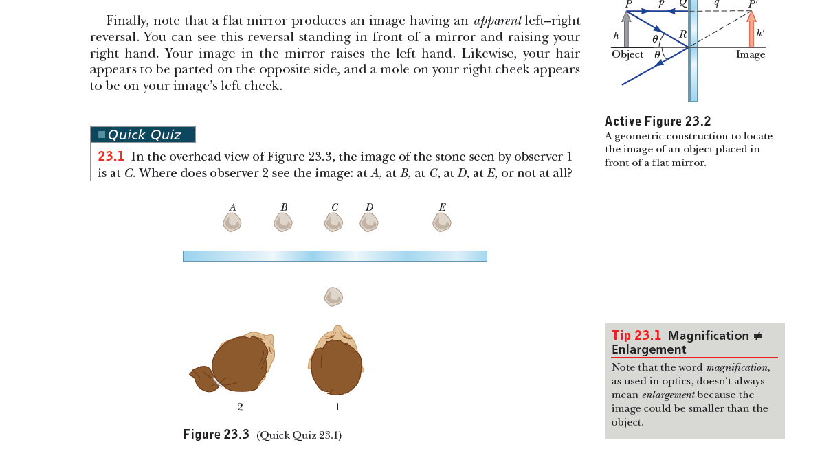

Slide 12
Quick Quiz 36.1
You are standing approximately 2 m away from a mirror. The mirror has water spots on its surface. True or False: It is possible for you to see the water spots and your image both in focus at the same time.
Quick Quiz 35.1
In the movies, you sometimes see an actor looking in a mirror and you can see his face in the mirror. During the filming of such a scene, what does the actor see in the mirror? (a) his face (b) your face (c) the director’s face (d) the movie camera (e) impossible to determine.

Slide 13
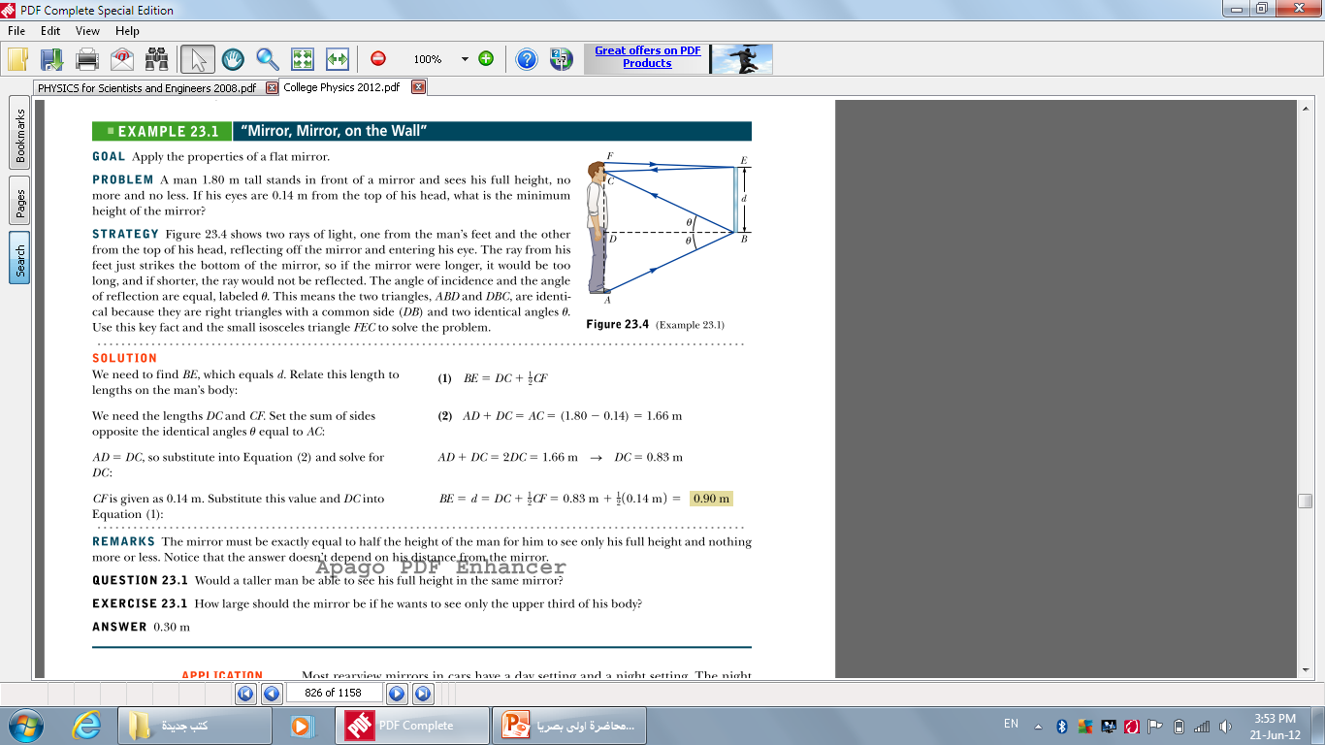

Slide 14
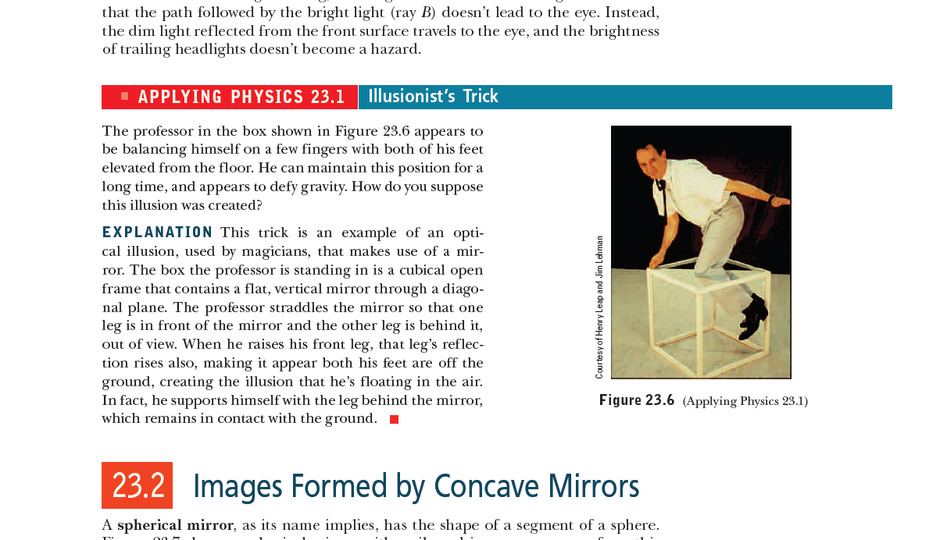

Slide 15
