Slide 1
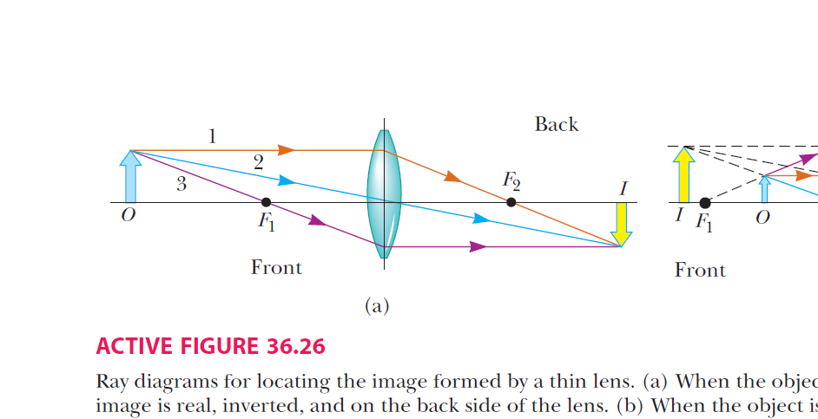
The Newton’s formula of lenses and the two points conjgate
f ′
X ′
X
f
f²=x′x
X is the distance between object and focal F1 .
X′ the distance between image and focal F2 .

Slide 2
Ray Diagrams of Thin converging lens
1. The first ray is drawn parallel to the principal axis. After being refracted by
the lens, this ray passes through (or appears to come from) one of the focal points.
2. The second ray is drawn through the center of the lens. This ray continues in a straight line.
3. The third ray is drawn through the other focal point and emerges from the lens parallel to the principal axis.

Slide 3
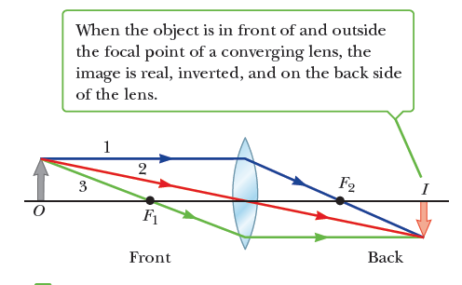

Slide 4
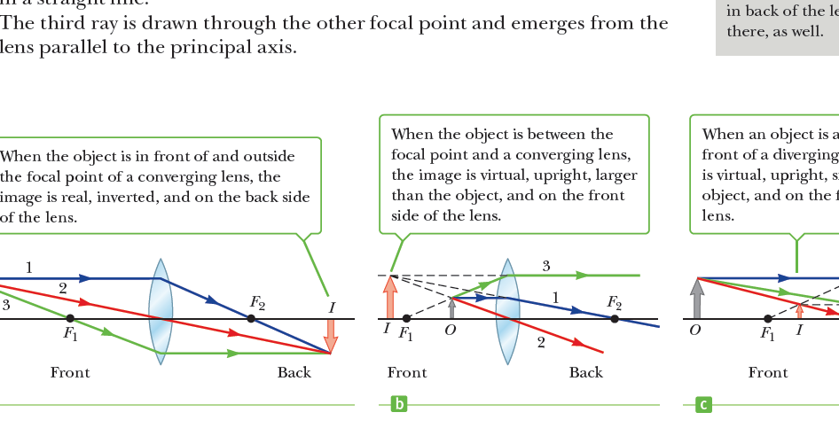

Slide 5
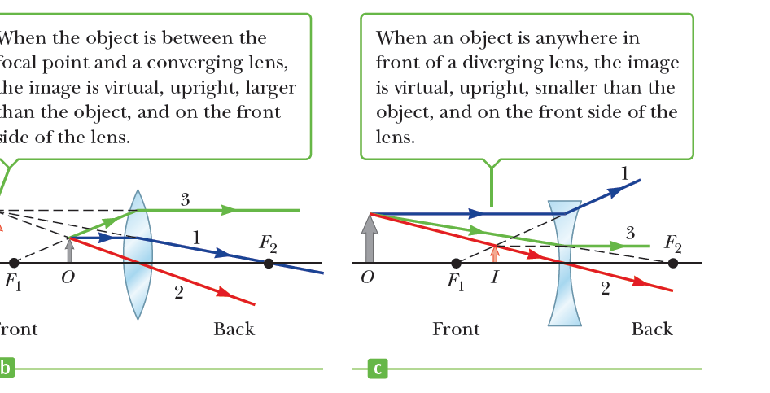
Ray Diagrams of Thin diverging lens
■ Ray 1 is drawn parallel to the principal axis. After being refracted by the lens, this ray emerges directed away from the focal point on the front side of the lens.
■ Ray 2 is drawn through the center of the lens and continues in a straight line.
■ Ray 3 is drawn in the direction toward the focal point on the back side of the lens and emerges from the lens parallel to the principal axis.

Slide 6
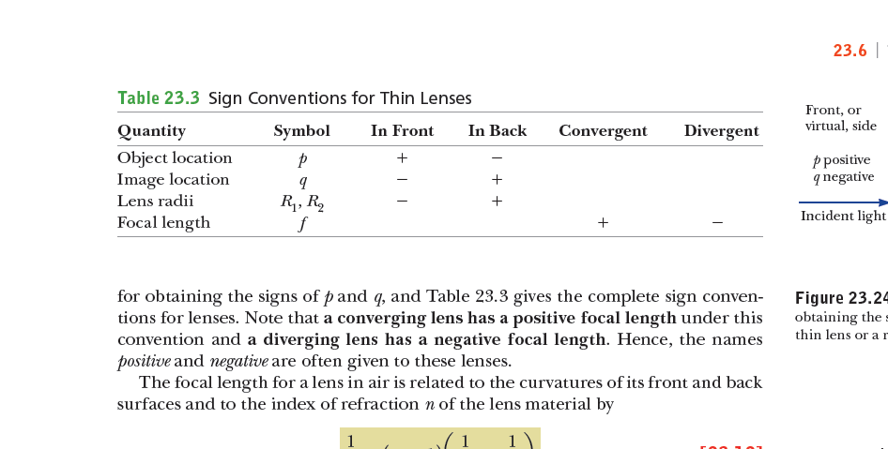
u
v
The power of a thin lens
The power of a thin lens in diopters is given :
P=1/f = 100/f
When we use the lens maker’s formula, we can write :
P = (n-1)(1/r1-1/r2)
Where r1,r2 are two radii ,measured in meters .

Slide 7
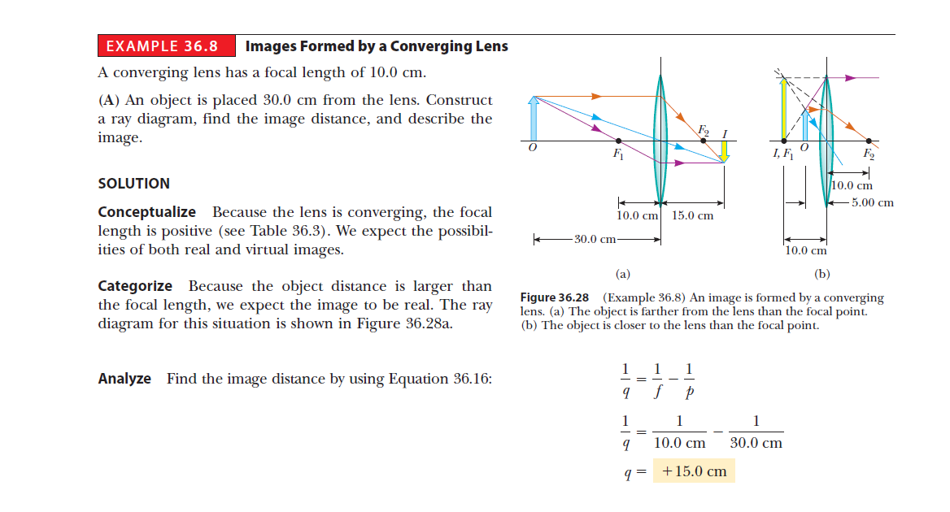
Images Formed by a Converging Lens :
A converging lens has a focal length of 10.0 cm.
An object is placed 30.0 cm from the lens. Construct a ray diagram, find the image distance, and describe the image.
(B) An object is placed 10.0 cm from the lens. Find the image distance and describe the image.
(C) An object is placed 5.00 cm from the lens. Construct a ray diagram, find the image distance, and describe the image.

Slide 8
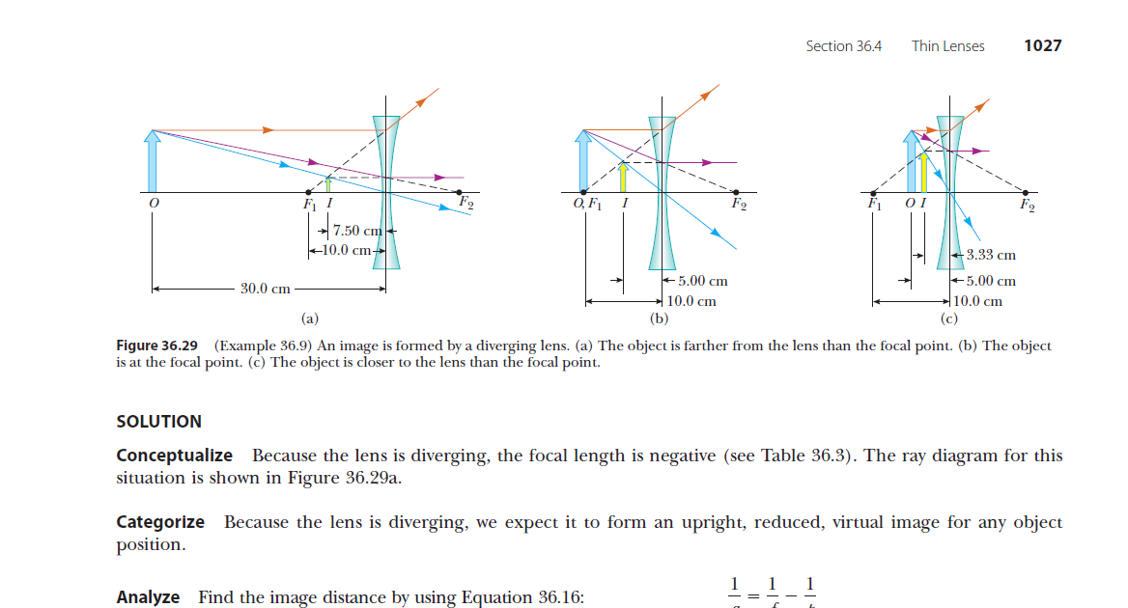
Images Formed by a Diverging Lens:
A diverging lens has a focal length of 10.0 cm.
(A) An object is placed 30.0 cm from the lens. Construct a ray diagram, find the image distance, and describe the image.
(B) An object is placed 10.0 cm from the lens. Construct a ray diagram, find the image distance, and describe the image.
(C) An object is placed 5.00 cm from the lens. Construct a ray diagram, find the image distance, and describe the image.

Slide 9


The alternates positions of convex lens
u
v
A
B
u
L
This relationship for calculate the focal distance of convention lens . We can find the length of image h by a length of the magnified image h1 in the first step and the smallest image in the second step h2 from:

Slide 10


Thin lenses in contact s
the image formed by the first lens is located as if the second lens were not present.
Then a ray diagram is drawn for the second lens, with the image formed by the first lens now serving as the object for the second lens.
A
B
C
O
u
v
I
’ I
v’
When two thin lenses are placed in contact they will act as a single lens ,so the focal length of the combination is equal to the sum of the reciprocals of focal lengths of individual lenses.
We can write the power of the combination

Slide 11
1-Appling the graphical method of thin lens combinations with disregard the second lens .
.
2-Find the image I1of object I which produced by the first lens .
5- We construct a 4 ray by drawing line 9 from I1 to W pass through the center of second lens.
I
T
7-The intersection of rays 9,11 located the image I2 which is a real image.
3
W
5
I2
F1
F2
A1
A2
F ’1
F ’2
9
6
7
I1
u
v
3-Any two of the incident rays 3,5 and 6 are sufficient for this purpose.
6-Ray 7 is refracted by second lens to F ’2.
4-The image I1 is real and inverted, that is become the object of the second lens (virtual object).

Slide 12
Because the magnification due to the second lens is performed on the magnified image due to the first lens, the overall magnification of the image due to the combination of lenses is the product of the individual magnifications:
M= M1M2

Slide 13
