Slide 1

COMMUNICATION SKILLS
COMMUNICATION SKILLS

Slide 2
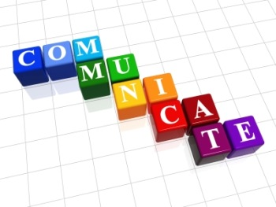
exchange information
exchange information or conversation with other people, using words, signs, writing etc

Slide 3
skill
the ability to do something well

Slide 4
Communication skills
Reading
Writing
Speaking
Listening

Slide 5
Unit 1
# People
# Introduce people and others
# Great visitors
# Ask questions about people
# Question tag

Slide 6
1-Meeting people

Slide 7
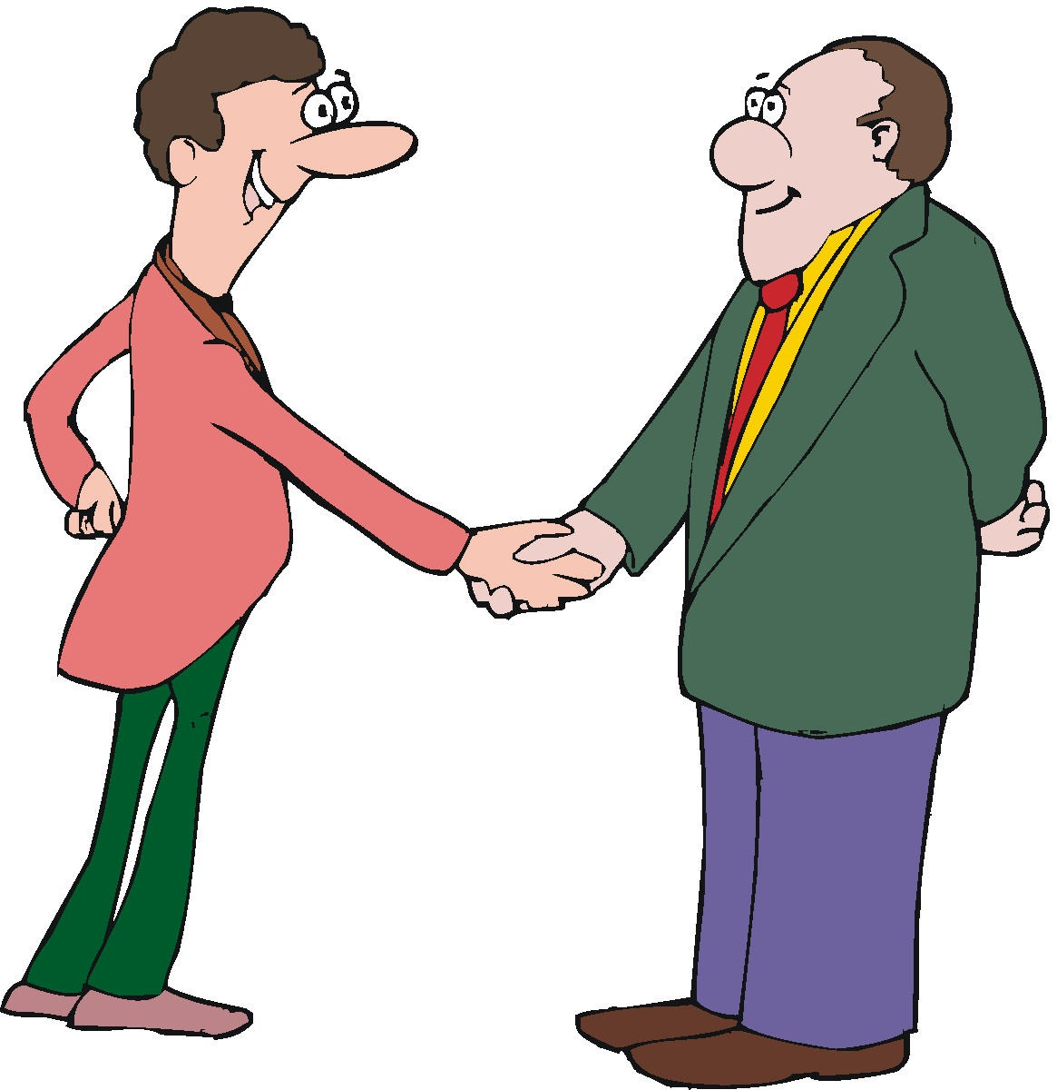

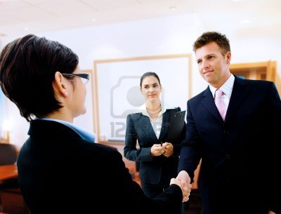
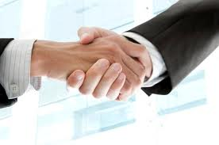

Slide 8
      Introducing yourself

Slide 9
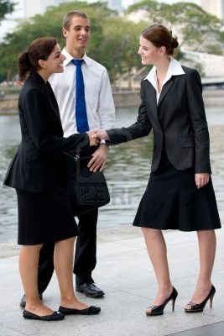
Hello, I’m Noor.
my Name’s Nada.
A: How do you do?
Pleased to meet you.
B: : How do you do?
Pleased to meet you, too.

Slide 10
Introducing someone else

Slide 11
This is Maha.
I’d like to introduce Lena.
Do you know Layla?
Have you met Malak?

Slide 12
Greeting someone you know
How are you?
Fine thanks.
Not too bad, thank you.

