Slide 1
Unit 2
Talking about companies

Slide 2
Describe different types of companies
Past tense
Irregulars verbs
WH-Q

Slide 3




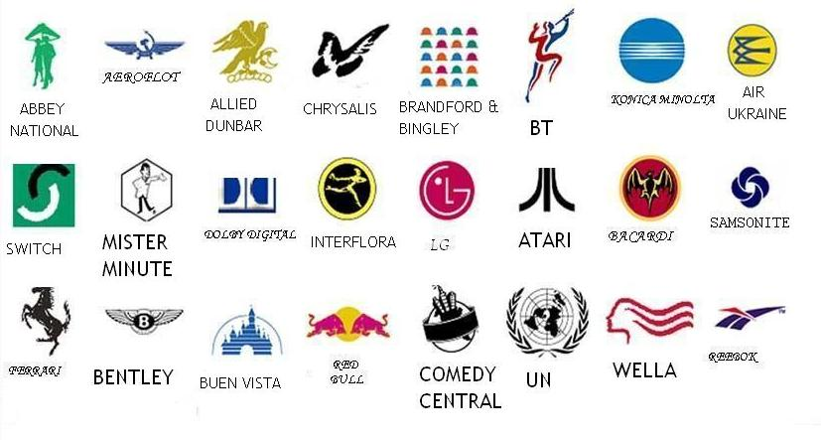

a small design that is the official sign of a company or organization
a small design that is the official sign of a company or organization

Slide 4
Logo\a small design that is the official sign of a company or organization.

Slide 5
vocabulary
Aerospace\the branch of technology and industry concerned with both aviation and space flight.
Airline\ air flight \Saudi Airline has a huge fleet.

Slide 6
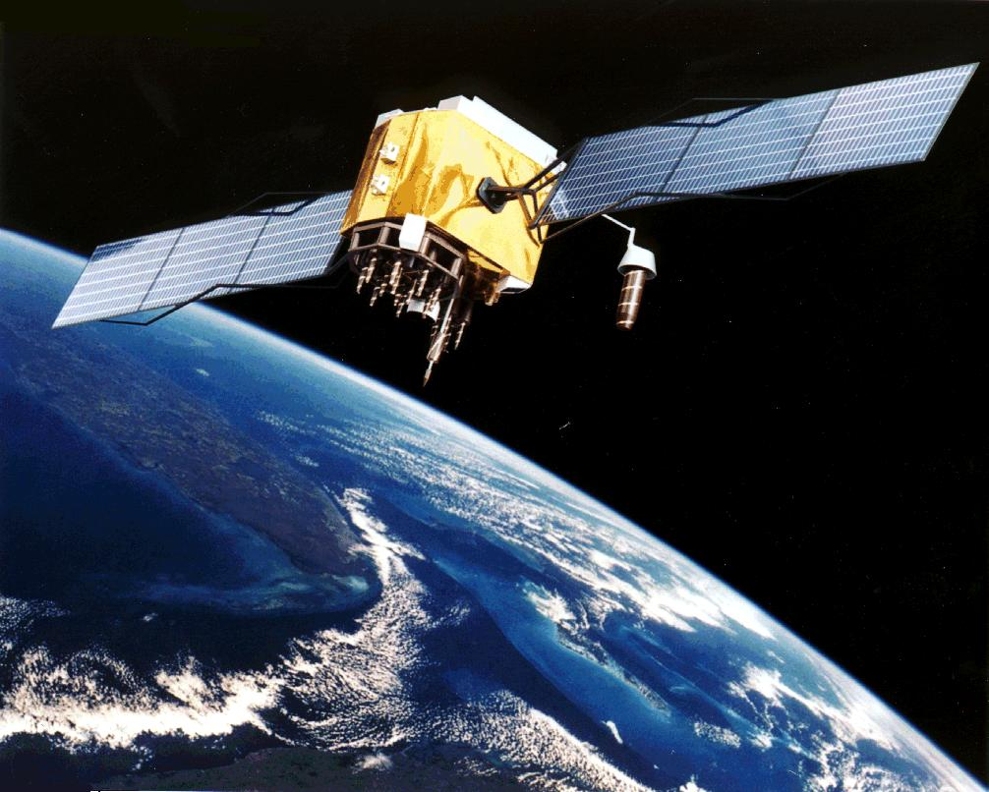


Slide 7

Computing\the use or operation of computers: she studies mathematics and computing
Financial service\moneys’ services
Banking\the business conducted or services offered by a bank> I like to study banking to work in a famous bank

Slide 8

Bar coding\ a group of thin and thick lines printed on products you buy in a shop, and which a computer can read. It contains information such as the price.

Slide 9
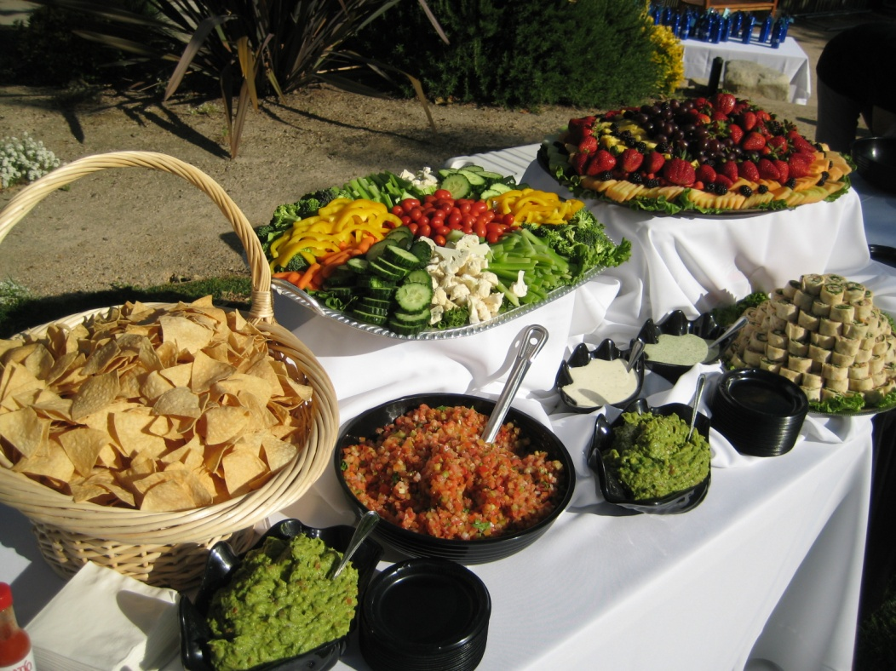
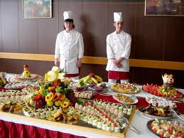
Catering\ cater- provide people with food and drink at a social event or other gathering:
my mother helped to cater for the party.

Slide 10
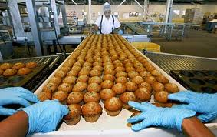
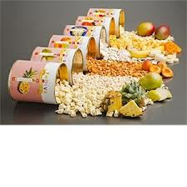
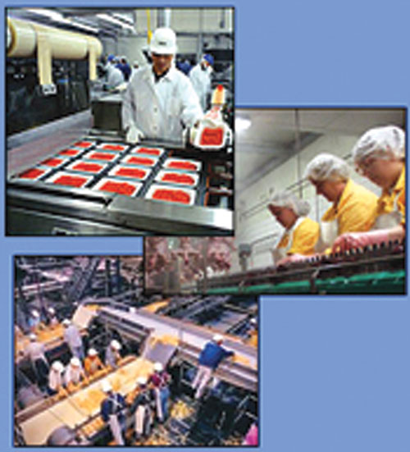
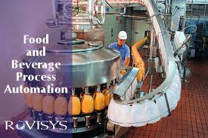
Food processing\

Slide 11

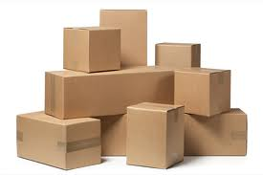

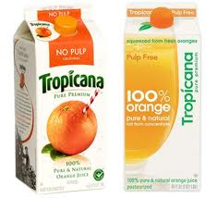
Packaging\
the container or material that a product is sold in: plastic packaging

Slide 12
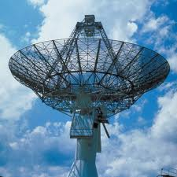


Telecommunications\the sending and receiving of messages by telephone, radio, television etc:
a new telecommunications company uses a developed system.

Slide 13
Transport\system or method for carrying passengers or goods from one place to another air/rail/sea/road transport
It's easier to get to the college if you have your own transport .

Slide 14
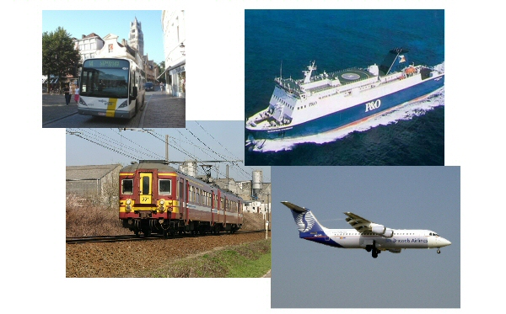
air/rail/road transport
air/rail/road transport
air/rail/road transport
air/rail/road transport
air/rail/road transport
air/rail/road transport
air/rail/road transport

Slide 15
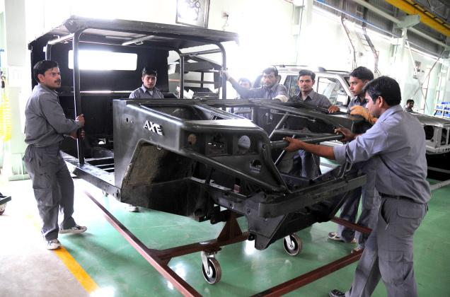
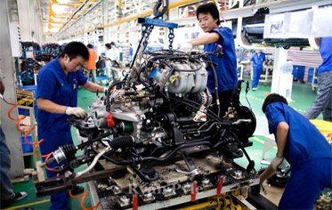
Vehicle Manufacturing
vehicle

Slide 16
How to write a report about a company:
It is ………….company
They are in …………..business. They make………
They have …………… employees
The headquarters are in …………
Their main markets are ……………….

Slide 17
How to write a report about a company:
Its name is Containex company
It is in the packaging business. They make
a range of consumer packaging in metal, glass and plastics.
They have 5300 employees
The headquarters are in England
Their main markets are European countries.

Slide 18
Statements (past tense)
Subject + v + object
She studied hard for the exam.
Negative (did not)
Subject +helping v +main v + object
She didn’t study hard for the exam.

Slide 19
Questions: what , when,…etc.
A :In 1978
1 2 3 4 5
Wh-. Word helping V Subject main V rest of s
when did Joan Slater set up her business?

Slide 20
Past Tense regular v: add –ed at the end of the verb call-called ask-asked
Irregular v: 1- form of the v changes go-went get-got
2- form doesn’t change e.g. cut cut cut

Slide 21
Answering the Phone
Answer the phone
Tell your name
Answer the caller’s questions & Inquiries
Give information
Offer to send some brochures
Ask for the caller’s name , address &email
Promise to email the information
End the call

