Slide 1
Unit 5
Transportation

Slide 2
Talk about infrastructure
Describe facilities
Compare advantages & disadvantages
Adjectives describing quality

Slide 3
Transportation
a system or method for carrying passengers or goods from one place to another

Slide 4
1-Describing infrastructure
infrastructure the basic systems and structures that a country or organization needs in order to work properly, for example roads, railways, banks etc:
Some countries lack a suitable economic infrastructure.

Slide 5
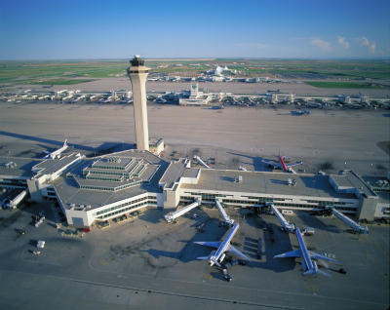
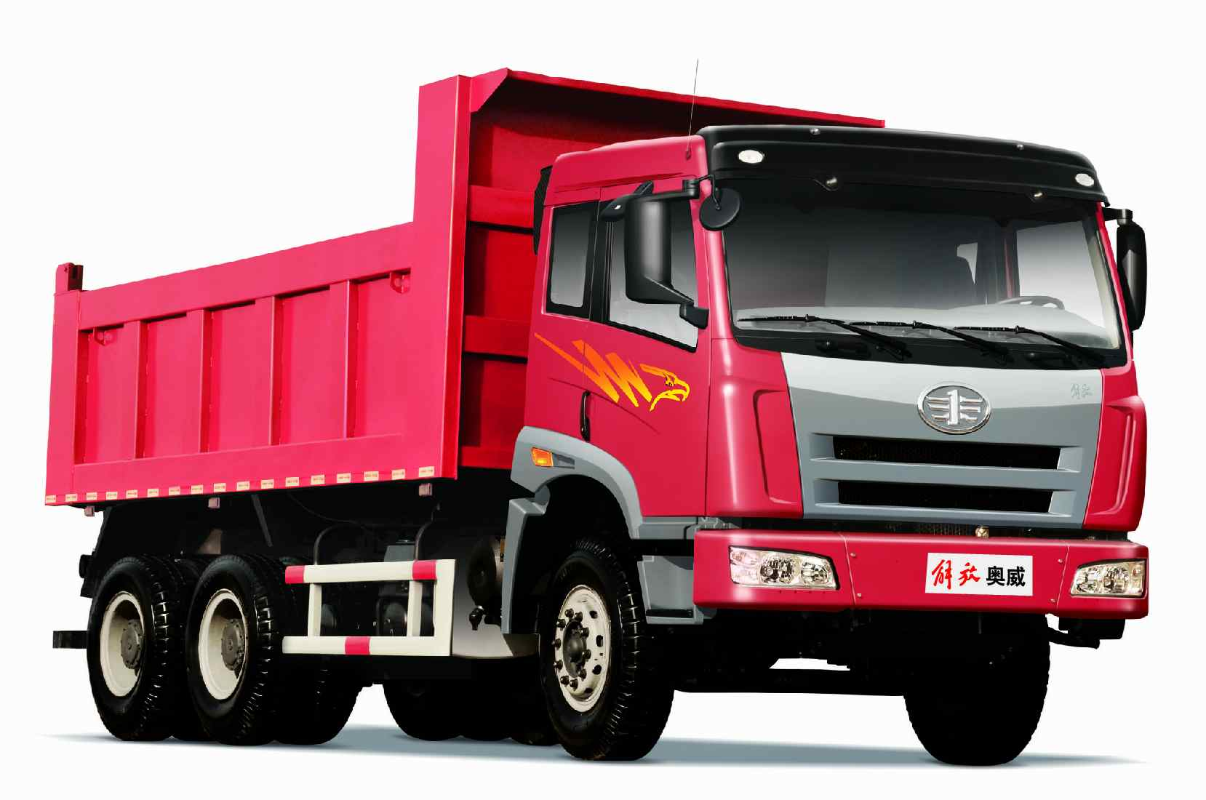
Airport
Truck = lorry

Slide 6
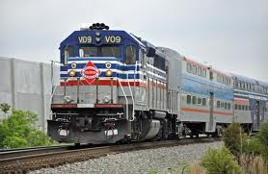
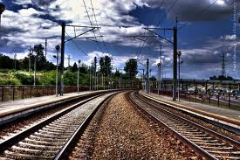
Railroad = railway

Slide 7
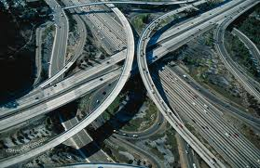
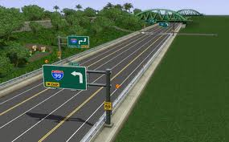
Highway = motorway

Slide 8
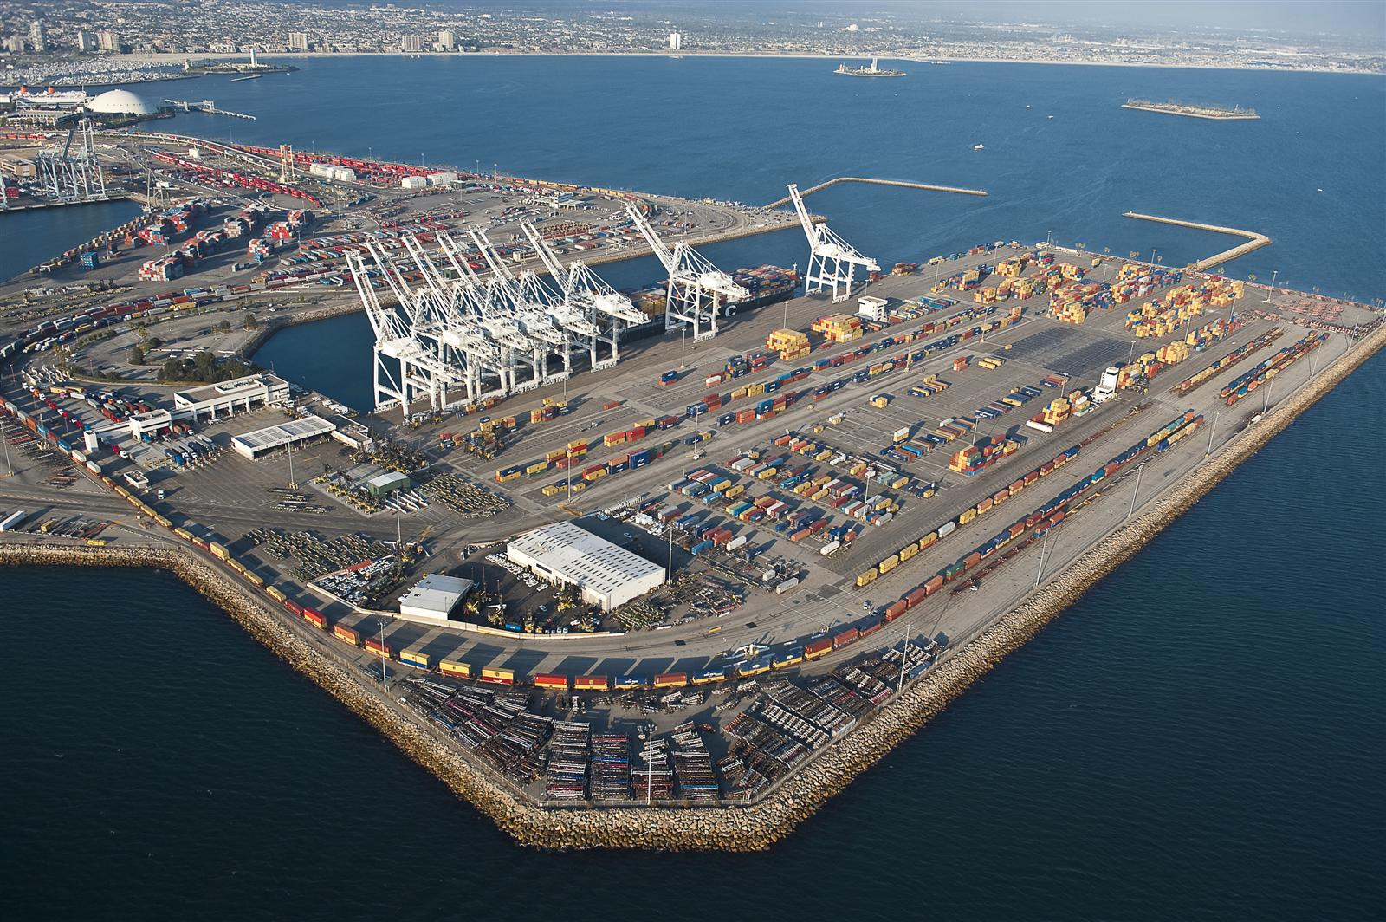
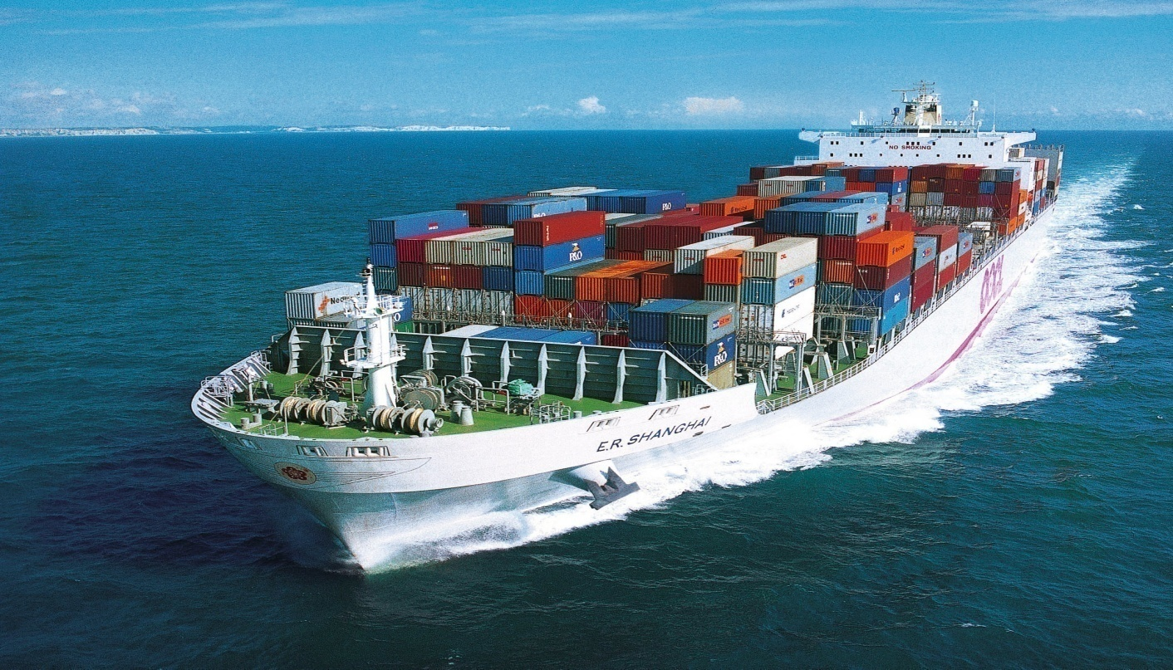
Port
Cargo ship

Slide 9
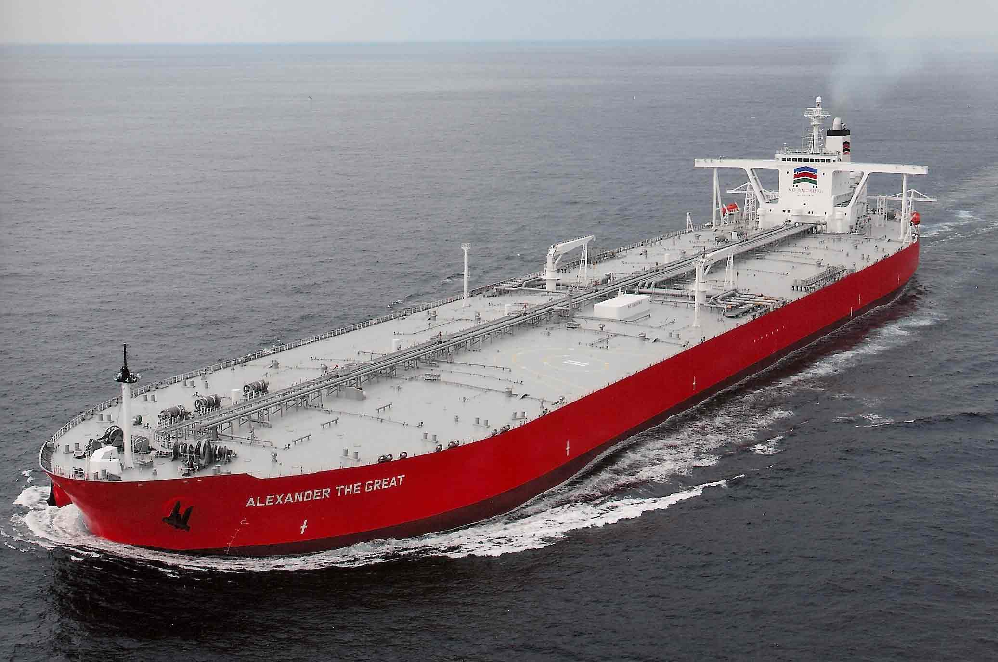
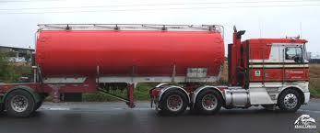
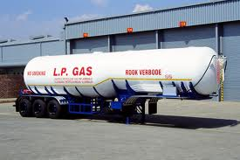
tanker

Slide 10
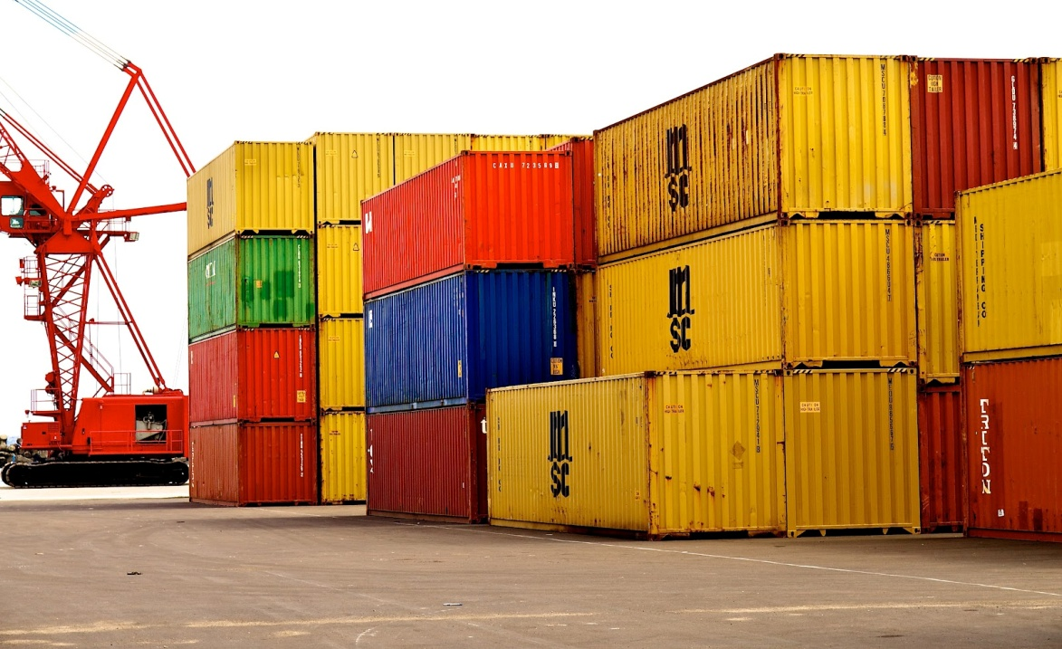
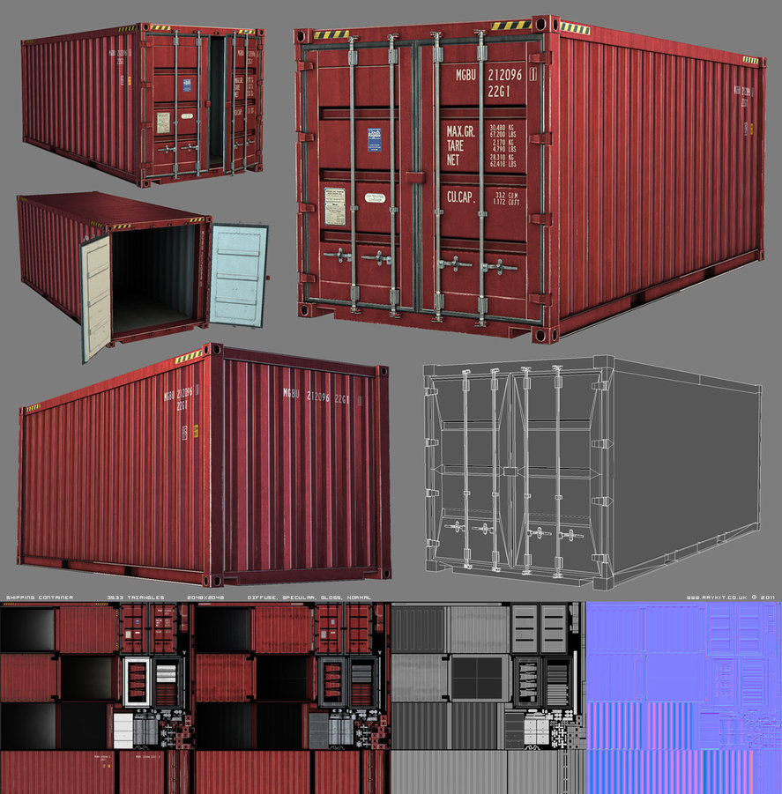
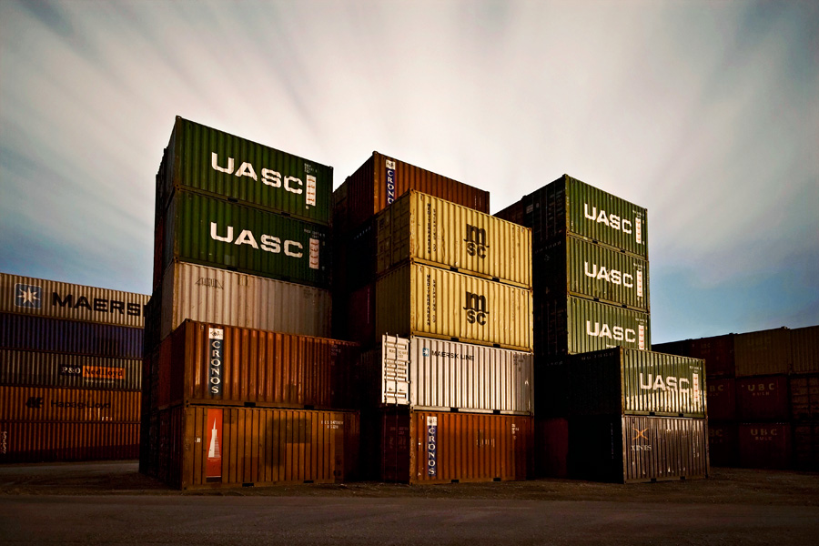
container

Slide 11
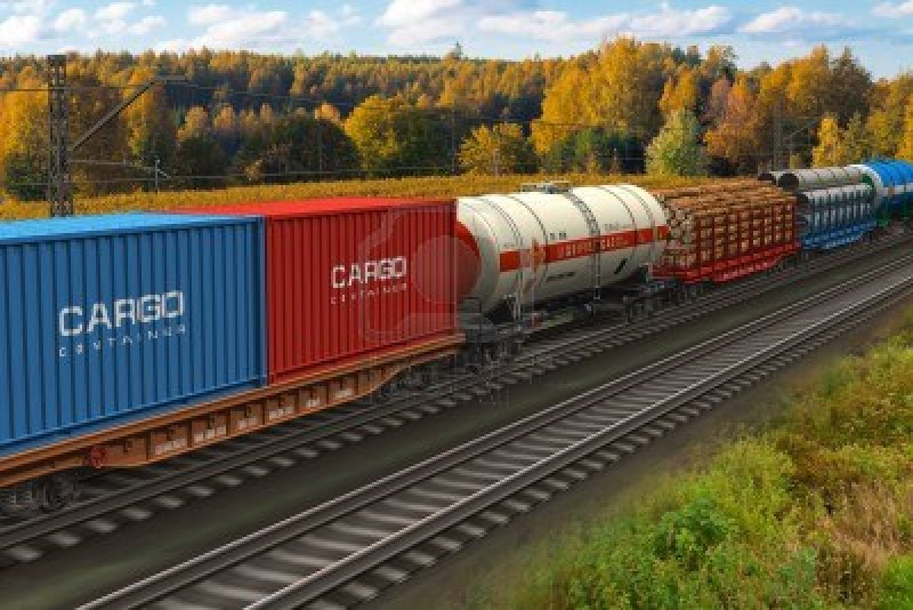
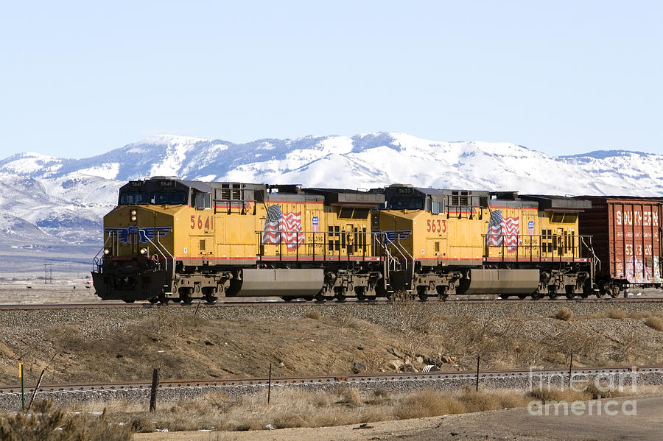
Freight train=goods
train

Slide 12
Describe facilities
+++ | +/- | ---
First class | Adequate | Terrible
Excellent | Fair | Poor
Very good | Satisfactory | Unsatisfactory

Slide 13
disadvantages | advantages | Transport
Expensive Large quantities not possible | Fast Insurance is cheap | By air
slow Ports expensive Delays common | Suitable for heavy goods or large quantities | By sea
Pollution factor | Door-to-door service | By truck
No door-to-door service | economical use of labour No pollution factor | By cargo train

Slide 14
Comparative & Superlative

Slide 15
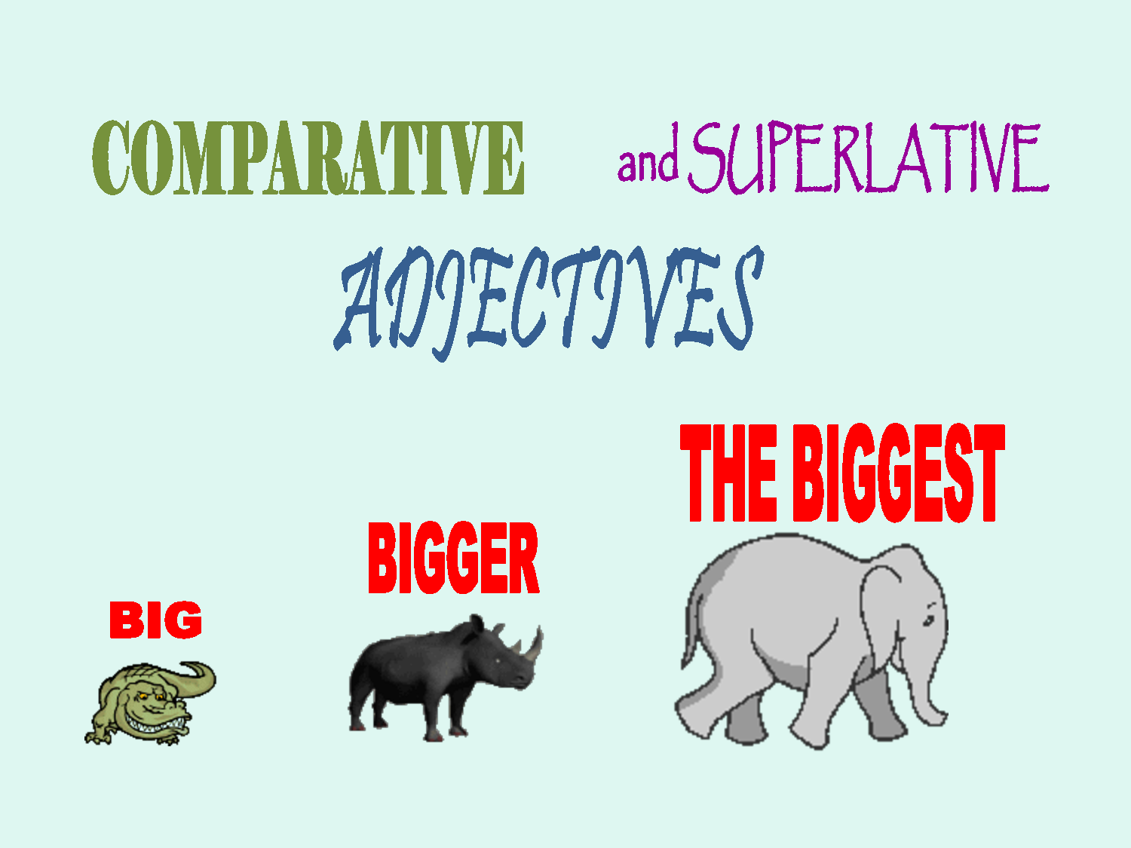
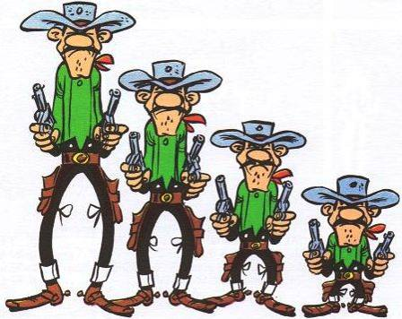

Slide 16
the comparative and superlative
one-syllable adjective by adding – er for the comparative and – est for the superlative.
One-Syllable Adjective | Comparative Form | Superlative Form
tall | taller | tallest
old | older | oldest
long | longer | longest
Mary is taller than Max.
Mary is the tallest of all the students.
Max is older than John.
Max is the oldest of all the students
My hair is longer than your hair.
Max's story is the longest story I've ever heard

Slide 17
two-syllables or more adjectives, comparative with( more ) more adj than the superlative with (most). The most adj
Two-Syllable Adjective | Comparative Form | Superlative Form
peaceful | more peaceful | most peaceful
pleasant | more pleasant | most pleasant
careful | more careful | most careful
thoughtful | more thoughtful | most thoughtful
This morning is more peaceful than yesterday morning.
Max's house in the mountains is the most peaceful in the world.
Max is more careful than Mike.
Of all the taxi drivers, Jack is the most careful.
Jill is more thoughtful than your sister.
Mary is the most thoughtful person I've ever met.

Slide 18
Irregular adjectives
Adjective | Comparative Form | Superlative Form
Good | better | best
Bad | worse | worst
Little | less | least
Many | more | most

Slide 19
…… As adjective As ………
Sara is taller than Ali .
Ali is not as tall as Sara .
Transporting goods by air is faster than by sea.
Transporting goods by sea is not as fast as by air.

Slide 20
Perishable goods: is likely to decay quickly fruits- meat -vegetables
Hazardous : dangerous , risky, nuclear
Livestock: (group of animals) sheep -cows
High value cargo : gold –silver
Fragile goods : easily broken or damaged glass
Flammable goods: burns easily oil

