Slide 1
Unit 11
statistics

Slide 2
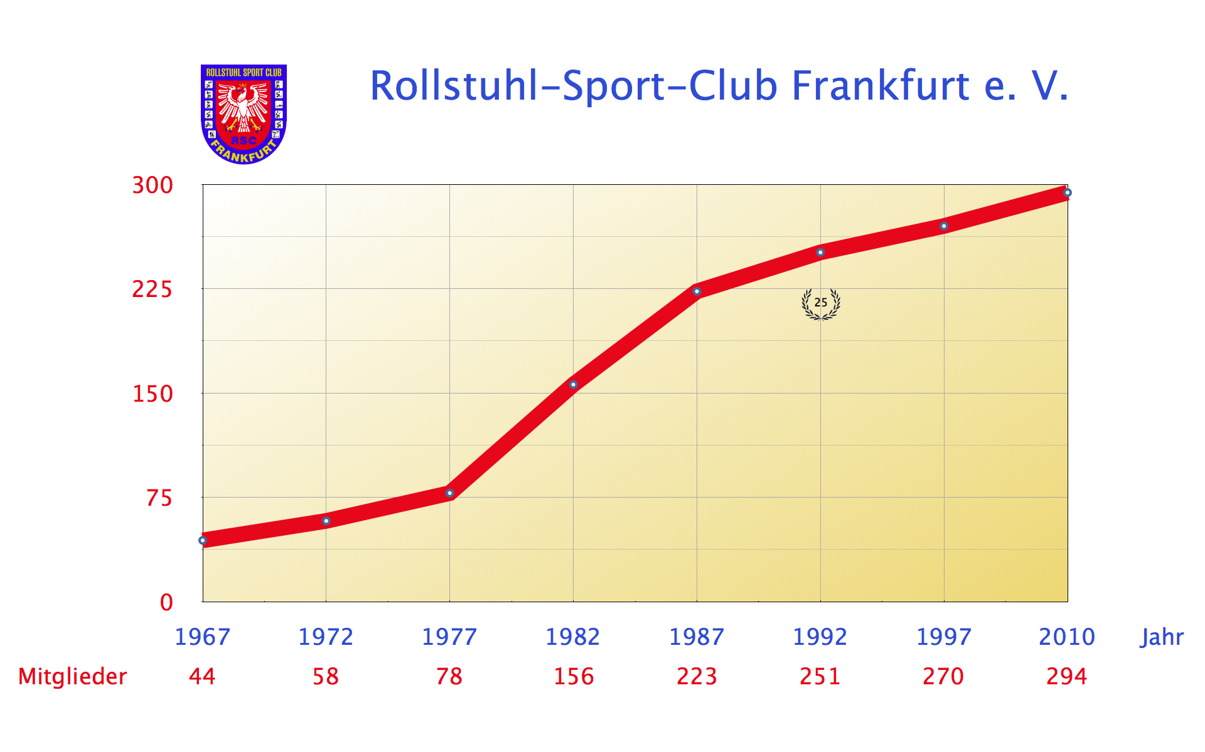

Slide 3
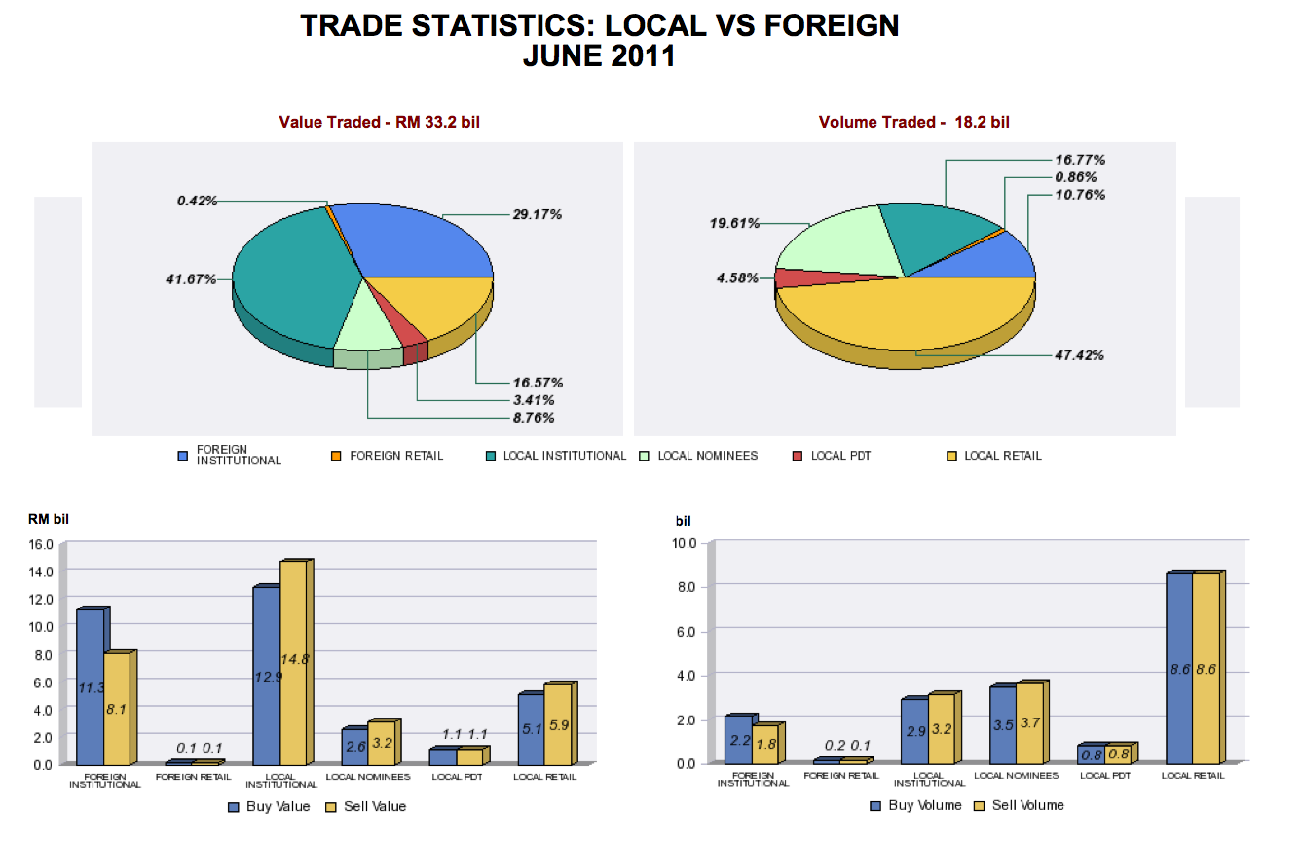

Slide 4


Slide 5



Slide 6
Adjectives
Adjectives modify the nouns
The dog is dangerous. – What is the dog like? –dangerous
A beautiful girl
Pretty lady
There was a sharp increase in sales
There was a slight decrease in sales

Slide 7
Adverbs
Adverbs are used to modify verbs, adjectives or other adverbs, e.g. The dog barks loudly. – How does the dog bark? – loudly
The baby slept peacefully
Sales increased sharply
Sales decreased slightly
It rained heavily

Slide 8
Giving Reasons:
because of
I was late due to the bad weather
as a result of

