Slide 1
Data grid view
objective of lecture:-
After completing this lecture , you will be able to:
Create a data grid view object on a windows form
and use it to display a database table.
what is a Data grid view tasks
Remove a column from a data gird view Object

Slide 2
Using DataGridView to display Database Records
The datagirdview controls presents information by establishing a gird of rows and columns on a form to display data as you might see it in a program such as Microsoft office Excel or access
DataGridView control can be used to display any type of tabular data : text, numbers, dates or the contents of any array

Slide 3
Data grid view
Establish a connection to adatabase table
1-Start visual, and create a new visual basic widows forms Application project named My datagrid View Sample
2- Click the add ---- New data source command on the data menu
3-Click the Database icon , and the click next
The wizard prompts you to build a connection string , but if you completed the exercises in chapter 18, the Student database is automatically offered to you as shown in the screen

Slide 4
Data grid view
Establish a connection to adatabase table
4- with the student .mdb connection string highlighted. Click next
5- click next to save string in the default location
6- expand the tables node to see the name of seven tables in the database and an additional entry called swichboard items

Slide 5
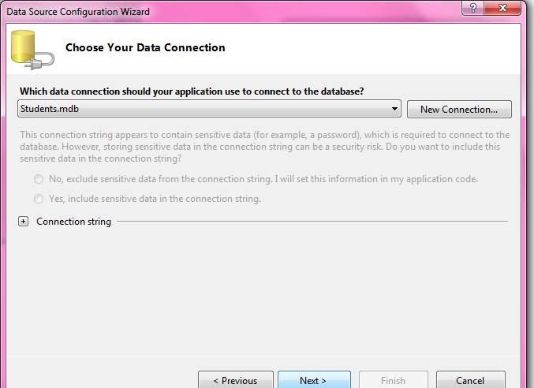
Data gridview controls

Slide 6
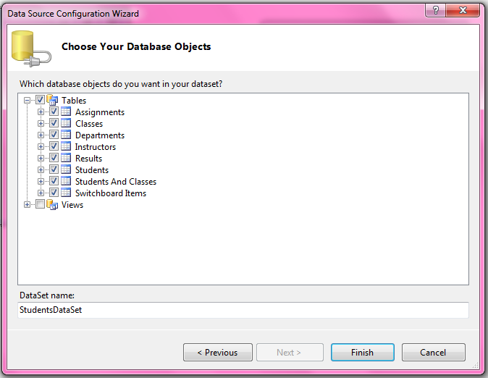
Data grid view
Establish a connection to adatabase table
7- click the check mark next to the tables node to select all eight items

Slide 7
Data gridview controls
8- click finish to close the data source configuration wizard
9- click the save all a button on the standard toolbars to save the project
10- click the show data sources command on the data menu

Slide 8
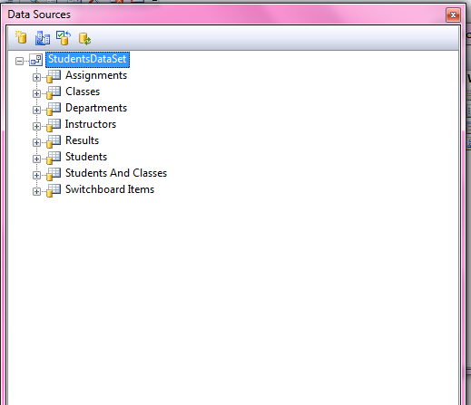
Data grid view
The data source widow displays the objects in studentsDataSet , as shown in the illustration

Slide 9
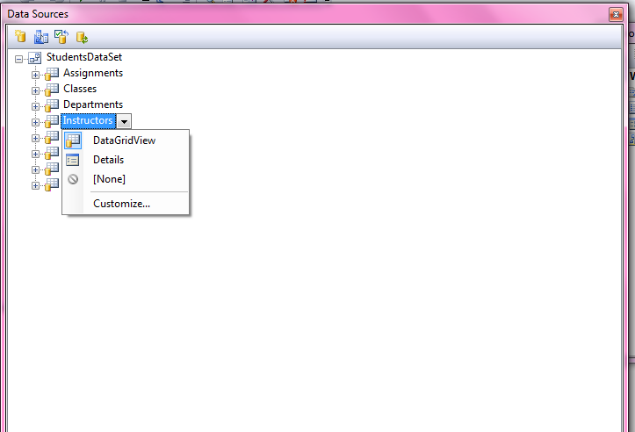
Create a data gird view object
1- Re size the form so that it covers most of screen
2- In the data sources window, click the Instruction table , and then click the arrow to its right to display the list of controls that can be bound to the instructors table on the form
The Data sources window looks like this

Slide 10
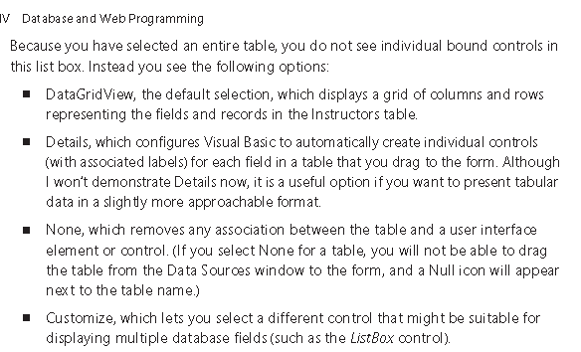
انشاء شبكية بيانات

Slide 11
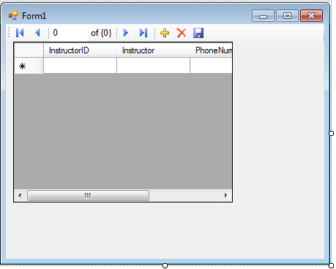
Create a data gird view object

Slide 12
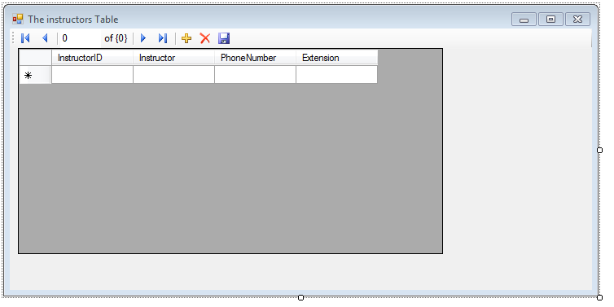
Create a data gird view object
5- use the properties window to set the form’s Text property to “the instructor table”

Slide 13
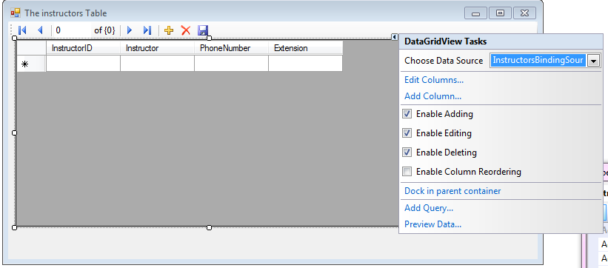
Data Gird view tasks
instructorsBinding source, an intermediary component that act as a conduit between instructors table and bound objects on the form

Slide 14
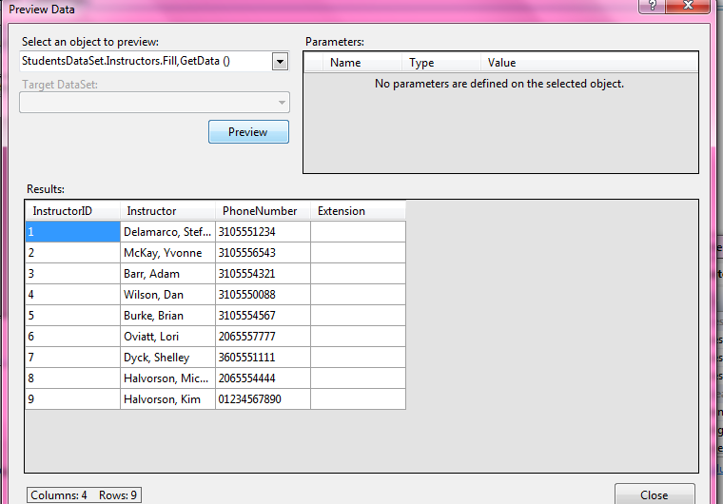
Preview the data bound to a data gird view objects

Slide 15

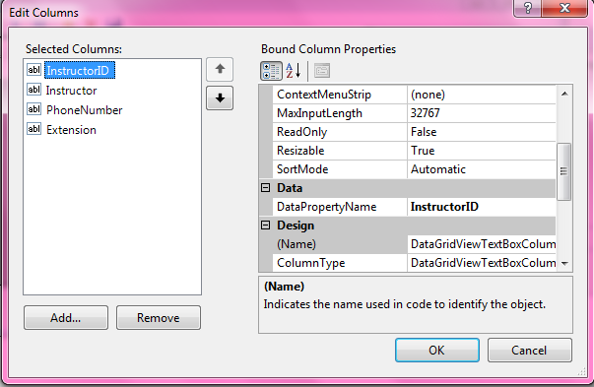

ازالة عمود من شبكية بيانات

Slide 16
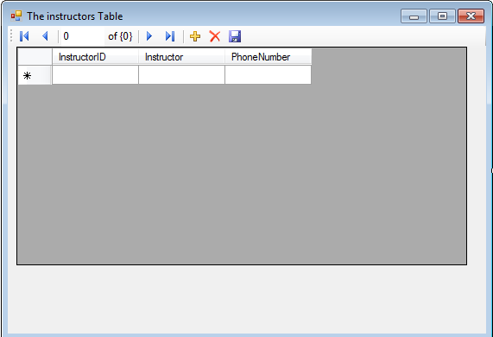
Remove a column from a data gird view Object

Slide 17
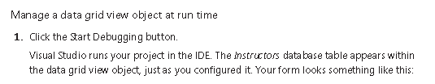
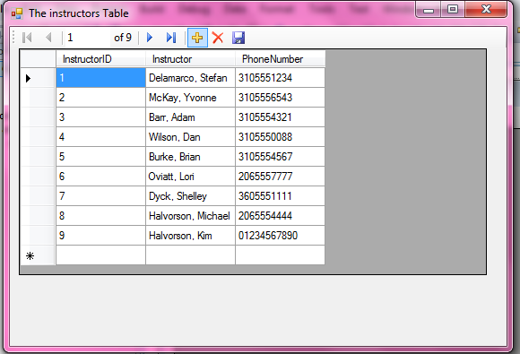
Manage a data gird view object at run time

Slide 18
Manage a data gird view object at run time
Me.InstructorsTableAdapter.Fill(Me.StudentsDataSet.Instructors)
This line was added to your program by visual studio when you dragged the instructors table to the form from the data sources window.
You can resize columns at run time because the data gird view object’s Allow user To Resize columns property is by default set to true
If you want to prevent resizing , you can set this property to false.

Slide 19
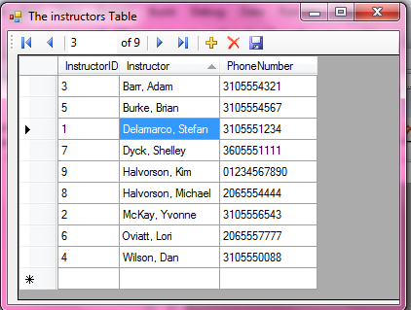
Manage a data grid view object at run time
                The arrow identifies the current sort key
                ( the instructor column ) and indicates
                an ascending order (A-Z)
                The instructors table sorted
                alphabetically by instructor name

