Slide 1
A and AN
We use A/AN (articles) with singular countable nouns.
I have a cup of coffee for breakfast !
There is an accident on the corner

Slide 2
A is used when the next word starts with a consonant sound.
A book
A guitar
A friend
A university (The start of the word university sounds like YOU, a consonant sound).

Slide 3
AN is used when the next word starts with a vowel sound.
An apple
An ice-cream
An orange
An hour (the letter H in this word is silent so it sounds like it starts with a vowel).

Slide 4
a unit
This u sounds like a consonant, so we use a.
an uncle
This u sounds like a vowel, so we use an.

Slide 5
We use SOME with plural nouns and uncountable nouns.
Some is generally used in positive sentences.
I have some information for you about flights to Paris.
(Positive - Uncountable)
We met some friends for drinks after work yesterday.
(Positive - Plural Countable)
I think he will have some time to speak to you today.
(Positive - Uncountable)

Slide 6
Questions with Some
SOME is used in the following circumstances:
1. When we are offering something.
Would you like some coffee?
Do you want some sugar for your coffee?
2. When we are asking for something.
Could I have some salt, please?
Can I have some fries with that?
3. When we are suggesting something.
Why don't we rent some movies to watch tonight?
Why don't you give her some advice?

Slide 7
Quiz
http://www.english-4u.de/a_an_some_ex1.htm

Slide 8
Would like/ like

Slide 9
Use:
1) Would like means want, but it is more polite.
You can use it in sentences and questions.
I’d like a biscuit.
Would you like some tea?
2) You can also use it to talk about your dreams and ambitions.
I’d like to go to Japan.
I wouldn’t like to live here!

Slide 10
Form:
1) Would like is the same for all persons.
I would like some tea.
You would like some tea.
He / she / James would like some tea.
We would like some tea.
They / our clients would like some tea.

Slide 11
2) To make questions, invert the subject and would.
Would you / James / your clients like some tea?
3) Use wouldn’t to make the negative form.
I wouldn’t like to work there.

Slide 12
4) Would like can be followed by a noun or to + verb.
noun: Would you like a biscuit?
verb: Would you like to go to Malaysia?
5) In positive sentences, you can contract would to ‘d.
I would like to go to the USA. => I’d like to go to the USA.
But NOT in negative sentences:
I’dn’t like to work in a factory. => I wouldn’t like to work in a factory.
And NOT in short answers:
Would you like to have a horse?
Yes, I’d. => Yes, I would.

Slide 13
Would you like ….?
Count Nouns
an apple? some apples?
a banana? some bananas?
an egg? some eggs?
a biscuit? some biscuits?

Slide 14
Would you like…….?
‘a’ ‘an’ some
sandwich sandwiches
apple apples
potato potatoes
orange oranges

Slide 15
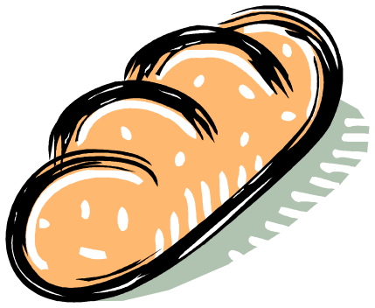

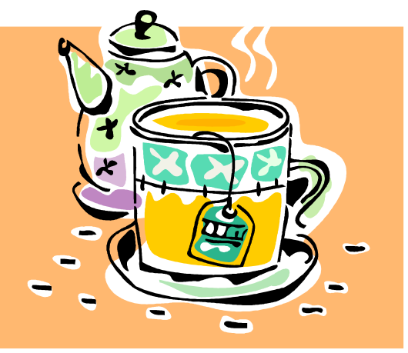
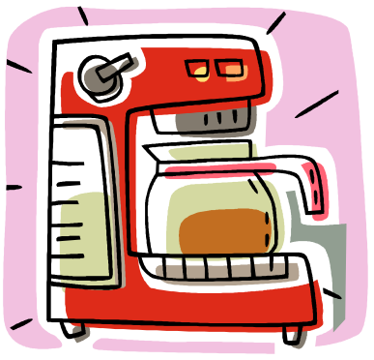
Would you like …..?
some bread
some rice
some coffee
some tea

Slide 16
Would you like….?
Non count nouns
any
milk?
cheese?
bread?

Slide 17
Use ‘some’
Use ‘any’
Positive
More than one count nouns.
Non count nouns
Negative and question
Count Nouns (more than one)
Non count nouns

Slide 18
COUNT and NON COUNT NOUNS
Positive +
I have ___ orange.
I have _____ oranges.
I have _____ milk.
Question ?
Do you have ___ orange?
Do you have ____ oranges?
Do you have ____ milk?
Negative -
I don’t have __ orange.
I don’t have ___ oranges.
I don’t have ___ milk.
an
some
some
any
any
any
any
any
any

Slide 19
Like
Use like to talk about things you like all the time.
I like chocolate cake. It’s my favorite food.
Use would like to talk about things you want now, or at some time in the future.
I’d like a cup of coffee please.
I’d like to work in a chocolate factory.
http://www.tolearnenglish.com/cgi2/myexam/voir2r.php?id=48729

