Slide 1

English Language
Reading
Instructor:
Ammar Sultan Al-Ma’ani
King Faisal University
e- Learning Deanship
& Distance Education
1

Slide 2
9th Lecture

Slide 3
Elements of the lecture
Skimming for the topic and main idea
Vocabulary Previewing
Reading Passage

Slide 4
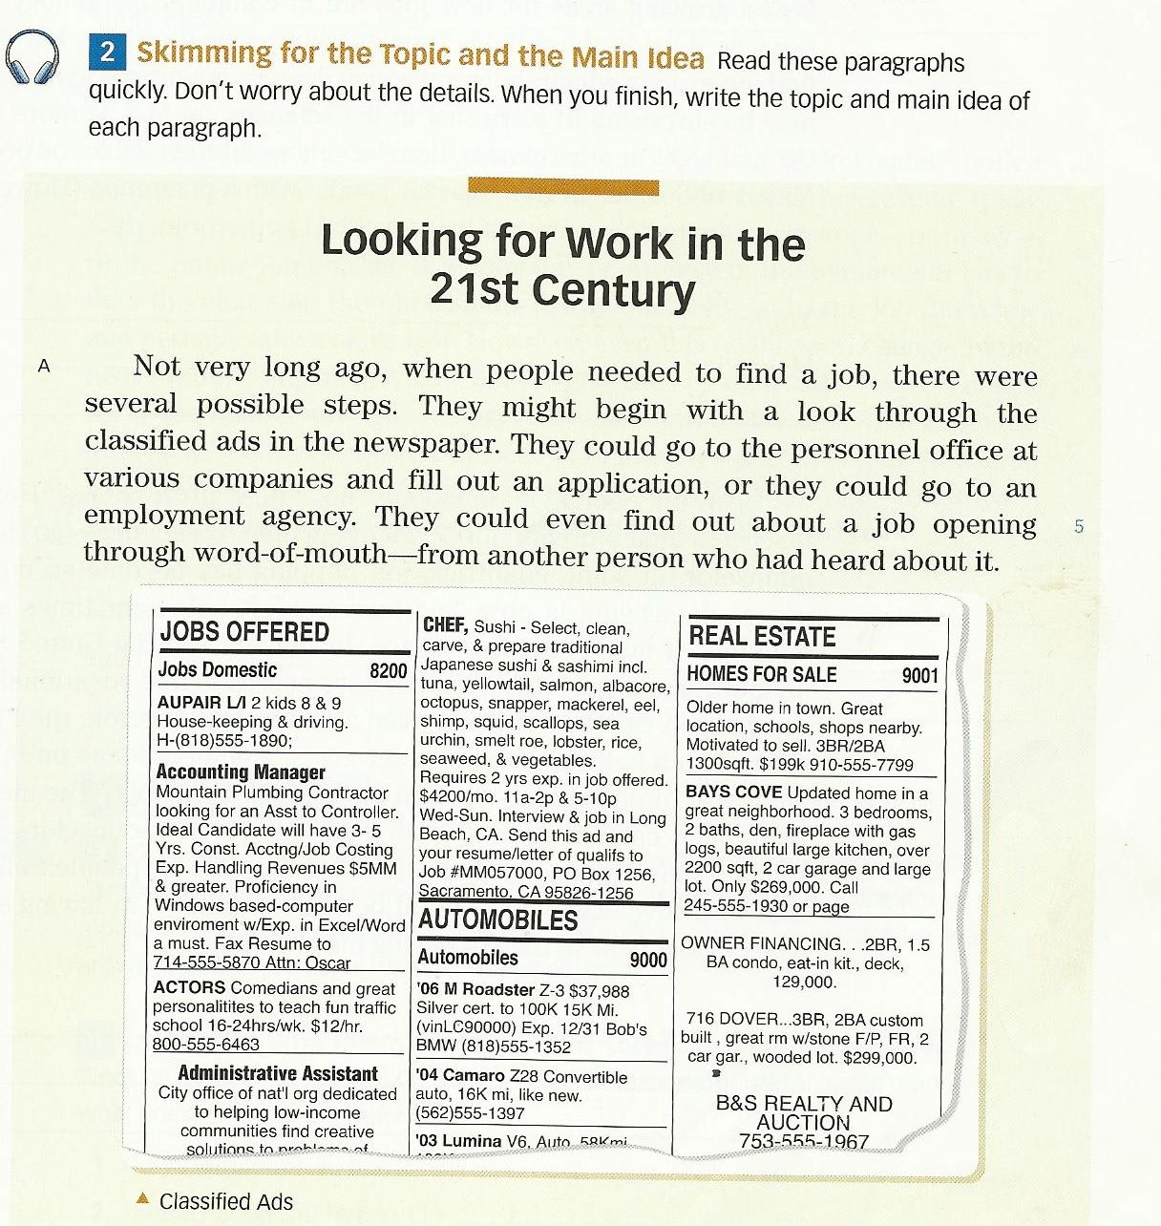
A. Topic: Steps of finding a job.
Main Topic: There were several
possible steps to find jobs
Not very long ago.
They (Paragraph A, Line 2)________________

Slide 5
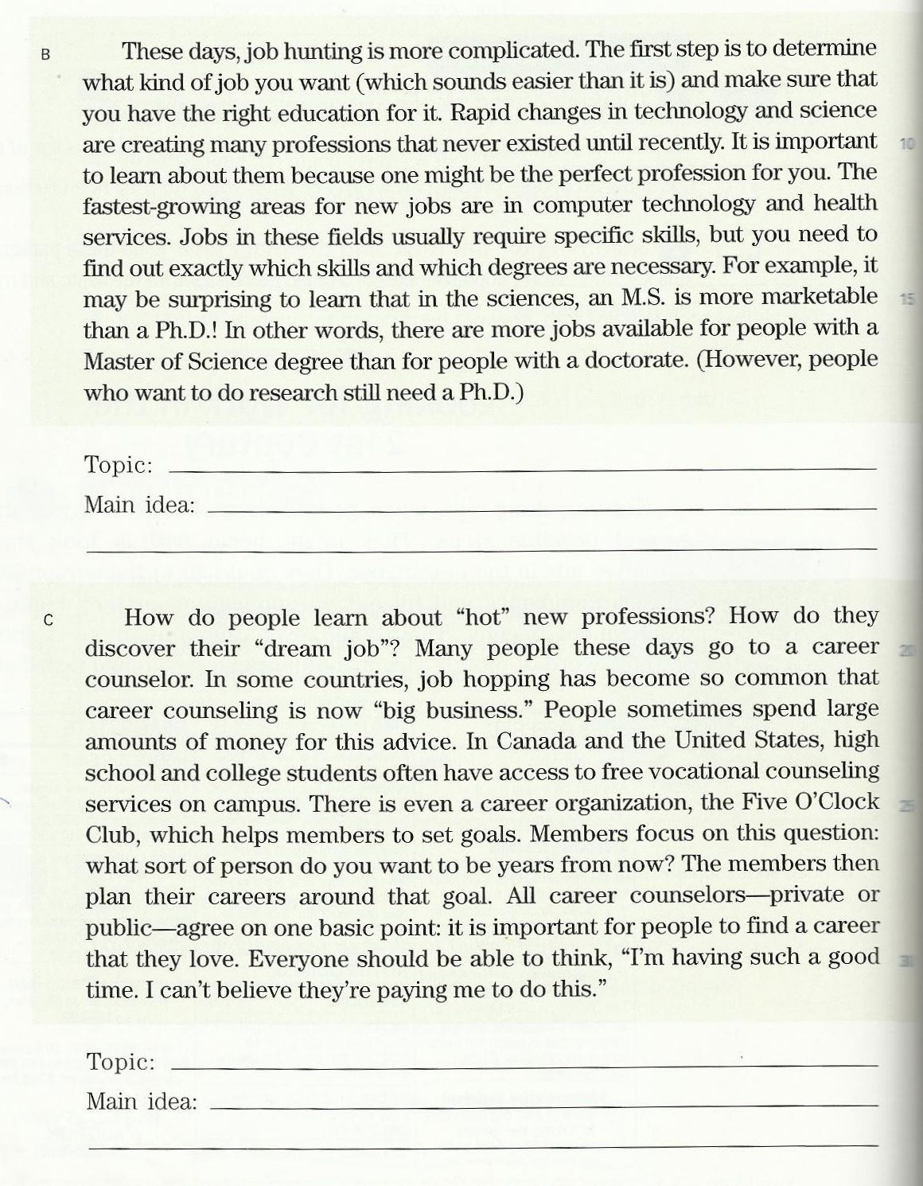
B. Topic: Job Hunting Steps nowadays
Main Idea: Job hunting has become
more complicated
these days
Them (Paragraph B, Line 11)_________________
C. Topic: Career Counseling
Main idea:
Job hopping has become so common that career counseling is now big business
It (Paragraph D, Line 33)___________

Slide 6
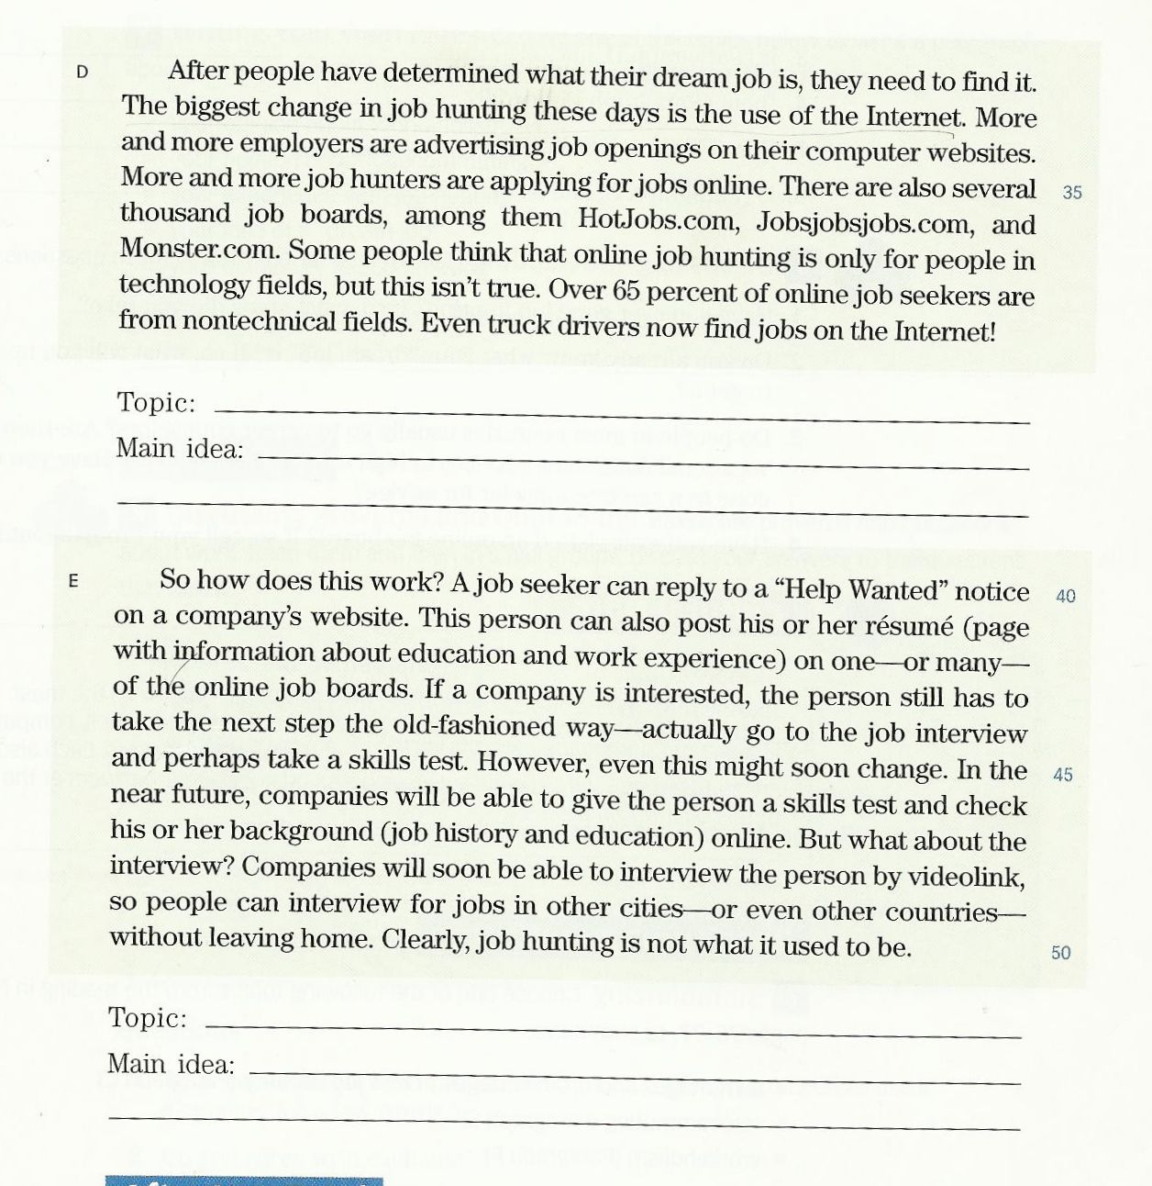
D. Topic:
Internet and Job Hunting
Main Idea:
More and more job hunters are applying
for jobs online.
It (Paragraph D, Line 33)__________
E. Topic:
Online Job Hunting Steps
Main Idea:
Job hunting nowadays is not
what it used to be
Them (Paragraph D, Line 36)_______

Slide 7
Vocabulary Previewing ( pages 123 / 131 / 135 )
meanings | New words | No.
A place by sea for ships and boats | harbor N | 1
A space between two things / a difference | gap N | 2
Very useful food | nutrients N | 3
hindrances | obstacles N | 4
advantages | benefits N | 5
places | Areas N | 6
An inspector who looks for criminals | detective N | 7
search | Look for V | 8
Make less | reduce V | 9
Need or want | require V | 10
surprise | astonish V | 11

Slide 8
Vocabulary Previewing ( pages 121 / 133 / 135 )
Meanings | New words | No.
Make happy | Excite V | 12
to rest | Relax V | 13
Concern / benefit | interest N | 14
Stand against | Challenge V | 15
Horrify / terrify / make others feel afraid | Frighten V | 16
Stop or prevent | Hold back PV | 17
Away from others/ nobody with him/ her | Alone Adj | 18

Slide 9
Questions
1.The word “_____________” is closest in meaning to the word “ surprise “.
a. terrify b. challenge
c. laugh d. astonish
2. If you go to the______________ you will many boats and ships.
a. harbor b. office
c. hospital d. restaurant
3. The word “need” is closest in meaning to the word____________________
a. question b. visit
c. require d. invest
4. The phrase “ a space/ distance between two things or persons” is a__________
a. building b. street
c. wall d. gap

Slide 10
Questions
5.The word “_____________” is closest in meaning to the phrase “ make less “.
a. reduce b. widen
c. require d. worsen
6. most people prefer to ______________ by the sea coast.
a. relax b. test
c. work d. type
7. The word “hindrances” is closest in meaning to the word_______________
a. questions b. obstacles
c. facilities d. stories
8. The phrase “ an inspector who looks for criminals” is called a/n __________
a. detective b. astronaut
c. teacher d. servant

Slide 11
Read the Following Passage . P130

Slide 12
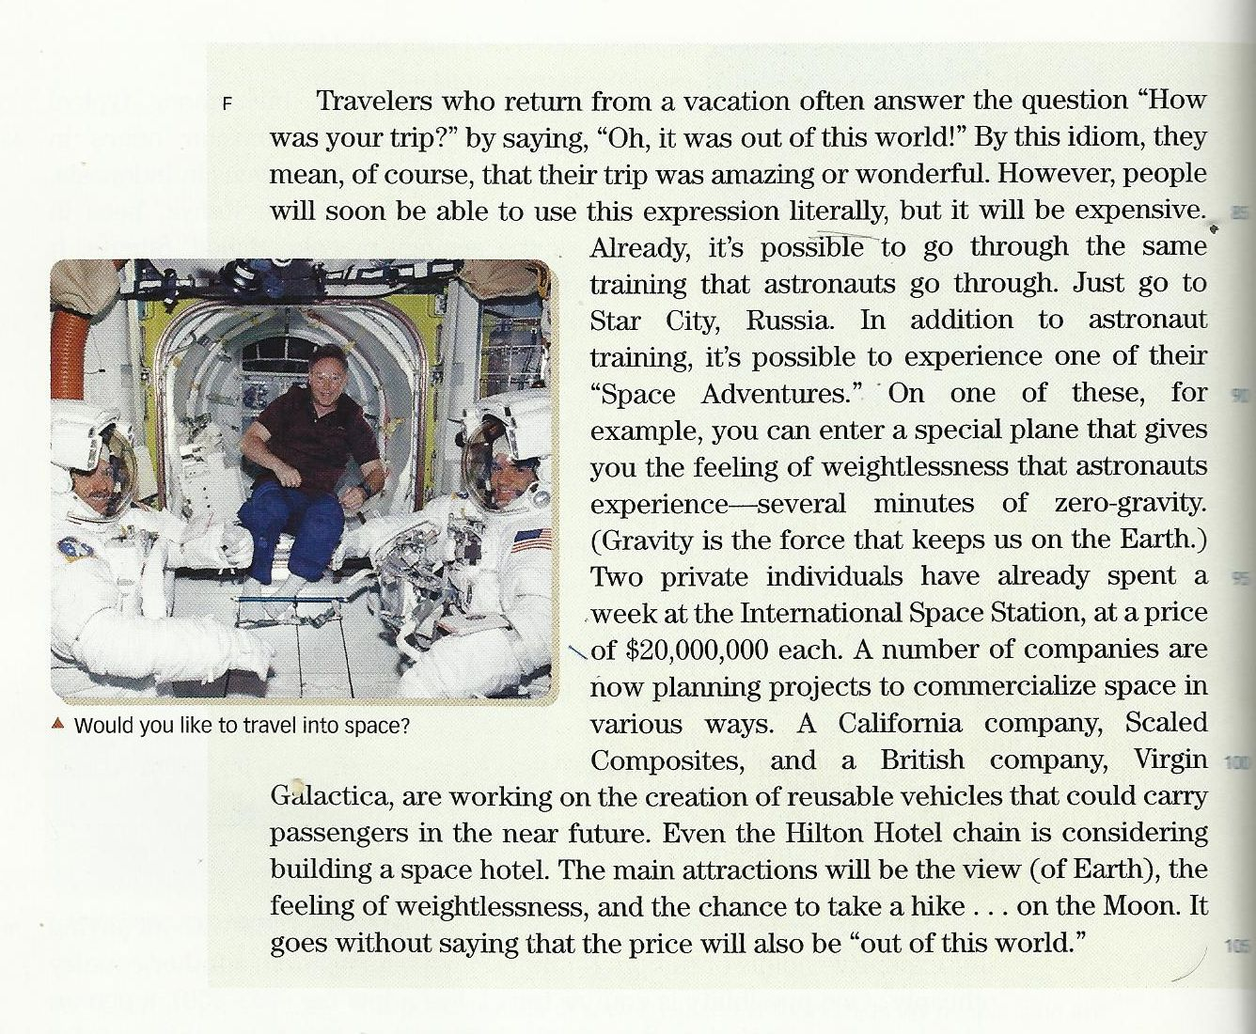

Slide 13
Questions
Choose the most appropriate answer:
1. What do the travelers who come from a vacation say about their trip?
a. We were sick? b. It was a long trip
c. Oh, it was out of the world d. Oh, Nice trip
2. The underlined pronoun “ it” line 2 refers to___________________ .
a. the answer b. the question
c. the trip d. this world
3. which of the following is closest in meaning to special ? ______________
a. strong b. enjoyable
c. public d. private
4. literally means: _______________:
a. word by word b. stay alive
c. unreal d. wonderful
5. How long does it take to give you the feeling of weightlessness?
a. Two weeks b. Three minutes
c. One hour d. Several minutes

Slide 14
Questions
6. The underlined pronoun “ their” line 3 refers to___________________ .
a. amazing trips b. people
c. travelers d. the vacations
7. It is clear that a trip to space is ______________
a. expensive b. tiring
c. public d. dangerous
8. How much did the two individuals who stayed a week at I S S pay?
a. $20,000,000 b. $40,000,000
c. it was free d. $10,000,000
9. The most appropriate TOPIC of the reading passage is____________________
a. California Company b. Travelling Into Space
c. Amazing Expression D. Galactica
10. The MAIN IDEA of the passage is_____________________________________
a. A trip to the sea is wonderful b. It is very cheap to go to space
c. Space travelling is now possible d. No one like to travel into space

Slide 15

بحمد الله

