Slide 1

English Language
Reading
Instructor:
Ammar Sultan Al-Ma’ani
King Faisal University
e- Learning Deanship
& Distance Education
1

Slide 2
5th Class
Getting Meaning From Context

Slide 3
Elements of the Lecture
Getting Meaning from Context

Slide 4
Getting Meaning from Context
Definition
A definition gives the meaning of words. The writer may use words, phrases, or statements to define something. The writer will use key words, or signal words to identify a definition so you need to look for them. See examples of key words below.
Key words is/are means/mean
is/are called what this means is
is/are known as consist of
is/are defined as refer to
is/are described as may be seen as
e.g.
Someone who explores and studies caves is known as a spelunker.
an unfamiliar word = spelunker
signal words = is known as
definition = someone who explores and studies caves

Slide 5
Exercise 1 Use signal words as your clues to find the meaning of the underlined words. Circle signal words and write their meaning in the space provided. 1. The encyclopedia defines astrology as “the ancient art or science of divining the fate and future of human beings from indications given by the positions of stars and other heavenly bodies.” astrology means______________________________________ 2. Sales literature means printed matters that contain information on the goods. Sales literature means_________________________________ 3. The part at the back of the car used for holding luggage is called the car boot in United Kingdom, whereas Americans would refer to this as the car’s trunk. car boot means______________________________________

Slide 6
2. Restatement
The writer may use other words, phrases, or sentences to provide the meaning of difficult words. We call this restatement; the writer describes it again or in a different way. Signal words for restatement are in the “Key words box” below.
e.g.
The surface of Africa consists mainly of plateaus, or large flat areas, although these occur at different levels.
an unfamiliar word = plateaus
signal word = or
meaning = large flat areas
or
that is to say
in other words
i.e. or that is

Slide 7
Exercise 2 Use signal words as your clues to find the meaning of the underlined words. Circle signal words and write the meaning in the space provided. 1. According to Indian custom, a great dowry of money and objects is given to the bridegroom, in other words, it is a dot. dot = ______________________________________ 2. There are several types of aerosol cans. Simple ones contain a liquefied gas, called the propellant, in which material is dissolved, i.e., melt. dissolved =__________________________________ 3. Our youth nowadays should not engage in intoxicating things such as alcohol, cigarettes, and tranquilizers, that is to say, they should not ingest them. engage =___________________________________

Slide 8
3. Punctuation marks
Punctuation is used to describe the meaning of unfamiliar words. The writer will write unfamiliar words and then use punctuation, words, phrases, or sentences to explain the meaning of the new words. Such punctuation is in the “Key words box” below.
e.g. Full-color pictures are printed using only black and three colors: yellow, cyan (a light blue) and magenta (a light purple).
an unfamiliar word = cyan and magenta
signal punctuation = ( )
meaning : cyan = a light blue and magenta = a light purple
The use of computers to handle text, or word processing, was foreseen in the 1950s.
an unfamiliar word = handle text
signal punctuation = , ,
meaning : handle text = word processing
, commas
, , appositive
( ) parentheses
? ? dashes
; semicolon
: colon

Slide 9
Exercise 4 Use signal words as your clues to find the meaning of the underlined words. Circle signal words and write the meaning in the space provided. 1. Both facsimile (known as fax) and electronic mail (email) are ways of sending documents. Facsimile =______________________________________ Electronic mail =__________________________________ 2. An FM radio DJ (disk jockey) broadcasts over the airwaves. DJ =___________________________________________ 3. Infection ? becoming ill through contact with bacteria ? of the respiratory system such as the nose, the throat, and the chest is among the most common of all diseases. Infection =______________________________________

Slide 10
4. Examples
help us to understand the meaning of new words. See key words or signal words used for
showing examples in the “Key words box”.
e.g.Use navigation buttons, such as, the “Next” button, the “Previous” button, the “Menu” button, and the “Exit” button, to go back and forth or jump to other topics while you are using your English software.
unfamiliar words = navigation buttons
signal word = such as
meaning = buttons on computer program that are used for turn on pages
such as
like
for example, …
for instance
is / are

Slide 11
Exercise 5 Use signal words as your clues to find the meaning of the underlined words by choosing the best answer for each question. Circle signal words. 1. Some people in the North of Thailand do wickerwork, for example, they make elephants, turtles, plates, beds, and chairs, from teak trees for earning money.
a) silver handicraft b) bronze handicraft c) niello handicraft d) wood handicraft 2. The Savanna grasslands are the home of grazing animals such as elephants, giraffes, antelopes and zebras. Lions, leopards and hyenas also live there.
a) non-backbone animals b) meat-eating animals c) invertebrate animals d) grass-eating animals 3. A tourist guide advised them to see the elephant round up. There was racing, colorful war procession, marching, kicking a ball and tug-of-war between men and elephants.
a) show | b) breed
c) sleep | d) born

Slide 12
5. Contrast
You can guess the meaning of new words by using signal words of contrast. They will show the opposite meaning of the new words. See key words or signal words of contrast in the “Key words box”.
Key words
but instead of even though in contrast to
yet in spite of although as opposed to
unlike despite however on the other hand
whereas fond of still provided that
e.g.
Althrough Dara and Vipa are very close friends but they are very different. Suda spends a lot of money to buy things while Vipa loves to economize.
a) spend more money | b) save money
c) buy things more than before | d) keep things in a safe place

Slide 13
Exercise 6 Use signal words as your clues to find the meaning of the underlined words by choosing the best answer for each question. Circle signal words. 1. Ladda was promoted to be the chief secretary of the manager of the company, whereas her colleague, Somechai, was penalized. a) promoted b) punished c) exiled d) Rewarded 2. Although small pox has almost been eradicated. Malaria is prevalent in Kanchanaburee, Thailand. A policeman just died from the PF (Plasmodium Falsiparum) malaria last month. a) destroyed completely b) common found c) fear of disease d) Furbish 3. The plane is scheduled to leave for Phuket at 7:00 am but the plane departure has been postponed for two hours. That is to say, it will leave at 9:00 am instead. a) retard b) stop c) extend d) went back

Slide 14
6. Similarity
You can guess the meaning of new words by using signal words of similarity. They will display the same meaning of the new words. See key words or signal words of similarity in the “Key words box”.
Key words
like similarly in the same way
as the same as just as
e.g.
Indonesia is producing Ford cars and trucks. Soon, Thailand and Vietnam will be
producing the same products with, no doubt, the same quality.
What does the words “the same products” mean? ___________________________
What is your clue? ___________________________________________________

Slide 15
Exercise 7 Use signal words as your clue to find the meaning of the underlined words. Circle signal words and write the meaning in the space provided. Learning should not be limited to the classroom or with teachers. We can learn by ourselves about things that are not taught by teachers. Similarly, “self-learning” is encouraged for our education system. What does the words “self-learning” mean? ------------------------- 2. Thailand and South Korea have made a break-through in developing a new technology that enables high-speed Internet connections, just as phone service links are made efficiently through electric power lines. Both countries have joined hands to do business. What do the words “high-speed Internet connections” mean?

Slide 16
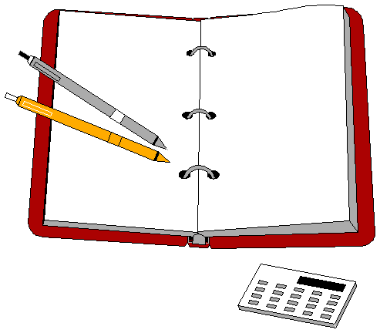
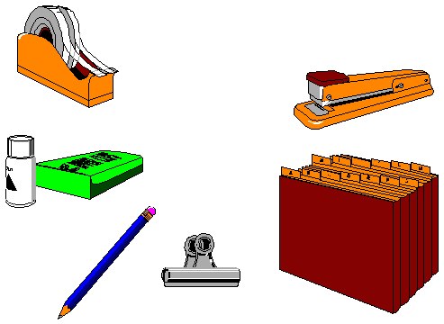
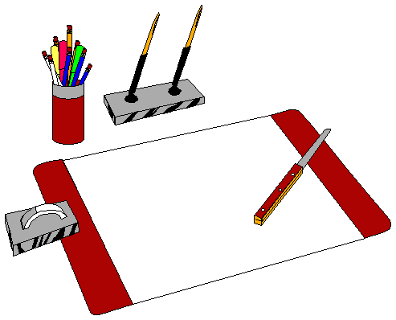
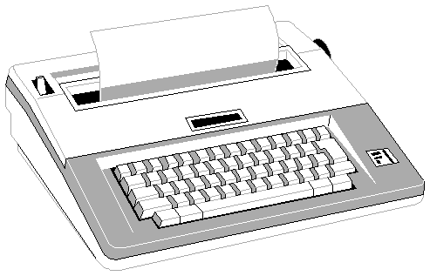
7. Pictures
“A picture is worth more than a thousand words” (an old Chinese saying) so a picture can help you to guess the meaning of a new word. Look at the pictures below and choose the best answer to explain the pictures.
Which is the best description for the above picture?
For Sale
Equipment used in an office
c) Instruments for you

Slide 17
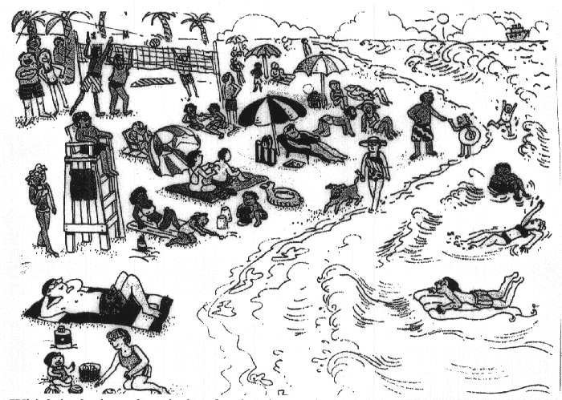
Which is the best description for the above picture?
a) Holiday on beach
b) Beautiful beach
c) Activity of people

Slide 18

بحمد الله

