Slide 1

English Language
Reading
Instructor:
Ammar Sultan Al-Ma’ani
King Faisal University
e- Learning Deanship
& Distance Education
1

Slide 2
Second Class
Chapter 2

Slide 3
Elements of the Lecture
Reading Strategies:
Getting Meaning from Context
Identifying the main idea
Identifying Supporting Details
Skimming for the Topic and Main Idea
Understanding Italics
Understanding Contrast
Understanding Scanning

Slide 4
Getting Meaning From Context
Here are another three ways that will help you to guess new words:
The words for example, for instance, such as, and among them:
Example: Almost four billion people will be living in cities in developing countries such as India and Nigeria.
Meaning: Developing Countries : not rich country

Slide 5
Getting Meaning Form Context
2. Sometimes another word or words in another sentence or sentence part has the opposite meaning from a new vocabulary item:
Example: In some cities, instead of worsening, urban life is getting much better.
Worsening = much better

Slide 6
Getting Meaning Form Context
3. A definition or explanation follows the connecting words that is or in other words:
Example: The downtown shopping area is now a pedestrian zone-in other words, an area for walkers only, no cars.
A pedestrian zone is an area for walkers only.

Slide 7
Let’s Do it Together
People spend hours in gridlock –that is, traffic so horrible that it simply doesn’t move – when thet commute.
Gridlock = _______

Slide 8
Another Example
Under his leadership, city planners established priorities – in other words, a list of what was most important.
Priorities = __________________

Slide 9
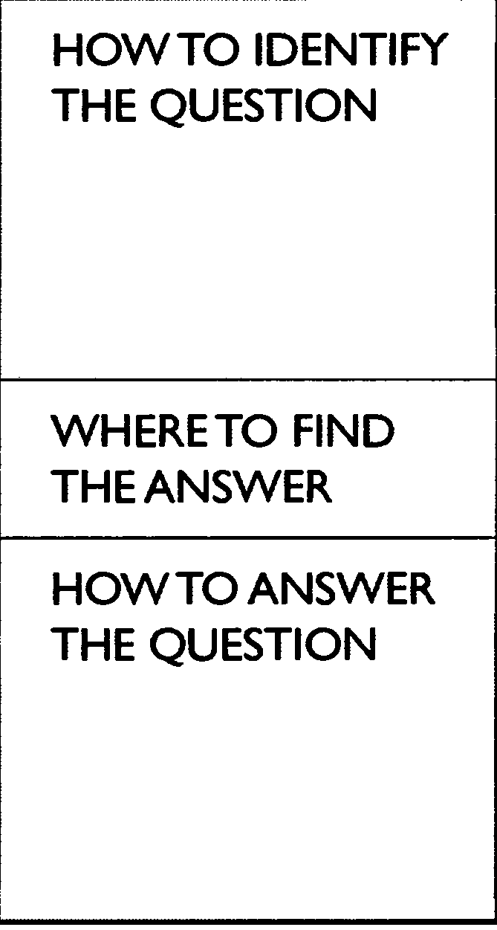
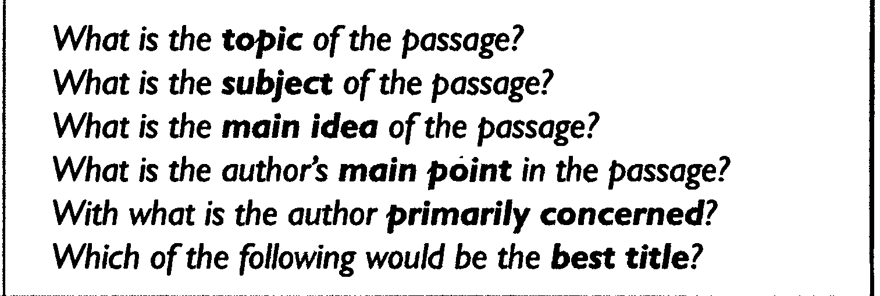

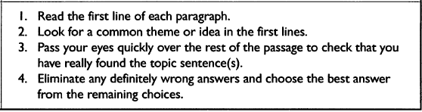
Identifying the Main Idea

Slide 10
Identifying Supporting Details
Specific Details (facts, ideas, and examples) that support and develop the main idea.
Let’s go and read the following passage to identify the main idea, the supporting details of each idea and the conclusion.

Slide 11
Identifying the Main idea & Supporting Details
Why I Want to Learn English(1) There are three reasons why I want to learn English. (2) One reason is that English has become an international language.(3) It is now used by most international companies, including the company where I work, for business communication. (4) Another reason why I want to learn English is so that I can travel to English-speaking countries. (5) The United States, England, Australia and many other countries all use English as their primary language. (6) Finally, I want to learn English because I plan to move to the U.S. in the future. (7) I will become a manager for my company soon. (8) For all these reasons, I am very excited about learning English.
Identify the topic sentence:
Identify the conclusion:
Identify the first main point:
Identify the second main point:
Identify the third main point:
Identify the support detail for the first main point:
Identify the support detail for the second main point:
Identify the support detail for the third main point:

Slide 12
Understanding Italics
It’s used :
Emphasis
Example:
Overcrowding is a huge problem in that city.
2. A foreign word in an English sentence
Example:
In open areas in Seoul, Kaenari blooms everywhere in the spring.

Slide 13
Understanding Contrast
Sometimes writers use contrast to express an idea. In other words, they begin with the opposite of the point that they want to make.
You use contrast clauses when you want to make two statements, one of which contrasts with the other or makes it appear unexpected or surprising. Some contrast clauses – called concessive clauses – are introduced by conjunctions such as although, even though or while.
Let’s Go and see the following example →

Slide 14
Example
Although Mrs. Sims had lived in Hong Kong all her life, she knew very little Cantonese.

Slide 15
Hint: Contrast
Don’t use but in sentences beginning with although, even though or while. Here is a mistake:
Although Kelvin worked hard, but he failed the examination.

Slide 16
Hint: Contrast
You will sometimes see the word albeit used in formal English. Albeit can come before an adjective, adverb, or adverbial phrase.
Example:
Jayne participated in the charity walk, albeit rather reluctantly.

Slide 17
Scanning
Scanning is often confused with skimming, but is in fact a distinct reading strategy involving rapid but focused reading of text, in order to locate specific information, e.g. looking for particular details such as dates, names, or certain types of words. It is processing print at a high speed while looking for answers to specific questions. When you scan, you must begin with a specific question which has a specific answer. Scanning for information in this way should be both fast and accurate.

Slide 18
Let’s Do Scanning
Pulp Friction
Every second, 1 hectare of the world's rainforest is destroyed. That's equivalent to two football fields. An area the size of New York City is lost every day. In a year, that adds up to 31 million hectares -- more than the land area of Poland. This alarming rate of destruction has serious consequences for the environment; scientists estimate, for example, that 137 species of plant, insect or animal become extinct every day due to logging. In British Columbia, where, since 1990, thirteen rainforest valleys have been clearcut, 142 species of salmon have already become extinct, and the habitats of grizzly bears, wolves and many other creatures are threatened. Logging, however, provides jobs, profits, taxes for the government and cheap products of all kinds for consumers, so the government is reluctant to restrict or control it.
1.How many species of salmon have become extinct in BC?
a. 27
b. 31
c. 137
d. 142

Slide 19
Use Scanning
Much of Canada's forestry production goes towards making pulp and paper. According to the Canadian Pulp and Paper Association, Canada supplies 34% of the world's wood pulp and 49% of its newsprint paper. If these paper products could be produced in some other way, Canadian forests could be preserved. Recently, a possible alternative way of producing paper has been suggested by agriculturalists and environmentalists: a plant called hemp.
2.How much of the world's newsprint paper is supplied by Canada?
a. 31 %
b. 49%
c. 34%
d. 19%

Slide 20
Do it by yourself ☺
However, there is a problem: hemp is illegal in many countries of the world. This plant, so useful for fibre, rope, oil, fuel and textiles, is a species of cannabis, related to the plant from which marijuana is produced. In the late 1930s, a movement to ban the drug marijuana began to gather force, resulting in the eventual banning of the cultivation not only of the plant used to produce the drug, but also of the commercial fibre-producing hemp plant. Although both George Washington and Thomas Jefferson grew hemp in large quantities on their own land, any American growing the plant today would soon find himself in prison -- despite the fact that marijuana cannot be produced from the hemp plant, since it contains in the drug).
What drug can be obtained from a relative of hemp?
a. Cocaine b. heroin c. Amphetamine d. marijuana

Slide 21
Do the Following Homework.
1. Chapter 2. Exercise 4. page 26
2. Chapter 2. exercise 6. page 29.
3. Chapter 2. exercise 2. page 34 + 35 + 36
4. Chapter 2. exercise 4.page 37

Slide 22

بحمد الله

