Slide 1

English Language
Reading
Instructor:
Ammar Sultan Al-Ma’ani
King Faisal University
e- Learning Deanship
& Distance Education
1

Slide 2
6th Lecture

Slide 3
Elements of the Lecture
Previewing Vocabulary
Getting Meaning from Context
Previewing Reading
Prefixes

Slide 4
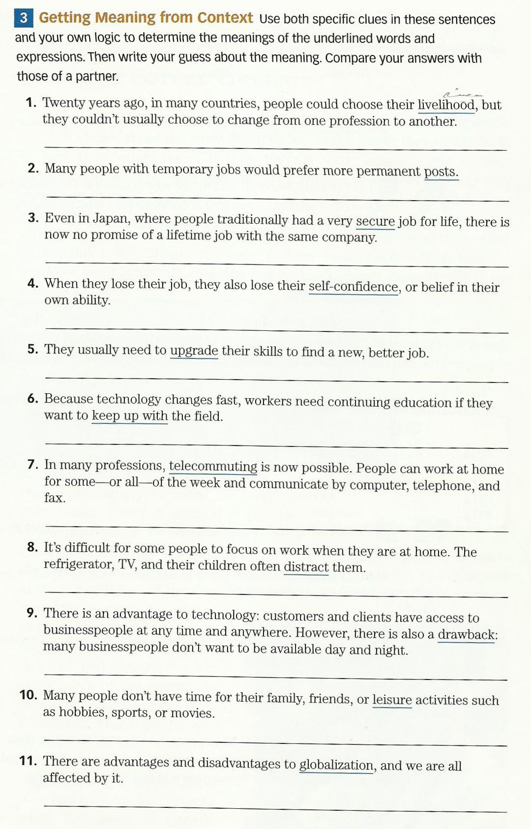

Slide 5
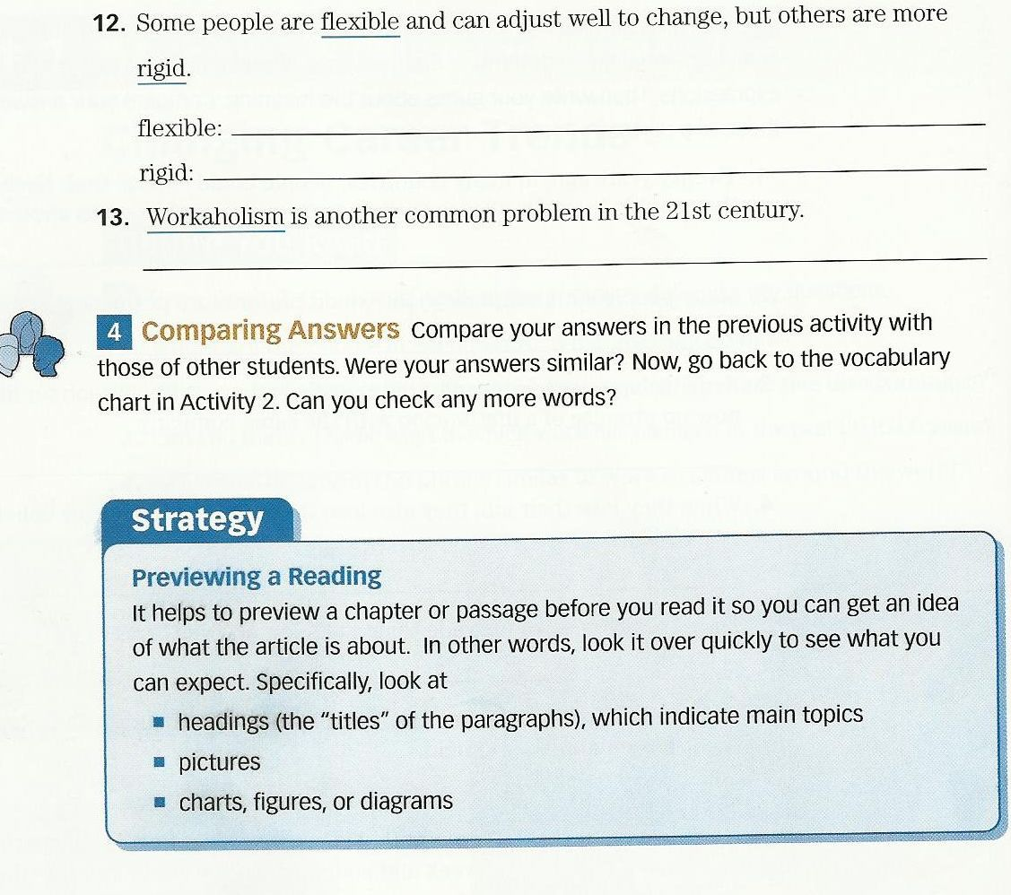

Slide 6
Previewing is a useful way to determine the usefulness of a text, how easy or difficult it will to read, and what reading speed to use to read it well.
Guidelines for Previewing Passages:
“Read the title.
Look at the pictures (if there are any).
Read the first few sentences in the first paragraph.
Read the first line of the other paragraphs.
Read the first and last sentences of the last paragraphs.”
When previewing, look at tables, graphs etc as well as headings

Slide 7
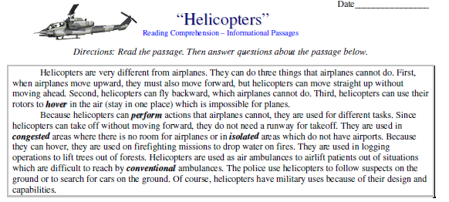

Slide 8
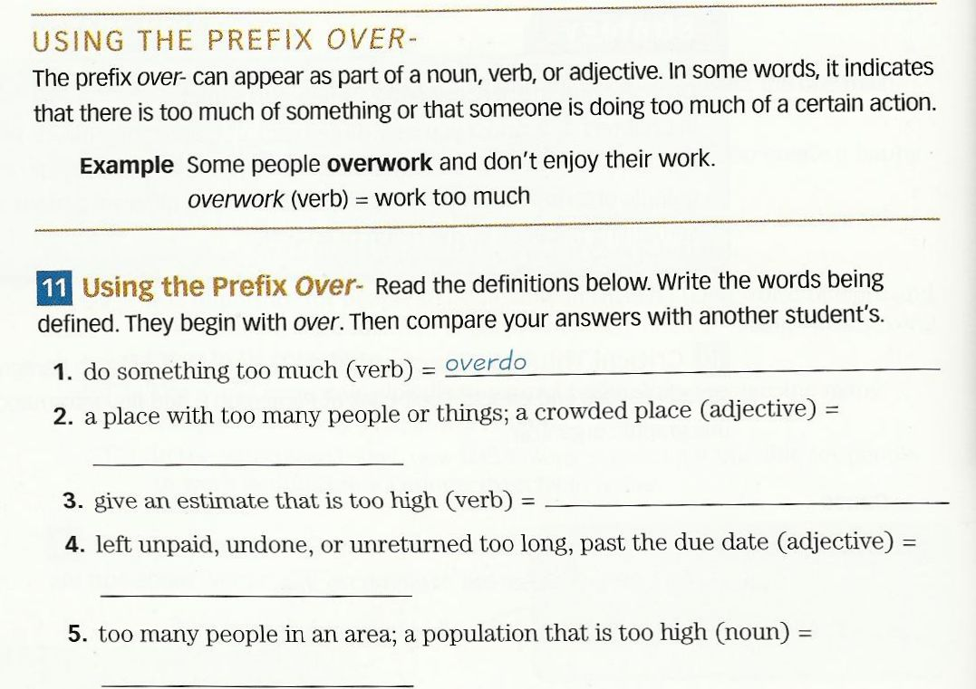

Slide 9
What Are Prefixes?
A prefix is a group of letters we add to the front of a word.
Prefixes change the meaning or purpose of the word, e.g.

Slide 10
Un = not
Un = reversal or cancellation of action or state
un + kind = unkind
unacceptable, unreal, unhappy, unmanned
unplug, unmask

Slide 11
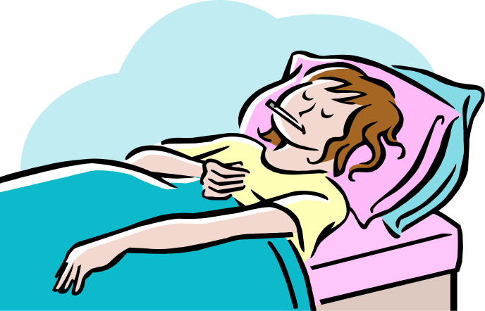
The prefix ‘un’
My mum was unwell at the weekend with a bad cold.

Slide 12
The prefix ‘un’
Jerry seemed unhappy that the cat was by his hole.

Slide 13
Dis = negation, removal, expulsion
disadvantage, dismount, disbud, disbar

Slide 14
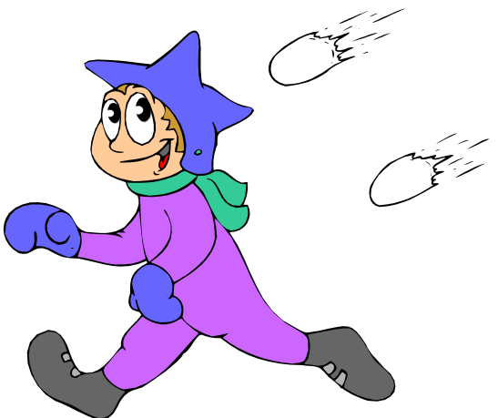
The prefix ‘dis’
Sally disagreed with Tom over who threw the snowball.
How has the word meaning been altered with this prefix?
agree-----disagree
Again the word has become an antonym (opposite) of the root word.

Slide 15

The prefix ‘dis’
Can you disable the alarm?

Slide 16
Add the prefix ‘un’ to these root words!
un
finished
un
do
un
fit
un
un
pack
un
well
un
load

Slide 17
Add the suffix ‘dis’ to these root words!
dis
coloured
dis
trust
dis
like
dis
dis
order
please
dis
dis
approve

Slide 18
Is it ‘un’ or ‘dis’?
un
well
dis
charge
unfit
un
cover
dis
agree
dis
obey
dis
appear
dis
approve
dis
belief

Slide 19
Prefixes 2 = re, de, pre
To understand what is meant by the term ‘prefix’;
To recognise and spell the prefixes: - re, de and pre.

Slide 20
re = again
repaint, reappraise, reawake

Slide 21
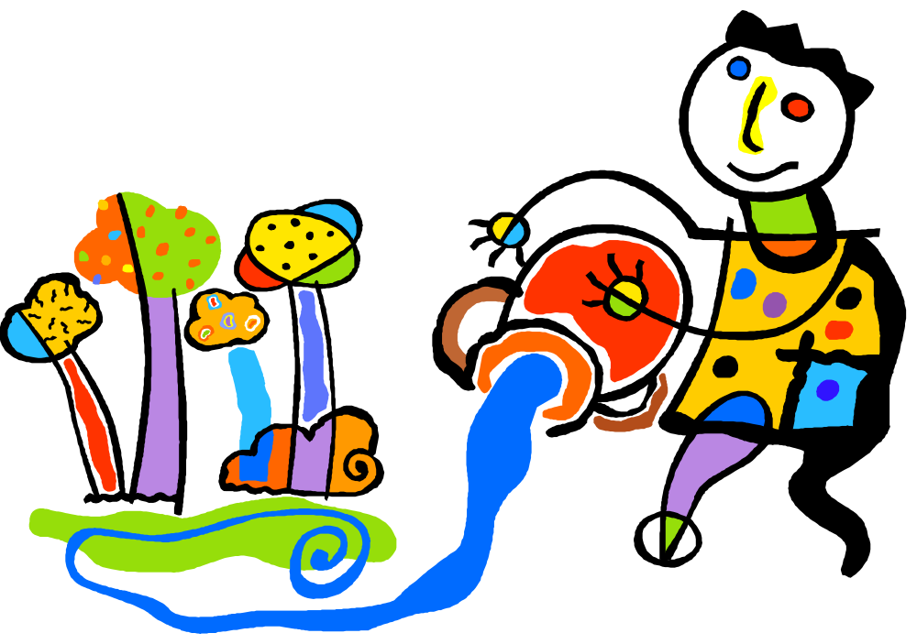
The prefix ‘re’
Danny had to refill the bucket.

Slide 22

The prefix ‘re’
The T.V. showed an action replay.

Slide 23
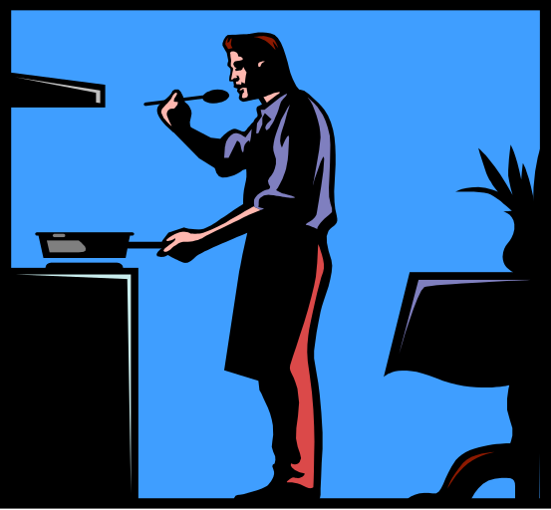
The prefix ‘de’
Dad had to defrost the chicken before he put it in the oven.

Slide 24
de = down, away
de= removal, reversal
Descend, despair, depend, deduct
de-ice, decamp

Slide 25
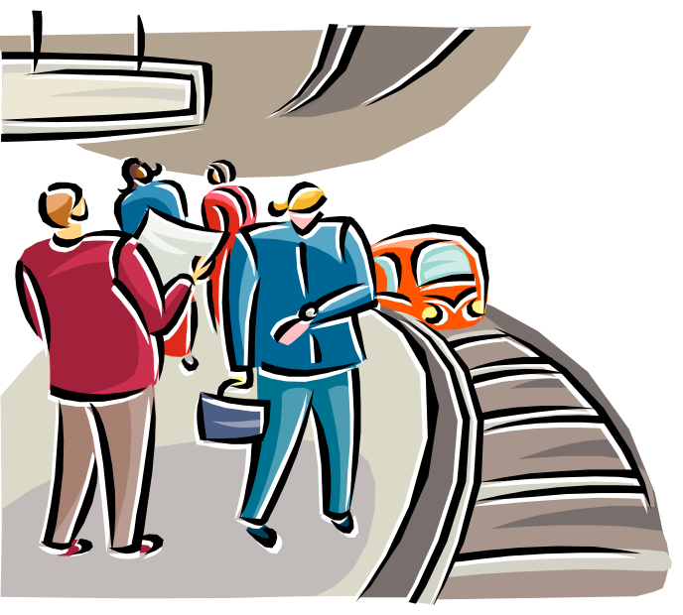
The prefix ‘de’
The time to depart from the station had arrived.

Slide 26
Pre = before in time, place, order or importance
pre-adolescent, prelude, precondition

Slide 27


The prefix ‘pre’
John liked prehistoric animals.

Slide 28
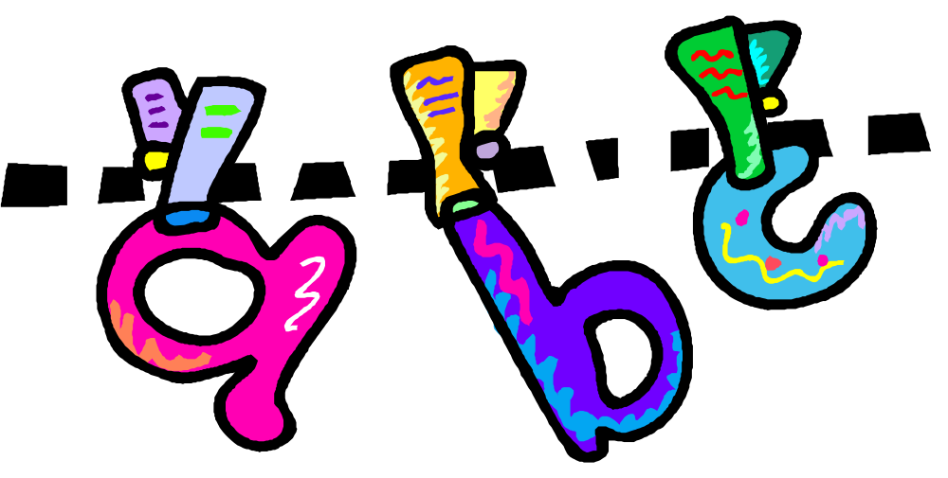
The prefix ‘pre’
A prefix is fixed to the front of a word.

Slide 29
To recognise and spell the prefixes: - re, de, pre, un and dis.
Read the sentence carefully.
Add the correct prefix and rewrite the sentence.
Use a dictionary to find more words with the prefixes ‘re’ ‘pre’ or ‘de.’

Slide 30
Is it ‘re’ or ‘de’ or ‘pre’?
pre
caution
pre
pre
mature
fix
de
face
heat
re
de
posit
port
re
arrange
re
de
face

Slide 31

بحمد الله

