Slide 1

English Language
Reading
Instructor:
Ammar Sultan Al-Ma’ani
King Faisal University
e- Learning Deanship
& Distance Education
1

Slide 2
Lecture 10
Interactions: Reading

Slide 3
Elements of the Lecture
I. Previewing Vocabulary
II. Scanning &Skimming A reading Passage
III. Parts of speech / Sentence structure

Slide 4
Previewing Vocabulary page 95/ 109/ 113/ 114/ 115
meanings | Parts of speech | words | No.
hints | Noun | gestures | 1
Choose / select or carry | PV | Pick up | 2
living things like animals and plants | Noun | Creatures | 3
A repeated / or sent back sound | V or N | Echo | 4
To demand/ advocate | V or N | claim | 5
Similar kinds or sorts | Noun | Species | 6
A metal piece of money | Noun | Coin | 7
To get or obtain or win | Verb | Acquire | 8
Concentrate on/ focus on | PV | Shed light on | 9
Honest & responsible / straight back | Adj | upright | 10

Slide 5
Previewing Vocabulary page / 143/ 148/ 158/ 167
meanings | Parts of speech | words | No.
Central point / concentrate | V / N | focus | 11
What a container can hold | N | Capacity | 12
Reply / answer | V | Respond | 13
Understand | V | Realize | 14
The main point/ the centre | expression | Head of something | 15
Give back / come back | Verb | return | 16

Slide 6
Questions
1.The word “_____________” is closest in meaning to the word “ hints “.
a. creatures b. lectures
c. gestures d. features
2. Our Doctor always _________on the meanings of new words in English.
a. relaxes b. sheds light
c. types d. types
” 3. The phrasal verb “___________” is closest in meaning to the word “return
a. pick up b. look forward to
c. give back d. interest in
4. I called him by phone so many times but he didn’t ______________________
a. respond b. ask
c. sleep d. eat

Slide 7
Questions
5.The word “_____________” is closest in meaning to the verb “ get or obtain “.
a. reduce b. widen
c. require d. acquire
6. All students should ______________ that English language is very important.
a. realize b. test
c. work d. go
7. The word “honest or responsible ” is closest in meaning to the word_________
a. criminal b. upright
c. lazy d. clever
8. The phrase “ a metal piece of money ” is closest in meaning to the word______
a. coin b. banknote
c. paper d. invoice

Slide 8
Parts of speech
Every Simple sentence must contains at least twoor some or all of the following parts of speech:
1. An article { a – an – the }
2. A noun ( singular/ plural = { subject noun / object noun }
3. A pronoun { I , he, She, their, us, me…….etc }
4. An adjective { easy, hot, important, high, ------ smaller, best ……etc }
5. An adverb { quickly, easily, fast, fluently, well ………..etc }
A main verb { present, past, future, }
6. An auxiliary { verbs to Be, verbs to Have, Modals }
7. A preposition { on, in, at, by, with, for ………………….etc

Slide 9
Exercise
Circle the most suitable answer a, b, c or d for each of the following
- The final test will be similar to the questions in the lectures exercises.
1. The part speech of “ final” is __________________________________
A. a verb B. an adverb
C. a noun D. an adjective
2. The part speech of “ questions ” is _____________________________
A. a verb B. an adverb
C. a noun D. an adjective
3. The part speech of “ will” is __________________________________
A. a main verb B. a verb to be
C. a modal D. a preposition
4. The part speech of “ in” is ___________________________________
A. a verb B. a preposition
C. a noun D. an adjective

Slide 10
Exercise
Circle the most suitable answer a, b, c or d for each of the following
The doctor gave us the first homework last week.
5. The part speech of “ us” is _________________________pronoun
A. a possessive B. an object
C. a subject D. a reflexive
6. The part speech of “ gave ” is ______________________________
A. a present verb B. an auxiliary
C. a future verb D. a past verb
7. The part speech of “ last” is ________________________________
A. an adjective B. a verb to be
C. an article D. a preposition
8. The part speech of “ doctor” is _________________________________
A. a verb B. a subject noun
C. an object noun D. an adjective

Slide 11
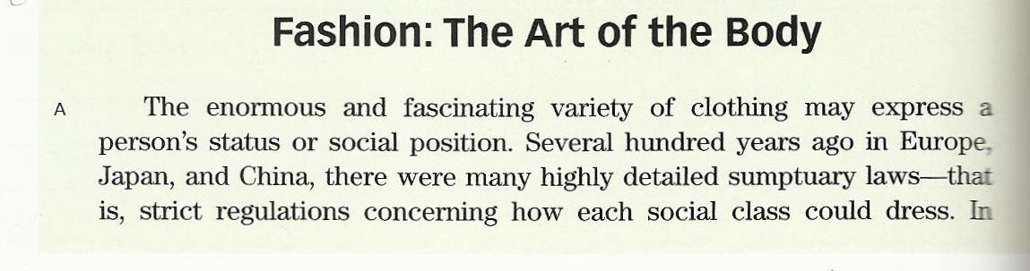
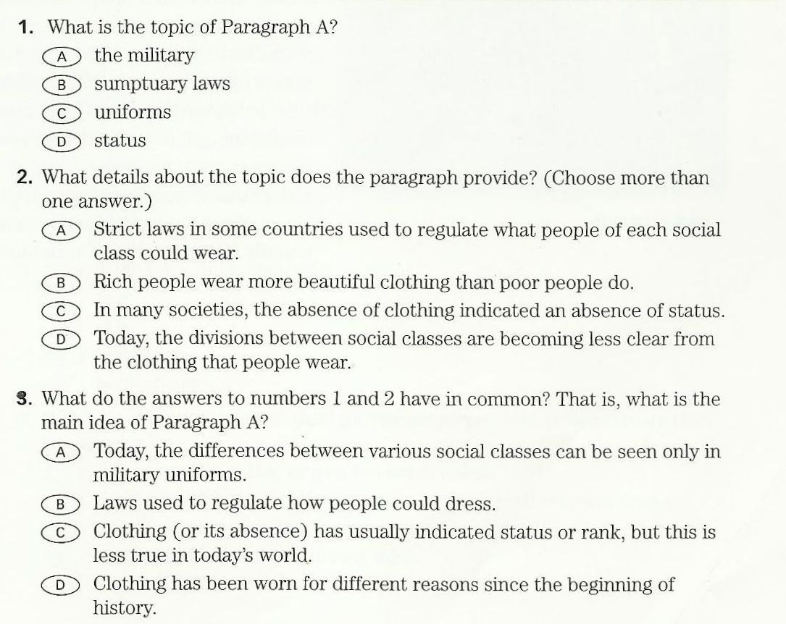
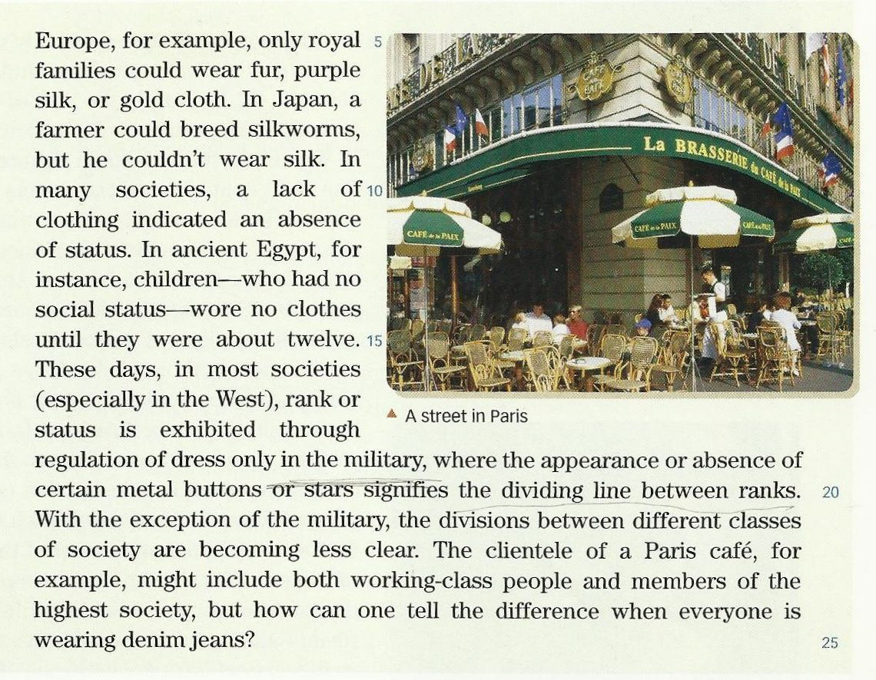

Slide 12
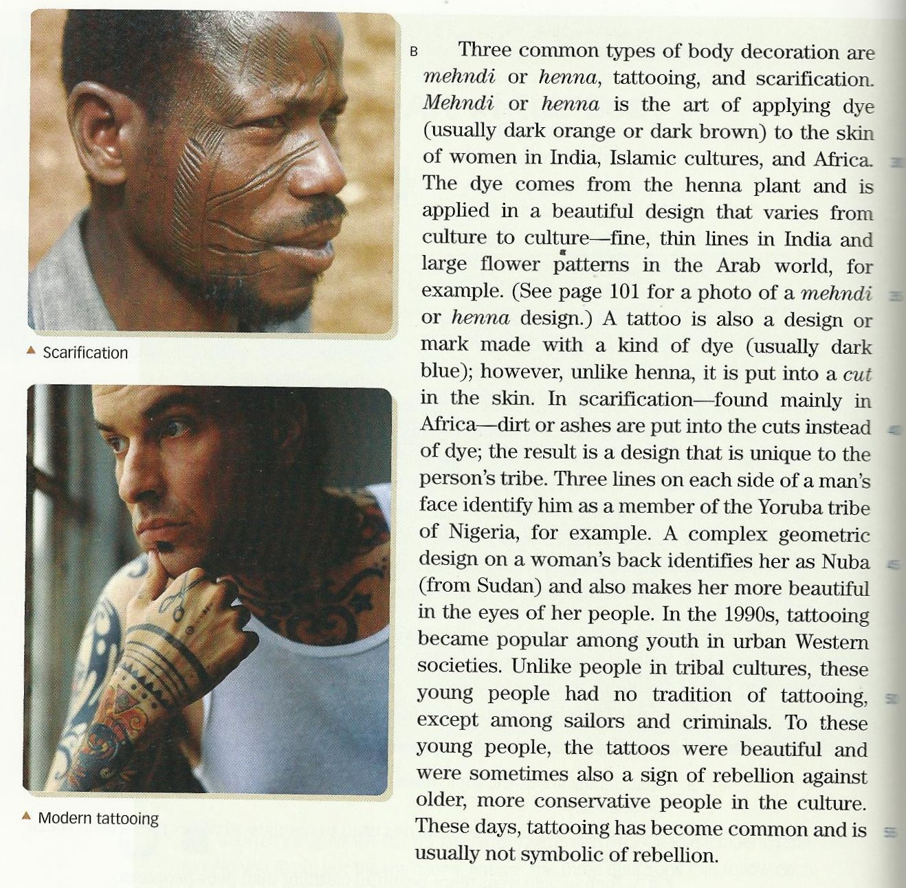
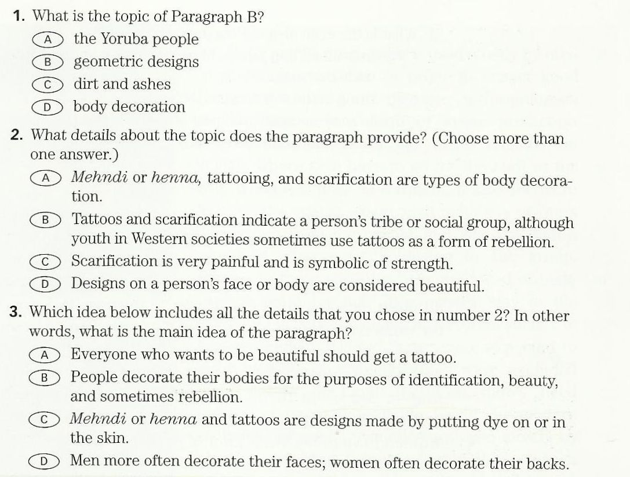

Slide 13
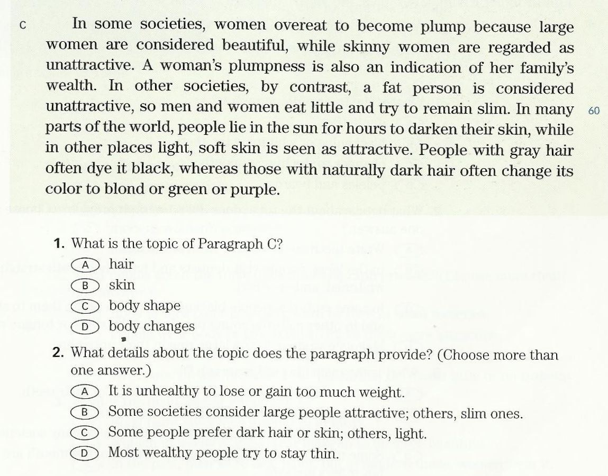
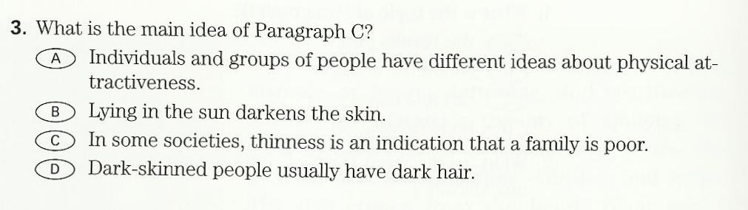

Slide 14
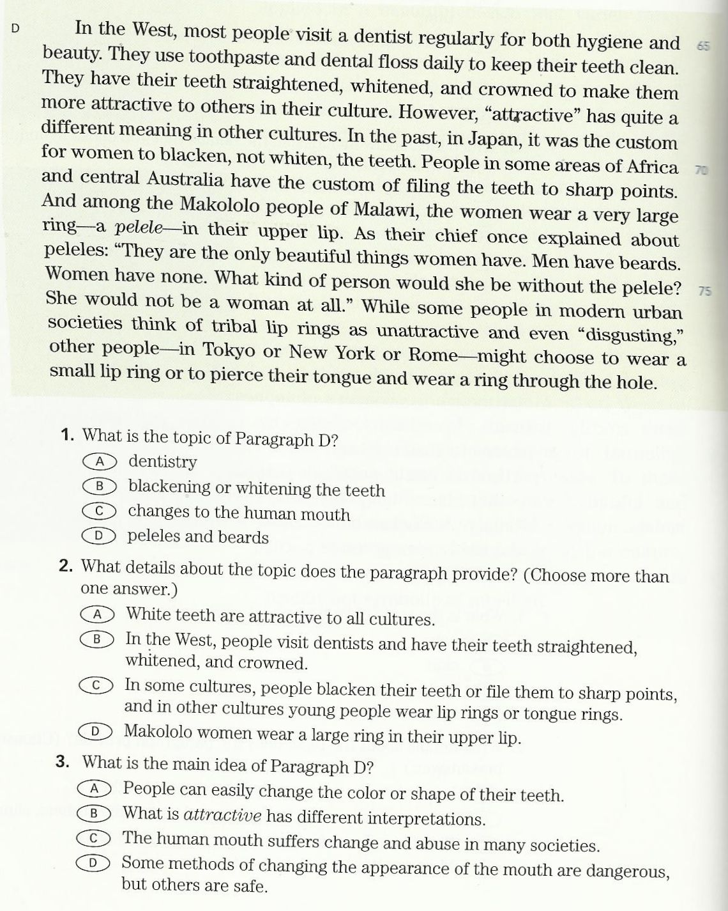

Slide 15
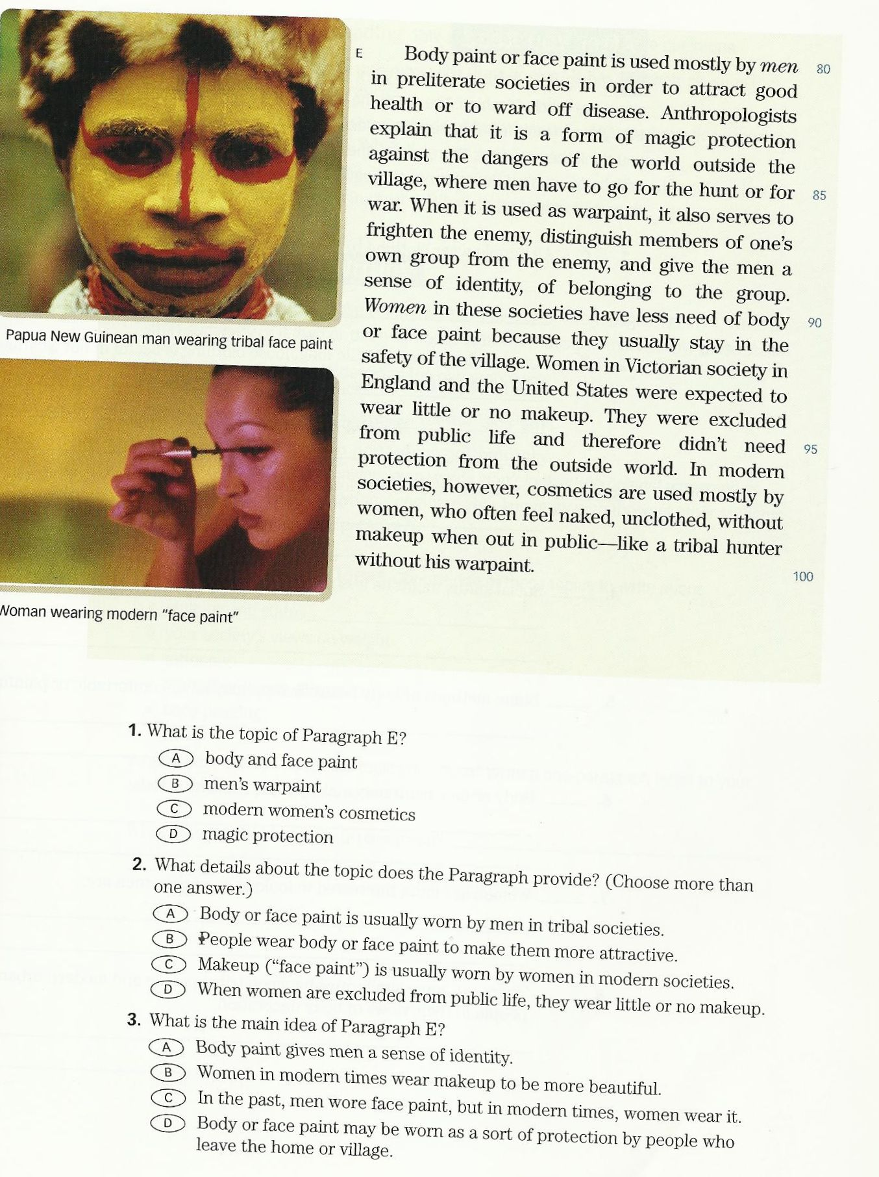

Slide 16
Scanning & skimming A reading passage page 183
In some societies, women overeat to become plump because large women are considered beautiful, while skinny women are regarded as unattractive. A women's plumpness is also an indication of her family's wealth. In other societies, by contrast, a fat person is considered unattractive, so men and women eat little and try to remain slim. In many parts of the world, people lie in the sun for hours to darkens their skin, while in other places light, soft skin is seen as attractive. People with gray hair often dye it black, whereas those with naturally dark hair often change its color to blond or purple.
Now answer the questions that follow.

Slide 17
Questions
Choose the most appropriate answer:
1. The most appropriate topic for the paragraph is_________________________
A. Skin Change B. Hair Color
C. Different views about body shape D. Family's Wealth
2. The best Main Idea of the paragraph is that_____________________________
A. people with gray hair often dye it with black B. people lie in the sun to darken their skin
C. women's plumpness is also an indication of wealth D. people have different attitudes about their bodies
3.Why do men and women eat little in some in some societies?______________
A. To remain slim B. To become plump
C. Because they are poor D. To save much money

Slide 18
Questions
Choose the most appropriate answer:
4. The underlined pronoun " their " Line 5 refers_______________________________
A. people B. women
C. men D. fat persons
5. The word in the paragraph that is closest in meaning to the word " thin" is_______
A. plump B. skinny
C. blond D. attractive
6. The underlined pronouns " it " line 6 refers to______________________________
A. skin B. body
C. gray hair D. color

Slide 19

بحمد الله

