Slide 1

Course Name and Number
English Listening-210
First Semester 1431- 1432 H
D. Allen William Probst
Education system, the developer of the Enrollment
College: Grocery Stores
Section: English Language
1

Slide 2
Lecture 4

Slide 3
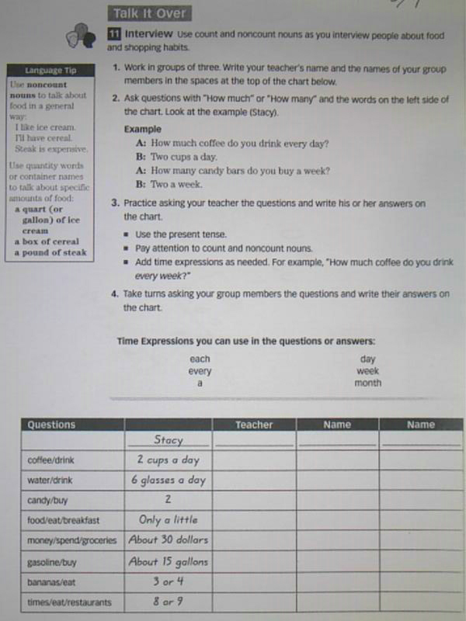

Slide 4
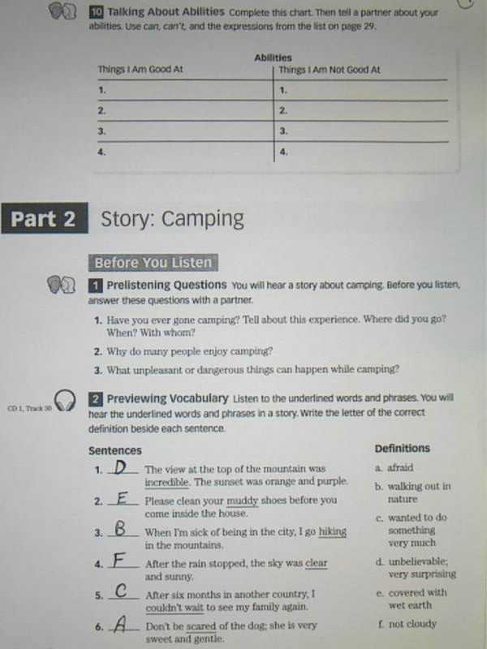

Slide 5
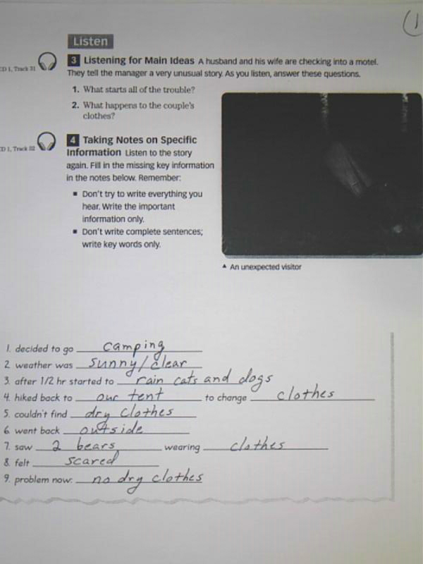

Slide 6
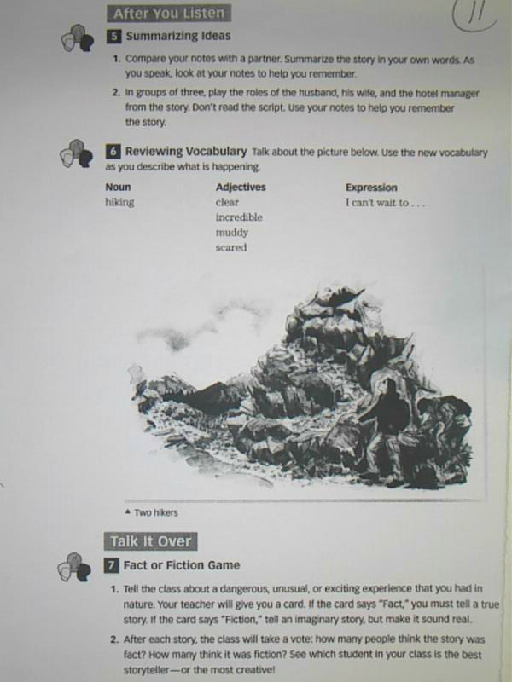

Slide 7
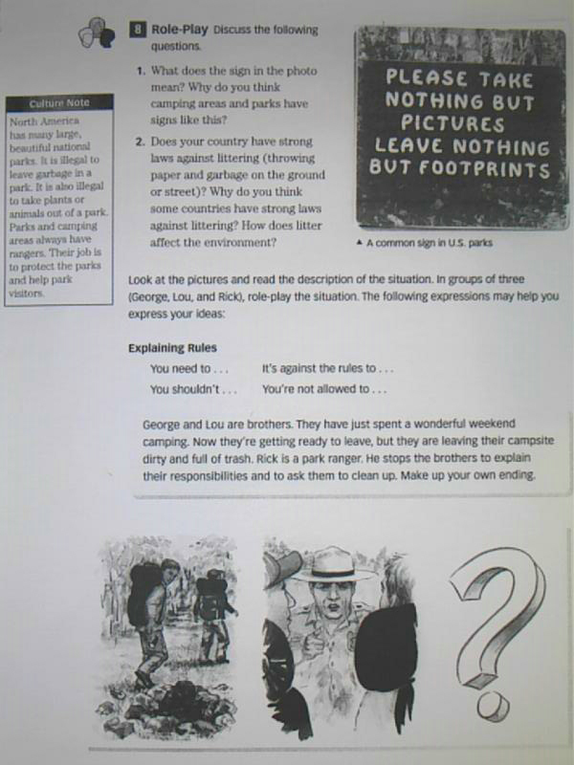

Slide 8
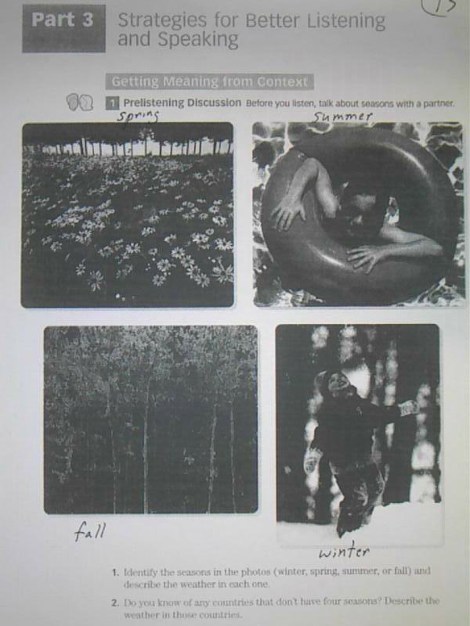

Slide 9
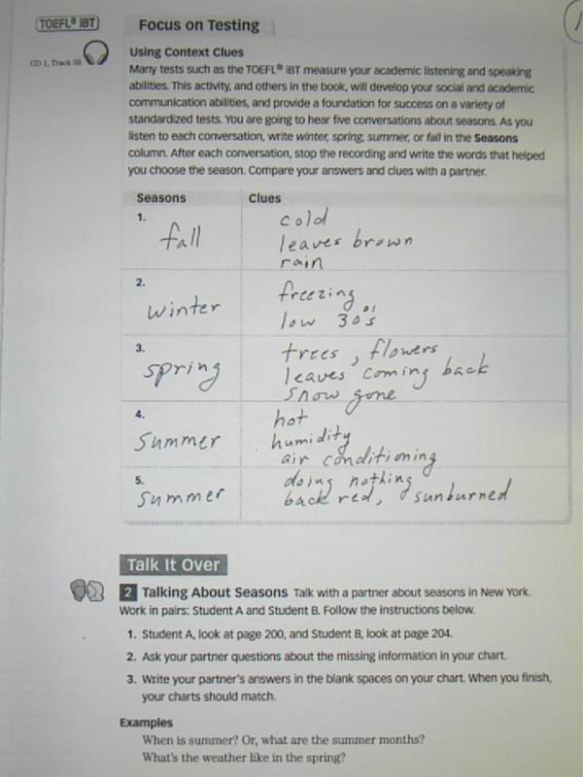

Slide 10
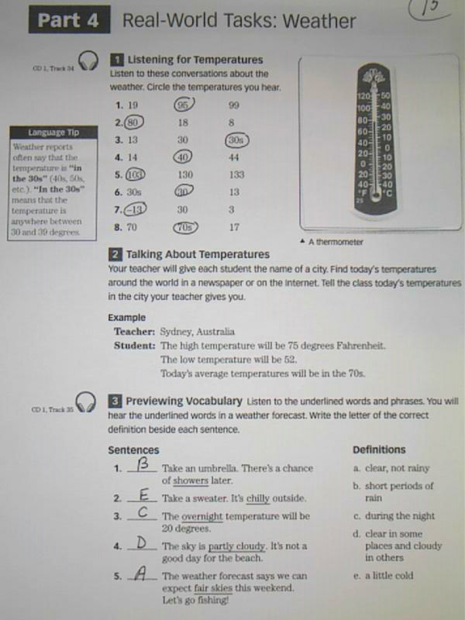

Slide 11
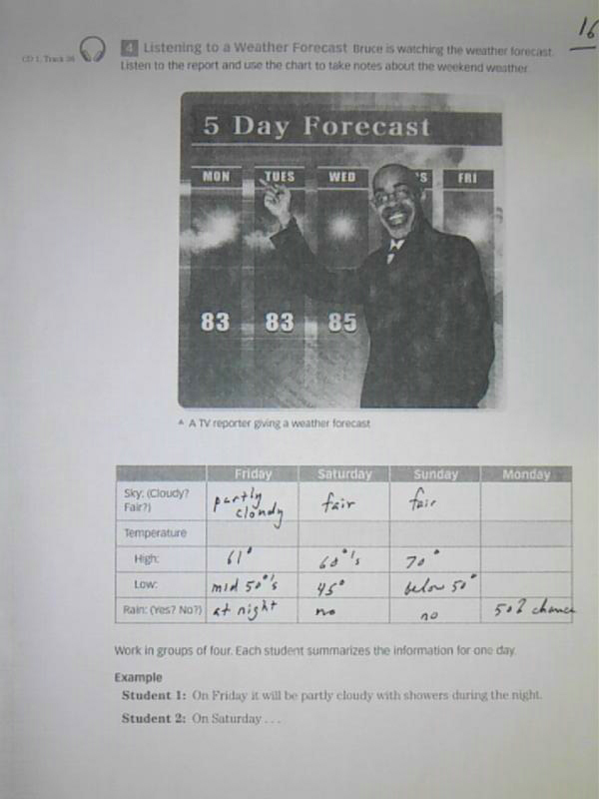

Slide 12
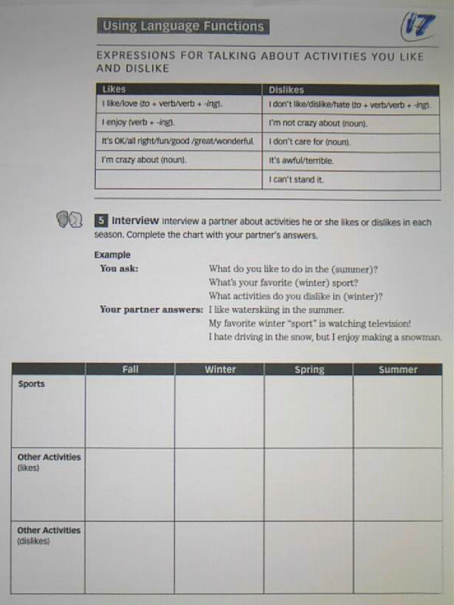

Slide 13
بحمد الله

