Slide 1
Finding the ideal job lctuer 1
Sara Al-Shammri

Slide 2
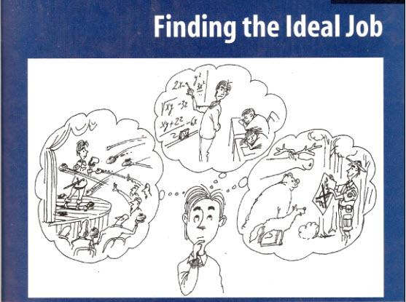
الرجل هنا يفكر بالوظيفة مثالية له
The man in the picture, as all of you see, is thinking about a perfect job for him

Slide 3
تعليق علي صور الثلاث
في الصوره الثانية يفكر ان يصبح مؤدي علي مسرح ولكن المستمعين غير معجبون به
he seems performing art in the stage
but the audience didn‘t like him, so of course this is not the ideal job
الصوره الاولي يفكر ان يصبح مدرس ولكن الطلبة في حالة نعاس
Now he is thinking about being a teacher
but as we can see the student fall asleep
so of course this is also not the ideal job for him
في الصوره الاخيره يتبين انه يعمل حارس في الغابات والحيونات مبتسمه فا بذلك تكون هذه هي الوظيفه المثالية
Now he is in the forest so he is a Forest worker
by the image of the animal being happy and he is smiling as will
so of course, Now it is the ideal job for him

Slide 4
Focus on the topic
What's the young man doing ?
he is thinking of many options
what kind of work is he thinking of ?
he is thinking of kind of performer maybe career in acting
he is also thinking of career in Education
what do you think is the ideal job for this young man ?
it is a forest worker

Slide 5
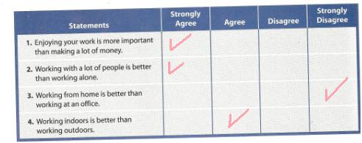
according to this statement and be intentioned, the answer will be different from person to another
رجوعا الي بينات موظحة في الجدول تكون الاجابه وتختلف من شخص الي اخر

Slide 6
vocabulary
Agree : To agree with something or someone
strongly agree : to agree with something or do any action with emphasis
satisfied: to feel good or happy about something
somewhat: not entirely, but getting there
example :" I somewhat forgave you"
extremely dissatisfied :it means that if someone forced him self to do
something he completely dislike it
vocabulary: Those words that we speak and we can use it to express ourselves
Comprehension: the Integration of. Knowledge and understanding
Career: kind of work a person does usually after learning how
Reward: good things you get return for work such as money
Employment: work someone pays you for
Hire: to give someone a job
Skill : something that you can do
Well : ability that you have learned and practiced
Manager: the person in charge of group of workers
Want ads : advertisements usually in newspaper for job that are available
Resume : a piece of paper with your work and education history

Slide 7
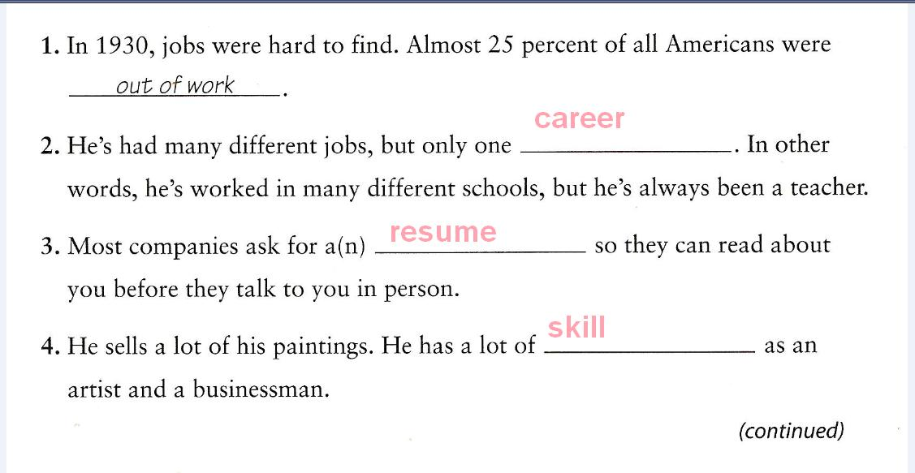
حل التمارين الموجوده في الكتاب

Slide 8
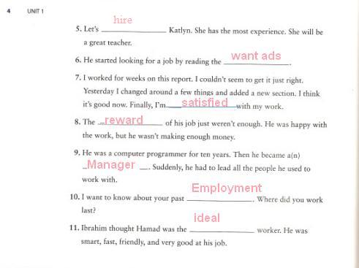
تابع حل التمارين

Slide 9

الواجب كان قراءة القطعة
تحياتي قمر شمر

