Slide 1

English Language
Reading
Instructor:
Ammar Sultan Al-Ma’ani
King Faisal University
e- Learning Deanship
& Distance Education
1

Slide 2
First Class
Chapter 1

Slide 3
Elements of the Lecture
Reading Strategies:
Getting Meaning from Context
Identifying the main idea
Skimming for the Topic and Main Idea
Pronoun Reference
Building Vocabulary
The Academic Word List
Target Vocabulary

Slide 4
Getting Meaning From Context
When you read, you don’t want to look up the meanings of all new words in a dictionary. You can often guess the meaning. Here are three ways that will help you to guess new words:
Punctuation: ( ) (-) , ; :
There is a drawback, a disadvantage, to that idea.
(Drawback means disadvantage.)
e.g.
Full-color pictures are printed using only black and three colors: yellow, cyan (a light blue) and magenta (a light purple).
an unfamiliar word = cyan and magenta
signal punctuation = ( )
meaning : cyan = a light blue and magenta = a light purple

Slide 5
Getting Meaning Form Context
2. A clue in another Sentence: (surrounding words)
A school system in one country is not identical to the system in any other country. It cannot be exactly the same because each culture is different.
(in the second sentence, you see the meaning of identical – exactly the same)

Slide 6
Getting Meaning Form Context
3. Logic:
The educational system is a mirror that reflects the culture.
(you probably know the word mirror, so you can guess that reflects means shows.)

Slide 7
Let’s Guess the Meaning ☺
In a number of countries, education is both compulsory-required-and universal, available to everyone, at least in primary school (elementary school.
Compulsory= __________
Universal=_______
Primary= ______

Slide 8
2. Public schools are all both free and egalitarian; all students are considered equal and learn the same the same material.
Egalitarian = ______________

Slide 9
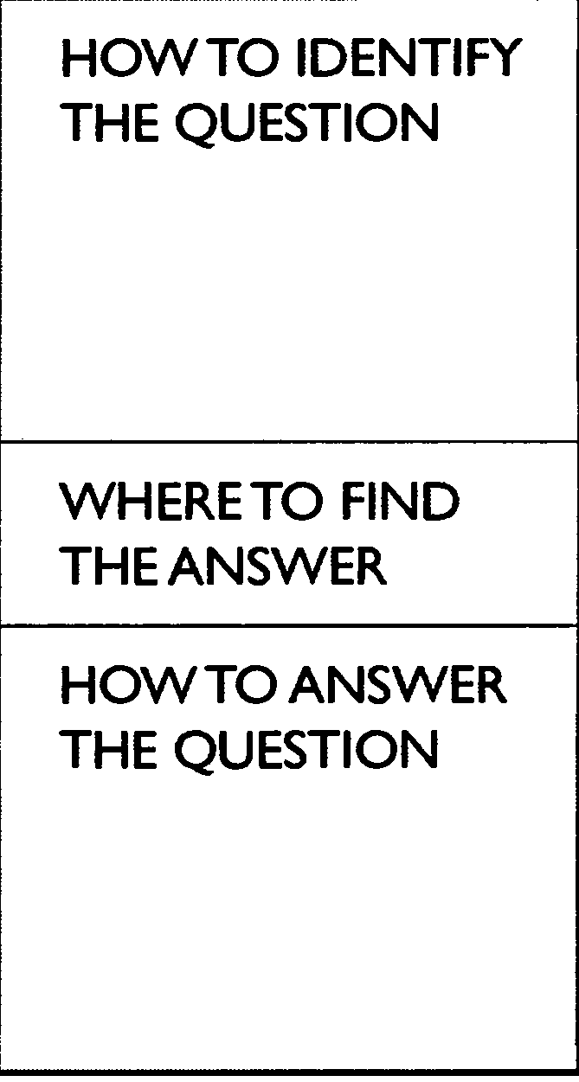
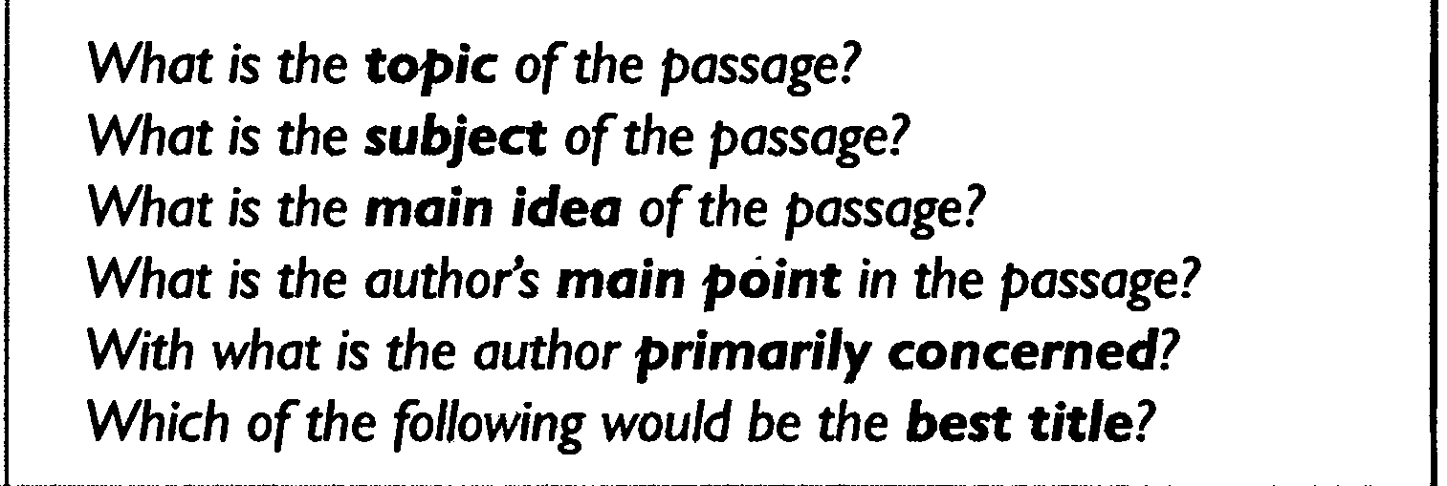

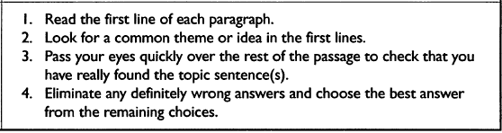
Identifying the Main Idea

Slide 10
Example
Here is a paragraph to consider. Look for the main idea of this paragraph:
The life of a doctor is not easy. Martin works a very long day, and he is very busy with a variety of activities. He spends a lot of time with people, but he also spends a lot of time working on reports in his office.
* What is the main idea of this paragraph?
If you said that the life of a doctor is not easy, you are correct.
a

Slide 11
Another Example
The CNA’s in this office can’t always come to work on the same schedule each week. Sometimes they have to talk to each other and work out differences in the schedule. They usually can do this without any trouble. Ben, Victoria, and Alex work together very well.
* What is the main idea of the paragraph?
If you said that they can all work together well, you are correct.

Slide 12
Skimming for the topic Main Idea
Hint: Remember that the topic is just a word or noun phrase – a few words. It is not a sentence.
The main idea is in a sentence or two and can be found at the beginning, middle, or end of a paragraph.
Each Paragraph has a main idea.

Slide 13
¹Do you have a favorite season? ²Winter, fall, and spring have many advantages. ³However, summertime is my favorite season because it offers the tranquility of the beach as well as the exhilaration of outdoor sports. ⁴First, sitting on the other side of a sand dune, hidden by sea oats and sedge, I like looking at the Atlantic Ocean, scanning for dolphins and pelicans. ⁵Looking at something larger than I am gives me a sense of awe and gratitude and provides a backdrop for some deep musings.⁶Second, summertime provides me with the chance to go sailing, surfing, and hiking along the shore. ⁷The exercise enhances my sense of well being and creates a feeling of optimism.
The topic of the paragraph is
a. sailing and surfing.
b. summertime.
c. seasons at the beach.
d. ways to develop optimism.
The main idea of the paragraph is
a. sentence 1. b. sentence 2. c. sentence 3. d. sentence 4.

Slide 14
Understanding Pronoun Reference
Because a pronoun REFERS to a noun or TAKES THE PLACE OF that noun, you have to use the correct pronoun so that your reader clearly understands which noun your pronoun is referring to.
Therefore, pronouns should:
Agree in number
If the pronoun takes the place of a singular noun, you have to use a singular pronoun.
If a student parks a car on campus, he or she has to buy a parking sticker.
(NOT: If a student parks a car on campus, they have to buy a parking sticker.)

Slide 15
Hint:
Remember:
The words everybody, anybody, anyone, each,
neither, nobody, someone, a person, etc. are singular and take singular pronouns.
Examples:
Everybody ought to do his or her best. (NOT: their best)
Neither of the girls brought her umbrella. (NOT: their umbrellas)

Slide 16
Understanding Pronoun Reference
2. Agree in person
If you are writing in the "first person" (I), don't confuse your reader by switching to the "second person" (you) or "third person" (he, she, they, it, etc.). Similarly, if you are using the "second person," don't switch to "first" or "third.“
When a person comes to class, he or she should have his or her homework ready.
(NOT: When a person comes to class, you should have your homework ready.)

Slide 17
Choosing the Correct Pronoun
Circle the pronoun that agrees in number with its antecedent in each sentence.
Each of the girls makes (her, their) own clothes.
The jury finally made (its, their) decision.
It often seems that television programmers are not concerned with (its, their) viewers.
Both Tim and Tony write (his, their) mothers twice a week from camp.

Slide 18
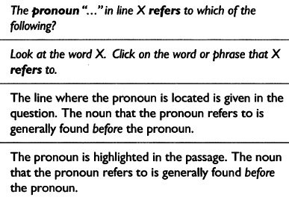
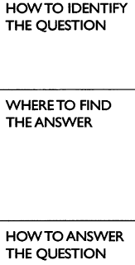
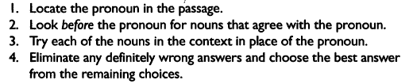
Understanding Pronoun Reference

Slide 19
Vocabulary: Recognizing Word Meanings
____ determine
____afford
____reflect
____nontraditional
____drawback
____ statistic
____ discipline
____ aspect
____involves
____ tuition
____ entire
____ creative
unusual
disadvantage
side, part, or characteristic
developing new ideas
fact in the form of a number
control
whole
decide on
have enough money for
show
fees (money) for school
includes

Slide 20
Do the Following Homework.
1. Chapter 1. Exercise 3. page 6
2. Chapter 1. exercise 5. page 9.
3. Chapter 1. exercise 1. page 13 + 14 + 15
4. Chapter 1. exercise 2.page 15 + 16
5. Chapter 1. Exercise 1. page 18
6. Chapter 1. exercise 3. page 19

Slide 21

بحمد الله

