Slide 1

Course: Introduction to Linguistics
Instructor: Dr Ahmed Al Khateeb
جامعة الملك فيصل
عمادة التعلم الإلكتروني والتعليم عن بعد
كلية الآداب
1
جميع الحقوق محفوظة لجامعة الملك فيصل ©
All Rights Reserved for KFU ©

Slide 2
Lecture 3
The sounds of language
(phonetics)
علم الصوتيات

Slide 3
In this lecture we will be looking at the following questions:
1. How the symbols of the International Phonetic Alphabet (IPA) can be used to represent both consonant and vowel sounds of English words?
(IPA is an internationally recognized set of phonetic symbols developed in the 19th century to restrict one-to-one correspondence between sounds and symbols)
2. What physical aspects of human vocal tract are involved in the production of those sounds?

Slide 4
Phonetics:
It refers to the general study of the features of speech sounds.
Phonetics is classified into:
Articulatory phonetics which refers to how speech sounds are made or articulated.
Acoustic phonetics which refers to the physical properties of sounds such as sound waves in the air.
Auditory phonetics which refers the perception of speech sounds.

Slide 5
Voiced and voiceless sounds
When the vocal cords are spread apart, the air from the lungs passes between them unimpeded. Sounds produced in the way are described as voiceless.
Such voiceless sounds are: S or F (by placing your fingertip on the top of your Adam’s apple, you can not feel any vibration).

Slide 6
Voiced and voiceless sounds
On the other hand, when the vocal cords are drawn together, the air from the lungs repeatedly pushes them apart as it passes through, creating a vibration effect. This is described as voiced.
Such voiced sounds are: Z or V (by placing your fingertip on the top of your Adam’s apple, you can feel some vibration).

Slide 7
The two classes of sounds:
1. Consonants (الحروف الساكنة) nearly 24 sounds
A consonant is a speech sound that is articulated with complete or partial closure of the vocal tract.
Most consonant sounds are produced through tongue to shape the oral cavity through which the air is passing.
Places of articulation of sounds describes the location inside the mouth at which the constriction takes place.

Slide 8
The two classes of sounds:
1. Consonant sounds (الحروف الساكنة)
Places of articulation are:
bilabials,
labiodentals,
dentals,
alveolars,
palatals,
velars and
glottals

Slide 9
Places of articulation of consonant sounds:
Bilabials = both lip
e.g.
([p],[b],[m])

Slide 10
Places of articulation of consonant sounds:
2. Labiodentals = the upper teeth with the lower lip
e.g.
([f], [v])

Slide 11
Places of articulation of consonant sounds:
3. Dentals = the tongue tip behind the upper teeth or between the teeth
e.g.,
([Ө][ð])

Slide 12
Places of articulation of consonant sounds:
4. Alveolars = the front part of the tongue on the alveolar ridge (the rough area behind and above the upper teeth)
e.g.,
([t],[d],[n],[s],[z])

Slide 13
Places of articulation of consonant sounds:
5. Palatals = the tongue and hard palate (on the roof of the mouth)
e.g.,
([j])

Slide 14
Places of articulation of consonant sounds:
6. Velars = the back of the tongue on the velum (soft palate)
e.g.,
([k],[g],[ŋ])

Slide 15
Places of articulation of consonant sounds:
7. Glottals = using the glottis, the open space between the vocal folds
e.g.,
([h])

Slide 16
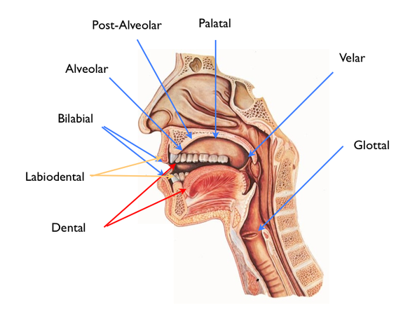
Places of articulation of consonant sounds:

Slide 17
The two classes of sounds:
Within consonant sounds, we have:
Familiar symbols which denote to most consonant sounds such as [p] in pop and [m] mom. (bilabial voiceless consonants - produced by both lips)
Unfamiliar symbols which refer to less familiar sounds, as they two ways of representing them, such as [th] in words thus and loathe. (dental voiceless consonants - produced with the involvement of teeth)

Slide 18
Manner of articulation (what kind of constriction is there)
It is concerned with the degree of obstruction or the type of channel imposed upon the passage of air at a given place of articulation.
It ranges from completely closed to completely open:
Stops Air flow is COMPLETELY CLOSED
Fricatives الاصوات الاحتكاكية
Affricatives
Nasals
Liquids
Glides
(Vowels) COMPLETELY OPEN

Slide 19
Manner of articulation (what kind of constriction is there)
Stops or plosives = produced by completely stopping the air.
Fricatives = produced by forcing the air through a narrow channel made by placing two articulators together, such as /f/ and /th/
Affricates = produced as stops at the beginning and released as fricatives at the end, such as /ch/ and /j/
Nasals = produced by allowing the air to escape freely through nose, such as /n/ and /m/.
Liquids = produced by partial closure in the mouth, such as /r/ and /i/.
Glides/semi-vowels = produced with the tongue in motion or from the position of a vowel, such as /w/ and /y/ in yes and west.

Slide 20
The two classes of sounds:
2. Vowels ((الحروف المتحركة
A vowel is produced with a relatively free flow of air. They are voiced.
Vowels have four positions: front, back, high and low areas. For example, the pronunciation of heat and hit have a high front vowels because the sound is made with the front part of the tongue in a raised position. On the other, the vowel in hat is produced with the tongue in lower position and the sound in hot can be described as a low-back vowel.

Slide 21
The two classes of sounds:
2. Vowels ((الحروف المتحركة
A vowel is a speech sound in which the mouth is open and the tongue is not touching the top of the mouth, the teeth. (Oxford Learner’s Dictionary).
Vowel is a speech sound produced by humans when the breath flows out through the mouth without being blocked by the teeth, tongue, or lips. (Cambridge Learner’s Dictionary).

Slide 22
The two classes of sounds:
2. Vowels ((الحروف المتحركة
The position of the highest point of the tongue is considered to be the point of articulation of the vowel.
The vertical dimension of the vowel diagram is known as vowel high, which includes high, central (mid), or low vowels. The horizontal dimension of the vowel diagram includes tongue advancement and identifies how far forward the tongue is located in the oral cavity during production.

Slide 23
The two classes of sounds:
2. Vowels ((الحروف المتحركة
e
mid, front, unrounded, example: lake
i
high, front, unrounded, example: reep
o
mid, back, rounded, example: oar
u
High, back, rounded, example: poop

Slide 24
Diphthongs
Diphthongs is a combination of two adjacent vowel sounds within the same syllable.
There are eight diphthongs commonly used in English: /eɪ/, /aɪ/, /əʊ/, /aʊ/, /ɔɪ/, /ɪə/, /eə/, and /ʊə/.
For example, the phrase no highway cowboys /ˌnoʊ ˈhaɪweɪ ˈkaʊbɔɪz/ has five distinct diphthongs, one in every syllable.
Words such as Hi or Bye have two vowel sounds and the movement of these diphthongs is from low towards high front.

Slide 25
Diphthongs
Diphthongs
double vowels
aɪ
ride, chloride, tide
ɔɪ
boy, toy, voice,
aʊ
trout, couch

Slide 26
Diphthongs
Standard English (RP = Received Pronunciation) has 44 phonemes (speech sounds):
Consonants, 24;
Vowels, 12;
Diphthongs, 8.

Slide 27
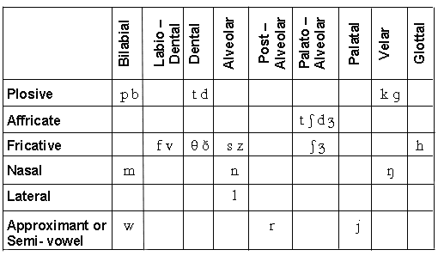
English consonant chart -24 (place + manner of articulation)

Slide 28
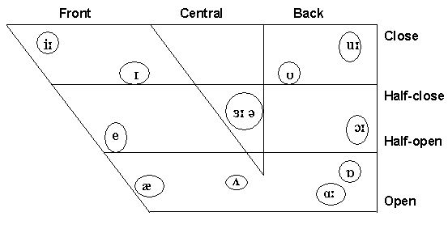
English vowels chart (12 vowels)

Slide 29
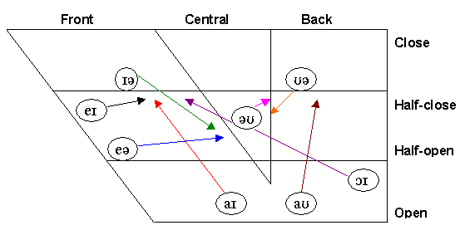
English diphthong chart (8 diphthongs)

Slide 30
Vowel sounds:
5 long vowels:
e.g., bean, barn, born, boon, burn
7 short vowels:
e.g., pit, pet, pat, putt, pot, put, another
8 diphthongs:
e.g, bay, buy, boy, no, now, pair, poor

Slide 31

بحمد الله
جميع الحقوق محفوظة لجامعة الملك فيصل ©
All Rights Reserved for KFU ©

