Slide 1

Renaissance Literature
Dr. Fouzi Slisli
جامعة الملك فيصل
عمادة التعلم الإلكتروني والتعليم عن بعد
1

Slide 2
Causes of the Renaissance:
The Reformation
Renaissance Literature

Slide 3
Main Points
Causes and Consequences of the Reformation
Before the Reformation ALL Christians in Europe were Roman Catholic
Reformation Ended the Religious Unity in Europe
Attack on the medieval church—its institutions, doctrine, practices and personnel
The Reformation caused a split in Christianity with the formation of the new Protestant religions

Slide 4
The Medieval Church
Mission of the Church: To save the soul of all the members.
Tithe: People donated one tenth (1/10) of the produce from their lands to the church each year.
Wealth: Church became wealthiest group in Europe
Church was the Center of daily life. The local church served as a church,
meeting place, and shelter during war.
Community: The church dominated community life and controlled interaction between Christians

Slide 5
The Problem of the Catholic Church
Greed, corruption and absenteeism
Sales of indulgences: The release of a soul from purgatory (hell) for
monetary donation – a HUGE abuse of Church power! Extortion of money from the poor
Unfair Land and wealth distribution
The corruption of the Papacy
European population was increasingly anti-clerical
Absenteeism of church leaders during natural disasters (plague, famine) or to solve everyday problems for people

Slide 6
New Socio-economic realities
Better educated, urban populace was more critical of the Church than rural
Peasantry
Renaissance monarchs were growing impatient with the power of the Church
Society was growing more humanistic and secular
Growing individualism

Slide 7
Technological Developments
Scientific developments contradicted Church doctrine
Invention of movable type (printing) in 1450 by Johann Gutenberg
Manufacture of paper becomes easier and cheaper
Spread of ideas faster than the Catholic Church could control them
Intensified intellectual criticism of the Church
Protestant ideals appealed to the urban and the literate

Slide 8
Calls for Reform
The Church’s political power started being challenged
Unwillingness to depend on the Church and rejection of the constraints it enforced
Growing human confidence vs. “original sin”
Catholic church becomes defensive and unable to respond to the criticism
The confusing nature of scholasticism and of church dogma

Slide 9
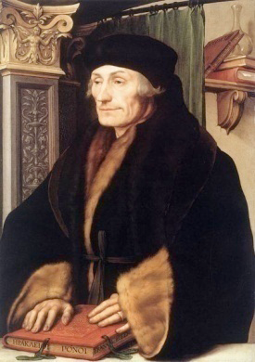
Reformers
Desiderius Erasmus (1466-1536)
A Dutch scholar, humanist, and theologian.
Was ordained a Catholic priest, but never
practiced priestly duties.
Studied, instead, theology and classical Greek
at the universities of Paris and Cambridge.
Was critical of some of the practices and
doctrines of the Catholic Church.
Sought to reform the Catholic Church.

Slide 10
In Praise of Folly - by Erasmus
Written in Latin in 1509
Best-seller (only the Bible sold more by 1550)
Erasmus was a devout Catholic who sought to reform the Church, not destroy it
Criticized immorality and hypocrisy of Church leaders and the clergy
The book inspired renewed calls for reform, and influenced Martin Luther

Slide 11
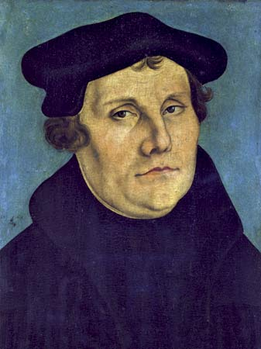
Reformers
Martin Luther (1483-1546)
A German Priest
Openly addressed the problems in the Church
Said that faith is private and church should have no
Control over it.

Slide 12
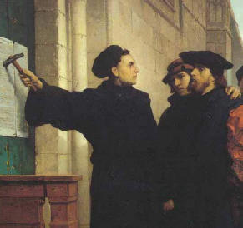
Oct 31, 1517, Martin Luther posted 95 Theses on the church door in Wittenburg, Germany
The 95 theses summarized his criticisms of Church
1000s of copies distributed throughout Germany and Europe.

Slide 13
Reformation Begins
By 1521 Luther was calling for Germany to spilt from the catholic Church
Wanted German princes to overthrow Papal power in Germany and establish a German Church
Jan 1521 – Luther is excommunicated
He was summoned by Imperial Diet of Holly Roman Empire to the city of Worms by Emperor Charles V and was ordered to change his ideas
Luther – “NO” – The Edict of Worms was issued, making Luther an outlaw
  Luther kept in hiding by German princes

Slide 14
Lutheranism
Lutheranism (Protestantism) Spreads
Followers of Luther’s religious practices increased
Protestantism Gained support among many German princes
1524, German peasants revolted (The Peasants’ Revolt) and hoped Luther would support them, but… because Luther needed the support of German princes, he did not help the peasants
Germany is in turmoil – is it Catholic? Is it Lutheran?
To establish peace, the Holy Roman Emperor Charles V accepted the Peace of Augsburg, and allowed German princes to choose their own faith and religion.

Slide 15
Protestantism Spreads across Europe
Ulrich Zwingli and the Zwinglian Reformation
John Calvin and Calvinism
Henry VIII and the English Reformation

Slide 16
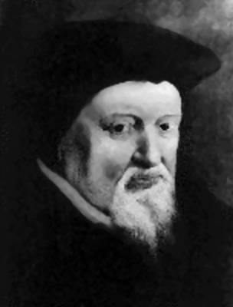
Protestantism Spreads across Europe
Ulrich Zwingli (1484-1531) / The Zwinglian Reformation
priest in Zurich, Switzerland
Revolted against the Catholic Church:
Banned all religious relics & images
Whitewashed all church interiors.
Banned music in church services
Did not merge with Luther because he disagreed with him on communion

Slide 17
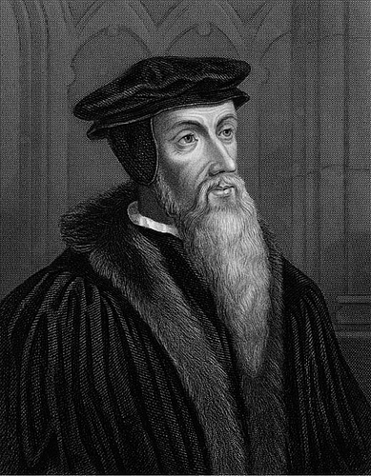
Protestantism Spreads across Europe
John Calvin (1509-1564) and Calvinism
Replaced Zwingli (killed in religious war)
French, fled to Switzerland for safety
1536 – began reforming Geneva, Switzerland
Created a church-government of elect and laity
Used consistory (moral police)
Sent missionaries throughout Europe to convert
Catholics
His ideas spread to France, Netherlands, Scotland
Mid 16th Century – Calvinism more pop than Lutheranism

Slide 18
Protestantism Spreads across Europe
John Calvin (1509-1564)
Anti-Catholic
Was influenced by Martin Luther, but..
Disagreed with Luther’s “Salvation through Faith alone.”
Established his own Protestant Religion in Switzerland

Slide 19
Protestantism Spreads across Europe
Calvinism: Started in Switzerland
England and America = Puritans
Scotland = The Presbyterians
Holland = The Dutch Reform
France = The Huguenots
Germany = The Reform Church
South Africa = Boers

Slide 20



Protestantism Spreads across Europe
Calvinism believes in:
Predestination: It is decided, at birth, if people will go to heaven or hell
Preach a purified existence and opposed to drinking, gambling, card playing, swearing, etc.

Slide 21
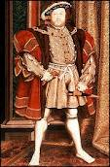
Reformation in England
Political, not religious motives for reform
Henry VIII – King of England needs a male heir
to carry on the Tudor Dynasty
  Married Catherine of Aragon
  (Aunt of Charles V, the Holly Roman Emperor)
  Catherine gave him a daughter, Mary and no son,
  So Henry wanted a divorce!
  In the Catholic Church, you need an annulment, granted by the
  Church. The Pope ONLY can grant it to a King.

Slide 22
Reformation in England
Political, not religious motives for reform
The Pope refused to grant the annulment, too political
Standoff between: The King of England and HRE Emperor
After a long argument, Henry decided to break away from the Catholic Church
Archbishop of Canterbury granted Henry VIII a divorce
Act of Supremacy(1534) established the Church of England
King Now controls over religious doctrine, appointments, etc
Henry VIII dissolved Catholic claims, sold its land and possessions
Took power but remained close to Catholic teachings

Slide 23
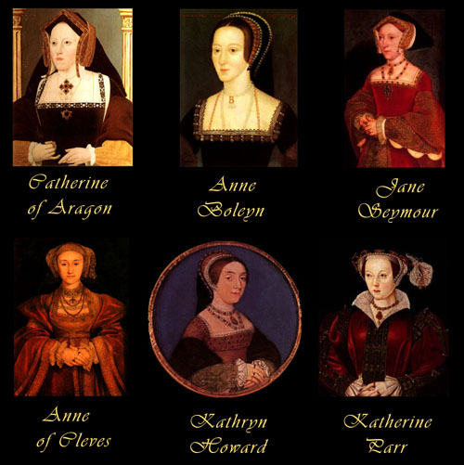
Henry and His Wives
Henry was desperate for a son. So much so he married 6 times!!
The saying goes…
Divorced, Beheaded, Died
Divorced, Beheaded, Survived

Slide 24
The Church of England
1547 – Henry died
  His 9 year old son, Edward VI, took the throne
The Church of England or the Anglican Church became more Protestant, which triggered the anger of the Catholic Church
1553 – Edward VI died
  His half-sister Mary (Catholic) took throne
Mary wanted to restore Catholicism
She had over 300 Protestants burned alive as heretics, which earned her the title “Bloody Mary.”
Mary increased tensions between Catholics and Protestants

Slide 25

بحمد الله

