Slide 1

English Language
Essay
Instructor:
Ammar Sultan Al-Ma’ani
King Faisal University
e- Learning Deanship
& Distance Education
1

Slide 2
^{12th} Lecture
Conjunctions (review)
Comparison (Parellelism)
Subordinating Conjunctions for Adverb, Adjective, Noun Clauses
Transition words

Slide 3
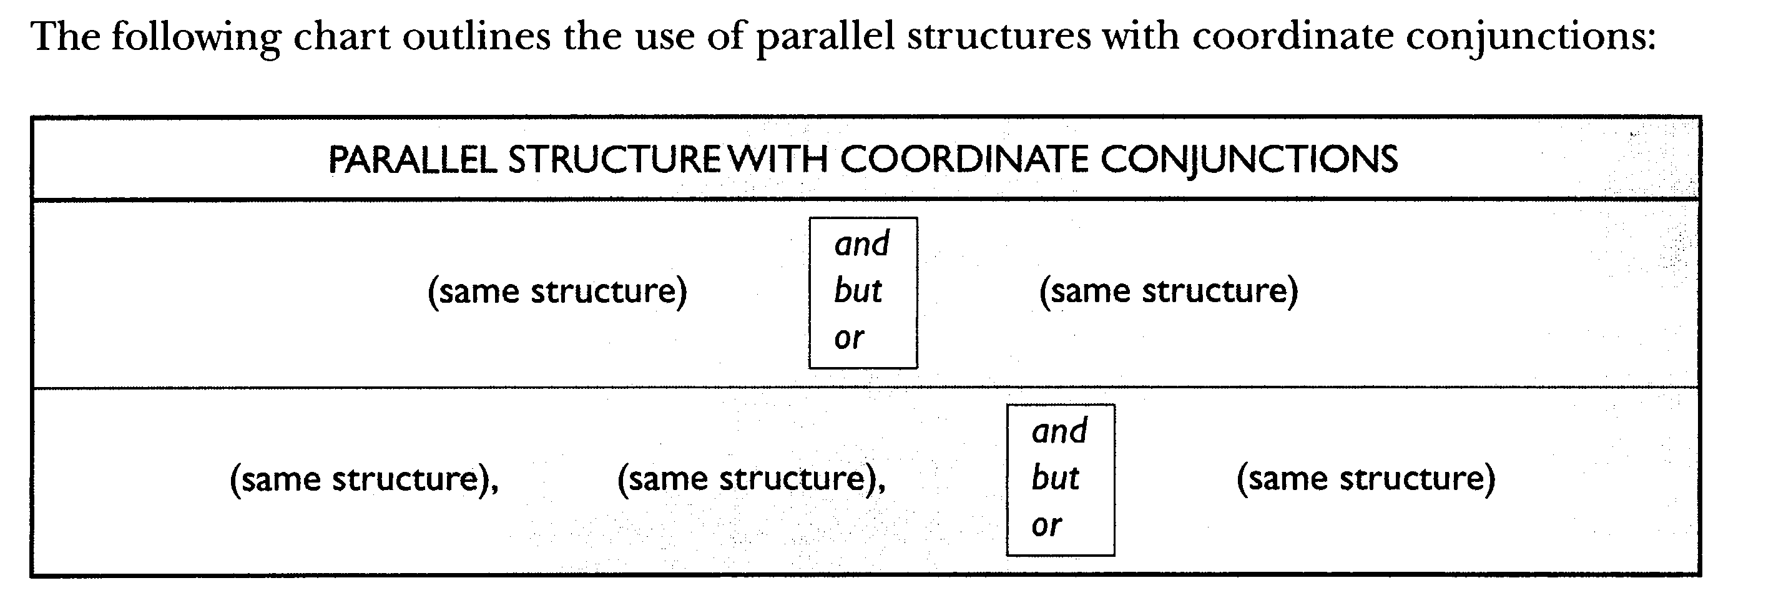

Slide 4
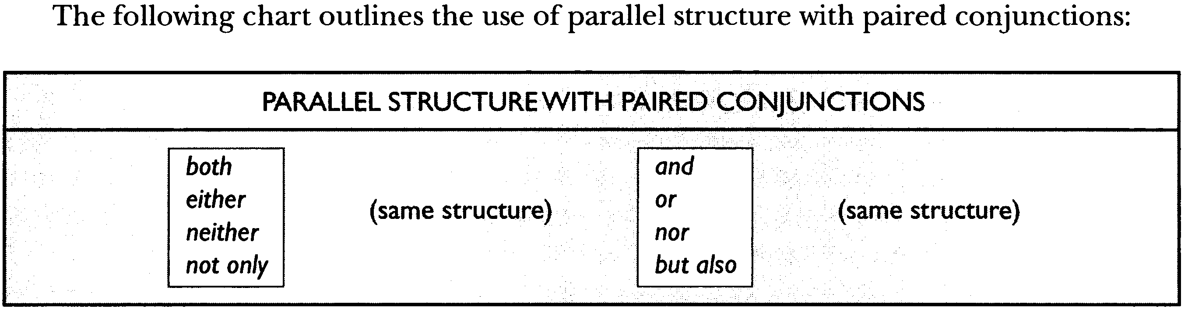

Slide 5
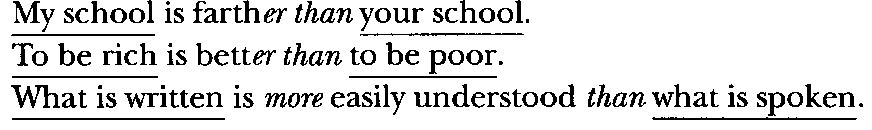
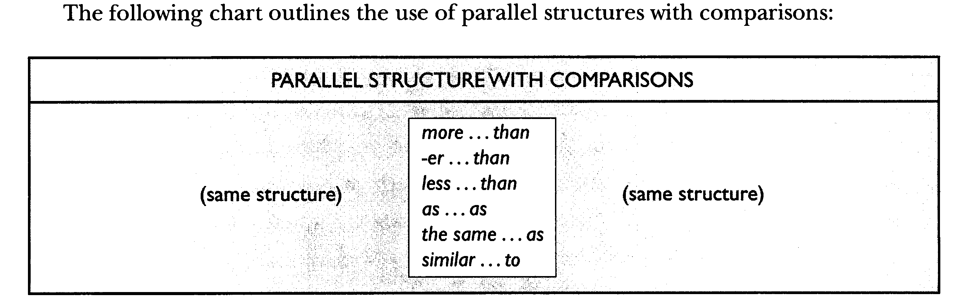

Slide 6
Adverb Clause
An adverbial clause is a dependent clause that functions as an adverb. In other words, it contains a subject (explicit or implied) and a predicate, and it modifies a verb.

Slide 7
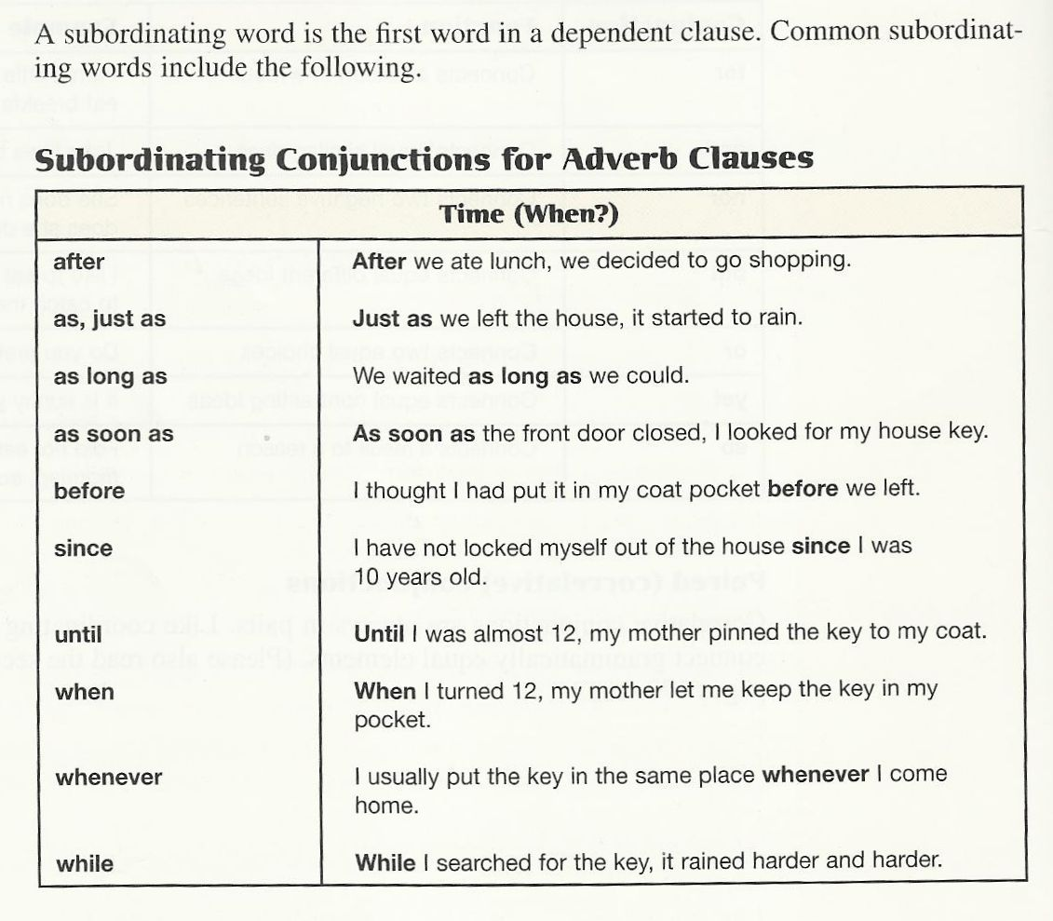
These clauses are used to say when something happens by referring to a period of time or to another event.

Slide 8
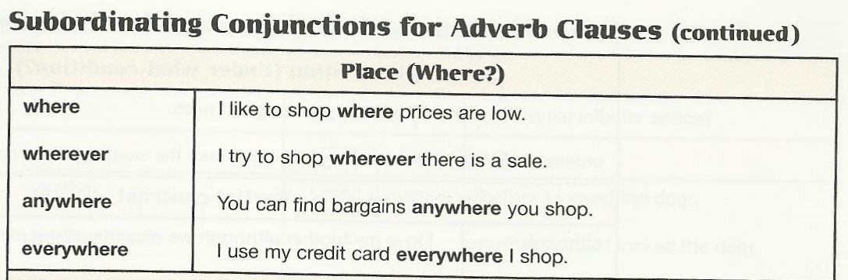
These clauses are used to talk about the location or position of something.

Slide 9
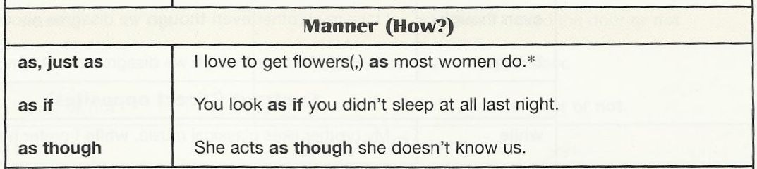
These clauses are used to talk about someone's behavior or the way something is done.

Slide 10
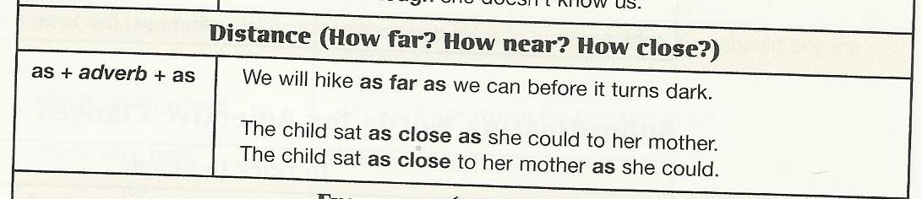

Slide 11
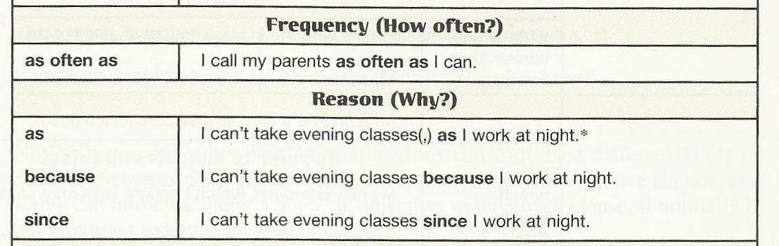
These clauses are used to indicate the reason for something.

Slide 12
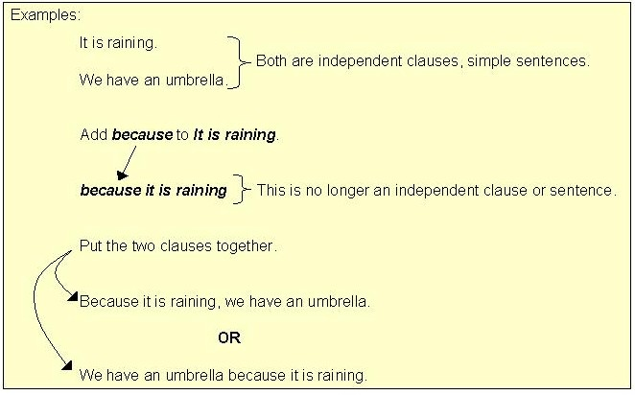
Subordinating conjunctions also join two clauses together, but in doing so, they make one clause dependent (or "subordinate") upon the other.

Slide 13
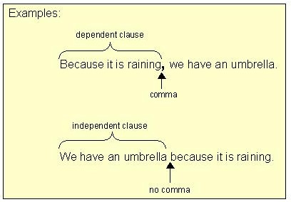
A subordinating conjunction may appear at a sentence beginning or between two clauses in a sentence.
Punctuation Note:
When the dependent clause is placed first in a sentence, use a comma between the two clauses. When the independent clause is placed first and the dependent clause second, do not separate the two clauses with a comma.

Slide 14
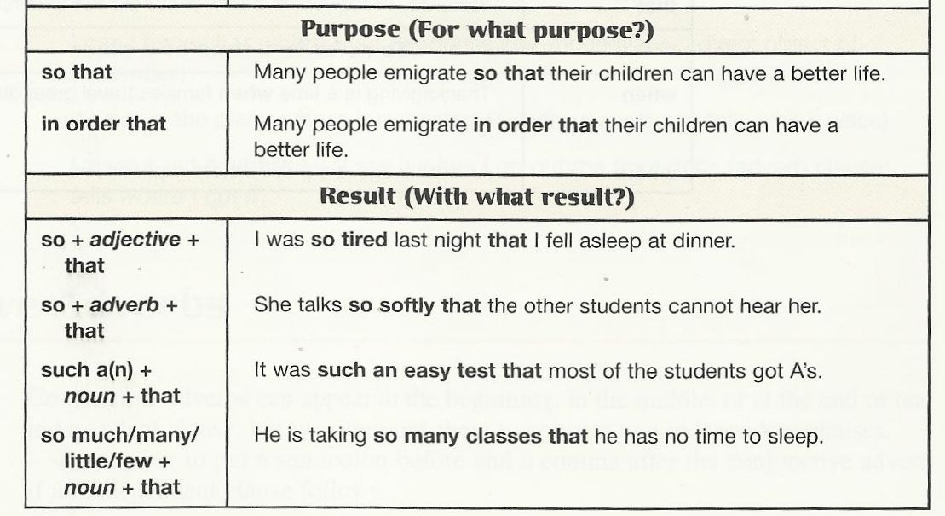
Purposes conjunctions are used to indicate the reason for something.
These clauses are used to indicate the result of something.

Slide 15
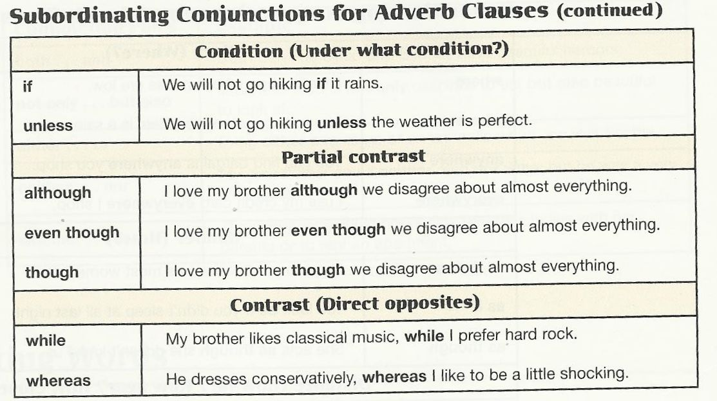
These clauses are used to talk about a possible or counterfactual situation and its consequences.
These clauses are used to make two statements, one of which contrasts with the other or makes it seem surprising.

Slide 16
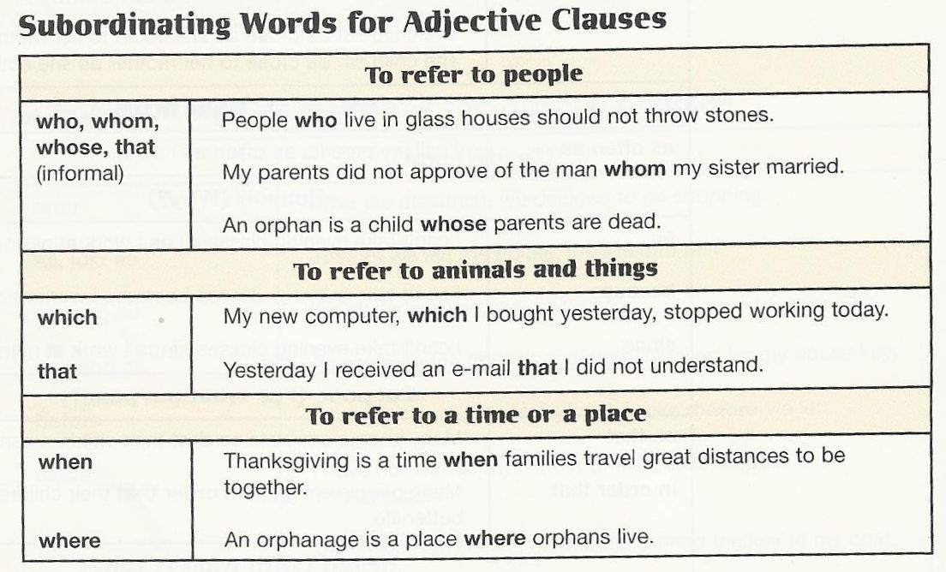
Adjective Clause is : A dependent clause that functions as an adjective and modifies a noun or pronoun. In other words, it adds extra information about that noun or pronoun.

Slide 17
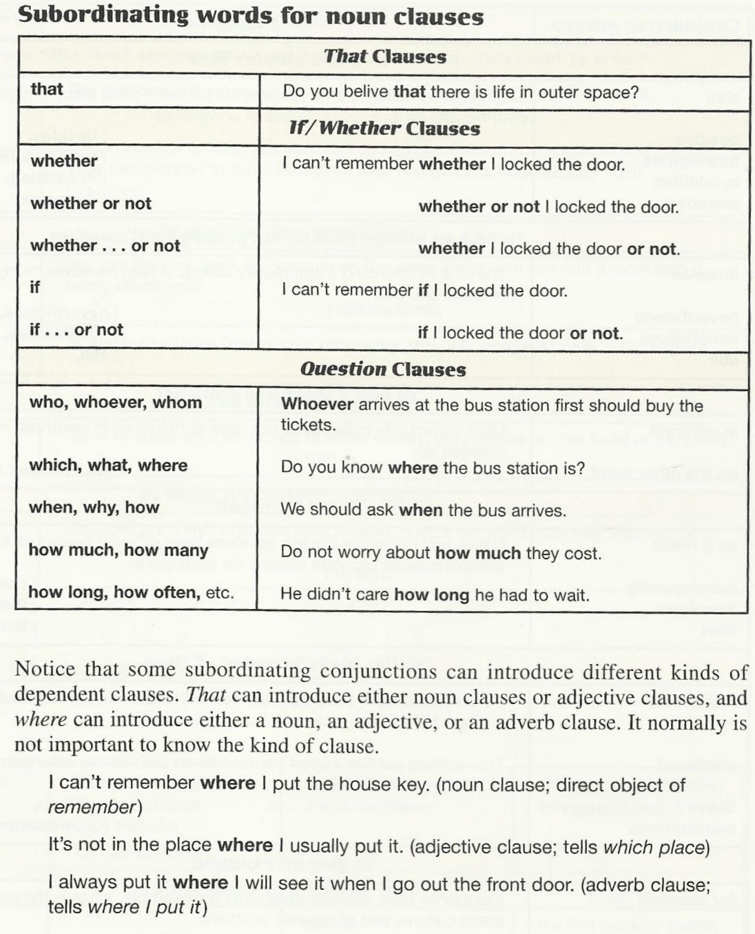
A dependent clause that functions as a noun in a sentence. Noun clauses can act as subjects, direct objects, and objects of prepositions.

Slide 18
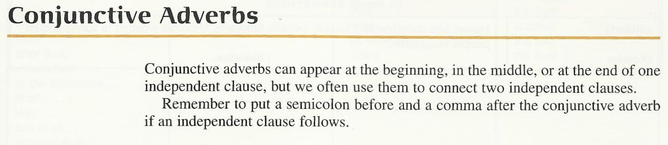
A conjunctive adverb is an adverb that connects two clauses. Conjunctive adverbs show cause and effect, sequence, contrast, comparison, or other relationships.

Slide 19
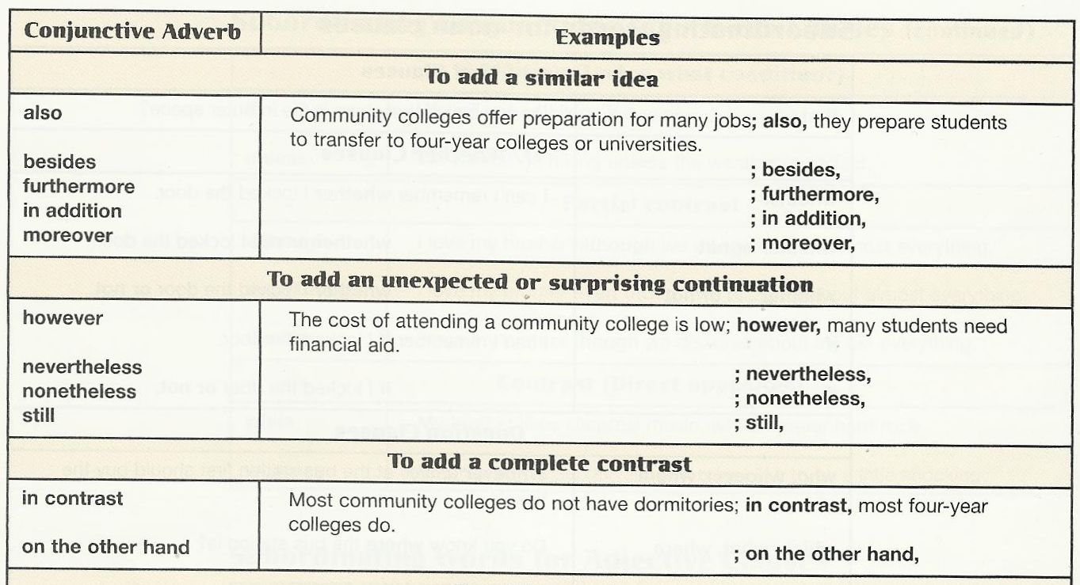

Slide 20
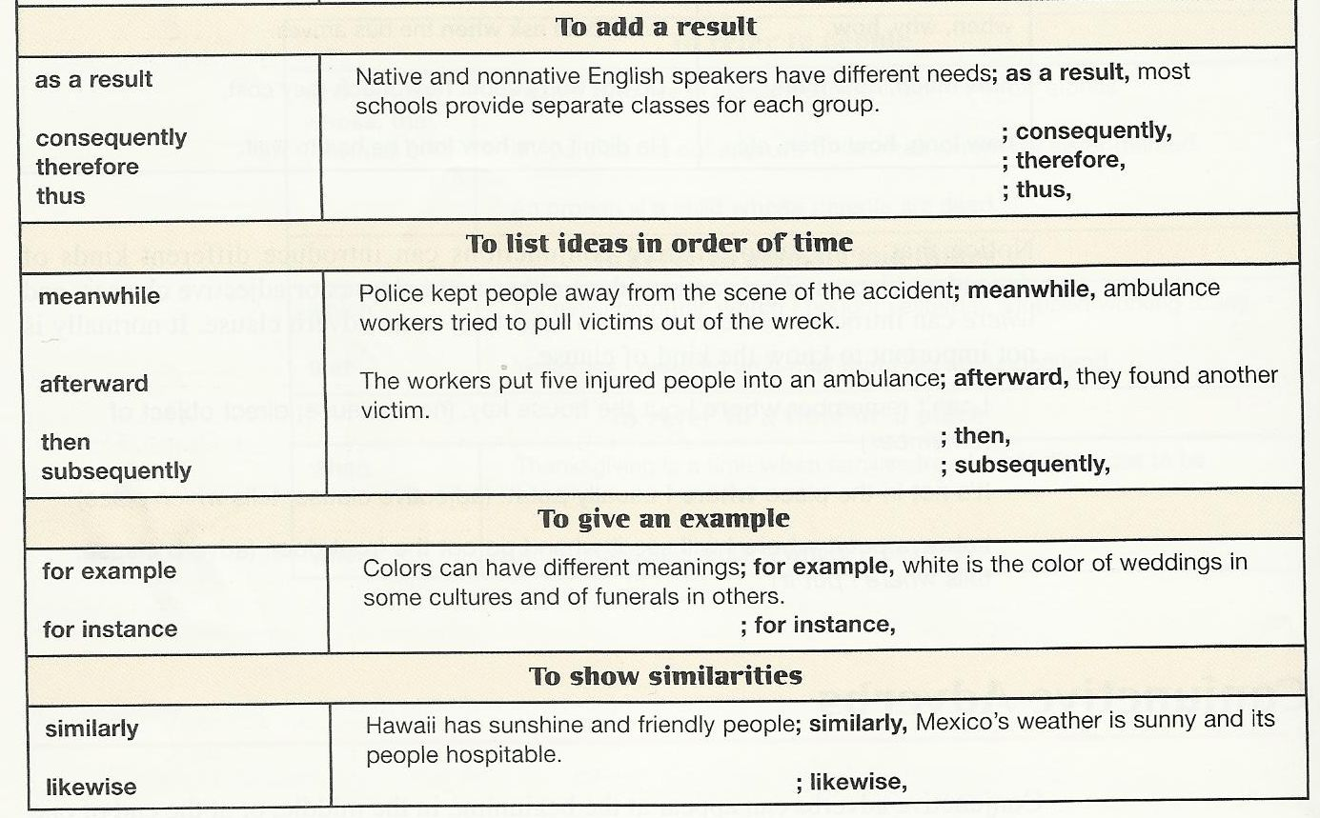

Slide 21
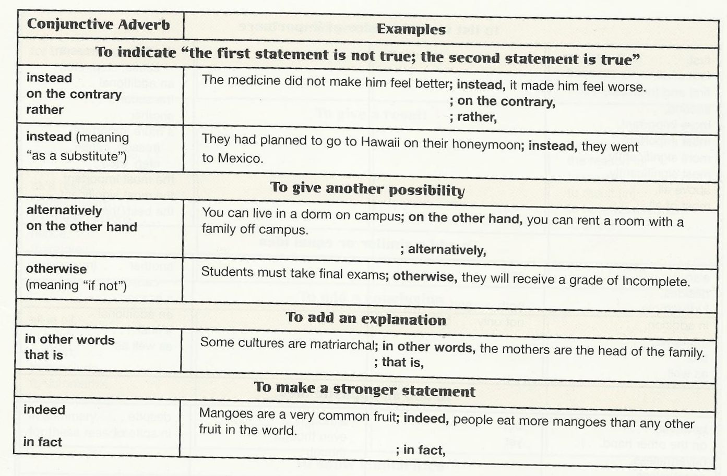

Slide 22
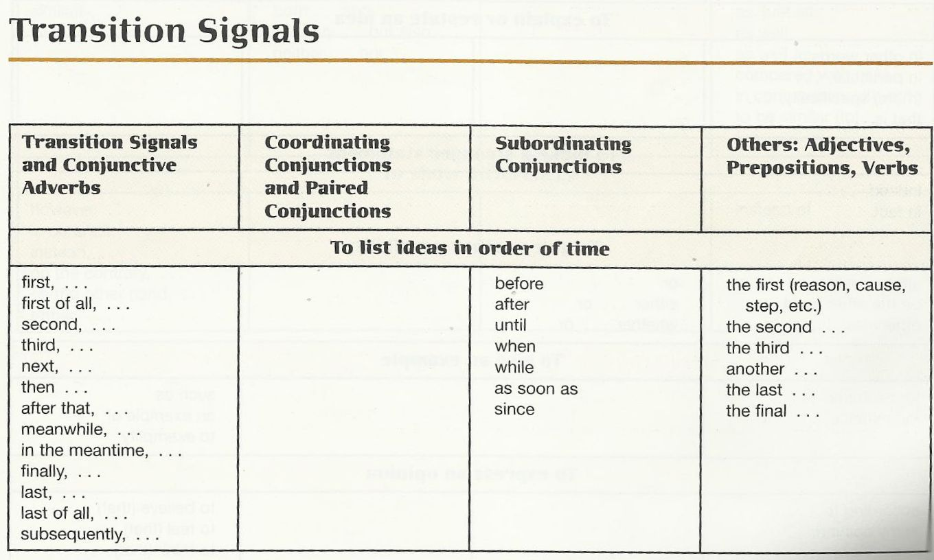
Transitions, transition words, or transitional expressions, et cetera, are certain words, expressions, or other devices that give text or speech greater cohesion by making it more explicit, or signaling, how ideas are meant by the writer or speaker to relate to one another.

Slide 23
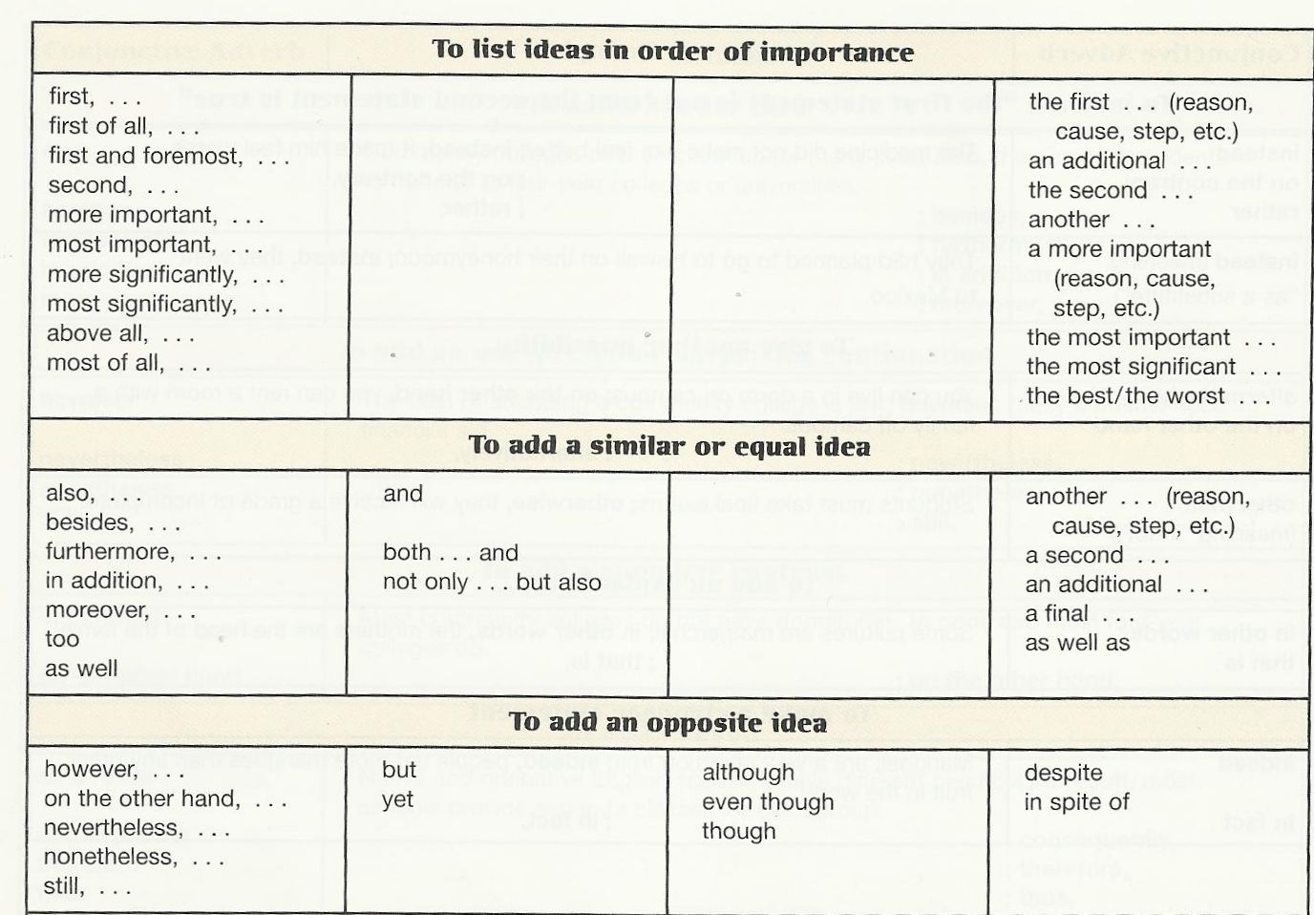

Slide 24
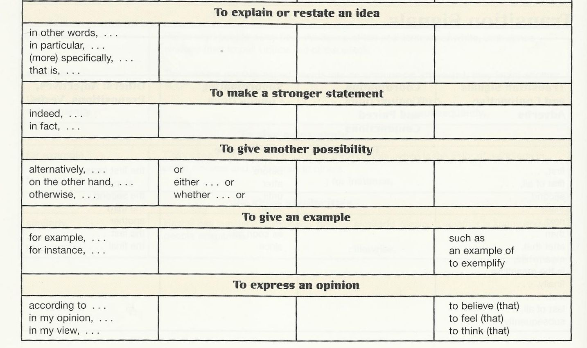

Slide 25
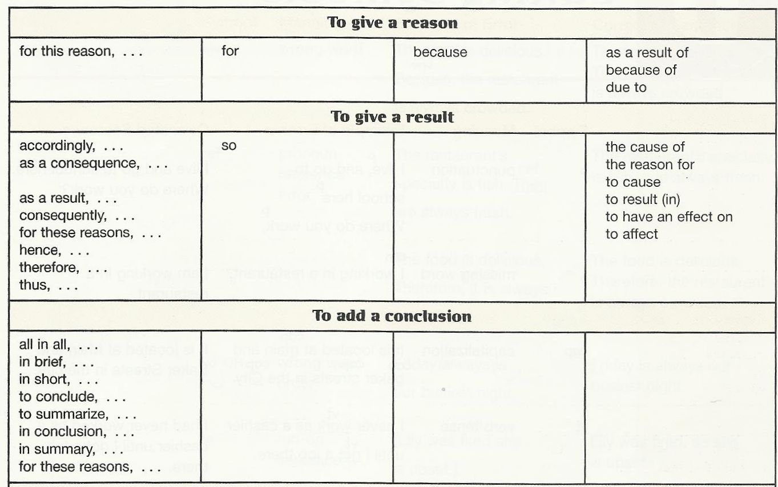

Slide 26
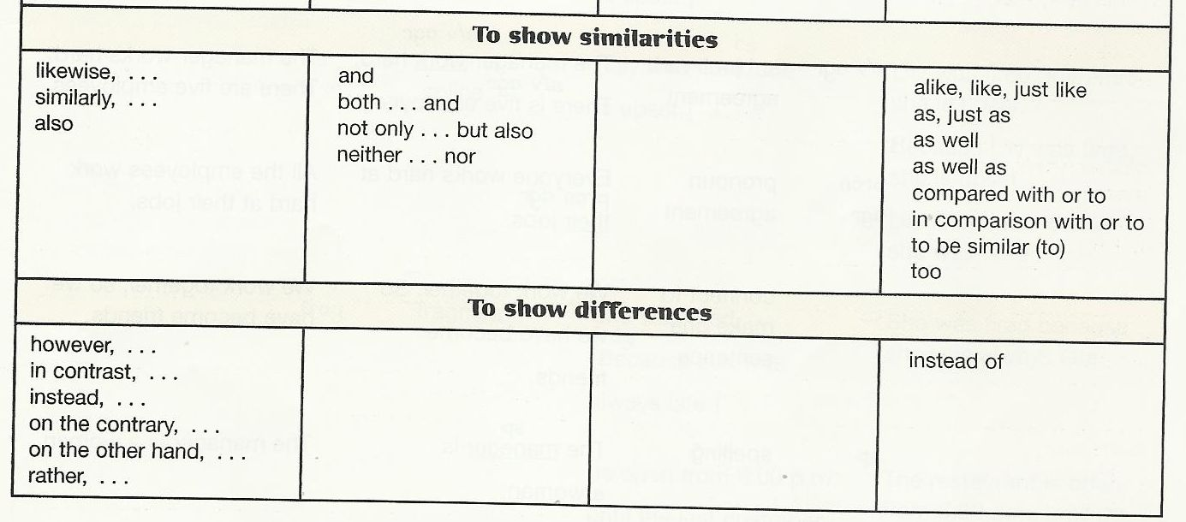

Slide 27
Exercises

Slide 28
Let’s practice:
Mr. Garcia has promised me a good job and to pay me a fair salary.
Mr. Garcia has promised me a good job and a fair salary.
The manager asked both groups to meet and share their differences and finally arriving at an agreement.
The manager asked both groups to meet and share their differences and to arrive at an agreement.
The magazine contains news, pictures, ads, tell you where to shop, and feature columns.
The magazine contains news, pictures, ads, shopping ads, and feature columns.
Tennis, modeling and to read suspense novels took up most of her time.
Tennis, modeling and reading suspense novels took up most of her time.
This is the life –to live, working and cooking outdoors.
This is the life –living, working and cooking outdoors.
Running towards the end zone, he slipped, got up, and was keeping on going as fast as he could.
Running towards the end zone, he slipped, got up, and kept on going as fast as he could.
Notes:
In correcting these sentences try to correct them in the simplest way without changing the sentences too much. Simplicity is the word!

Slide 29
It’s Your Turn Now…
Let’s go down to the store for a hamburger, donuts and drinking some coffee or tea.
After a hard fought war in a foreign land and he travels a long way home, Dad deserves a little rest.
We tried to snap pictures and catch fish, but we got mosquito bites and sunburned.

Slide 30
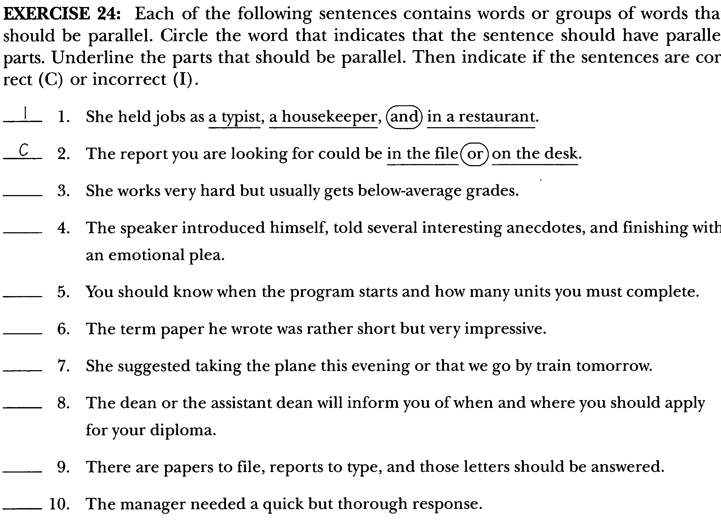

Slide 31
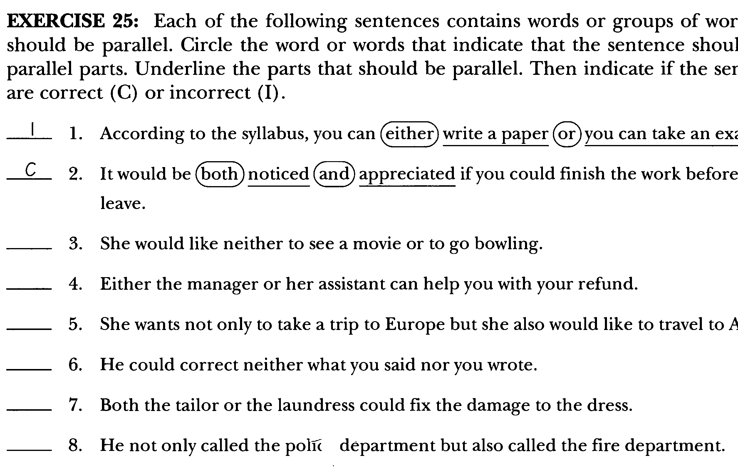

Slide 32
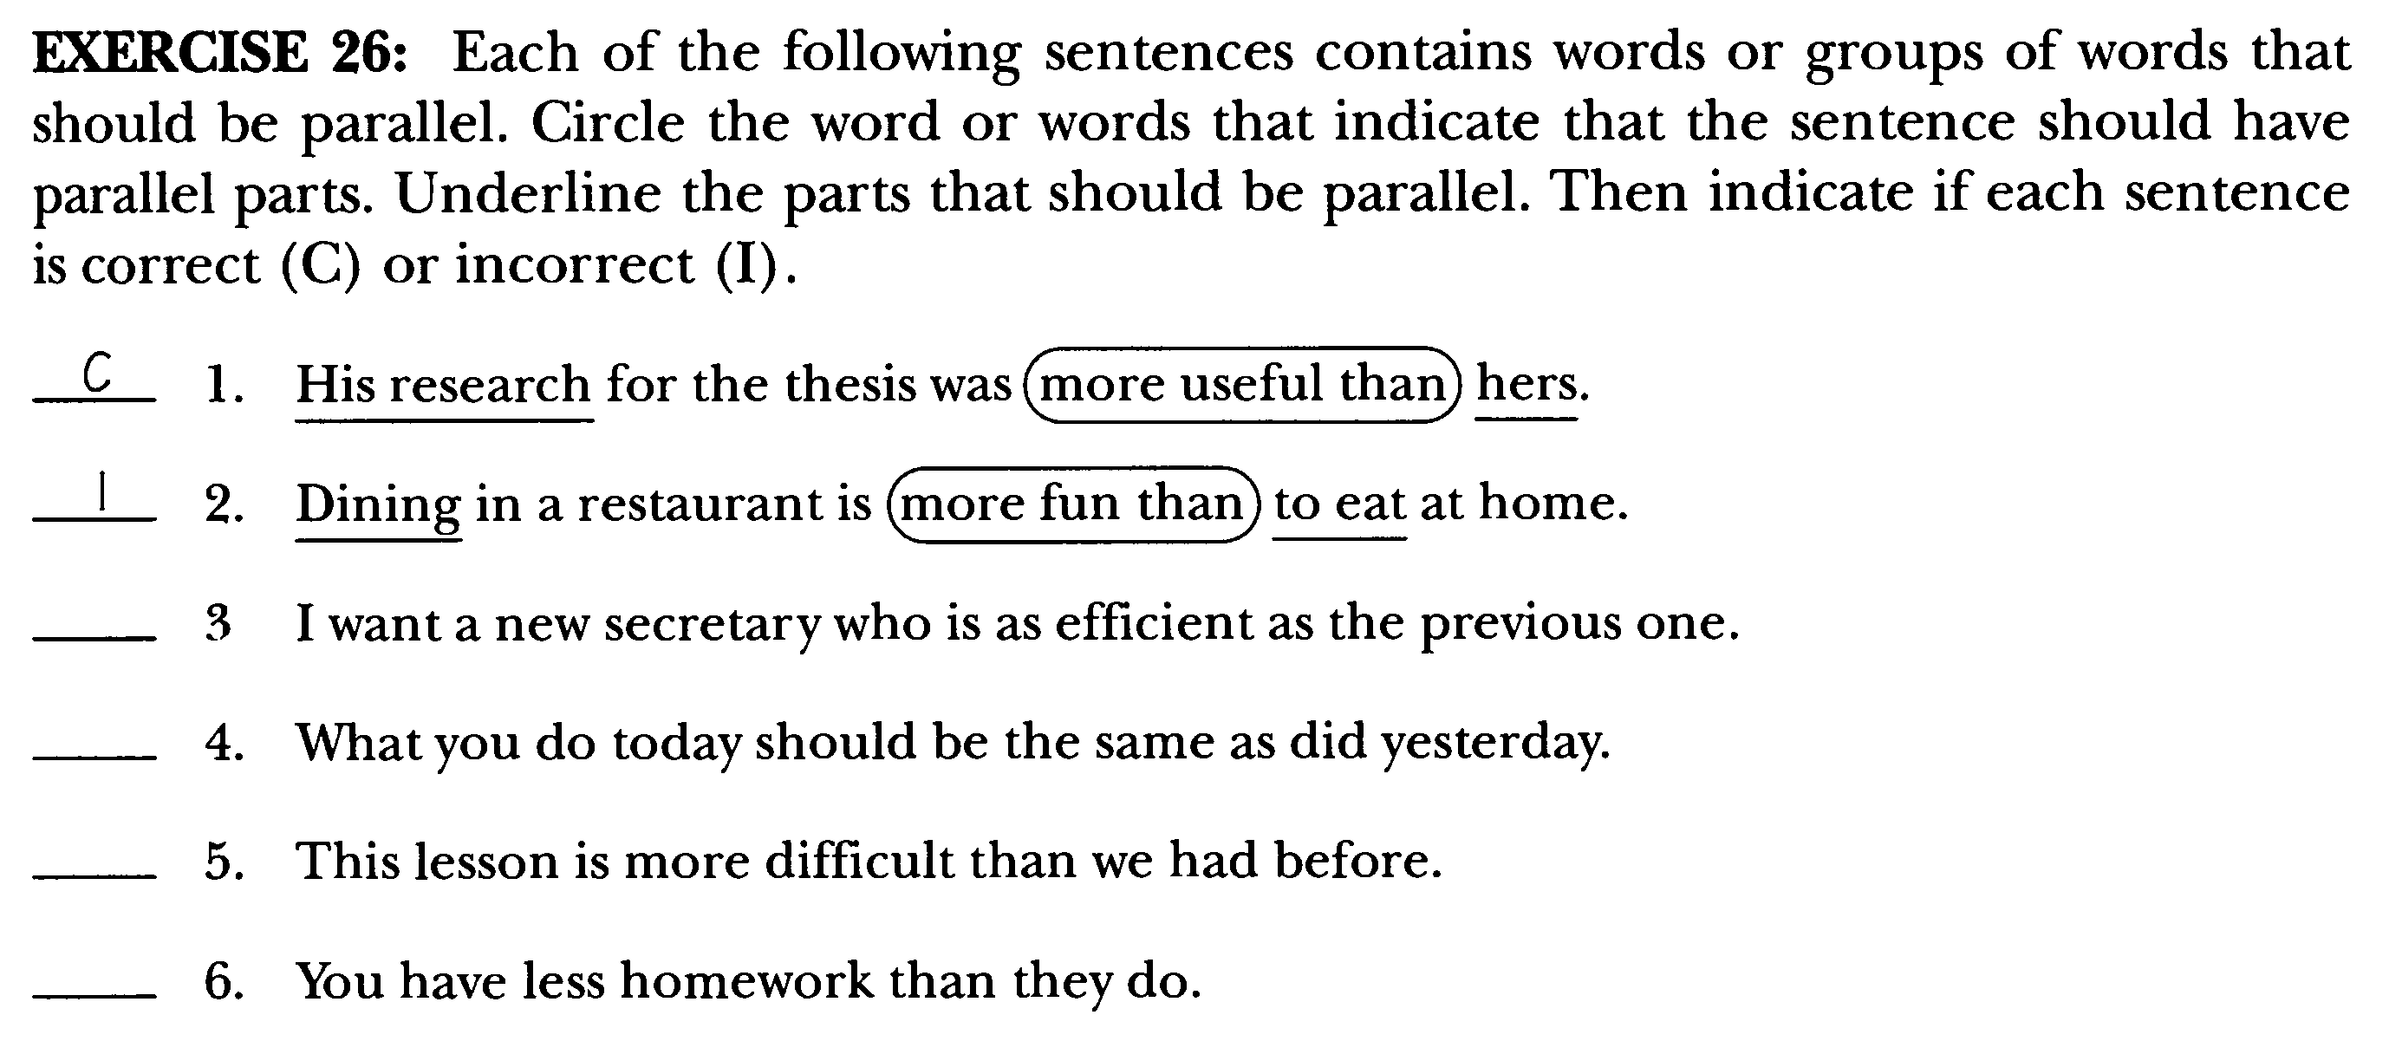

Slide 33

بحمد الله

