Slide 1

Course Title:
The Rise of the Novel
Instructor:
Dr Abdulgawad Elnady
Associate Professor of Literature, Department of English,
King Faisal University.
King Faisal University
Deanship of E-Learning
1

Slide 2
Fifth Lecture

Slide 3
In this lecture:
Censorship
How writers escaped from censorship
Individualism
Sentimentalism
Demerits of the English novel in the 18th century
Journalism
Coincidence
Elements of the novels
Summary of weaknesses
Merits of the English novel in the 18th century
Censorship
Patronage
Serialisation

Slide 4
Characteristics of the 18th Century Novel: Censorship
A Novelty means something that is strange, unfamiliar, unacceptable.
The novel was considered to be a novelty.
It could not be published easily.
This had to do with the nature of the novel at that time as it was a new genre and was considered by many to be a novelty, something which not many people were proud of. Robinson Crusoe for example was not published as a novel but a s a history or journalistic repertoire.

Slide 5
Characteristics of the 18th Century Novel: Censorship
What did writers do to escape from censorship?
Writing prefaces to justify the writing of novels
Changing the setting like solitary islands or remote places and past times
The setting is the (time- place- time and place) of the novel.
Seeking patronage
Calling the novel history or tale or adventure or just giving it any other name in order to avoid censorship.

Slide 6
Characteristics of the 18th Century Novel: Censorship
Was this good for the rising novel?
True or False?
Censorship was good for the rising novel
Of course not
Unnecessary prefaces
Exaggeration
Not giving the novel its proper name

Slide 7
Characteristics of the 18th Century Novel: Censorship
Individualism
Individualism means the interest in one's own problems, desires, hopes, ambitions, and dilemma.
It is a tendency that began in the modern ages especially the eighteenth century.

Slide 8
Individualism
Most works of art written in that age talked about individuals rather than about groups of people. Examples are Robinson Crusoe, Gulliver's Travels, Emma, Rasselas, Hamlet, King Lear, Macbeth, Othello, Romeo and Juliet, Silas Marner, and Oliver Twist.
All features of the age (geographical expansion, scientific discoveries, the clash between science and religion) led to individualism.

Slide 9
Individualism
In Robinson Crusoe, the writer focuses entirely on the character of Robinson as if no one else exists.
When Robinson deals with anyone even his parents and friends, we understand that his own good and desires come first.
That is why he does not listen to the advice of his parents or even know what happened to his friend.

Slide 10
Individualism
In Robinson Crusoe, the writer focuses entirely on the character of Robinson as if no one else exists. When Robinson deals with anyone even his parents and friends, we understand that his own good and desires come first. That is why he does not listen to the advice of his parents or even know what happened to his friend.

Slide 11
sentimentalism
Tendency to shed tears over any occasion
It is affected and not sincere
It is a demerit

Slide 12
Verisimilitude
A French term
Verite
Smili
Tude
= realism= probable= possible= can happen
Things as they can be not things as they are

Slide 13
Features of the novel
Title expressive (remote-exotic)
Prefaces
No dialogue
Illustrations
repetition
All places very queer
Setting
Sharp but indirect criticism

Slide 14
Demerits
Titles of novels and chapters
Subtitles
Coincidence
Language
Illustrations

Slide 15
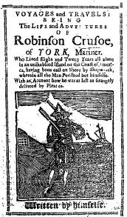

Slide 16


Slide 17
Robinson Crusoe by Daniel Defoe

Slide 18
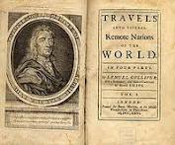

Slide 19
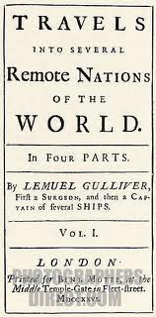
Gulliver’s Travels by J Swift

Slide 20
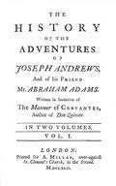
Joseph Andrews by henry fielding

Slide 21
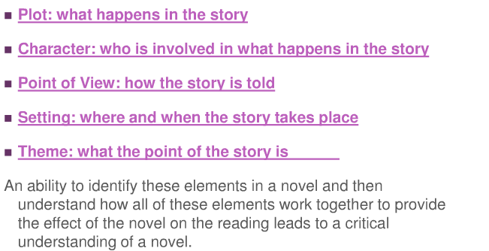
Elements of the Novel

Slide 22
Summary of Weaknesses
Titles of novels and chapter headings:
sentences
Repetition
Structure
plots
story-telling
Coincidence
Sentimentalism
long and detailed
Long and complex
Repetition
Weak
Weak
Loose, multiple
Crude and abrupt
Overrated and revolting

Slide 23

بحمد الله

