Slide 1
Transition Signals
To introduce an additional idea: in addition, furthermore, moreover, besides, also, too, and.
To introduce an opposite idea or contrast: on the other hand, in contrast, however, nevertheless, instead, still, and nonetheless, but, yet, although, while, whereas, though, even though..
To introduce a choice or alternative: otherwise, or, if, unless.
To introduce a restatement or explanation: in fact, indeed, that is .
To list in order: first, second, third, next, last, finally, the first, second, the next, last, final…
To introduce an example: for example, for instance
To introduce a conclusion or summary: clearly, in brief, in conclusion, indeed, in short, in summary
To introduce a result: accordingly, as a result, as a consequent, therefore, consequently, hence, thus, so

Slide 2
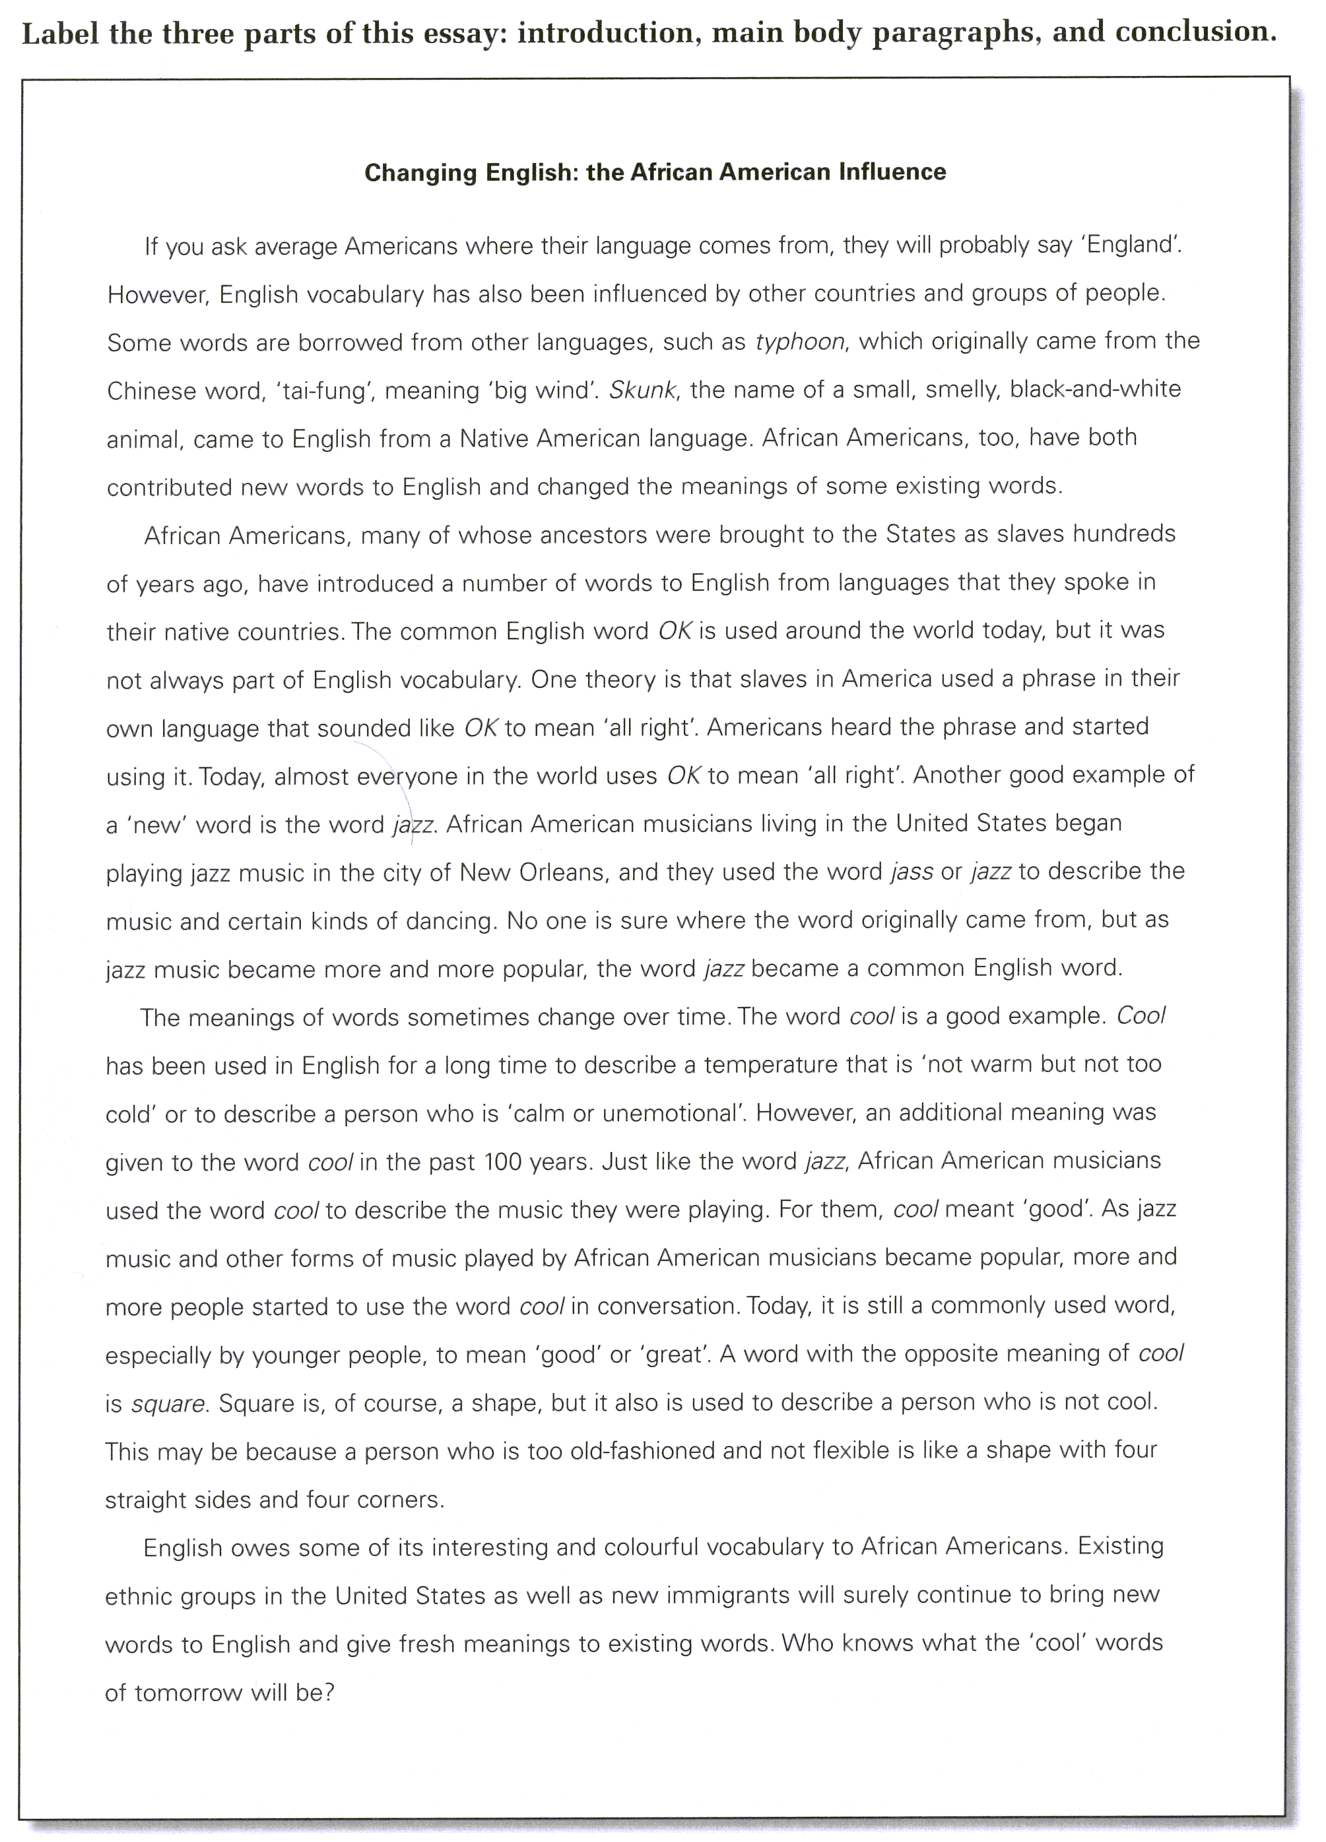

Slide 3
2. Dramatic, interesting, or funny story introduction
A dramatic, humorous, or otherwise interesting opening will generate interest in the reader. It is important, after all, to capture the reader’s attention. For process paper’s it is often useful to begin with a description of a scene that establishes the need for a process explanation. Observe here how one student uses a description to set up a process essay.

Slide 4
Underline the Thesis Statement
The rain pours down as if running from a faucet, lightning streaks across the dark restless sky, and thunder pounds the roof and walls of the house. All of a sudden the wind kicks up. Trees sway madly back and forth; loose objects are picked up and thrown all around. The house creaks and moans with every gust of wind. Windows are broken by pieces of shingle from a neighbor’s roof or by loose objects picked up by the wind. Power lines snap like thread. The unprepared house and its occupants are in grave danger as the awesome hurricane approaches. Had they prepared for the hurricane, they might not be in such danger. Indeed, careful preparation before a hurricane is essential to life and property.

Slide 5
3. Surprising Statistics or Facts Introduction
Got high blood pressure? Try a truffle. Worried about heart disease? Buy a bon-bon. It’s the best news in years! Studies in two prestigious scientific journals say dark chocolate is good for you. It seems that eating a small piece of dark chocolate regularly can reduce the risk of heart disease because dark chocolate – but not milk chocolate or white chocolate – contains high amounts of flavenoids, powerful cholesterol-fighting compounds. What is the next health food going to be? Ice cream? Sugar cookies? There are so many conflicting news stories about which foods are good for you that it is often difficult to make the right choices at the supermarket.

Slide 6
4. Historical Background Introduction
The Pilgrims who arrived in Massachusetts in 1620 came to find religious freedom. In the seventeenth and eighteenth centuries, large numbers of African men and women were brought as slaves to work on large plantations in the South. Immigrants from northern and southern Europe came in the early nineteenth century to escape poor economic conditions at home. Later in the nineteenth century, the first immigrants from China came as contract laborers to build the railroads connecting East and West. In the twentieth century, political and economic refugees arrived from Asia, Eastern Europe, and Latin America. Indeed, the United States has seen immigrants come from many different parts of the world, and they have come for many different reasons. Their ability to adjust to life in their adopted land has depended on several factors.

Slide 7

Thesis Statements

Slide 8
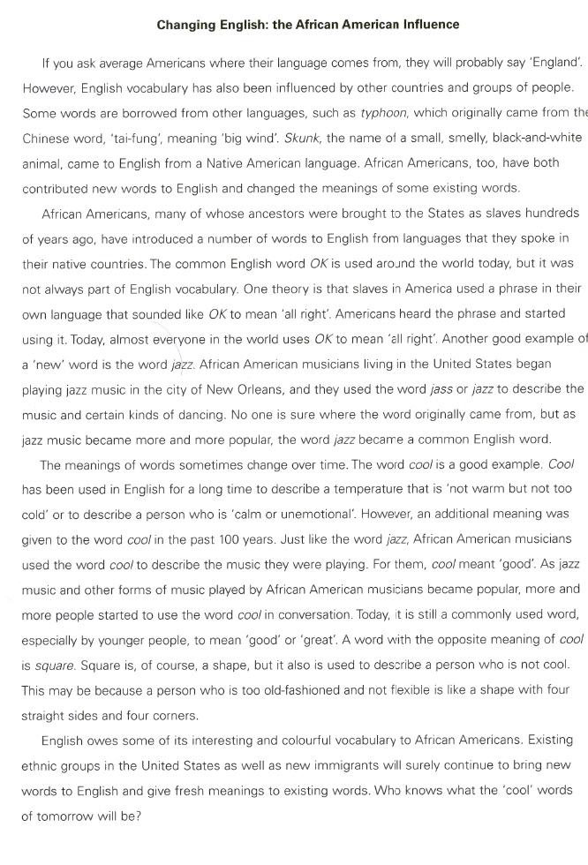
Underline the Thesis Statement

Slide 9
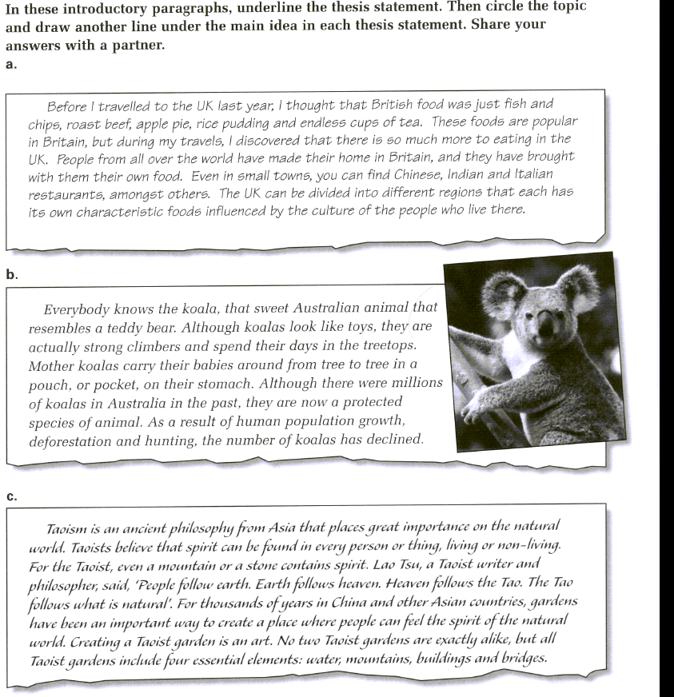

Slide 10


Slide 11
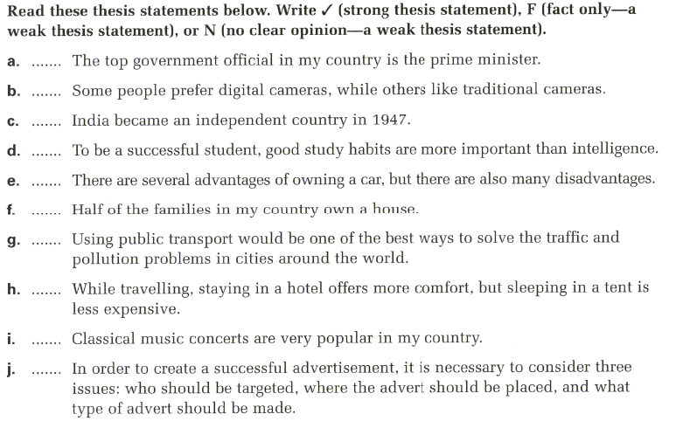

Slide 12
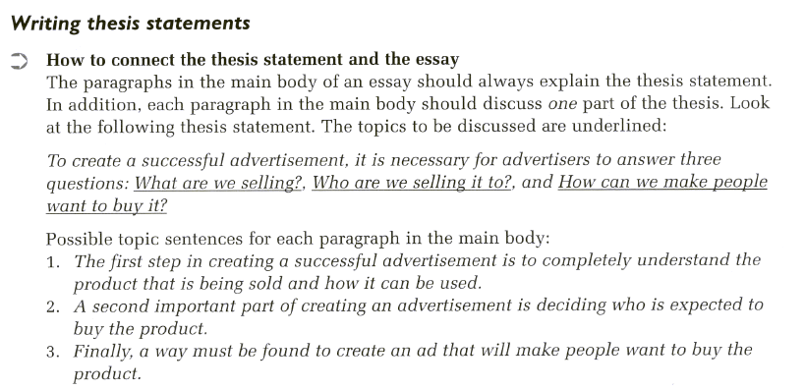

Slide 13
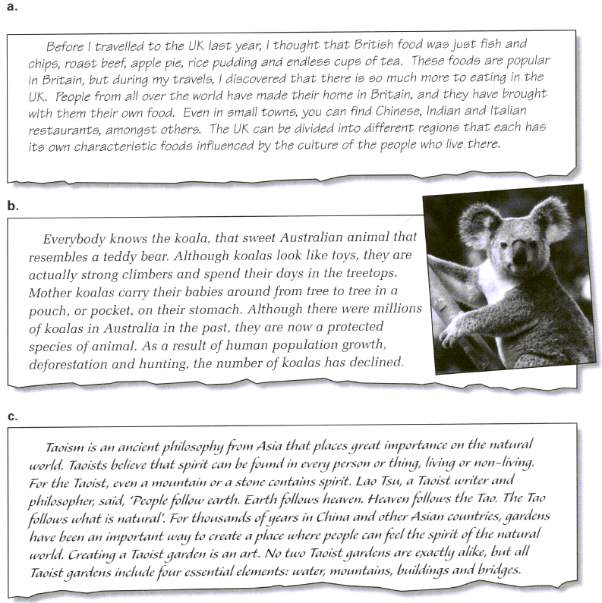
Look at these introductory paragraphs. What should the paragraphs in the main discuss for each thesis statement?

Slide 14
