Slide 1

English Language
Essay
Instructor:
Ammar Sultan Al-Ma’ani
King Faisal University
e- Learning Deanship
& Distance Education
1

Slide 2
^{14th} Lecture
Review

Slide 3
The Introductory Paragraph
It has two parts:
A. General statements
1. introduce the general topic of the essay
2. capture the reader’s interests
B. Thesis statements
1. states the specific topic
2. may list subtopics or subdivisions of the main topics
3. may indicate the pattern of organization of the essay
4. is normally the last sentence in the introductory paragraph,

Slide 4
Different Models of Introductory Paragraph
Funnel Introduction
Dramatic, interesting, or funny story introduction
Surprising Statistics or Facts Introduction
Historical Background Introduction

Slide 5

Thesis Statements

Slide 6
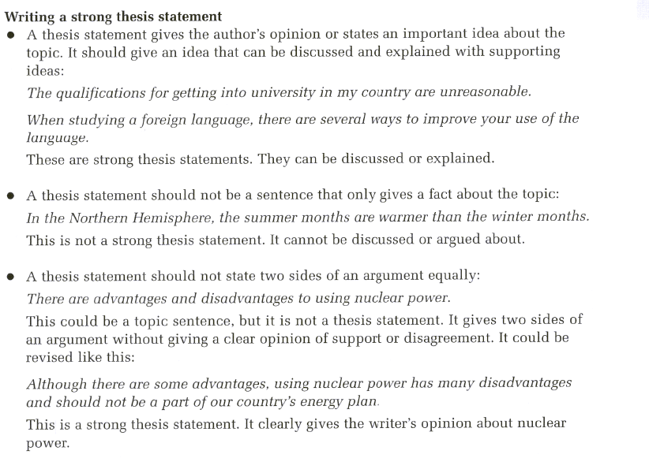

Slide 7
Body Paragraphs
The body paragraph in an essay are like the supporting sentences in a paragraph. They are the place to develop your topic and prove your points. You should organize your body paragraph according to some sort of pattern, such as
- Chronological order
- Comparison/ contrast
- or both

Slide 8
Logical division of Ideas
( basic pattern for essays is logical division of ideas.)
In this pattern, you divide your topic into subtopics and then discuss each subtopic in a separate paragraph.
Logical division is an appropriate pattern for explaining causes, reasons, types, kinds, qualities, methods, advantages, and disadvantages, as these typical college exam questions ask you to do.
For Example: College questions are as the following:
Economic Explain the three causes of inflation
Agriculture/ Landscape design Describe the basic types of soils and additives needed to prepare each type for planting.

Slide 9
Thesis statement Pitfalls.
A thesis is the most important sentence in your essay, so write it with special though and care. Avoid these common problems:
Problem 1: The thesis is too general.
TOO GENERAL A college education is a good investment.
IMPROVED A college education is a good investment for four reasons.
TOO GENERAL Lasers are very useful .
IMPROVED lasers have several applications in industry and medicine.
TO BE CONTINUED →

Slide 10
Thesis Statement Second Pitfall.
Problem 2: The thesis makes a simple announcement.
ANNOUNCEMENT I am going to write about sports injuries.
IMPROVED Avoid sports injuries by taking a few simple precautions.
Problem 3: The Thesis stats an obvious fact.
OBVIOUS FACT The internet is a communication superhighway.
IMPROVED The explosion of the internet has had both positive and negative consequences.

Slide 11
Transition Signals For Logical Division of Ideas… Here are some examples
Transition signals for logical division essays include many that you may already know.
Transition Words or Phrases
first, first of all, second, third, etc. next, last, finally, also, in addition, moreover, furthermore | First, excessive government spending can lead to inflation. In addition, unrestrained consumer borrowing can cause inflationary tendencies. Finally, an increase in the supply of paper money gives rise to inflation

Slide 12
Concluding Paragraph
The conclusion is your last chance to make your point clear.
The concluding paragraph consists of:
• A summary of the main points, or a restatement of your thesis in different words;
• Your final comment on the subject, based on the information you have provided.
The concluding paragraph should be introduced with a conclusion transition signal:
in conclusion, in summary, in brief, in short, indeed

Slide 13

What’s Essay Outlining ?
Before you begin writing the first
draft of your essay, it is best to make
an outline. An outline is a general
plan of what you are going to write.
You can compare making an outline
to drawing plans to build a house.
Before one begins to build a house, it
is best to draw up plans to make sure
that a house is built in the way you
want. The same is true with writing
an essay and making an outline.

Slide 14
Example
Outline
Here is an example of how a blank outline might look:
Essay Outline
Introduction Thesis: _____________________
Body Paragraph #1- Topic Sentence: _____________
A. supporting idea
B. supporting idea
III. Body Paragraph #2- Topic Sentence: ____________
A. supporting idea
B. supporting idea
IV. Body Paragraph #3- Topic Sentence: ____________
A. supporting idea
B. supporting idea
V. Conclusion

Slide 15
The Process
Making an Outline
In a formal outline,
Roman numerals can
be used to represent
paragraphs. Capital
letters can be used to
represent supporting
details for the
paragraphs.
Click here to see a
list of Roman numerals.
Essay Outline
I. Introduction Thesis: ____________________
II. Body Paragraph #1- Topic Sentence: _________
A. supporting idea
B. supporting idea
III. Body Paragraph #2- Topic Sentence: _________
A. supporting idea
B. supporting idea
IV. Body Paragraph #3- Topic Sentence: _________
A. supporting idea
B. supporting idea
V. Conclusion

Slide 16

Elements of the Lecture
Process Essay (Practice)
Cause and Effect Essay

Slide 17
Process Essay
A Process essay is a description of a procedure, a step-by-step analysis and explanation of a process.
You are "the expert" and the organization of the essay is governed by chronological order, so it should be the easiest essay to write for you.

Slide 18
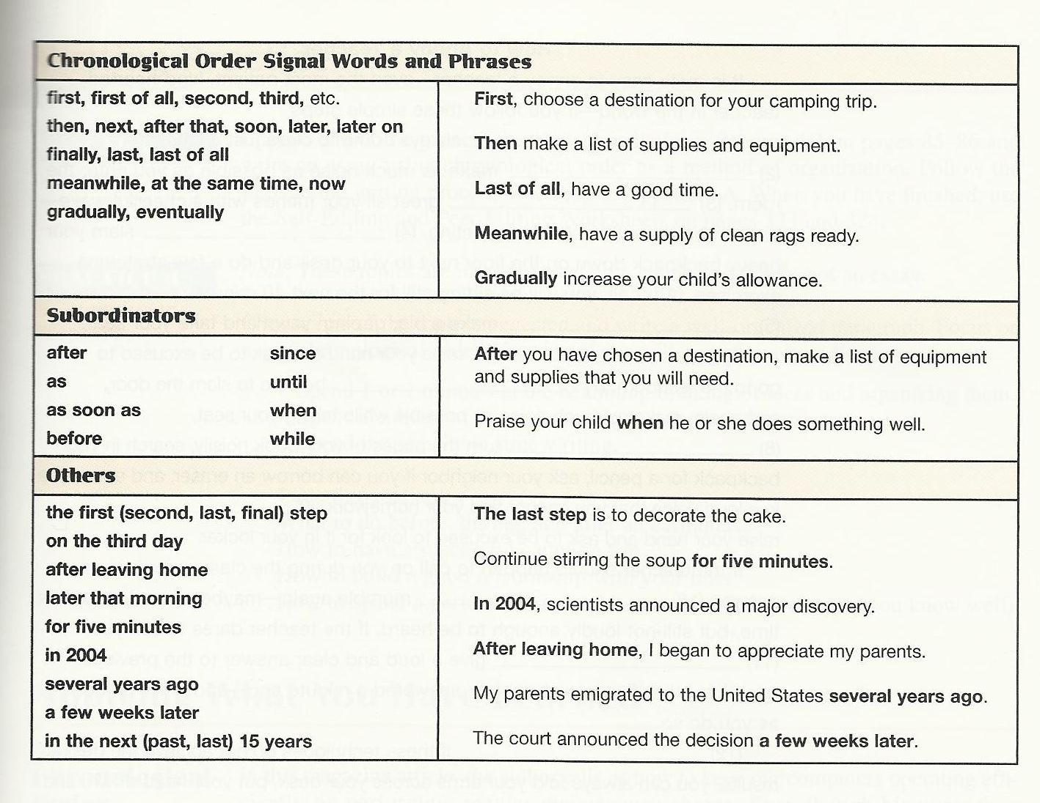

Slide 19


What is a cause? What is an effect?
Cause and effect depend on each other. You can’t have one without the other. A plane crashed. That is the effect. What are the possible causes? Was it a mechanical or human error? Was it due to the weather? Was it a terrorist action? Obviously there are many possible causes.

Slide 20
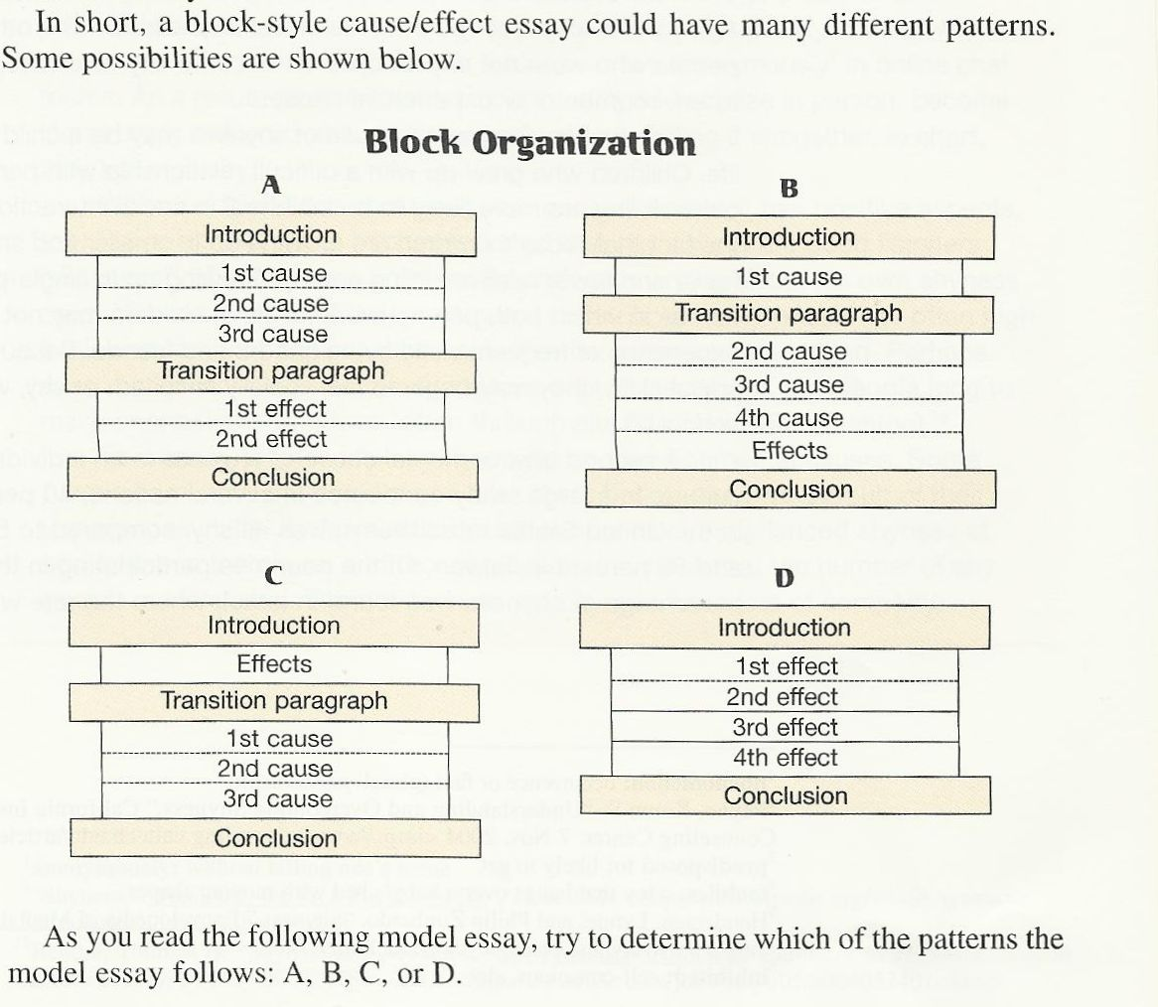

Slide 21
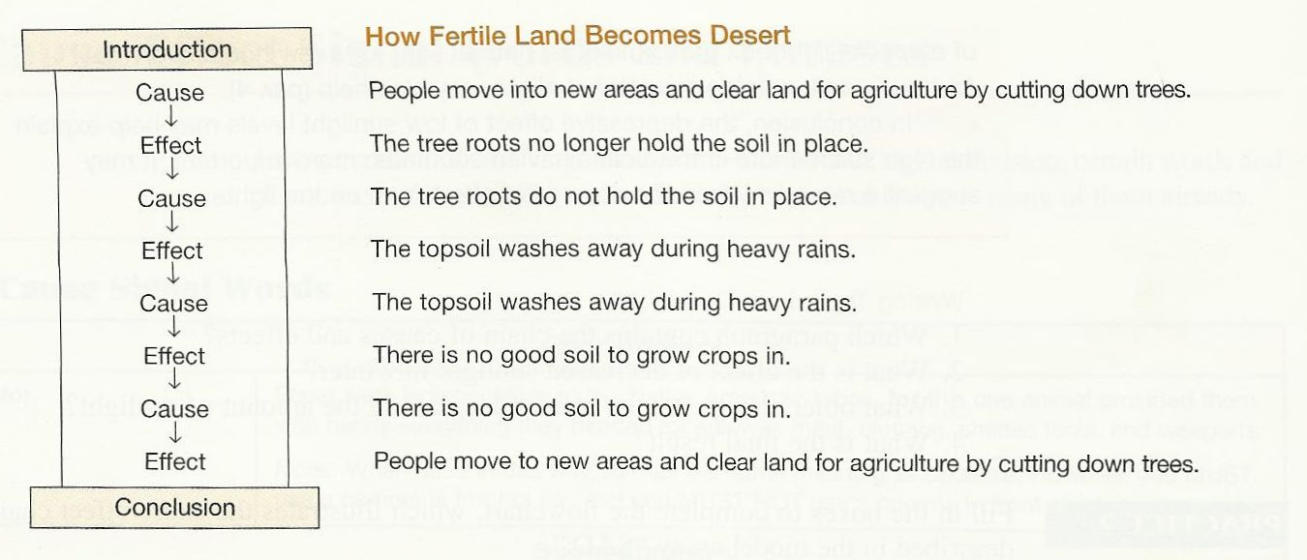
Notice the Chain Organization

Slide 22
What are Comparison and Contrast Essays?
Comparing things is something we do every day when we have to make decisions. For example, you might think of similarities or differences when we are buying a new MP3 player or choosing a place to study English.
You may need to evaluate two sides of an issue you have studied in a class or two proposals for research or projects at your workplace. In these cases, you will need to write an essay or report to discuss your ideas about the topic. This is a comparison and contrast essay.

Slide 23
Comparison/Contrast Essay Organization
Like other types of essays, a comparison and contrast essay must have a clear introduction and conclusion.
The body of the essay can be organized many ways. We will look at two organizational styles.
Point by point organization
Block organization

Slide 24
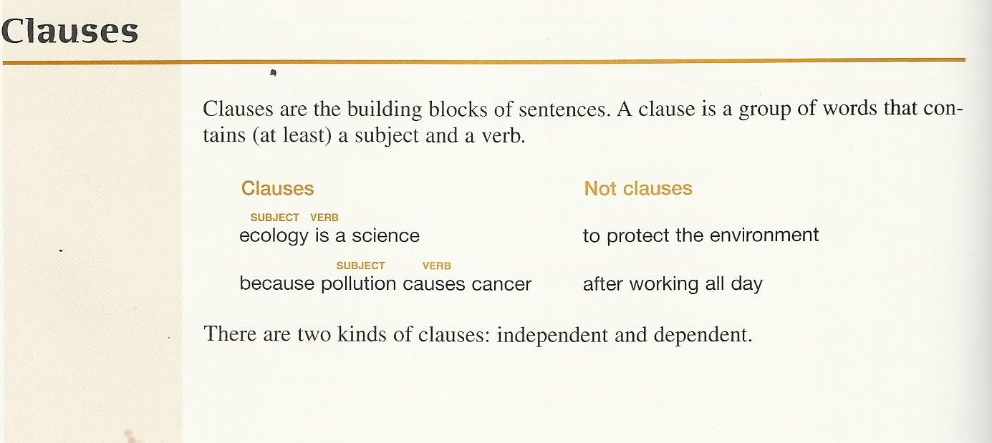

Slide 25
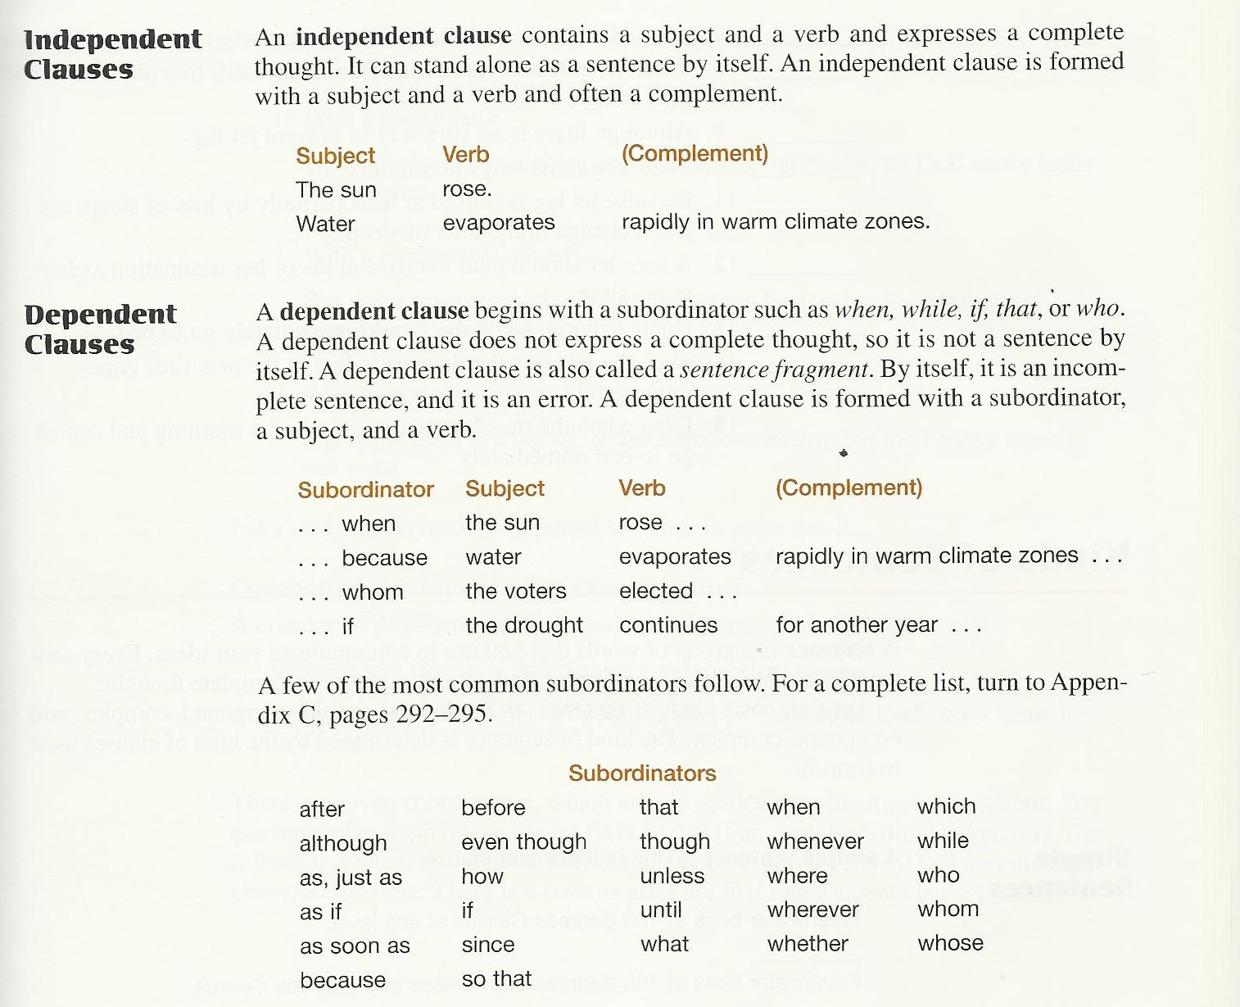

Slide 26
The Simple Sentence
A simple sentence has one independent clause (one subject and a verb):
I live in San Francisco.
Subject
Verb

Slide 27
Compound Sentence
A compound sentence contains two independent clauses that are joined together.
She works in the city, but she lives in the suburbs.
Independent Clause
Independent Clause

Slide 28
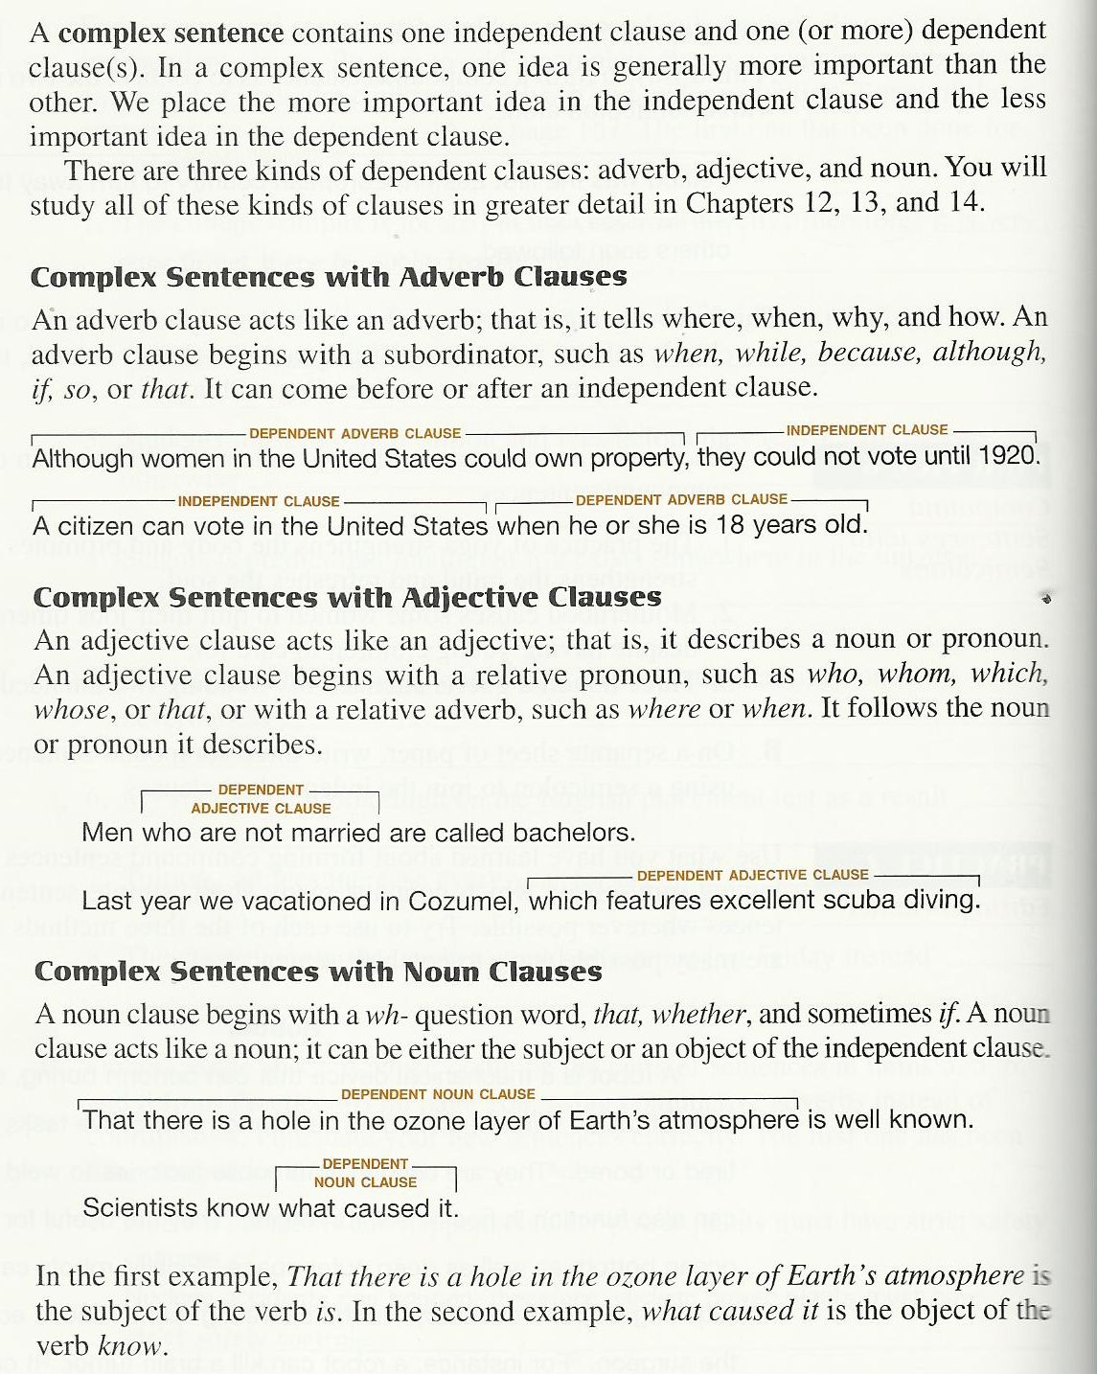

Slide 29
What is parallelism in grammar?
The best way to understand the idea of parallelism is to look at examples.
For example:
(Not parallel)
We wanted to cook and to go swimming.
(Parallel)
We wanted to cook and to swim.

Slide 30
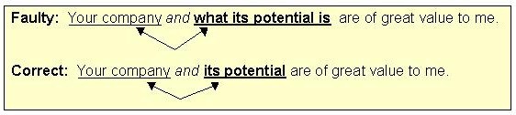
How Can we make a paralleled structure?
Use parallel structure with elements joined by coordinating conjunctions.

Slide 31
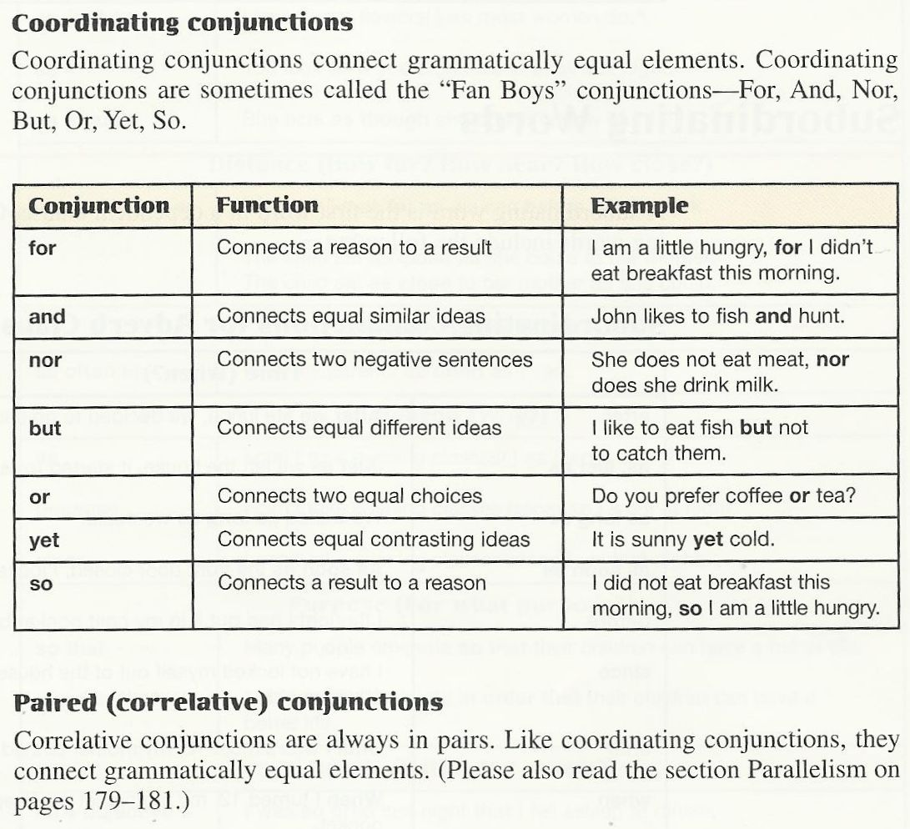

Slide 32
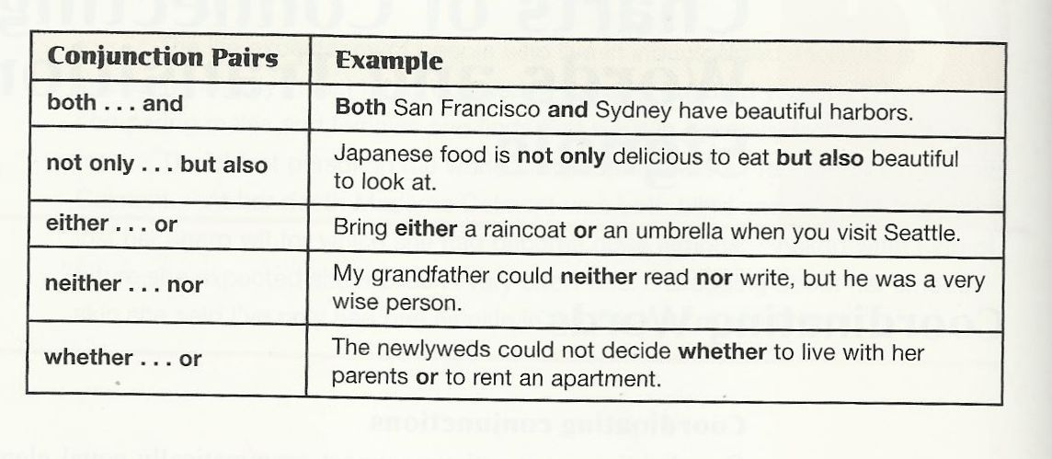
PAIRED CONJUNCTION

Slide 33
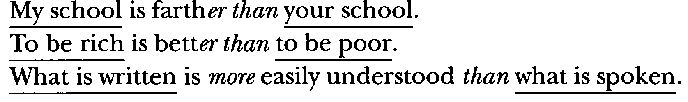
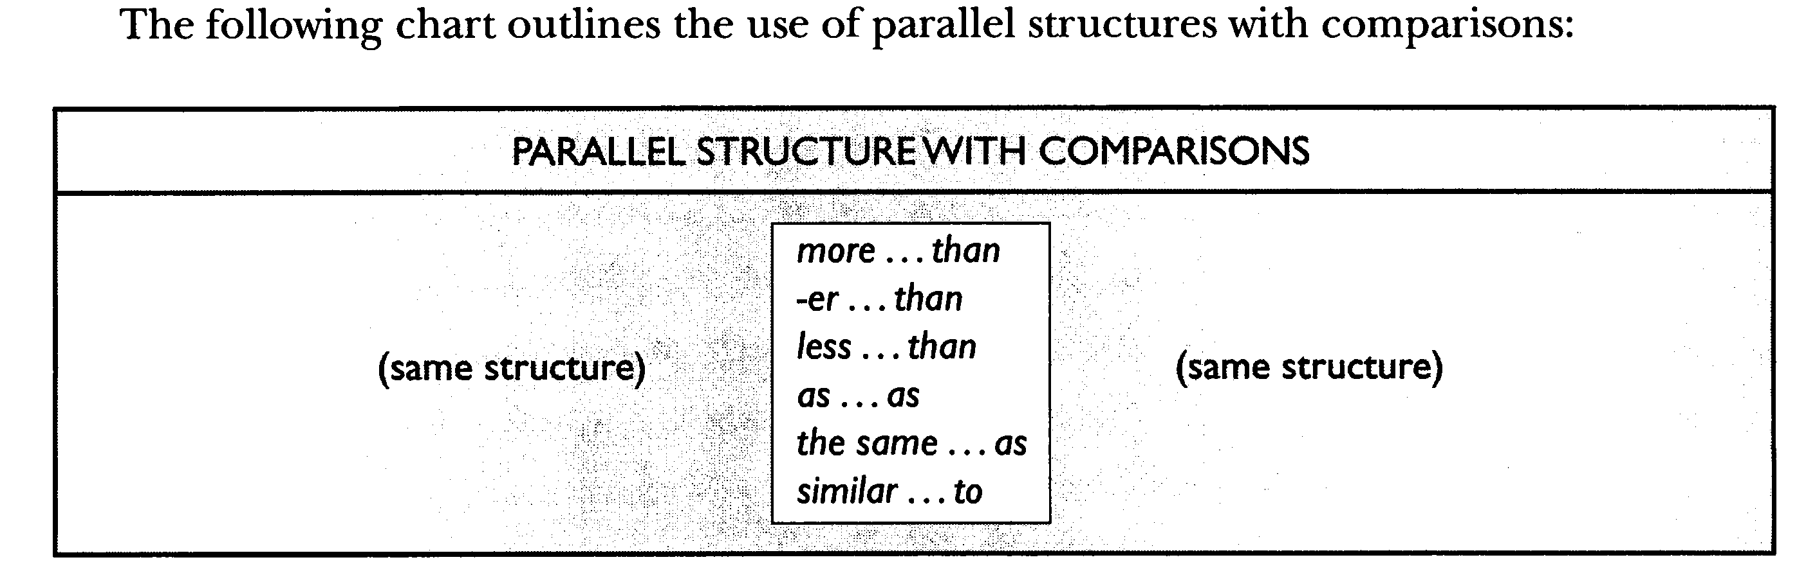

Slide 34
Adverb Clause
An adverbial clause is a dependent clause that functions as an adverb. In other words, it contains a subject (explicit or implied) and a predicate, and it modifies a verb.

Slide 35
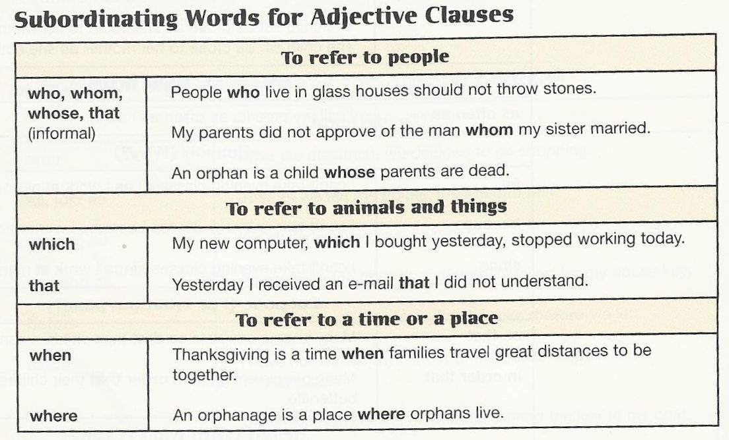
Adjective Clause is : A dependent clause that functions as an adjective and modifies a noun or pronoun. In other words, it adds extra information about that noun or pronoun.

Slide 36
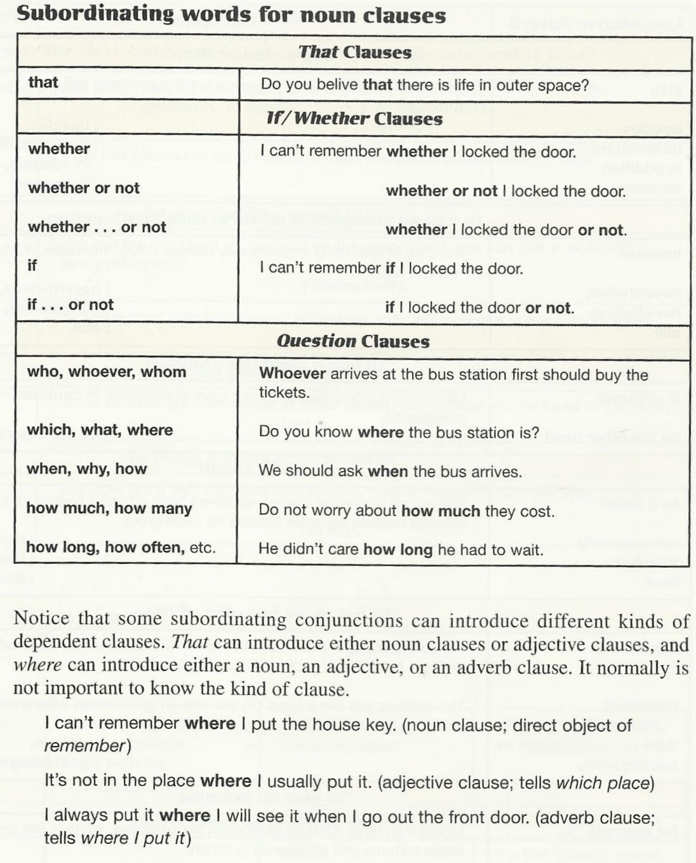
A dependent clause that functions as a noun in a sentence. Noun clauses can act as subjects, direct objects, and objects of prepositions.

Slide 37
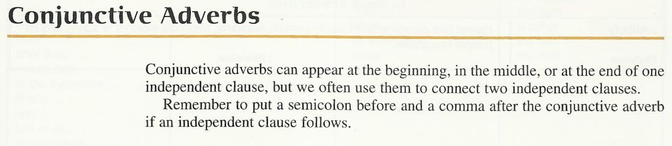
A conjunctive adverb is an adverb that connects two clauses. Conjunctive adverbs show cause and effect, sequence, contrast, comparison, or other relationships.

Slide 38
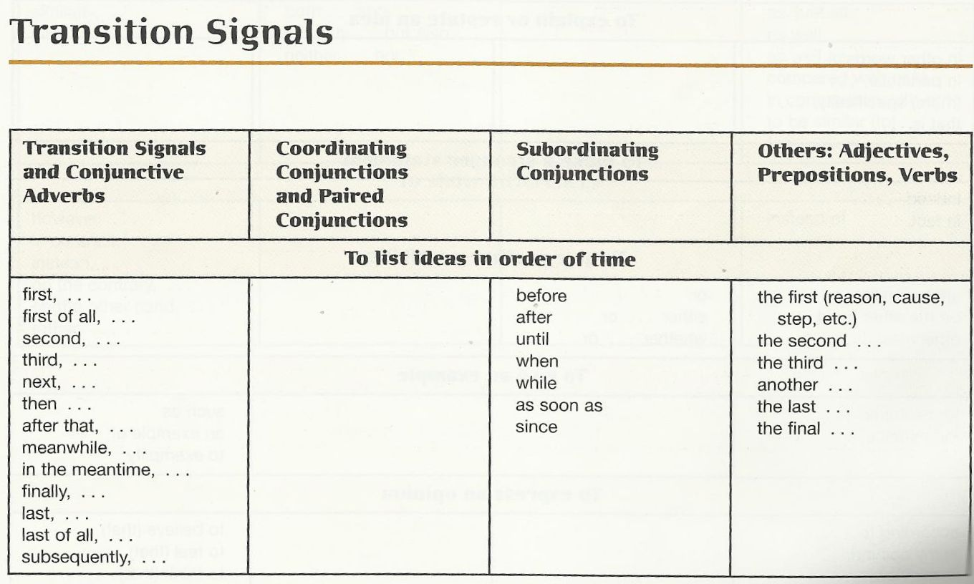
Transitions, transition words, or transitional expressions, et cetera, are certain words, expressions, or other devices that give text or speech greater cohesion by making it more explicit, or signaling, how ideas are meant by the writer or speaker to relate to one another.

Slide 39
COMMA
1. In a Series – Place a comma between three or more items connected by a coordinating conjunction.
words
Jones, Smith, and Jackson presented an interesting report.
phrases
The novel is available in print, on audio tape, and on video cassette.
clauses
The lawyer argued that the weather was bad, that the car had poor brakes, and that the other driver was speeding.

Slide 40
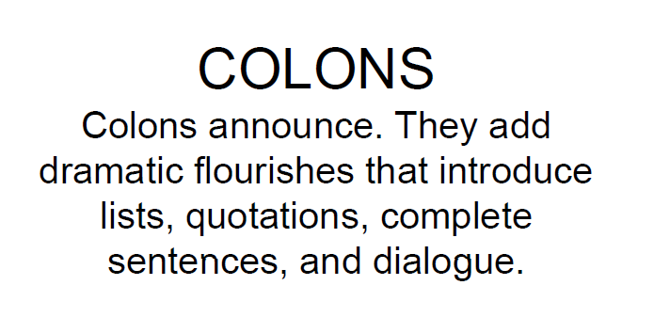

Slide 41
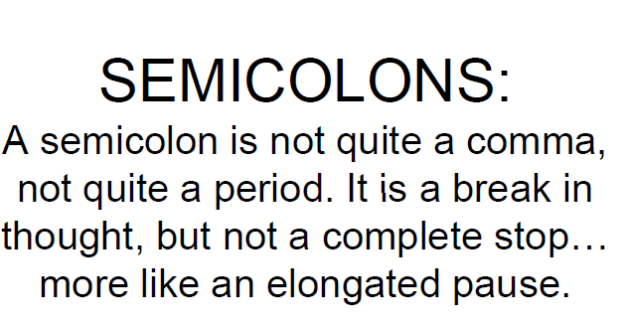

Slide 42
Thank You So Much

Slide 43

بحمد الله

