Slide 1

Phonetics and Phonology
Dr. Mohammed Al-Hilal
مقرر الصوتيات والنظام الصوتي
_{قسم اللغة الإنجليزية}
جامعة الملك فيصل
عمادة التعلم الإلكتروني والتعليم عن بعد
1

Slide 2
المحاضرة التمهيدية

Slide 3
Course Content
“Phonetics and Phonology” introduces the main areas in the study of sounds in human language. It covers the main areas of articulatory Phonetics of English. It focuses on the phonology of English starting from the units of the phoneme and the syllable. The course has been suggested because it provides the foundations for the study of the linguistic level of sounds as discussed in Phonetics and Phonology.

Slide 4
Course Objectives
By the end of this course, students should be able to:
1- Demonstrate knowledge of the place and manner of articulation of various sounds produced in human language.
2- Show knowledge of the English phoneme and syllable.
3- Show knowledge of the main features of English stress.
4- Demonstrate knowledge of the main features of English intonation.

Slide 5
Teaching Methods
The course makes use of the following teaching methods & techniques:
1) Recorded Lectures.
2) Power point presentations.
3) Online live sessions.
5
5

Slide 6
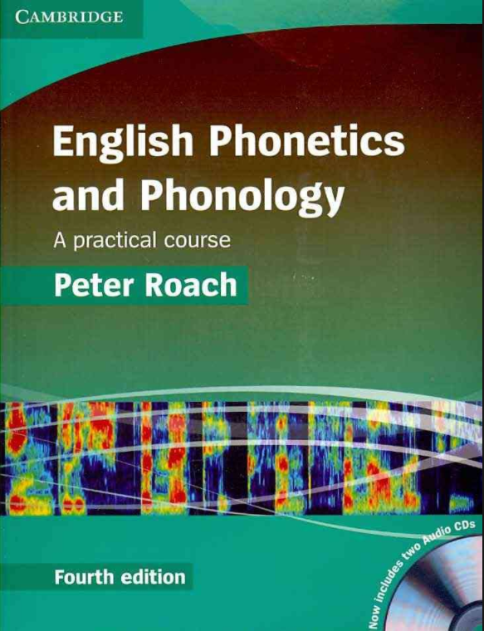
References and teaching learning resources
Main Textbook:
Roach Peter (2009). English Phonetics and Phonology: A Practical Course (Fourth Edition).
English phonetics and phonology glossary.
Prepared by the author. Available online
6
6

Slide 7
Distribution of Course Materials.
Lecture 0: Introduction to the Course
Lecture 1: introduction to English Phonemes
Lecture 2: vowels and consonants
Lecture 3: short vowels and long vowels (1)
Lecture 4:short vowels and long vowels (2)
Lecture 5: diphthongs and triphthongs
Lecture 6: Articulary Phonetics (1)
Lecture 7: Articulary Phonetics (2)
Lecture 8: Plosives (1)
7

Slide 8
Distribution of Course Materials.
Lecture 9: Plosives (2)
Lecture 10: Fricatives and Affricates (1).
Lecture 11: Fricatives and Affricates (2).
Lecture 12: Nasal Consonants (1)
Lecture 13: Nasal Consonants (2).
Lecture 14: Strong and week syllable.
Revision and Exam Sample.
8
8

Slide 9
Course Evaluation
1- Participation. 30
  a. attendance 10
  b. assignment 10
  c. topics discussion 10
2- Final Exam 70
Students have to watch the recorded lectures, attend the live sessions and answer the discussion questions.
ملاحظة: تُعتمد المحاضرات للمقرر ويُلغى العمل بالمحاضرات السابقة المسجلة في فصول سابقة.
9
9

Slide 10

بحمد الله

