Slide 1

Phonetics and Phonology
Dr. Mohammed Al-Hilal
مقرر الصوتيات والنظام الصوتي
_{قسم اللغة الإنجليزية}
جامعة الملك فيصل
عمادة التعلم الإلكتروني والتعليم عن بعد
1

Slide 2
Lecture 1
Phonetics and Phonology

Slide 3
In this Lecture, we will discuss the following:
1- Vowels and consonants
2- Phonetics vs phonology
3. Phonemes vs letters
4. IPA International Phonetic Association.
5- Accent vs dialect.
6- Cardinal vowels

Slide 4
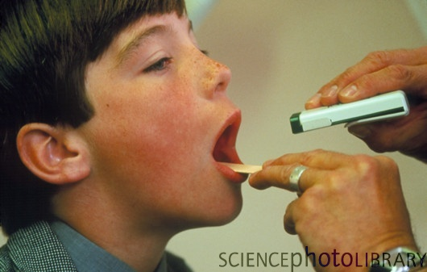
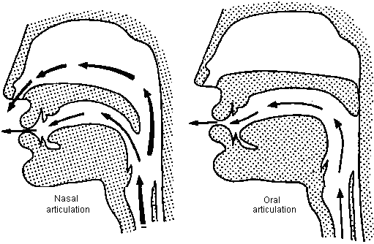
Vowels
  Vowels are the class of sound which makes the least obstruction to the flow of air when it passes from the larynx to the lips
  Making this sound is the best way for presenting an unobstructed view for the back of a patient’s mouth.

Slide 5
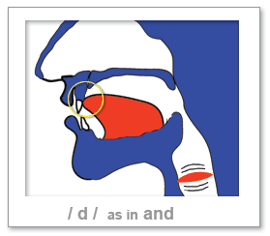
Consonants
Consonants are sounds that obstruct the flow of air through the vocal tract.

Slide 6
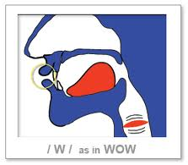
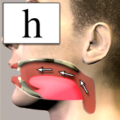
Consonants or not consonants
However, some consonants do not really obstruct the follow of air and we still consider them as consonants. Ex. The sounds at the beginning of words like hay, way, etc.
Different languages have different ways of dividing their sounds into vowels and consonants.
Ex. The /r/ sound in red which is felt to be a consonant in English is treated as a vowel in Mandarin Chinese.

Slide 7
Vowels vs consonants
The difference between vowels and consonants is not only a difference in the production but is also a difference in Distribution
Distribution of sounds refers to examining the positions in which each particular phoneme can occur:
Or
“looking at the different context and positions in which particular sounds can occur.
Eg. the distribution of the h phoneme
h can only occur before a vowel, hen, hat, hide
Eg. only consonants can follow the vowel sound a,
cat, can, nab

Slide 8
What is the purpose of this book:
To explain how standard English is pronounced .
Phonetics and phonology is a theoretical context: The book is a general theory about speech sounds and how they are used in language.
The theoretical material is necessary for anyone who needs to understand the principles regulating the use of sounds in spoken English

Slide 9
Phonetics vs phonology
Phonetics: the scientific study of speech sounds, including their production, reception, etc. the study of how we can record speech sounds with written symbols and how we hear and recognize different sounds.
Phonology: is a thorough description of the sounds of a language, including their classification, organization, distribution etc.

Slide 10
Phonology: the study of Phonemes
Phonemes are the regularly used sounds (vowels and consonants) in a language. The smallest unit of sound employed to form meaningful contrasts between utterances.
Phonemes: an identifiable small number of regularly used sounds (vowels and consonants) Eg.
    bin ban
    get set
/i/ and /a/ are two different phonemes
/g/ and /s/ are two different phonemes

Slide 11
Phonemes vs letters
We think of English pronunciation in terms of phonemes rather than letters of the alphabet.
Eg.
Enough /in^f/ 4 sounds
Enough e n o u g h 6 letters
Symbols are used to represent speech letters sounds

Slide 12
Symbols used to represent speech sounds
IPA International Phonetic Association.
Association which has taken the responsibility for maintaining a standard set of phonetic symbols used to represents the letters sounds of a language

Slide 13
Accents and dialects
Accent: the word ‘accent’ is used for varieties which differ from each other only in matters of pronunciation while ‘dialect’ also covers differences in such things as vocabulary and grammar.
Eg.
سافرت ناديا إلى السعودية
ناديا سافرت إلى السعودية
-I met the student (accent difference)
-I want some water
Received Pronunciation , BBC Pronunciation

Slide 14
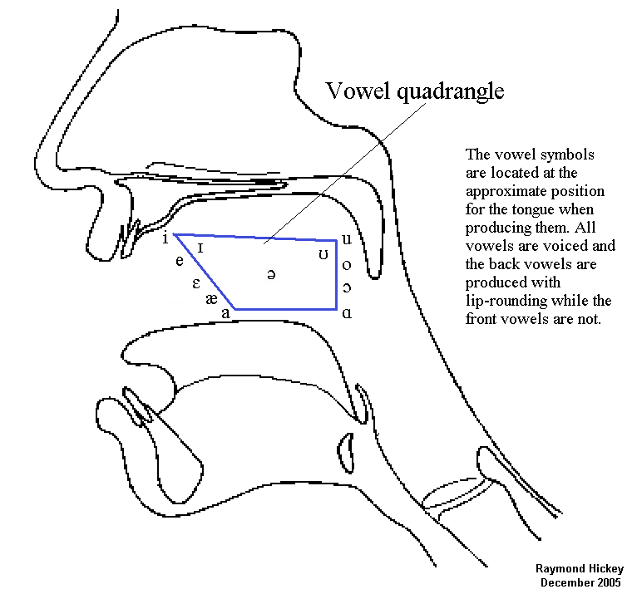
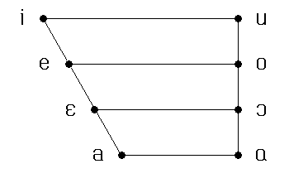
Cardinal vowels
They refer to the way of classifying vowels independently of the vowel system of any particular language; they would serve as reference points that other vowels could be related to. English phonetician Daniel Jones.

Slide 15
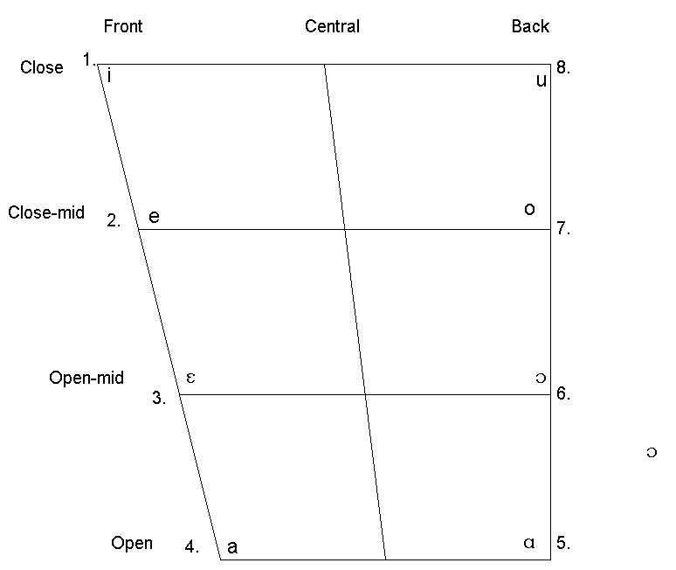
Cardinal vowels
There are tow groups: a. Primary cardinal vowels b. secondary cardinal vowels
they are not vowels of any particular language.
they are a standard reference system.
they represent the range of vowels that the human vocal apparatus can make
Or they are extremes of vowel quality.
they are used to describe, classify, and compare vowels
they are distinguished from English vowels by using square brackets. [..]

Slide 16

بحمد الله

