Slide 1
Transcribe the following words using phonemic transcription.
Help
Can
Cut

Slide 2
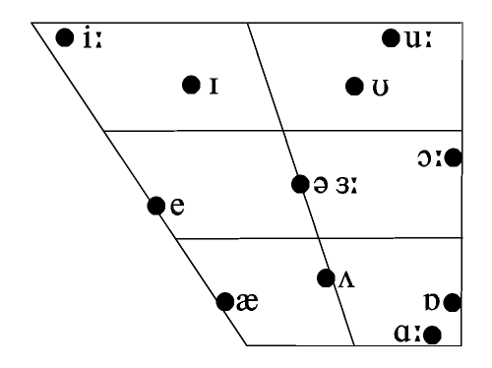
Draw the quadrilateral chart and locate the short vowels

Slide 3
Draw the quadrilateral chart and locate the long vowels

Slide 4
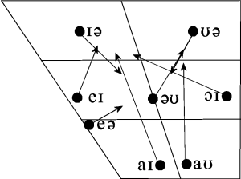
Draw the quadrilateral chart and locate the centering diphthong.

Slide 5
Describe the short vowel /æ/ in terms of tongue height and tongue position

Slide 6
Give a full description for the short vowel /ə/

Slide 7
Draw a quadrilateral chart for the cardinal vowel

Slide 8
Explain the function of the cardinal vowels

Slide 9
Explain the the difference between vowels and consonants

Slide 10
Explain the the difference between diphthongs and pure vowel.

Slide 11
Why do we call the centering diphthong “centring”?

Slide 12
Why do we call the closing diphthong “closing”?

Slide 13
What is the difference between /t/ and /ʔ/?

Slide 14
What is the difference between phonemic transcription and phonetic transcription?

Slide 15
Explain why does aspiration takes place?

Slide 16
Explain when does aspiration takes place giving illustrative example to support your point?

Slide 17
What is the difference between lenis and Fortis consonants?

Slide 18
Draw a quadrilateral chart and locate short and long vowels and describe each one of them in terms of tongue height and tongue position.

Slide 19
Give an example of pre-fortis clipping and explain your example.

Slide 20
What is the difference between phonology and articulatory phonetics?

Slide 21
What is the difference between accents and dialects?

Slide 22
What do we mean by RP?

Slide 23
What do we mean by RP?

Slide 24
Which language uses cardinal vowels in its phonemic system?

Slide 25
Explain the criteria used for short vowel description.

Slide 26
What is the difference between tongue height and tongue position?

Slide 27
Give an example of a word involving the short vowel /ʌ/

Slide 28
What is the function of the larynx?

Slide 29
What is the function of the soft palate?

Slide 30
What sounds can be produced when there is a blockage formed by the back of the tongue and the soft palate?

Slide 31
Which part of the diphthong stronger and longer?

Slide 32
What is the glottis?
What sound can be produced at the glottis?

Slide 33
Why /p/ is considered bilabial?
Why /d/ is considered alveolar?

Slide 34
What is Egressive pulmonic airstream?
How do we produce whispering sounds?

Slide 35
What is Egressive pulmonic airstream?
How do we produce whispering sounds?

Slide 36
How does phonation happen?
What is the function of the arytenoid cartilages?

Slide 37
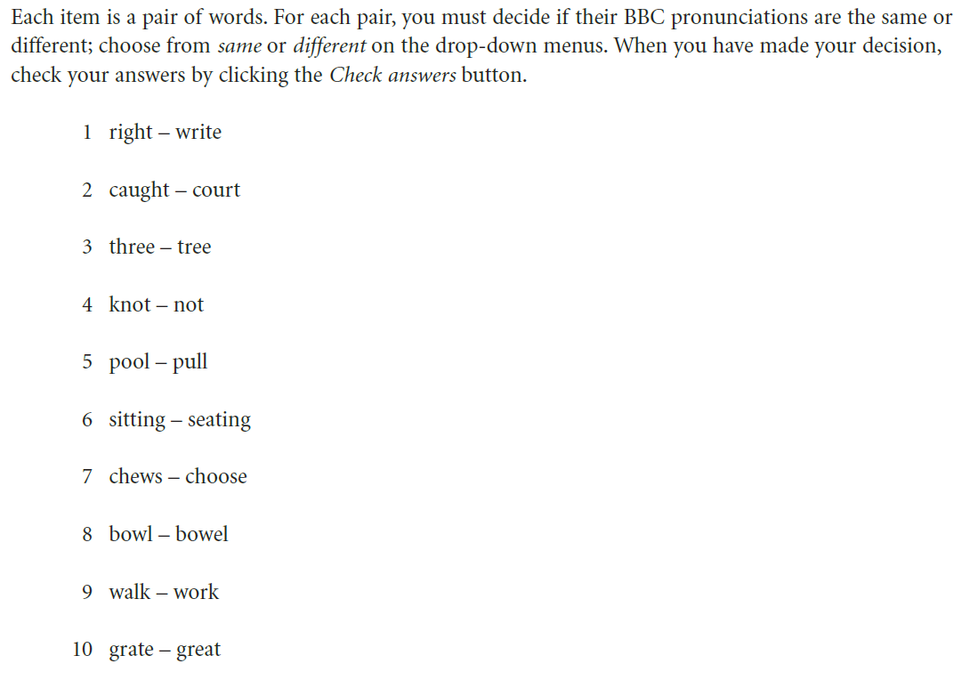

Slide 38
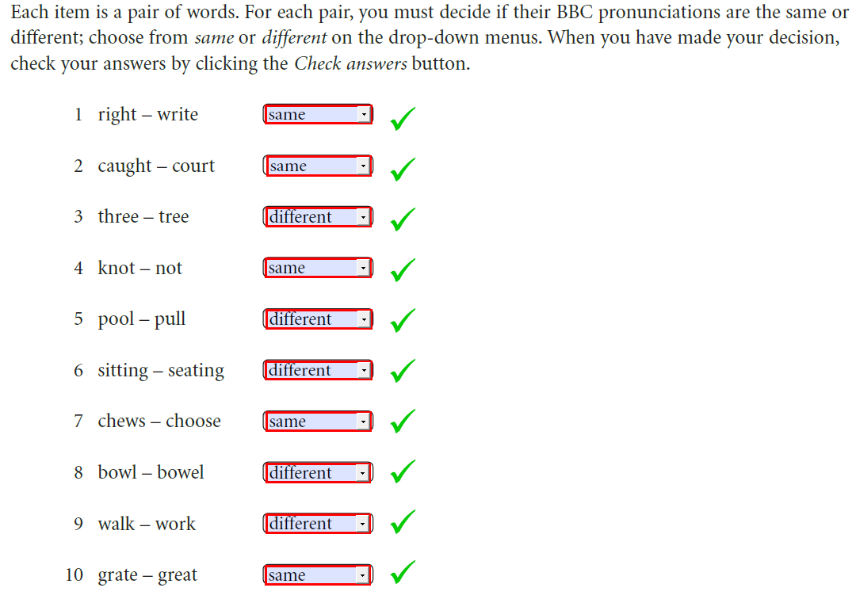

Slide 39
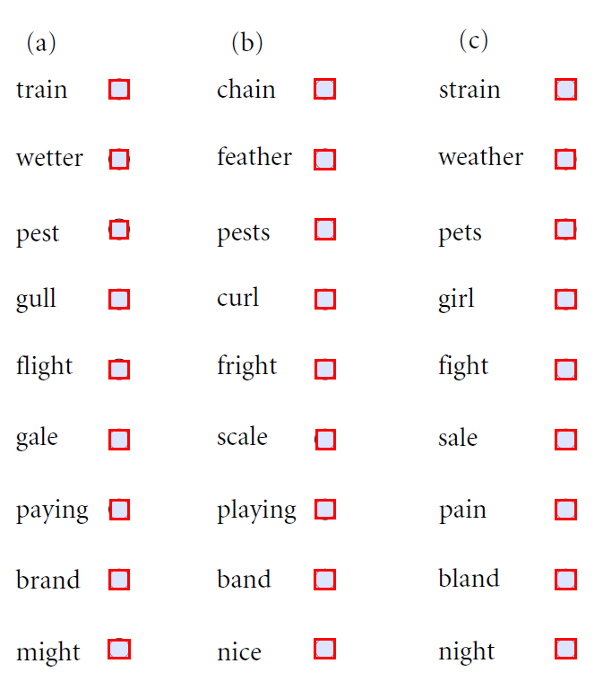

Slide 40



















Slide 41
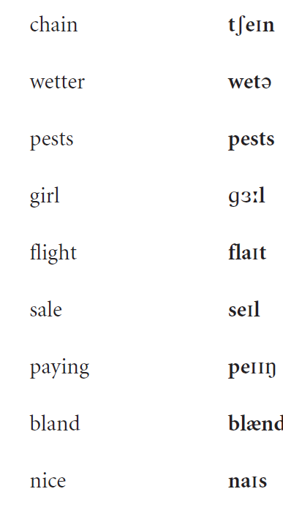

Slide 43
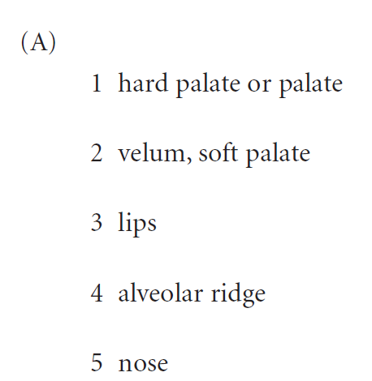

Slide 44
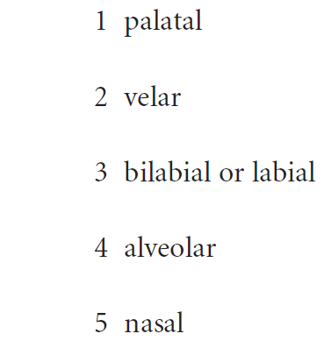
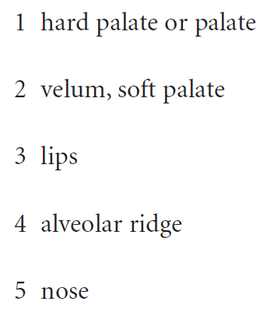
Give the corresponding adjective

Slide 45
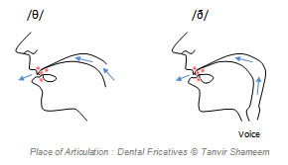
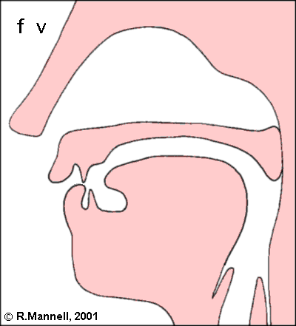
Fricatives and Affricates.
Fricatives:
Definition: consonants in which air escapes through a narrow passage and makes a hissing sound. Ex. /s/

Slide 46
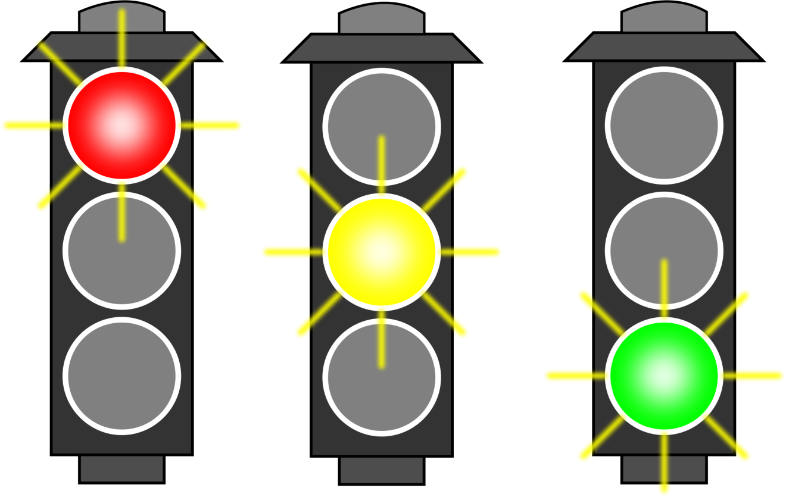
Complementary distribution
Two phonemes are in complementary distribution when they can never appear in more than one place at the same time.
Cat vs man
Clear vs. help
الشمس القمر

