Slide 1

5
Phonetics and Phonology
Dr. Mohammed Al-Hilal
مقرر الصوتيات والنظام الصوتي
_{قسم اللغة الإنجليزية}
جامعة الملك فيصل
عمادة التعلم الإلكتروني والتعليم عن بعد
1

Slide 2
Lecture 7
Phonetics and Phonology

Slide 3
In this lecture, we will study
English Plosives
How plosives are produced?
Different places of articulation.
Phases of plosive production
Aspiration
Fortis vs lenis consonants
Pre-fortis clipping

Slide 4
English plosives
English plosives
We have six plosive consonants:
p, t, k,
Voiced and Voiceless plosives
Voiced (+V) b, d, g.
Voiceless (-V) p, t, k.
b, d, g
Notes:
f

Slide 5
English plosives
When they are produced, plosives cause plosion.
Plosion is the noise produced by the compressed air is released.

Slide 6
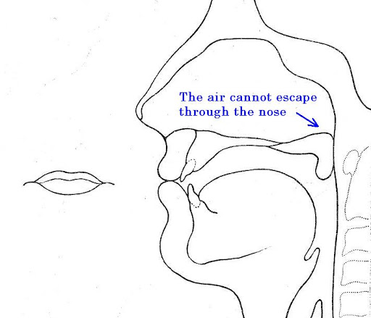
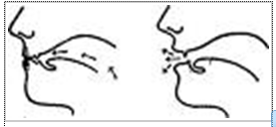
English plosives
How plosives are produced?
1-They are produced by forming a complete obstruction to the flow of air
2-this results in a build-up of compressed air inside the chamber formed by the closure.
3- When the closure is released, there is a small explosion that causes a sharp noise.

Slide 7

English plosives
Plosives are among the first sounds used by children when they start to speak

Slide 8
English plosives
Different places of articulation:
-p b = bilabial
-alveolar = t d (blade of the tongue+alveolar ridge)
- velar = k g (back of the tongue+soft palate)
Notes:
f

Slide 9
English plosivesv
Distribution of plosives.
Plosives are fully distributed:
They can come initially, medially, and finally.
C= consonant. V= Vowel
initially, medially, finally
CV VCV VC
pat. spat, step take, stake, sit kit, skirt, shook
box, tuber, sab dog, sedate, sad good, rigid, fog
Notes:
f

Slide 10
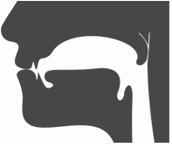
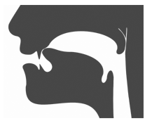

English plosives
places of articulations for plosives
Plosives are produced at different places of articulation,
-p b = bilabial (lips)
-t d = alveolar (blade of the tongue+alveolar ridge)
-k g = velar (back of the tongue+soft palate)

Slide 11
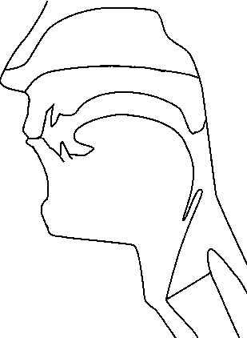
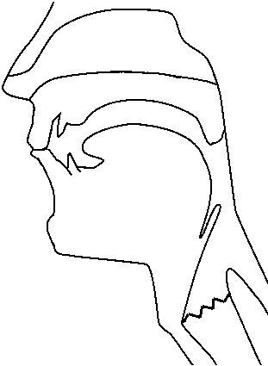
English plosives
- Different places of articulation:
p b = bilabial

Slide 12
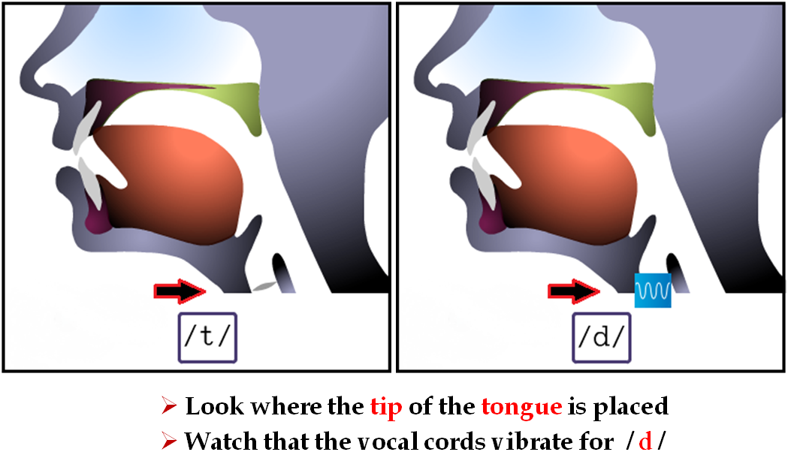
English plosives
-Alveolar = t d (blade of the tongue + alveolar ridge)

Slide 13
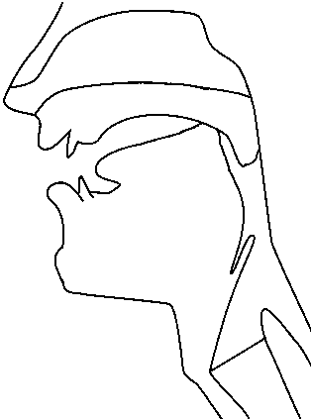
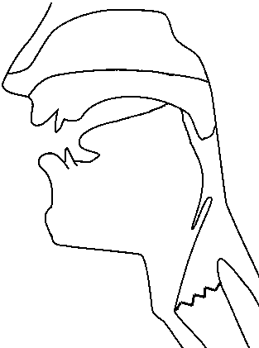
English plosives
k g = velar (back of the tongue+soft palate)

Slide 14
English plosives
Phases of plosive production
Closing phase:
When the articulator moves to form a stricture for the plosive
Compression phase:
When the compressed air is stopped from escaping
Release phase:
When the articulators used to make a stricture allow the air to escape.
Post-release phase:
Refers to what happens after allowing air to escape.

Slide 15
English plosives
Number of plosives
There are six plosive consonants p, t, k, b, d, g.
The glottal stop /ʔ/ is an alternative pronunciation for p, t, k in certain contexts, and is therefore less important.
Ex.
The glottal stop can replace the plosive /t/ when it follows a stressed vowel:
‘getting better’ is pronounced /ɡeʔɪŋ beʔə/
Ex.
Between two vowels:
Water /wɔːʔə/
Lettuce /leʔɪs/

Slide 16
English plosives
Aspiration
Refers to the /h/-like sound recognized after the release phase of an initial voiceless plosive and before the voicing of the following vowel begins.
E.g pat [pʰ]
pill | [pʰɪl]
till | [tʰɪl]
kill | [kʰɪl]
Still | stɪl
• In English, voiceless plosives /p t k/ are aspirated [pʰ tʰ kʰ], especially in word-initial position before a stressed vowel
Pack /pæk/ [pʰæk]

Slide 17
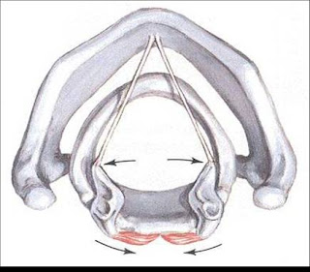
English plosives
Why does it happen?
This is the result of the vocal folds being widely parted at the time of the articulatory release.

Slide 18
Unaspirated p, t, k
It is noticeable that when p t k are preceded by S at the beginning of a syllable they are not aspirated
Pot spot
Kin skin
Top stop
pill | [pʰɪl] | spill | [spɪl]
till | [tʰɪl] | still | [stɪl]
kill | [kʰɪl] | skill | [skɪl]

Slide 19
Fortis and lenis
b, d, g are scarcely voiced at the beginning and final position.
p, t, k are produced with more force than b, d, g.
We need terms to indicate these facts
p t k are called fortis = strong voiceless plosives
b d g are called lenis = weak voiced plosives.

Slide 20
English plosives
Pre- fortis clipping
Fortis consonants have the effect of shortening a preceding vowel.
For example:
Feet feed

Slide 21

بحمد الله

