Slide 1

Phonetics and Phonology
Dr. Mohammed Al-Hilal
مقرر الصوتيات والنظام الصوتي
_{قسم اللغة الإنجليزية}
جامعة الملك فيصل
عمادة التعلم الإلكتروني والتعليم عن بعد
1

Slide 2
Lecture 8
Phonetics and Phonology

Slide 3
In this lecture, we will study
English Fricatives
How Fricatives are produced?
Definition
Complementary distribution
Phonemic vs Phonetic transcription
Diacritics
Importance of the narrow passage
How many fricatives do we have?
Fortis vs lenis distinction
Clipping of preceding vowel
Practical exercises for the vowels.

Slide 4
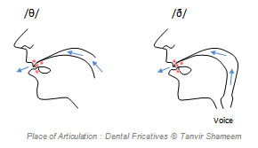
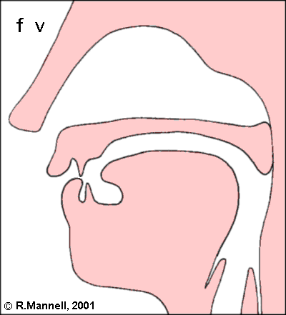
Fricatives
Definition: consonants in which air escapes through a narrow passage and makes a hissing sound. Ex. /s/

Slide 5
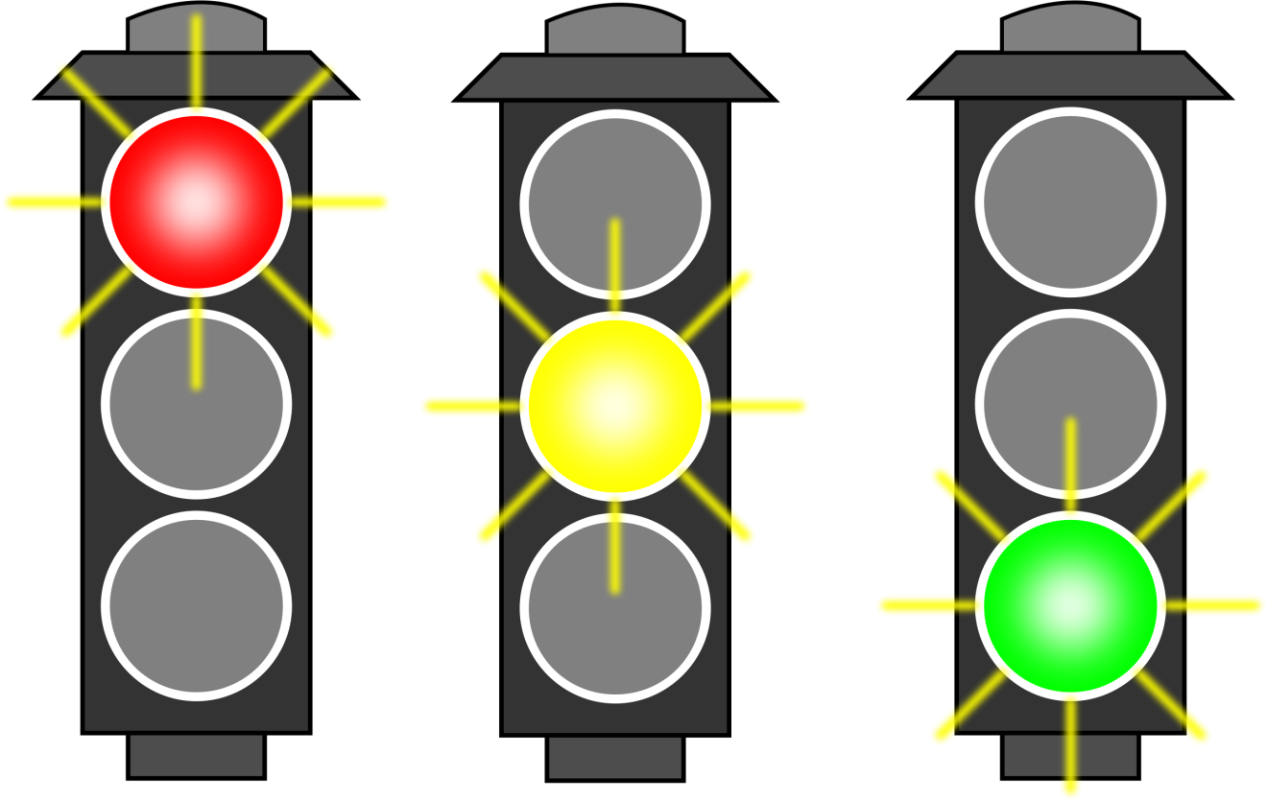
Complementary distribution
Two phonemes are in complementary distribution when they can never appear in more than one place at the same time.
Clear vs. help

Slide 6
Phonemic vs Phonetic transcription
Phonemic transcription: every speech sound must be identified as one of the phonemes. It only involves the use of phonemes and uses slashes or slant brackets.
Ex:
Pit /pɪt/
Phonetic transcription: a transcription which is more accurate than the phonemic transcription. It (Phonetic transcription) contains much more information.
Ex: [pʰɪt]

Slide 7
Diacritics
A diacritic is a mark used to modify the pronunciation of a phoneme in some way.
[pʰɪt]
The ʰ in [pʰ] is a diacritic.

Slide 8

Fricatives
Characteristics
Fricatives are continuant consonants: you can continue making them without interruption as long as you have enough air in you lungs.

Slide 9
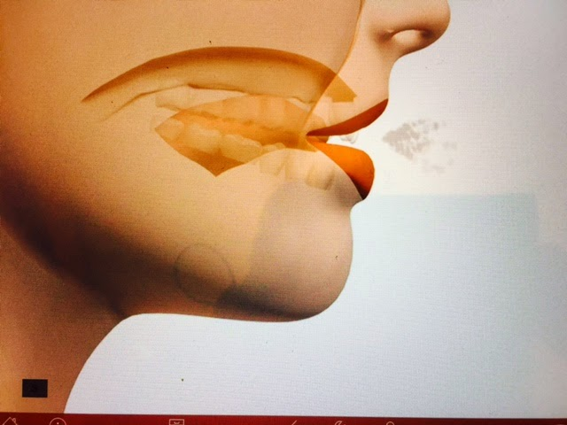
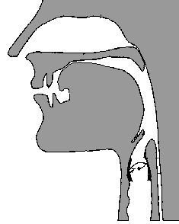
Importance of the narrow passage
Importance of the narrow passage
A. make a long hissing sound and gradually lower your tongue so that it is no longer close to the roof of the mouth. The hissing sound will stop as the air passages gets larger.

Slide 10


Importance of the narrow passage
Importance of the narrow passage
B. While producing an /f/ sound, pull the lower lip away from the upper teeth, the hissing sound will suddenly stop.

Slide 11
How many fricatives do we have?
f v
θ ð
s z
ʃ ʒ
h

Slide 12
Fortis vs lenis distinction
FORTIS LENIS
θ ð
s z
ʃ ʒ
f v
h

Slide 13
VIBRATION OF VOCAL CORDS
NO VIBRATION VIBRATION
θ ð
s z
ʃ ʒ
f v
h

Slide 14
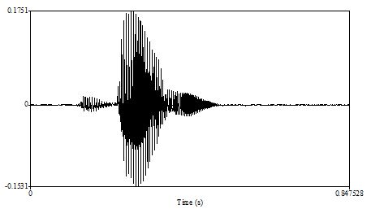
VOICING
The lenis fricatives have little or no voicing in initial and final positions.
But they may be voiced when they occur between voiced sounds.

Slide 15
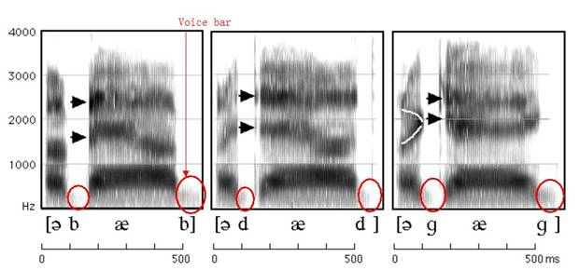
VOICING
The lenis fricatives have little or no voicing in initial and final positions.
But they may be voiced when they occur between voiced sounds.

Slide 16
Clipping of preceding vowel
Voiceless fortis fricative have the ability to reduce a preceding vowel.
Ex.
Ice eyes
Breath
breathe

Slide 17
Practical exercises
Vowels

Slide 18
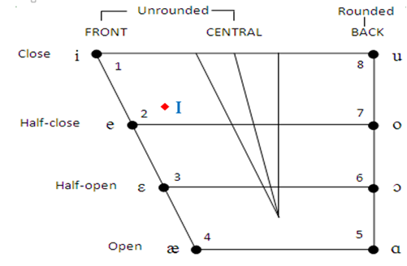
1. Choose the correct description for the short vowel /I/.
Close front vowel.
Open back vowel
Central vowel
Half-open vowel

Slide 19
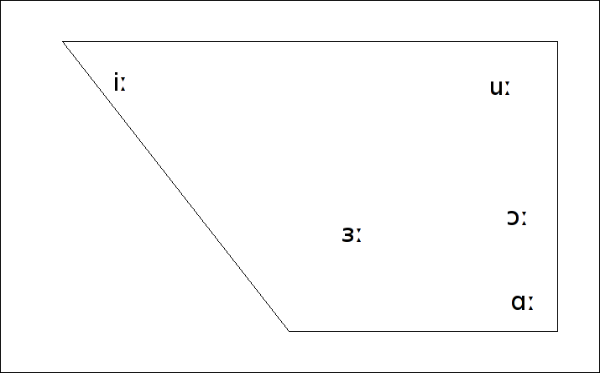
2. Choose the correct description for the long vowel /i:/.
Close front vowel.
Open back vowel
Central vowel
Half-open vowel

Slide 20
3. Choose the incorrect description for the long vowel / ɜː /.
Central vowel
Well known in English as a hesitation sound
spelt er and the lips are neutral
A front vowel

Slide 21
4. Choose the correct description for the long vowel / ɜː /.
A Central vowel .
A front vowel
A Back vowel
A close vowel

Slide 22
5. Choose the correct description for the long vowel / ɑː /.
An open and back vowel .
A front vowel
A central vowel
A close vowel

Slide 23
6. Choose the incorrect description for the long vowel / ɑː /.
An open vowel
A back vowel .
Close to cardinal vowel number 5.
A central vowel.

Slide 24
7. Choose the correct description for the long vowel / ɔː /.
It has strong lip rounding
It has neutral lips
It has spread lips
It is a front vowel

Slide 25
8. Choose the correct description for the long vowel /uː /.
It is a back vowel
It is a front vowel
It is an open vowel
It is a central vowel

Slide 26
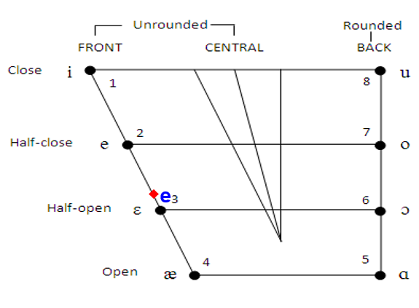
9. Choose the correct description for the short vowel /e/.
Half-open front vowel.
Half-open back vowel
Central vowel
Close vowel

Slide 27
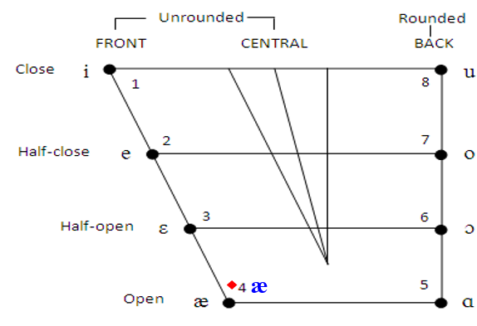
10. Choose the correct description for the short vowel / æ /.
Open front vowel.
Close back vowel
Half-open vowel
Close vowel

Slide 28
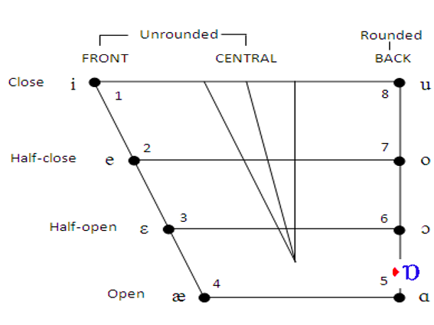
11. Choose the correct description for the short vowel / ɒ /.
between half-open and open and it is a back vowel
Open front vowel.
Close and front vowel
Central vowel

Slide 29
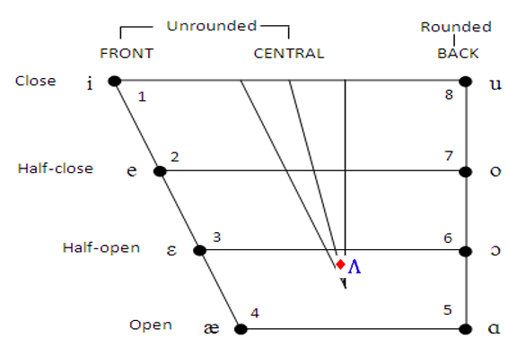
12. Choose the correct description for the short vowel / ʌ /.
half-open and central vowel
Open front vowel.
Half-open vowel
Close vowel

Slide 30
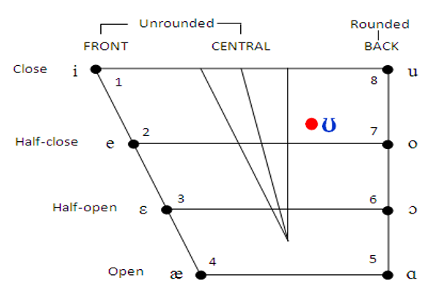
13. Choose the correct description for the short vowel / ʊ /.
half-close nearer to the centre
Open front vowel.
Half-open vowel
Close vowel

Slide 31
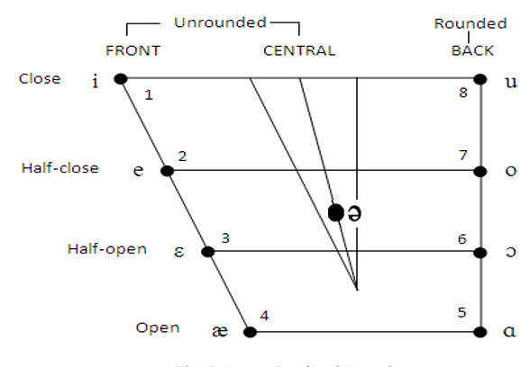
14. Choose the correct description for the short vowel / ə /.
between half-close and half-open and a central vowel.
open and front vowel
Close and back vowel
Very close to cardinal vowel number 1.

Slide 32

1- The criteria used for short vowel description
Short vowels description
short vowel | tongue height | tongue position | shape of the lips | example
/I/ | close | front | slightly spread | bid
/e/ | half-open | front | slightly spread | bed
/æ/ | open | front | slightly spread | bad
/ʌ/ | half-open | central | neutral | bud
/ɒ/ | between half-open and open | back | slightly rounded | pot
/ʊ/ | half-close | nearer to the centre | rounded | put
/ə/ | between half-close and half-open | central | neutral | mother

Slide 33

بحمد الله

