Slide 1

Phonetics and Phonology
Dr. Mohammed Al-Hilal
مقرر الصوتيات والنظام الصوتي
_{قسم اللغة الإنجليزية}
جامعة الملك فيصل
عمادة التعلم الإلكتروني والتعليم عن بعد
1

Slide 2
Lecture 9
Phonetics and Phonology

Slide 3
In this lecture, we will study
Different places of articulations for fricatives.
English Affricatives

Slide 4
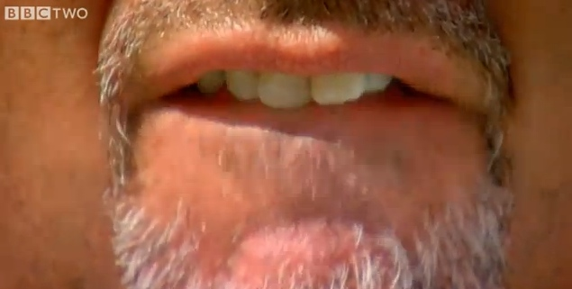
Fricatives places of articulation
Labiodental fricatives /f/, /v/
the lower lip is in contact with the upper teeth . The fricative noise is never very strong
/f/ /v/
‘fan’ ‘van’
‘safer’ ‘saver’
‘half’ ‘halve

Slide 5
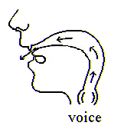
Fricatives places of articulation
Dental fricatives /θ/, /ð/
the tongue is normally placed behind the teeth, with the tip touching the inner side of the lower teeth. The air escapes through the gaps between the tongue and the teeth
/θ/ /ð/
‘thumb’ ‘thus’
‘ether’ ‘father’
‘breath’ ‘breathe’

Slide 6
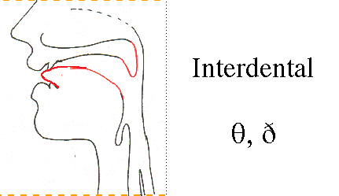
Fricatives places of articulation
Dental fricatives /θ/, /ð/
Dental vs interdental

Slide 7
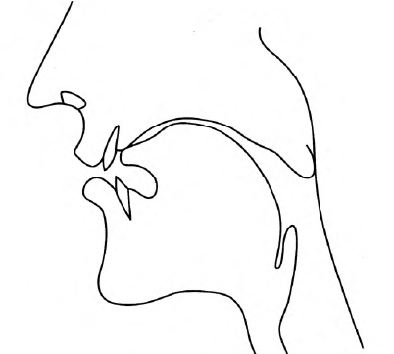
Fricatives places of articulation
Alveolar Fricatives /s/, /z/
tongue blade is pressed against the alveolar ridge
/s/ /z/
‘sip’ ‘zip’
‘facing’ ‘phasing’
‘rice’ ‘rise’

Slide 8
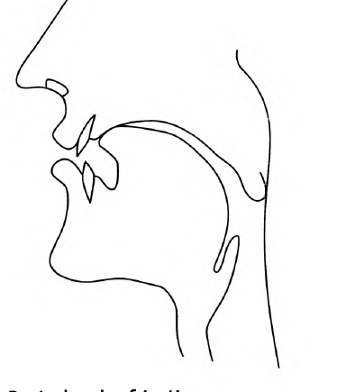
Fricatives places of articulation
Post-Alveolar Fricatives /ʃ/, /ʒ/
the tongue is in contact with an area slightly further back than that for /s/,/ z/
/ʃ/
‘ship’
‘Russia’,
‘Irish’,
/ʒ/
initial is very rare in English);
‘measure’
‘garage’

Slide 9
Fricatives places of articulation
Alveolar vs Post-Alveolar fricatives.
If you make /ʃ/ then /ʒ/ , you should be able to feel your tongue move backwards.

Slide 10
Fricatives places of articulation
Alveolar vs Post-Alveolar fricatives
The air escapes through a passage along the centre of the tongue, as in /s/, /z/, but the passage is a little wider in /ʃ/ and /ʒ/

Slide 11
Fricatives places of articulation
Alveolar vs Post-Alveolar fricatives.
Most BBC speakers have rounded lips for /ʃ/ and /ʒ/, and this is an important difference between these consonants and /s/, /z/.

Slide 12
Fricatives places of articulation
Alveolar vs Post-Alveolar fricatives
The fricative ʃ is a common and
widely distributed phoneme, but ʒ is not.

Slide 13
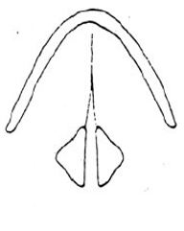
Fricatives places of articulation
Glottal fricative /h/
Glottal fricative: a sound that is produced when
the air passes through the glottis as it is
narrowed: Ex. /h/ in high.

Slide 14
Fricatives places of articulation
Glottal fricative /h/
/h/
Example : ‘head’, ‘ahead’, ‘playhouse’)
the narrowing that produces the friction noise is between the vocal folds
If you breathe out silently, then produce h, you are moving your vocal folds from wide apart to
close together.

Slide 15
Glottal fricatives /h/
Why does /h/ have an /æ/ quality?
In the word ‘hat’, the /h/ is followed by an /æ/ vowel. The tongue, jaw and lip positions for the vowel are all produced simultaneously with the /h/ consonant, so that the glottal fricative /h/ has an /æ/ quality.

Slide 16
Fricatives places of articulation
Glottal fricative /h/
Why does /h/ have an a quality
the glottal /h/ consonant always has the quality of the
vowel it precedes.
hat
house

Slide 17
Fricatives places of articulation
Glottal fricative /h/
Why does /h/ have an /æ/ quality
It is noticeable that when /h/ occurs between voiced sounds (as in the words ‘ahead’, ‘greenhouse’), it is pronounced with voicing

Slide 18
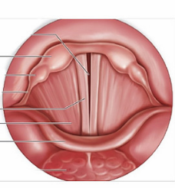
Breathy voice
Weak, slightly fricative sound is called breathy voice
breathy /breθi/ voice
Breathy is one of the adjectives used to describe voice quality. In breathy voice, the vocal folds vibrate but allow a considerable amount of air to escape at the same time; this adds “noise” (similar to loud breathing) to the sound produced by the vocal folds. It is conventionally thought that breathy voice makes women’s voices sound attractive,

Slide 19
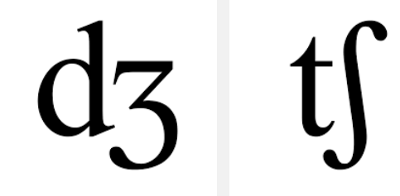
Affricates: /tʃ/ /dʒ/
Definition:
Affricates are complex consonants that begin as a plosive and end as a FRICATIVE.
Ex. Judge, Change, church

Slide 20

بحمد الله

